Slide 1
Mining and Learning from Big Time Series Data
Abdullah Mueen
Associate Professor
Computer Science
University of New Mexico

Slide 2
Outline
Overview: Mining and Learning from Time Series
Seismic Data Processing Pipeline
  Challenges
Problem 1: Signal Detection
  Semi-supervised Motif Discovery
Problem 2: Phase Classification
  Visual representation
  Evaluation on a Global Network
Data Mining Example: Social Media Analytics

Slide 3
What are Time Series?
25.1750
25.2250
25.2500
25.2500
25.2750
25.3250
25.3500
25.3500
25.4000
25.4000
25.3250
25.2250
25.2000
25.1750
..
..
24.6250
24.6750
24.6750
24.6250
24.6250
24.6250
24.6750
24.7500
A time series is a collection of observations made sequentially in time.
29
28
27
26
25
24
23
0
50
100
150
200
250
300
350
400
450
500
Notes:
Let’s start with defining time series. A time series is a collection of observations made sequentially in time. Here I show a time series plot where the x-axis is the index of the observation and y-axis shows the value. The x-axis could be the time stamps. In this talk we will use the index as we assume the observations are sampled uniformly.

Slide 4
Time Series are Ubiquitous!
People measure things...
  Biden’s popularity rating.
  Their blood pressure.
  The annual rainfall in Seattle.
  The value of their Tesla stock.
  The number of web hits per second.
… and things change over time.
Time series occur in virtually every domain.
Notes:
Time Series are ubiquitous. We measure many things. Obama’s popularity, stock price, clicks per second and so on. These measurements change over time and thus make time series occur virtually in every domain. You will see a number of time series throughout the talk and I confirm none of them are simulated or artificially made all of them are taken from UCR time series archive.

Slide 5
Data Mining Primitives
Periods
Bursts
Motifs
Intuitive for human
Good feature for machines
Domains exist where the above are true
Discords
Shapelets
Notes:
Here are some primitives. Periods, Bursts, Motifs, Discords, Shapelets and numerous others that will come in future. All of these primitives have one thing in common. They are all segments of time series with some specific properties and thus give us a local perspective of the time series. The primitives can help human to intuitively understand time series and help data mining/machine learning algorithms with better feature values. But for that we need good algorithms that are exact rather than approximate and fast to work on large datasets. In the rest of the talk I will present two exact algorithms for motifs and shapelets which are fastest reported such algorithms until now.

Slide 6
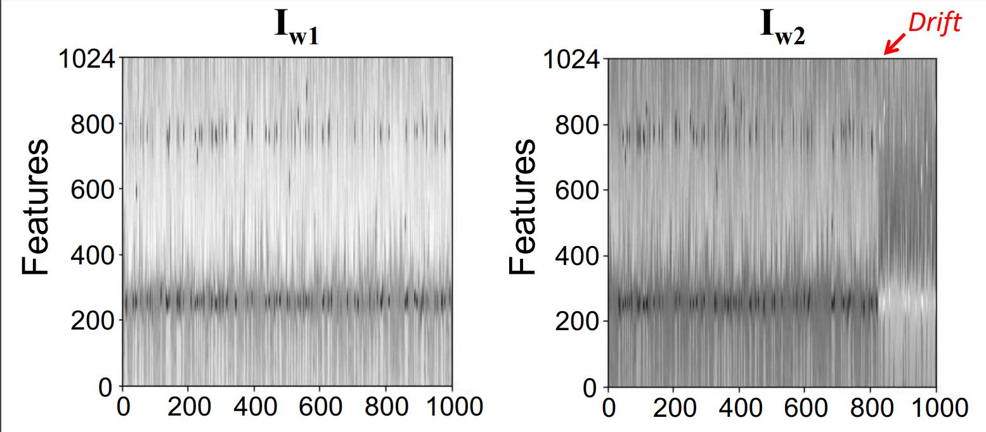
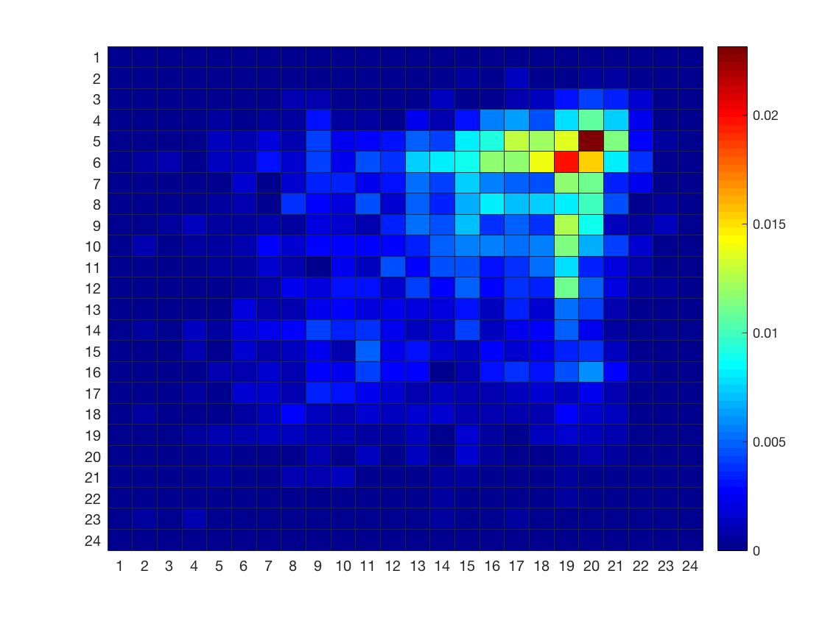
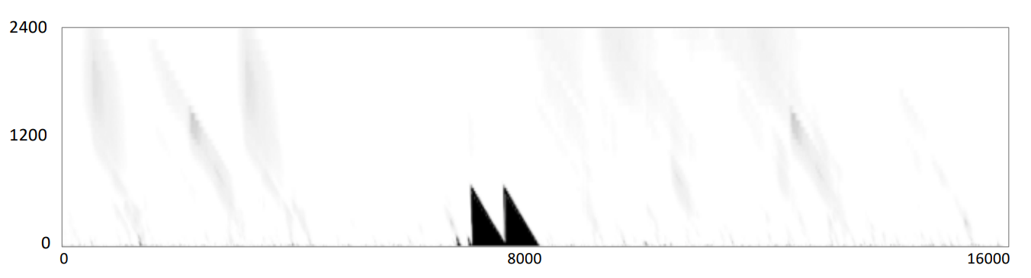
Representations for Machine Learning
10Hz
0.4 Hz
60 seconds
Seconds
x10⁻³
20
24 Hours
15
Probability of posting
10
Window
5
Seconds
0
24 Hours
Notes:
Here are some primitives. Periods, Bursts, Motifs, Discords, Shapelets and numerous others that will come in future. All of these primitives have one thing in common. They are all segments of time series with some specific properties and thus give us a local perspective of the time series. The primitives can help human to intuitively understand time series and help data mining/machine learning algorithms with better feature values. But for that we need good algorithms that are exact rather than approximate and fast to work on large datasets. In the rest of the talk I will present two exact algorithms for motifs and shapelets which are fastest reported such algorithms until now.

Slide 7
Outline
Overview: Mining and Learning from Time Series
Seismic Data Processing Pipeline
  Challenges
Problem 1: Signal Detection
  Semi-supervised Motif Discovery
Problem 2: Phase Classification
  Visual representation
  Evaluation on a Global Network
Data Mining Example: Social Media Analytics

Slide 8
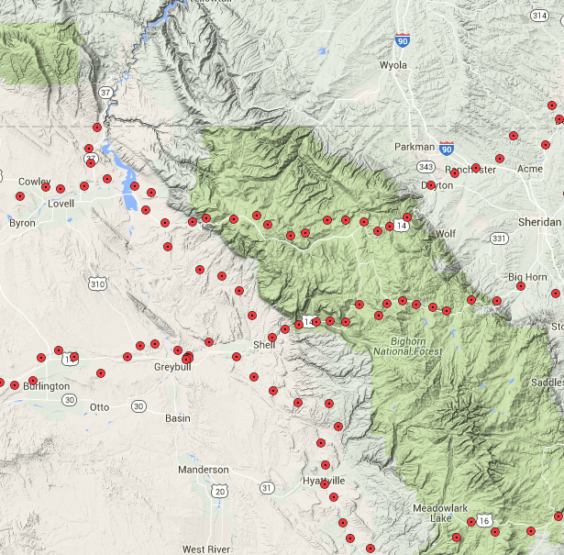
Seismic Data Processing Pipeline
BHN
Origin time (Y-M-D H:M:S)
Latitude (°)
Longitude (°)
Depth (km)
Magnitude
500
0
BHZ
BHE
-500
BHZ
-1000
Signal Detection
Identify a spike in waveform as arrival
Phase Identification
Identify phase type of the arrival
Phase Association
Group phases from the same event
Event Formation
Detect and classify all phase types
Bulletin Record
Derive attributes: magnitude, depth, etc.
One Trace
Multiple Channels
Multiple Stations
Multiple Networks

Slide 9
Need
  To produce early warning for damage mitigation
  To enforce Comprehensive Nuclear-Test-Ban Treaty (CTBT)
  To understand earth structure and predict large magnitude events
  To understand the effect of human induced seismicity
https://www.norsar.no
Physical Geology, by Steven Earle
Usgs.gov

Slide 10
Key Challenges
Real-time Data Processing
  40Hz-100Hz data rate
  Large network with many stations
Seismology
  Planet scale learning
Constrained processing
  Single Station
  Far from the Event
Monitoring Challenges
  No or few human involvement
  Variable system load

Slide 11
Outline
Overview: Mining and Learning from Time Series
Seismic Data Processing Pipeline
  Challenges
Problem 1: Signal Detection
  Semi-supervised Motif Discovery
Problem 2: Phase Classification
  Visual representation
  Evaluation on a Global Network
Data Mining Example: Social Media Analytics

Slide 12
Automated Seismic Signal Detection
Strong events are easy to notice, and easy to detect.
Weaker events are rarely noticed, hard to detect, and often uncatalogued.
Low magnitude events are frequent and potentially informative to prediction, classification and localization tasks.
Count
Noticeable
The Problem: Given a long seismograph, spot the low magnitude seismic events.
Magnitude
Distribution of event magnitudes in Northern California

Slide 13
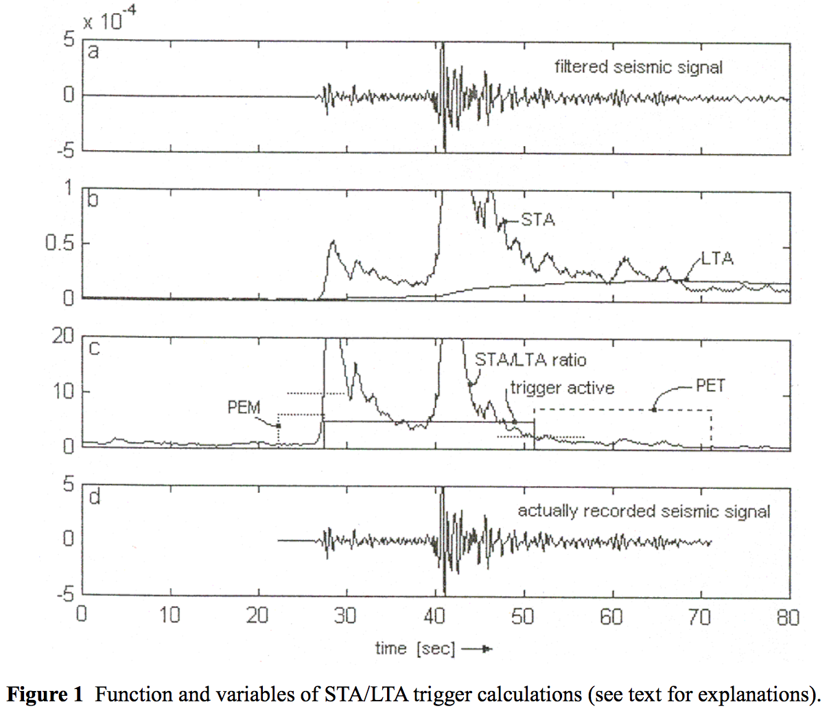
Signal Processing Technique
List of parameters
STA window duration
LTA window duration
STA/LTA trigger threshold level
STA/LTA detrigger threshold level.
Trigger filters
Pre-event time (PEM)
Post-event time (PET)
Very high false
detection rate.
Understanding and parameter setting of STA/LTA trigger algorithm, Amadej Trnkoczy

Slide 14
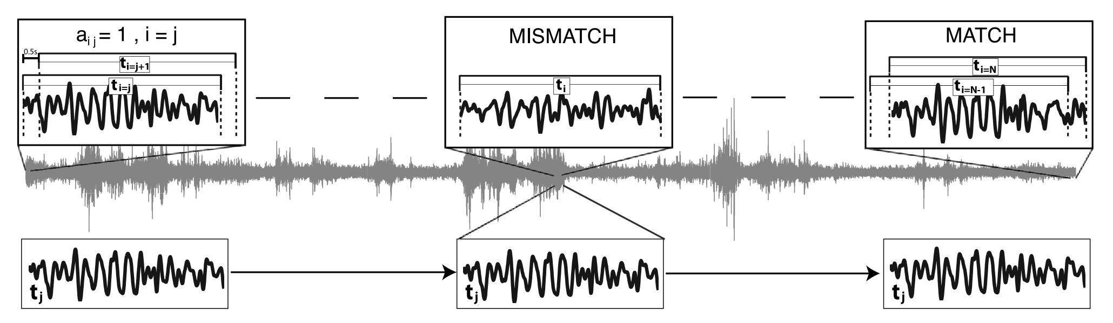
Auto-correlation Technique
High correlation indicates identical dynamics at the source(s).
One parameter, high accuracy, time consuming.
An autocorrelation method to detect low frequency earthquakes within tremor, J.R. Brown, G.C. Beroza, and D.R. Shelly, Geophysical Research Letters, 2008

Slide 15
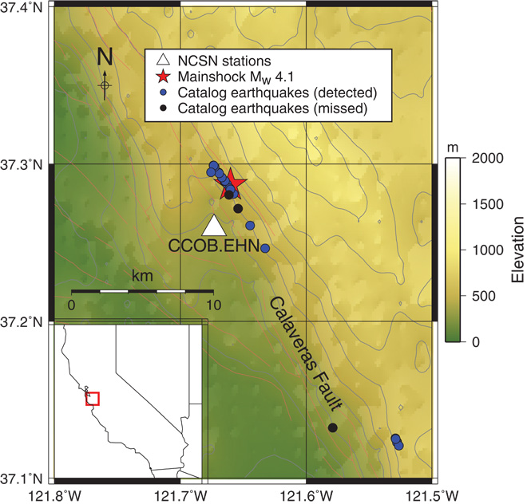
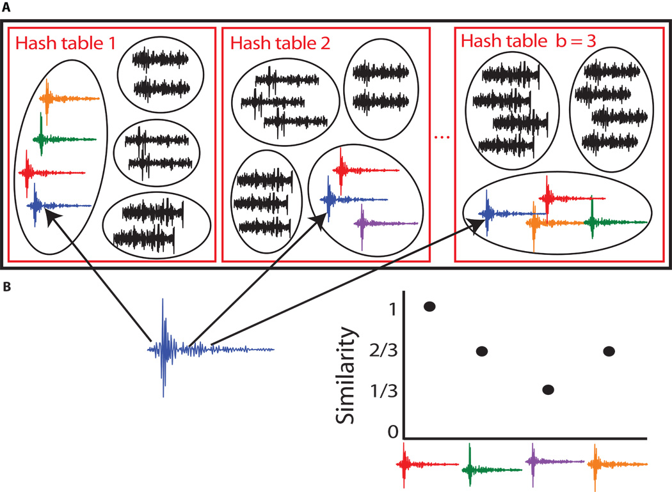
Approximate Correlation
Very FAST algorithm, admits few false detection.
Earthquake Detection Through Computationally Efficient Similarity Search
Clara E. Yoon, Ossian O’reilly, Karianne J. Bergen, Gregory C. Beroza Science Advances, 2015 : E1501057

Slide 16

Semi-supervised Technique
Catalog Events
300
3000
500
200
80
200
2500
150
60
100
2000
100
40
1500
0
50
20
0
1000
0
-100
500
0
-20
0
-500
-50
-40
-200
-500
-100
-60
-300
-1000
-150
-80
-1500
-100
FAST Events
-400
-2000
-1000
-200
-120
80
30
15
150
25
60
60
20
10
100
20
40
15
40
10
5
50
10
20
20
0
5
0
0
0
0
0
-10
-5
-50
-5
-20
-10
-20
-20
-10
-100
-15
-40
-40
-30
-20
-60
-15
-150
-25
January 15, 2015
0
2
4
6
8
10
12
x10$6$
January 8, 2015
30
25
80
30
30
20
20
60
20
20
15
40
10
10
20
10
10
0
5
0
0
0
0
-20
-10
-5
-40
-10
-10
-20
-10
-20
-20
-15
-60
-30
-20
-80
-30
-30
SeiSMo Events

Slide 17
SeiSMo: Semi-supervised Motif Discovery
Nearest Neighbor Graph (NNG)
Create NNG
Find sinks
Count support of each sink
If support is high enough report all nodes on the paths from any given node to the sink
Set of Discovered Events
Catalog Events
Sink

Slide 18
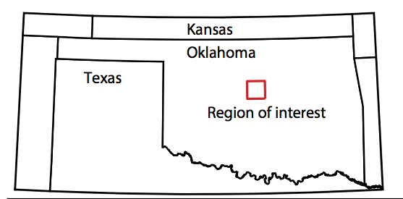
SeiSMo on OK
-7250
-6000
-6800
0
-4000
-7300
-6500
-7000
-2000
-5000
-7350
-7000
-7200
-4000
-6000
-7400
-7500
-7400
-6000
-7000
-7450
-8000
-8000
-7500
-8000
-7600
-10000
-9000
-7550
-8500
-7800
-12000
-10000
-7600
-9000
-8000
-14000
-11000
April 8, 2014
SeiSMo Events
April 1, 2014
2
4
6
8
10
12
x10⁶
Catalog Events
-3000
2
10⁴
1
10⁴
10
x10⁴
1.5
x10⁴
-4000
1.5
0.5
8
1
-5000
1
0
6
0.5
-6000
0.5
4
0
-7000
0
-0.5
2
-0.5
-8000
-0.5
-1
0
-9000
-1
-2
-1
-10000
-1.5
-1.5
-4
-1.5
-11000
-2
-2
-6
-2
-12000
-2.5
-2.5
-2.5
-3
-8
Convolutional neural network for earthquake detection and location, Thibaut Perol, Michaël Gharbi and Marine Denolle
Science Advances 14 Feb 2018: Vol. 4, no. 2, e1700578 DOI: 10.1126/sciadv.1700578

Slide 19
Novel Events
4
8
3
SeiSMo
(39)
SeiSMo
(9)
Autocorrelation
(102)
Autocorrelation
(5)
ConvNetQ
(291)
2
FAST
(87)
6
Oklahoma
California
SeiSMo has detected novel events that existing methods missed.

Slide 20
Performance
25
1400
1200
20
SeiSMo
1000
15
800
SeiSMo
Execution Time in Seconds
Execution Time in Seconds
10
600
Optimized SeiSMo
400
Optimized SeiSMo
5
Autocorrelation
200
Autocorrelation
0
0
100
200
300
400
500
600
700
800
900
1000
100
200
300
400
500
600
700
800
900
1000
Length of the time series in thousands
Number of labeled events
SeiSMo can process hours long seismographs in seconds.

Slide 21
Outline
Overview: Mining and Learning from Time Series
Seismic Data Processing Pipeline
  Challenges
Problem 1: Signal Detection
  Semi-supervised Motif Discovery
Problem 2: Phase Classification
  Visual representation
  Evaluation on a Global Network
Data Mining Example: Social Media Analytics

Slide 22
Phase Classification
The Problem: Identify the phase in given waveforms from a three-component station with vertical, north-south, east-west channels at the arrival time.
We consider only 3-C stations without any corroboration with other stations in the arrays.
New monitoring stations are unlikely to be arrays and more likely to be uncalibrated 3-C stations.
BHN
BHE
BHZ

Slide 23
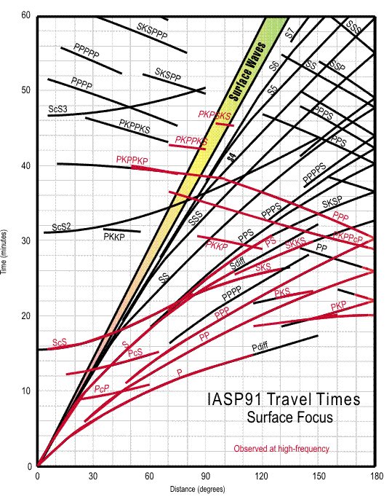
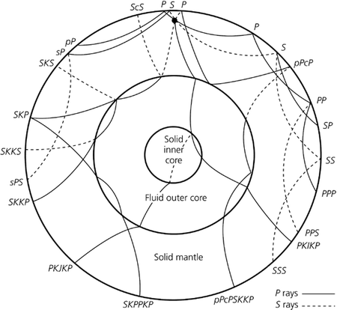
Seismic Phases
Six phases: P, Pg, Pn, S, Sn, Lg
We consider the final phase that arrived at a station, ignoring path. For example, pPcP is considered as P.
Havskov J., Ottemöller L. (2010) Earth Structure and Seismic Phases. In: Routine Data Processing in Earthquake Seismology. Springer, Dordrecht
USGS.gov

Slide 24
Phase Distributions
10
5
10
4
Log Scale
10
3
10
2
10
1
Lg
P
PKP
PKPab
PKPbc
PKiKP
PcP
Pg
Pn
S
SKP
SKPbc
ScP
Sn
pP
pPKP
pPKPbc
sP
pPKiKP
x10⁵
5
4
3
2
1
0
Lg
P
PKP
PKPab
PKPbc
PKiKP
PcP
Pg
Pn
S
SKP
SKPbc
ScP
Sn
pP
pPKP
pPKPbc
sP
pPKiKP

Slide 25
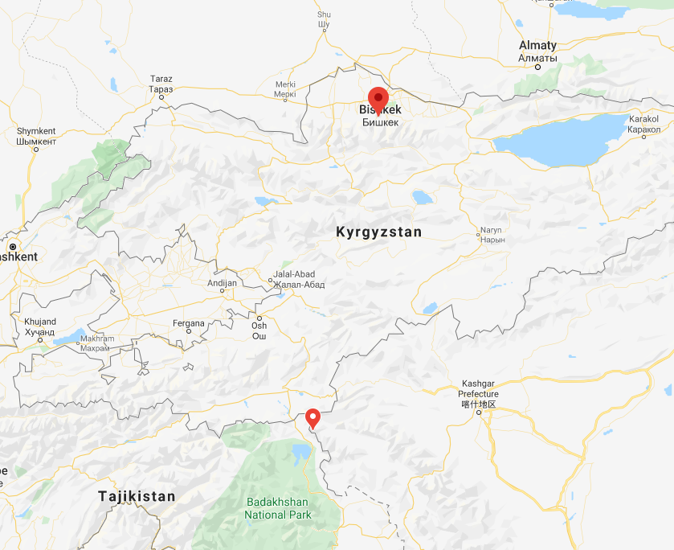
Continuous Wavelet Transform
AAK
BHZ
0.4 – 10Hz
2000
64
Red
1000
1500
Event
500
1000
500
0
0
-500
0
2400
(60 Sec)
Phase: Pn
Station: AAK
Distance: 3.43 degree
Depth: 0
0
500
1000
1500
2000
2500
0
500
1000
1500
2000
2500
BHE
200
400
Green
0
200
-200
-400
0
-600
-200
10Hz
-800
-1000
0
500
1000
1500
2000
2500
-400
0
500
1000
1500
2000
2500
BHN
0
600
Blue
-500
400
200
0.4 Hz
-1000
0
-1500
-200
-400
-2000
0
500
1000
1500
2000
2500
-600
0
500
1000
1500
2000
2500

Slide 27
t-SNE visualization of the feature space
https://lvdmaaten.github.io/tsne/

Slide 28








FASER: A Deep Neural Network for Seismic Phase Classification
Input
3$×3$ conv, 64 filters, 1$×1 stride$
3$×3$ conv, 8 filters, 1$×1 stride$
BN + ReLU
BN + ReLU
1$×2$ maxpool, 1$×2$ stride
2$×2$ maxpool, 2$×2$ stride
L
S
T
M
L
S
T
M
L
S
T
M
L
S
T
M
3$×3$ conv, 16 filters, 1$×1 stride$
BN + ReLU
L
S
T
M
L
S
T
M
L
S
T
M
L
S
T
M
2$×2$ maxpool, 2$×2$ stride
3$×3$ conv, 32 filters, 1$×1 stride$
Fully Connected, 64 units
BN + ReLU
Fully Connected, 32 units
2$×2$ maxpool, 2$×2$ stride
Output, 6 Classes

Slide 29
Comparison to other ML Classifiers
 |  | Precision | Recall | F1-Score | Accuracy
XGBoost |  | 68.4 | 67.2 | 67.2 | 67.2
MLP |  | 76.2 | 75.6 | 75.3 | 75.6
CNN |  | 75.2 | 75.2 | 75.2 | 75.2
LSTM |  | 75.7 | 74.3 | 75 | 75.3
CNN-Bi-LSTM |  | 81.3 | 80.2 | 80.7 | 81.5
FASER |  | 84.6 | 81.6 | 83.1 | 82.8

Slide 30
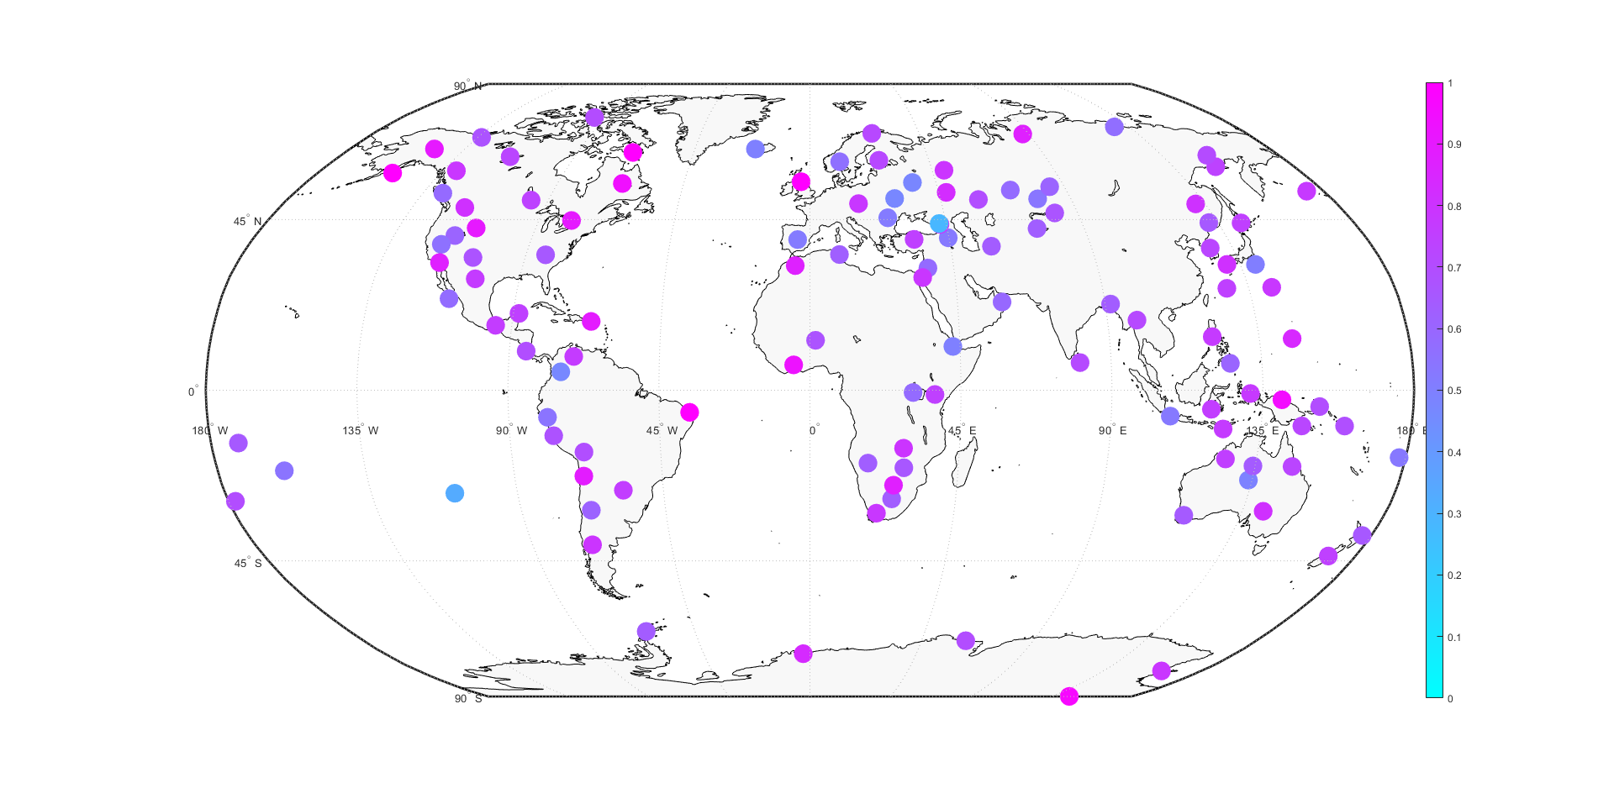
Model Performance on Held-out IMS Stations
Accuracy

Slide 31
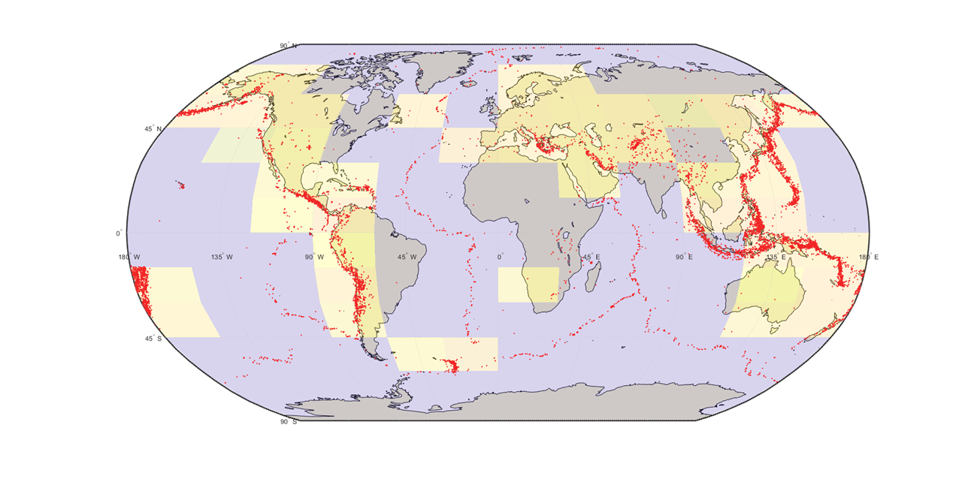
Model Performance on Held-out Source Regions
Average accuracy is 0.7727 with standard deviation 0.0413

Slide 32
Thank you!

