Slide 1
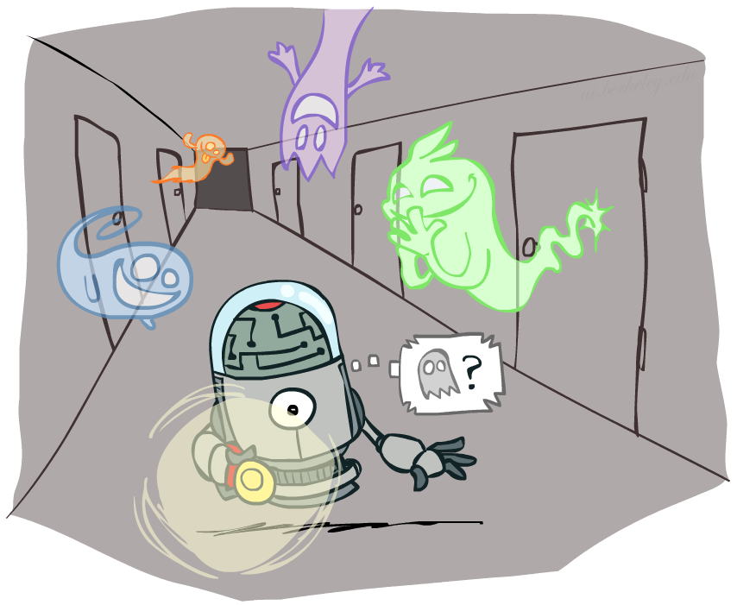
CS 4/527: Artificial Intelligence
Hidden Markov Models
Instructor: Jared Saia --- University of New Mexico
[These slides were created by Dan Klein, Pieter Abbeel, and Anca. http://ai.berkeley.edu.]
Notes:
Please retain proper attribution, including the reference to ai.berkeley.edu. Thanks!

Slide 2


Markov Models
  Value of X at a given time is called the state
  Parameters: called transition probabilities or dynamics, specify how the state evolves over time (also, initial state probabilities)
  Stationarity assumption: transition probabilities the same at all times
  Same as MDP transition model, but no choice of action
  A (growable) BN: We can always use generic BN reasoning on it if we truncate the chain at a fixed length
X₁
X₂
X₃
X₄

Slide 3
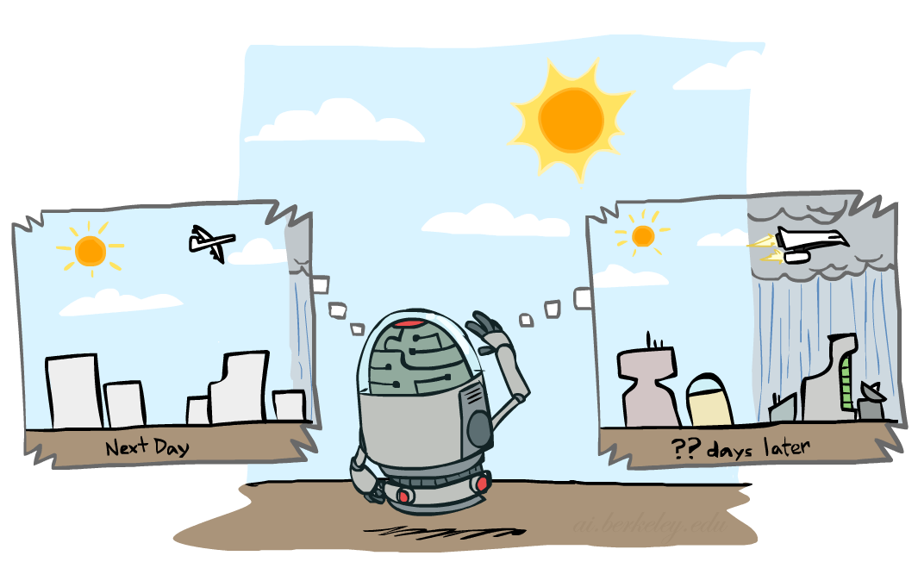

Mini-Forward Algorithm
Question: What’s P(X) on some day t?
X₁
X₂
X₃
X₄
Forward simulation

Slide 4

Application of Stationary Distribution: Web Link Analysis
PageRank over a web graph
  Each web page is a possible value of a state
  Initial distribution: uniform over pages
  Transitions:
    With prob. c, uniform jump to a
    random page (dotted lines, not all shown)
    With prob. 1-c, follow a random
    outlink (solid lines)
Stationary distribution
  Will spend more time on highly reachable pages
  E.g. many ways to get to the Acrobat Reader download page
  Somewhat robust to link spam.
  Google 1.0 returned the set of pages containing all your keywords in decreasing rank, now all search engines use link analysis along with many other factors (rank actually getting less important over time)
Notes:
Before: most search engines were merely based on how well a page matches your search words.
Note: currently dominated by clickstreams

Slide 5

Hidden Markov Models

Slide 6
Hidden Markov Models
Markov chains not so useful for most agents
  Need observations to update your beliefs
Hidden Markov models (HMMs)
  Underlying Markov chain over states X
  You observe outputs (effects) at each time step
X₁
X₂
X₃
X₄
X₅
E₁
E₂
E₃
E₄
E₅

Slide 7


Example: Weather HMM
Rain_{t-1}
Rain_{t}
Rain_{t+1}
Umbrella_{t-1}
Umbrella_{t}
Umbrella_{t+1}
An HMM is defined by:
  Initial distribution:
  Transitions:
  Emissions:
R_{t-1} | R_{t} | P(R_{t}|R_{t-1})
+r | +r | 0.7
+r | -r | 0.3
-r | +r | 0.3
-r | -r | 0.7
R_{t} | U_{t} | P(U_{t}|R_{t})
+r | +u | 0.9
+r | -u | 0.1
-r | +u | 0.2
-r | -u | 0.8
Notes:
demo

Slide 8

Inference: Find State Given Evidence
We are given evidence at each time and want to know
Idea: start with P(X₁) and derive B_{t} in terms of B_{t-1}
  equivalently, derive B_{t+1} in terms of B_{t}

Slide 9

Two Steps: Passage of Time + Observation
X₁
X₂
X₃
X₄
X₅
E₁
E₂
E₃
E₄
E₅

Slide 10
Passage of Time
Assume we have current belief P(X | evidence to date)
Then, after one time step passes:
Basic idea: beliefs get “pushed” through the transitions
  With the “B” notation, we have to be careful about what time step t the belief is about, and what evidence it includes
X₁
X₂
Notes:
TODO: intermediate step in derivation!

Slide 11


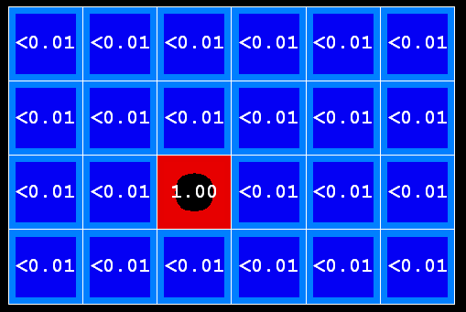
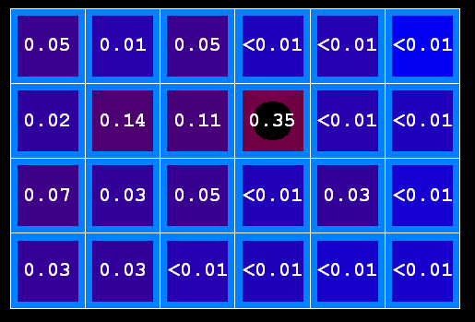
Example: Passage of Time
As time passes, uncertainty “accumulates”
(Transition model: ghosts usually go clockwise)
T = 1
T = 2
T = 5

Slide 12

Observation
X₁
Assume we have current belief P(X | previous evidence):
Then, after evidence comes in:
Or, compactly:
E₁
Basic idea: beliefs “reweighted” by likelihood of evidence
Unlike passage of time, we have to renormalize
Notes:
Basic idea: beliefs “reweighted” by likelihood of evidence
Unlike passage of time, we have to renormalize

Slide 13
Observation
X₁
Assume we have current belief P(X | previous evidence):
Then, after evidence comes in:
E₁
Basic idea: beliefs “reweighted” by likelihood of evidence
Unlike passage of time, we have to renormalize
Notes:
Basic idea: beliefs “reweighted” by likelihood of evidence
Unlike passage of time, we have to renormalize

Slide 14



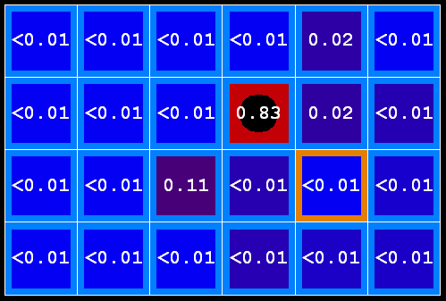
Example: Observation
As we get observations, beliefs get reweighted, uncertainty “decreases”
Before observation
After observation

Slide 15
Example: Weather HMM
B’(+r) = 0.5
B’(-r) = 0.5
B’(+r) = 0.627
B’(-r) = 0.373
B(+r) = 0.5
B(-r) = 0.5
B(+r) = 0.818
B(-r) = 0.182
B(+r) = 0.883
B(-r) = 0.117
Rain₀
Rain₁
Rain₂
R_{t} | R_{t+1} | P(R_{t+1}|R_{t})
+r | +r | 0.7
+r | -r | 0.3
-r | +r | 0.3
-r | -r | 0.7
R_{t} | U_{t} | P(U_{t}|R_{t})
+r | +u | 0.9
+r | -u | 0.1
-r | +u | 0.2
-r | -u | 0.8
Umbrella₁
Umbrella₂
Notes:
demo

Slide 16
Online Belief Updates
Every time step, we start with current P(X | evidence)
We update for time:
We update for evidence:
The forward algorithm does both at once (and doesn’t normalize)
X₁
X₂
X₂
E₂

Slide 17
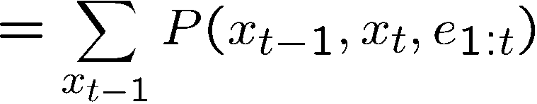
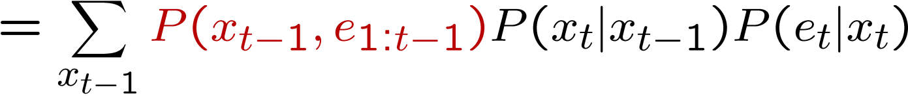
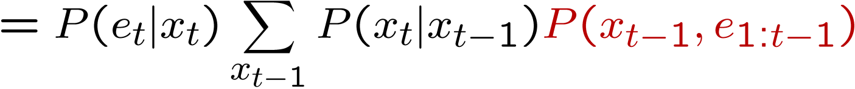
The Forward Algorithm
We are given evidence at each time and want to know
We can derive the following updates
We can normalize as we go if we want to have P(x|e) at each time step, or just once at the end…
t
[Demo: Ghostbusters Exact Filtering (L15D2)]
Notes:
TODO: explain propto and it’s X_t, not X

Slide 18
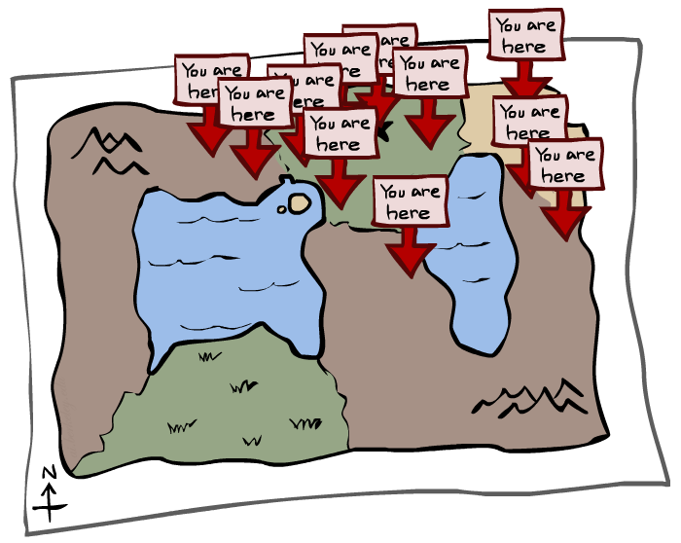
Particle Filtering

Slide 19
Particle Filtering
Filtering: approximate solution
Sometimes |X| is too big to use exact inference
  |X| may be too big to even store B(X)
  E.g. X is continuous
Solution: approximate inference
  Track samples of X, not all values
  Samples are called particles
  Time per step is linear in the number of samples
  But: number needed may be large
  In memory: list of particles, not states
This is how robot localization works in practice
Particle is just new name for sample
0.0
0.1
0.0
0.0
0.0
0.2
0.0
0.2
0.5

Slide 20
Representation: Particles
Our representation of P(X) is now a list of N particles (samples)
  Generally, N << |X|
  Storing map from X to counts would defeat the point
P(x) approximated by number of particles with value x
  So, many x may have P(x) = 0!
  More particles, more accuracy
For now, all particles have a weight of 1
Particles:
(3,3)
(2,3)
(3,3)
(3,2)
(3,3)
(3,2)
(1,2)
(3,3)
(3,3)
(2,3)

Slide 21
Recall
Every time step, we start with current P(X | evidence)
(1) We update for time:
(2) We update for evidence:
X₁
X₂
X₂
E₂

Slide 22

Particle Filtering: (1) Elapse Time
Each particle is moved by sampling its next position from the transition model
  This is like prior sampling – samples’ frequencies reflect the transition probabilities
  Here, most samples move clockwise, but some move in another direction or stay in place
This captures the passage of time
  If enough samples, close to exact values before and after (consistent)
Particles:
(3,3)
(2,3)
(3,3)
(3,2)
(3,3)
(3,2)
(1,2)
(3,3)
(3,3)
(2,3)
Particles:
(3,2)
(2,3)
(3,2)
(3,1)
(3,3)
(3,2)
(1,3)
(2,3)
(3,2)
(2,2)

Slide 23


Particle Filtering: (2) Update for Evidence
Particles:
(3,2)
(2,3)
(3,2)
(3,1)
(3,3)
(3,2)
(1,3)
(2,3)
(3,2)
(2,2)
Slightly trickier:
  Don’t sample observation, fix it
  Similar to likelihood weighting, downweight samples based on the evidence
  As before, the probabilities don’t sum to one, since all have been downweighted (in fact they now sum to (N times) an approximation of P(e))
Particles:
(3,2) w=.9
(2,3) w=.2
(3,2) w=.9
(3,1) w=.4
(3,3) w=.4
(3,2) w=.9
(1,3) w=.1
(2,3) w=.2
(3,2) w=.9
(2,2) w=.4

Slide 24
Particle Filtering: (3) Resample
Rather than tracking weighted samples, we resample
N times, we choose from our weighted sample distribution (i.e. draw with replacement)
This is equivalent to renormalizing the distribution
Now the update is complete for this time step, continue with the next one
Particles:
(3,2) w=.9
(2,3) w=.2
(3,2) w=.9
(3,1) w=.4
(3,3) w=.4
(3,2) w=.9
(1,3) w=.1
(2,3) w=.2
(3,2) w=.9
(2,2) w=.4
(New) Particles:
(3,2)
(2,2)
(3,2)
(2,3)
(3,3)
(3,2)
(1,3)
(2,3)
(3,2)
(3,2)

Slide 25
Recap: Particle Filtering
Particles: track samples of states rather than an explicit distribution
Elapse
Weight
Resample
Particles:
(3,3)
(2,3)
(3,3)
(3,2)
(3,3)
(3,2)
(1,2)
(3,3)
(3,3)
(2,3)
Particles:
(3,2)
(2,3)
(3,2)
(3,1)
(3,3)
(3,2)
(1,3)
(2,3)
(3,2)
(2,2)
Particles:
(3,2) w=.9
(2,3) w=.2
(3,2) w=.9
(3,1) w=.4
(3,3) w=.4
(3,2) w=.9
(1,3) w=.1
(2,3) w=.2
(3,2) w=.9
(2,2) w=.4
(New) Particles:
(3,2)
(2,2)
(3,2)
(2,3)
(3,3)
(3,2)
(1,3)
(2,3)
(3,2)
(3,2)
[Demos: ghostbusters particle filtering (L15D3,4,5)]

Slide 26

Video of Demo – Moderate Number of Particles

Slide 27
Video of Demo – One Particle

Slide 28
Video of Demo – Huge Number of Particles

Slide 29
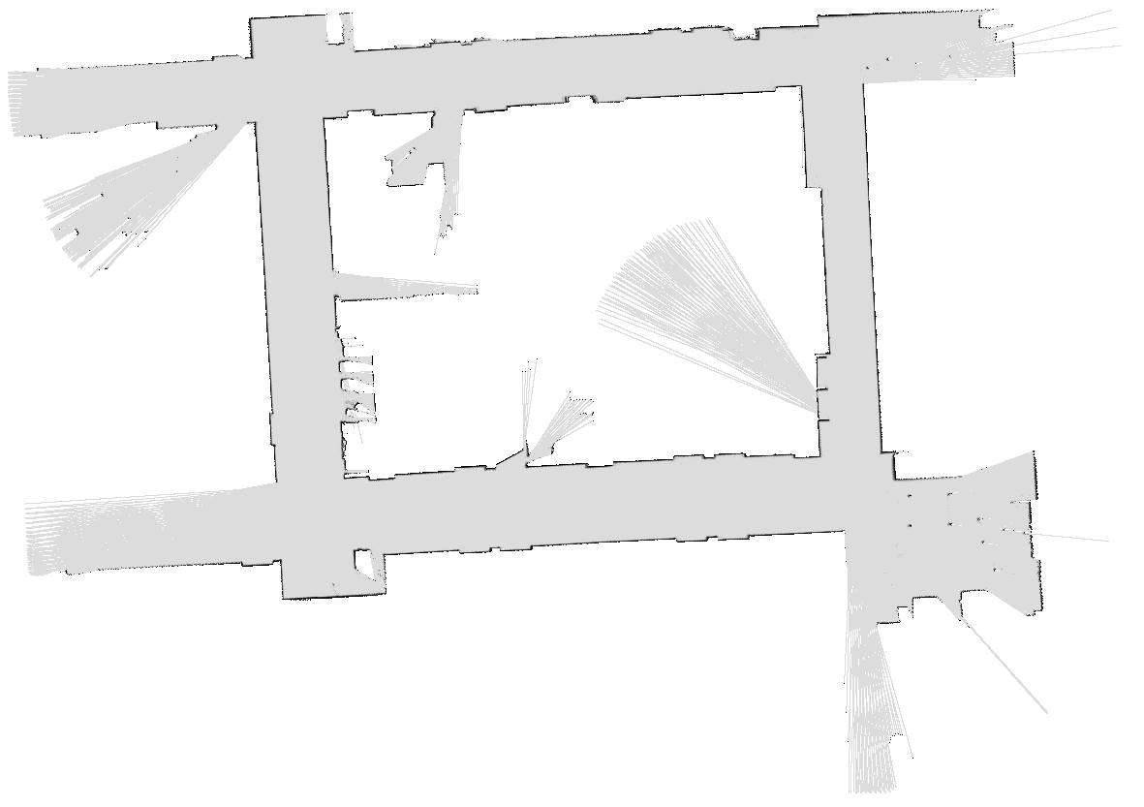

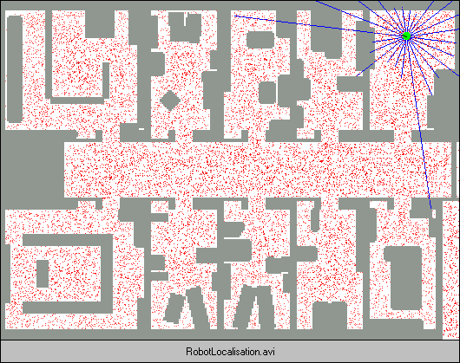
Demo Bonanza!

Slide 30
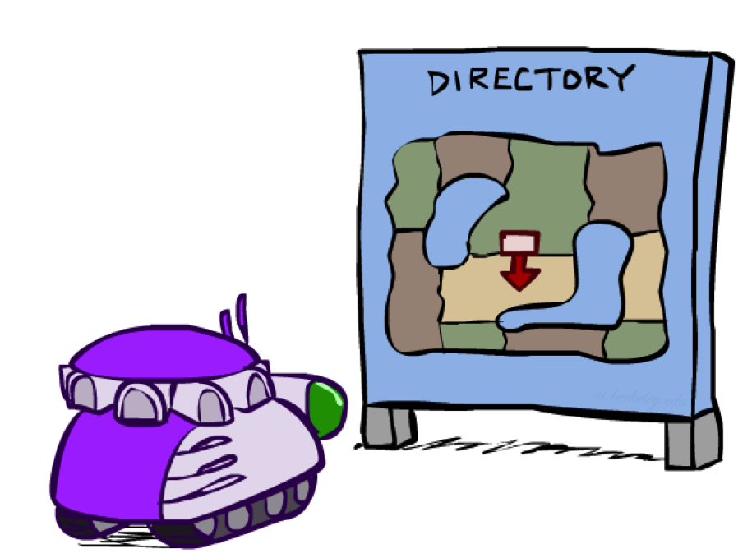
Robot Localization
In robot localization:
  We know the map, but not the robot’s position
  Observations may be vectors of range finder readings
  State space and readings are typically continuous (works basically like a very fine grid) and so we cannot store B(X)
  Particle filtering is a main technique

Slide 31

Particle Filter Localization (Sonar)
[Dieter Fox, et al.]
[Video: global-sonar-uw-annotated.avi]

Slide 32
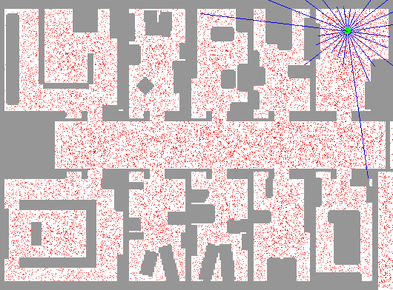
Particle Filter Localization (Laser)
[Dieter Fox, et al.]
[Video: global-floor.gif]

Slide 33

Robot Mapping
SLAM: Simultaneous Localization And Mapping
  We do not know the map or our location
  State consists of position AND map!
  Main techniques: Kalman filtering (Gaussian HMMs) and particle methods
DP-SLAM, Ron Parr
[Demo: PARTICLES-SLAM-mapping1-new.avi]

Slide 34

Particle Filter SLAM – Video 1
[Sebastian Thrun, et al.]
[Demo: PARTICLES-SLAM-mapping1-new.avi]

Slide 35

Particle Filter SLAM – Video 2
[Dirk Haehnel, et al.]
[Demo: PARTICLES-SLAM-fastslam.avi]

Slide 36
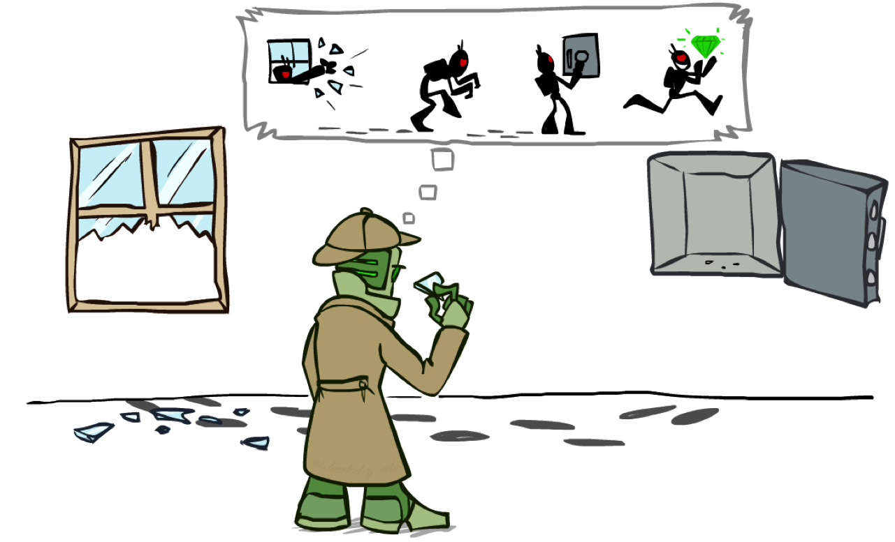
Most Likely Explanation*

Slide 37

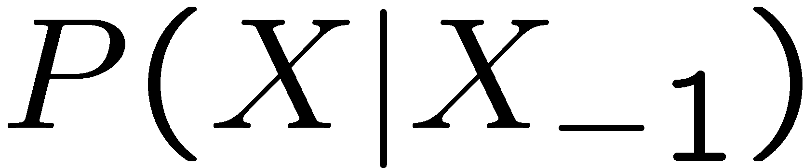
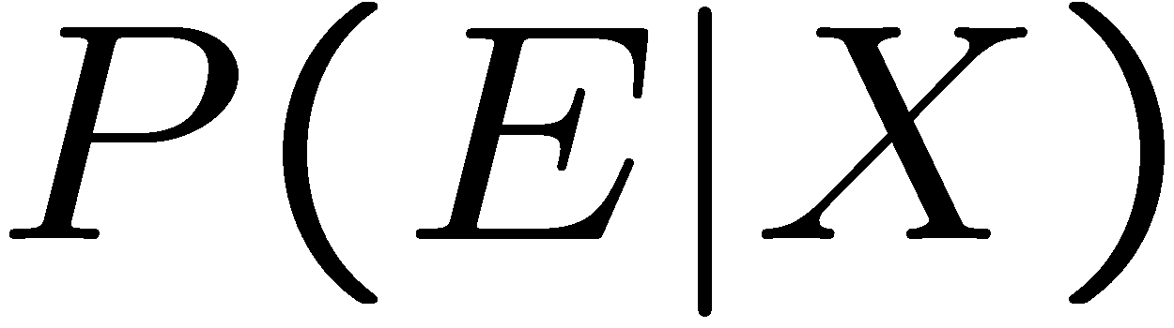
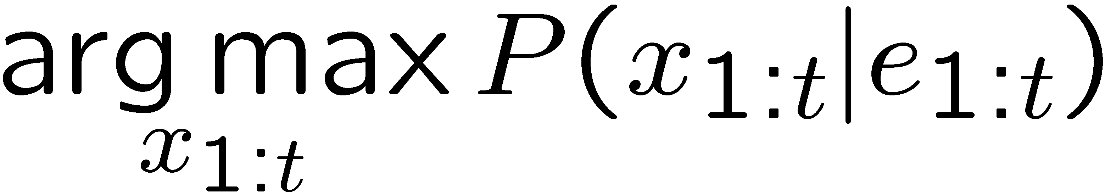
HMMs: MLE Queries*
HMMs defined by
  States X
  Observations E
  Initial distribution:
  Transitions:
  Emissions:
New query: most likely explanation:
New method: the Viterbi algorithm
X₁
X₂
X₃
X₄
X₅
E₁
E₂
E₃
E₄
E₅

Slide 38
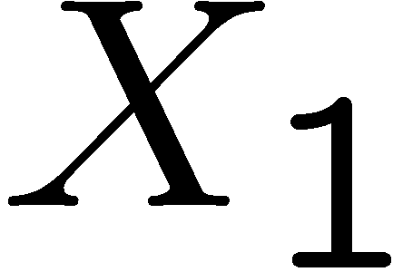
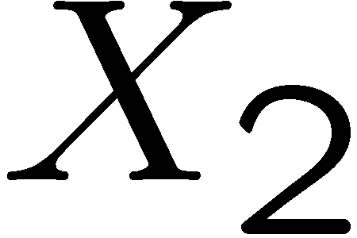

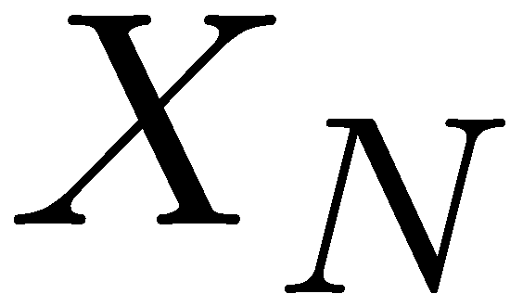

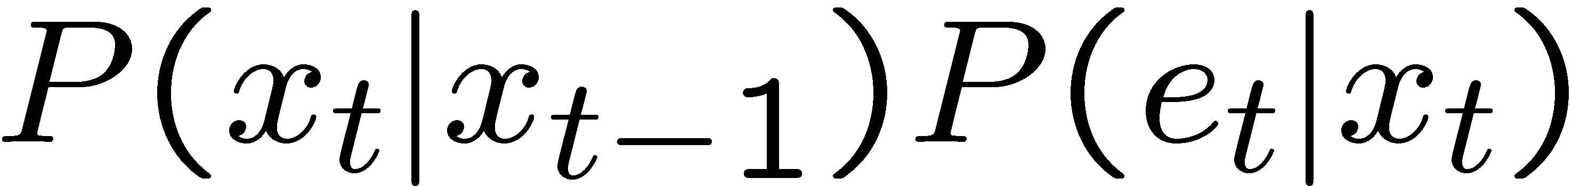
State Trellis*
State trellis: graph of states and transitions over time
Each arc represents some transition
Each arc has weight
Each path is a sequence of states
The product of weights on a path is that sequence’s probability along with the evidence
Forward algorithm computes sums of paths, Viterbi computes best paths
sun
sun
sun
sun
rain
rain
rain
rain

Slide 39

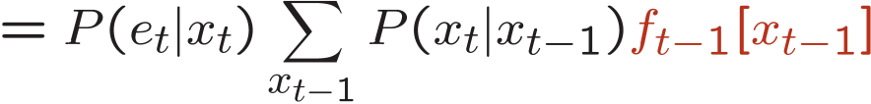
Forward / Viterbi Algorithms*
sun
sun
sun
sun
rain
rain
rain
rain
Forward Algorithm (Sum)
Viterbi Algorithm (Max)

