Slide 1
Simple Case Studies Using MASS
Dear Reader: This document offers examples some short, self contained examples of how we can use MASS: Mueen's Algorithm for Similarity Search
If you are new to MASS, we strongly recommend you spend ten minutes running these examples, it will help you build your skills and intuitions for what MASS can do for you.
Corrections and suggestions to eamonn@cs.ucr.edu
See also www.cs.ucr.edu/~eamonn/MatrixProfile.html and www.cs.unm.edu/~mueen/FastestSimilaritySearch.html

Slide 2
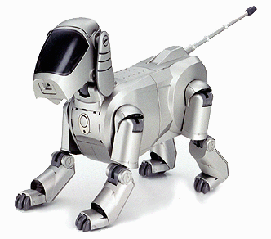
Query
The dataset comes from an accelerometer inside a Sony AIBO robot dog. The query comes from a period when the dog was walking on carpet, the test data we will search comes from a time the robot walked on cement (for 5000 data points), then carpet (for 3000 data points), then back onto cement.
Have we ever seen a pattern that looks just like this?
0
10
20
30
40
50
60
70
80
90
100
0
2000
4000
6000
8000
10000
12000
This task is trivial with MASS …
  >> load robot_dog.txt , load carpet_query.txt % load the data
  >> dist = findNN(robot_dog ,carpet_query ); % compute a distance profile
  >> [val loc] = min(dist); % find location of match
  >> disp(['The best matching subsequence starts at ',num2str(loc)])
  The best matching subsequence starts at 7479
Below we plot the 16 best matches. Note that they all occur during the carpet walking period. This entire process takes about 1/1000th of a second.
7450
7500
7550
7600
The best match, shown in context
0
2000
4000
6000
8000
10000
12000
Notes:
load robot_dog.txt , load carpet_query.txt
demo_search( robot_dog , carpet_query);
---
function demo_search( robot_dog, carpet_query )
dist = findNN(robot_dog ,carpet_query ); % compute a distance profile
[val loc] = min(dist);
figure;, hold on;, plot(robot_dog)
for i = 1 :16 % plot the top matches
[val loc] = min(dist) % find the best match
index_to_plot = loc;
plot([index_to_plot:index_to_plot+length(carpet_query)], robot_dog(index_to_plot:index_to_plot+length(carpet_query)),'color',[1 rand rand])
dist(index_to_plot-80:index_to_plot+80)= inf; % remove trival matches, before going to the top of the loop
end
end

Slide 3
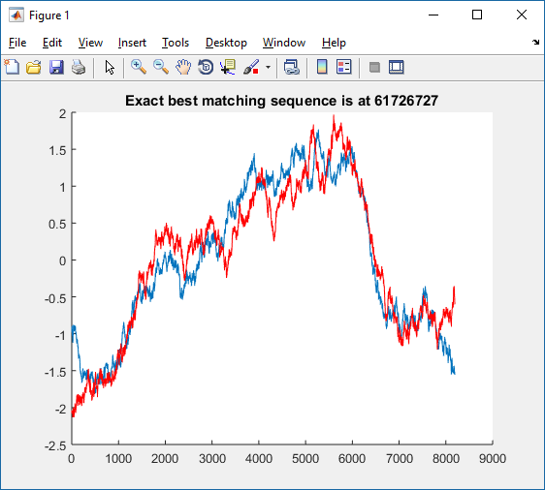
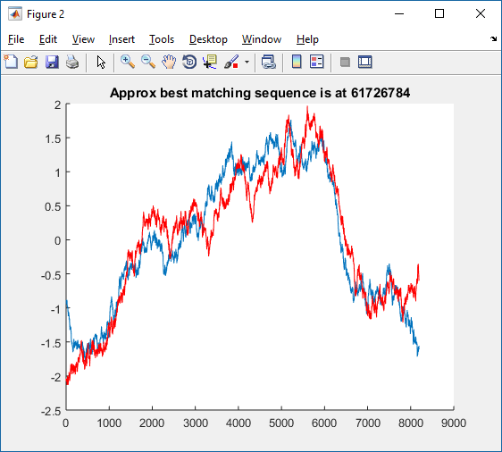
How do I quickly search this long dataset for this pattern, if an approximate search is acceptable?
As shown elsewhere in this document, exact search is surprisingly fast under Euclidean Distance. However, let us suppose that you want to do even faster search, and you are willing to do an approximate search (but want a high quality answer). A simple trick is to downsample both the data and the query by the same amount (in the below, by 1 in 64) and search the downsampled data. If the data has low intrinsic dimensionality, this will typically give you very good results.
Let us build a long dataset, with 67,108,864 datapoints, and a long query, with 8,192 datapoints
A full exact search takes 12.4 seconds, an approximate search takes 0.24 seconds, and produces (at least in this example) almost exactly the same answer. The answer is just slightly shifted in time.
How well this will work for you depends on the intrinsic dimensionality of your data.
rng('default') % set seed for reproducibility
data= cumsum(randn(1,2^26)); % make data
query= cumsum(randn(1,2^13)); % make a query
tic
dist = MASS_V2(data ,query );
[val,loc] = min(dist); % find best match location
hold on
plot(zscore(data(loc:loc+length(query))))
plot(zscore(query),'r')
title(['Exact best matching sequence is at ', num2str(loc)])
disp(['Exact best matching sequence is at ', num2str(loc)])
toc
figure;
downsampled_data = data(1:64:end); % create a downsampled version of the data
downsampled_query = query(1:64:end); % create a downsampled version of the query
tic
dist = MASS_V2(downsampled_data ,downsampled_query );
[val,loc] = min(dist);
hold on
plot(zscore(data((loc*64):(loc*64)+length(query)))) % multiply the 'loc' by 64 to index correctly
plot(zscore(query),'r')
title(['Approx best matching sequence is at ', num2str(loc*64)])
disp(['Approx best matching sequence is at ', num2str(loc*64)])
toc
exact
exact
approximate
approximate
    Exact best matching sequence is at 61726727, Elapsed time is 12.40 seconds.
    Approx best matching sequence is at 61726784, Elapsed time is 0.240 seconds.

Slide 4
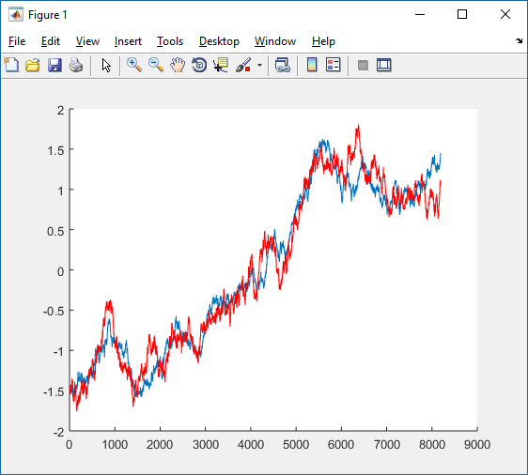


see also “How do I quickly search this long dataset for this pattern, if an approximate search is acceptable?”
How can I optimize similarity search in a long time series?
Suppose you want to find a query inside a long time series, say of length 67,000,000.
First trick: MASS (and several other FFT and DWT ideas) have their best case when the data length is a power of two, so pad the data to make it a power of two (padding with zeros works fine).
Second trick: MASS V3 is a piecewise version of MASS that performs better when the size of the pieces are well aligned with the hardware. You need to tune a single parameter, but the parameter can only be a power of two, so you can search over say 2¹⁰ to 2²⁰. Once you find a good value, you can hardcode it for your machine.
rng('default') % Set seed for reproducibility
data= cumsum(randn(1,67000000)); % make data
query= cumsum(randn(1,2^13)); % make a long query
tic
dist = MASS_V2(data ,query );
[val,loc] = min(dist); % find best match location
hold on
plot(zscore(data(loc:loc+length(query))))
plot(zscore(query),'r')
disp(['Best matching sequence is at ', num2str(loc)])
toc
figure
data = [data zeros(1,2^nextpow2(67000000) -67000000)]; % pad data to
tic % next pow of 2
dist = MASS_V2(data ,query );
[val,loc] = min(dist); % find best match location
hold on
plot(zscore(data(loc:loc+length(query))))
plot(zscore(query),'r')
disp(['After padding: Best matching sequence is at ', num2str(loc)])
toc
figure
tic
dist = MASS_V3(data ,query, 2^16 );
[val,loc] = min(dist); % find best match location
hold on
plot(zscore(data(loc:loc+length(query))))
plot(zscore(query),'r')
disp(['MASS V3 & padding: Best matching sequence is at ', num2str(loc)])
toc
Naive
If you run this code, it will output…
Best matching sequence is at 32463217
Elapsed time is 14.30 seconds.
After padding: Best matching sequence is at 32463217
Elapsed time is 12.31 seconds.
MASS V3 & padding: Best matching sequence is at 32463217
Elapsed time is 5.82 seconds.
Trick 1
Note that it outputs the exact same answer, regardless of the optimizations, but it is fast, then faster, then super fast.
Trick 1 & 2

Slide 5
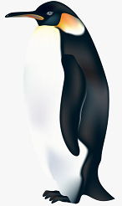
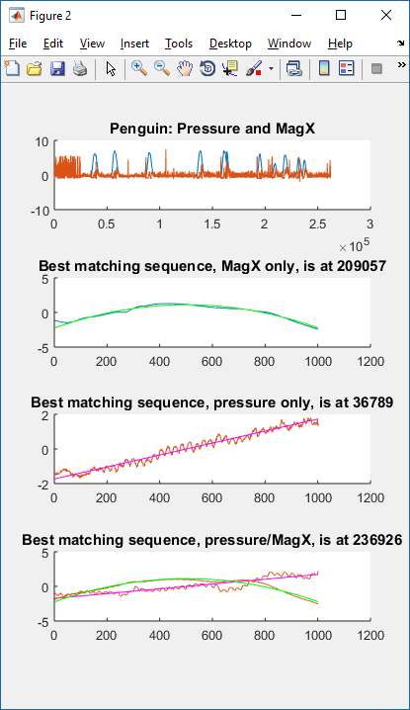
Have we ever seen a multidimensional pattern that looks just like this?
Pressure
MagX
0
250,000
I have 262,144 data points that record a penguin’s orientation (MagX) and the water/air pressure as he hunts for fish.
Question: Does he ever change his bearing leftwards as he reaches the apex of his dive.
This is easy to describe as a multidimensional search. The apex of a dive is just an approximately parabolic shape. I can create this with query_pressure = zscore([[-500:500].^2]*-1)’; it looks like this
I can create bearing leftwards with a straight rising line, like this query_MagX = zscore([[-500:500]])’; It looks like this
We have seen elsewhere in this document how to search for a 1D pattern. For this 2D case, all we have to do is add the two distance profiles together, before we find the minimum value.
Note that the best match location in 2D is different to either of the 1D queries.
We can do this for 3D or 4D…
However, there are some caveats. In brief, it almost never makes sense to do multidimensional time series search in more than 3 or 4D. See Matrix Profile VI: Michael Yeh ICDM 2017 and “Weighting” Bing Hu, ICDM 2013. In addition, in some cases we may want to weight the dimensions differently, even though they are both z-normalized Euclidean Distance.
Orientation (MagX)
load penguintest.mat
figure;, hold on;
query_pressure = zscore([[-500:500].^2]*-1)';
dist_p = MASS_V2(penguintest(:,1),query_pressure);
query_MagX = zscore([[-500:500]])';
dist_m = MASS_V2(penguintest(:,2),query_MagX);
[val,loc] = min([dist_m + dist_p]); % find best match location in 2D
plot(zscore(penguintest(loc:loc+length(query_MagX),2)),'color',[0.85 0.32 0.09])
plot(zscore(query_MagX),'m')
plot(zscore(penguintest(loc:loc+length(query_pressure),1)),’b’)
plot(zscore(query_pressure),'g')
title(['Best matching sequence, pressure/MagX, is at ', num2str(loc)])
Pressure
Best match in 2D space
0
1000
Notes:
load penguintest.mat
figure
subplot(411); hold on;
plot(penguintest)
title(['Penguin: Pressure and MagX'])
subplot(412); hold on;
query_pressure = zscore([[-500:500].^2]*-1)';
dist_p = MASS_V2(penguintest(:,1),query_pressure);
[val,loc] = min(dist_p); % find best match location
plot(zscore(penguintest(loc:loc+length(query_pressure),1)))
plot(zscore(query_pressure),'g')
title(['Best matching sequence, MagX only, is at ', num2str(loc)])
subplot(413); hold on;
query_MagX = zscore([[-500:500]])';
dist_m = MASS_V2(penguintest(:,2),query_MagX);
[val,loc] = min(dist_m); % find best match location
plot(zscore(penguintest(loc:loc+length(query_MagX),2)),'color',[ 0.8500 0.3250 0.0980])
plot(zscore(query_MagX),'m')
title(['Best matching sequence, pressure only, is at ', num2str(loc)])
subplot(414); hold on;
[val,loc] = min([dist_m + dist_p]); % find best match location
plot(zscore(penguintest(loc:loc+length(query_MagX),2)),'color',[ 0.8500 0.3250 0.0980])
plot(zscore(query_MagX),'m')
plot(zscore(penguintest(loc:loc+length(query_pressure),1)))
plot(zscore(query_pressure),'g')
title(['Best matching sequence, pressure/MagX, is at ', num2str(loc)])

