Slide 1
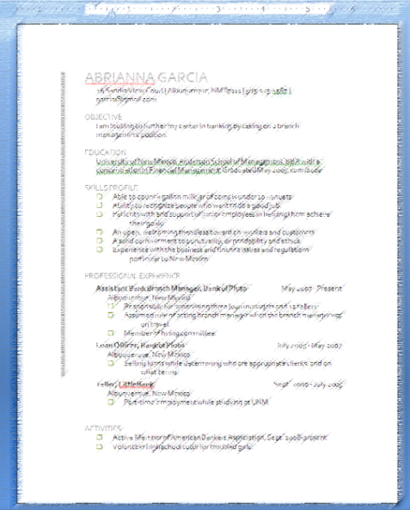
CS-150L
Computing for Business Students
Lab 1:
The Résumé and Microsoft Word
Instructor:
Matthew Barrick
e-mail: barrick@cs.unm.edu
www.cs.unm.edu/~barrick
Office: Farris Engineering Center (FEC) room 106

Slide 2

Lab 1: The Résumé and Word
Using Microsoft Word to Create a Résumé to Strict Specifications
Skills
Web Browser and URL
File Extensions
Save as file format.
Numbered and bulleted lists
Line spacing, paragraph spacing,
Alignment, and indenting.
The Ruler
Use a simple table to control page layout.

Slide 3


Windows – Gotta Love it
"Why should I press the Start button to turn the computer off ?" — A Windows user.
"Computer are like air conditioners: they stop working when you open windows.“
Schedule your time accordingly.

Slide 4
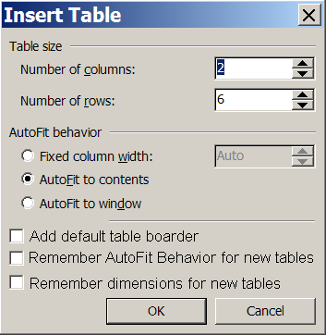
GUI (Graphical User Interface)
Dialog Box
Edit Field
Label
Radio Buttons
Inactive Edit Field
Check Boxes
Button

Slide 5
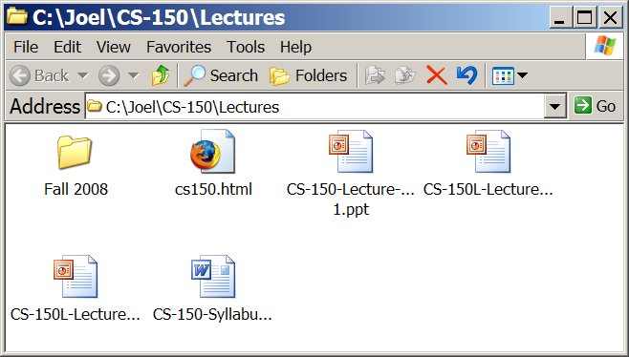
Windows XP's Window GUI
Maximize
Close
Minimize
Change Size

Slide 6
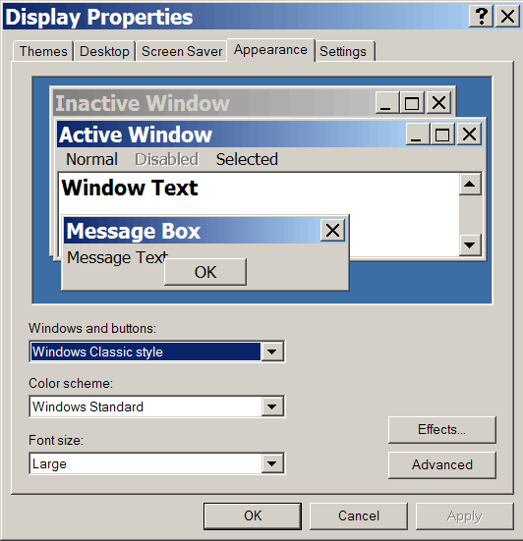
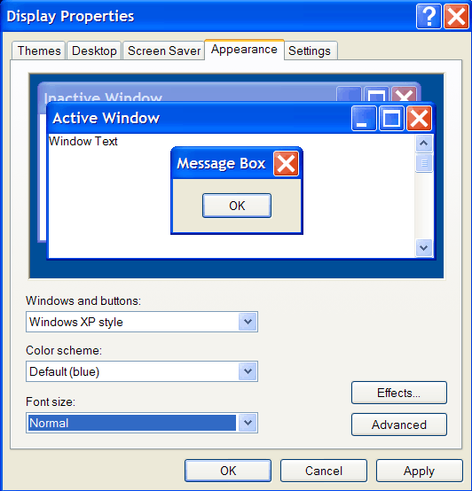
Settings → Control Panel → Display
"Windows and Buttons" & "Font size"

Slide 7


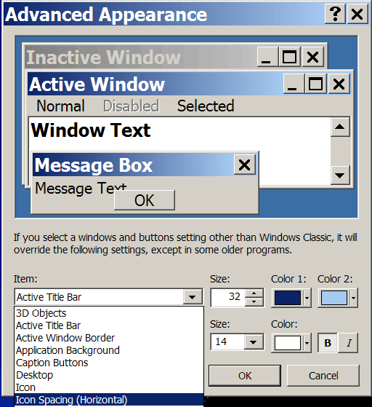
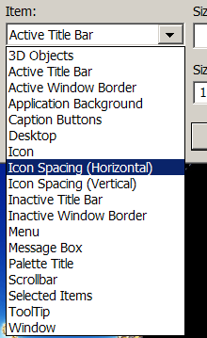
→

Slide 8
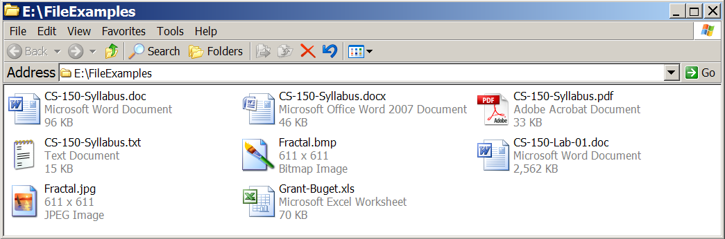
File Extension Examples
.jpg: JPEG Image
.doc: Microsoft Word 97-2003 Document
.docx: Microsoft Word 2007 Document
.pdf: Adobe Acrobat Document

Slide 9
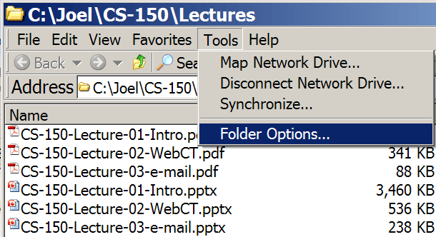
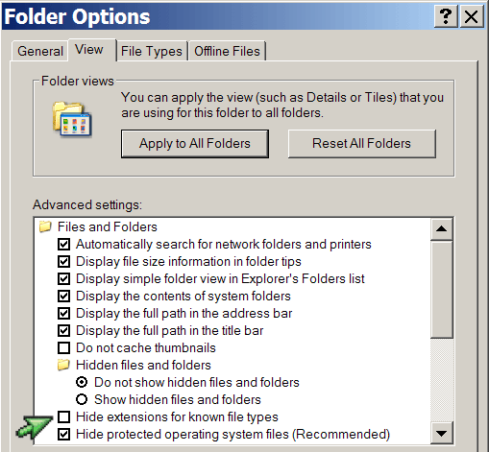
Hide / Show Extensions (XP)

Slide 10
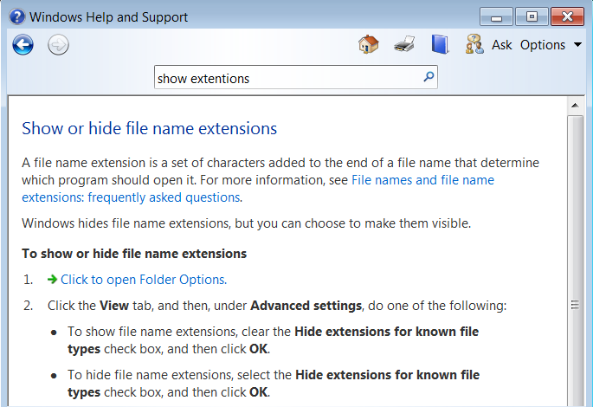
Hide / Show Extensions (Windows 7)

Slide 11

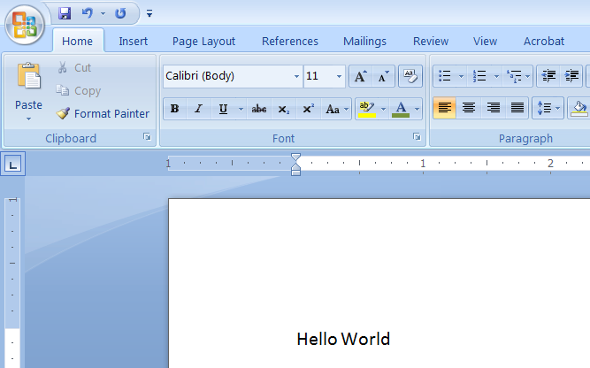
Microsoft Word
Undo

Slide 12


Align Text
Align Text Left
Align Text Right
Whose woods these are I think I know.
His house is in the village though;
He will not see me stopping here
To watch his woods fill up with snow.
$1.23
$234.00
$2,000.00
$45.95

Slide 13
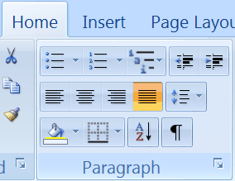
Justify: Paragraph Alignment
Align text to both the left and right margins, adding extra space between words as necessary.
This creates a clean look along the left and right side of the page.
Justified text looks best when there are many words on a line.
Justify
Text formatted with “Justify” may or may not include paragraph indenting.

Slide 14
Line Spacing
28 pt Arial with line spacing set to 1.5.
Line spacing is vertical space added between each line.
Paragraph spacing is vertical space added between each paragraph.
Paragraph spacing is different from leaving a blank line between each paragraph.

Slide 15
Paragraph Spacing
28 pt Arial with Paragraph Spacing set to 14 pt.
Line spacing is vertical space added between each line.
Paragraph spacing is vertical space added between each paragraph.
Paragraph spacing is different from leaving a blank line between each paragraph.

Slide 16
Blank Line Between Paragraphs
28 pt Arial with Blank Line Between Paragraphs
Line spacing is vertical space added between each line.
Paragraph spacing is vertical space added between each paragraph.
Paragraph spacing is different from leaving a blank line between each paragraph.

Slide 17
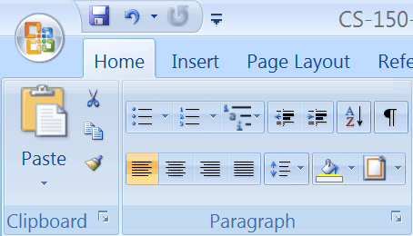
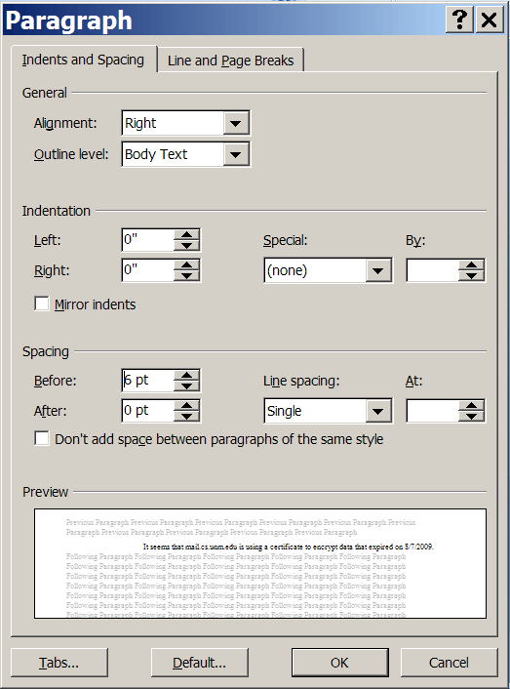
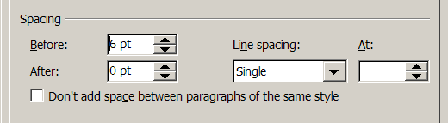
Line and Paragraph Spacing

Slide 18

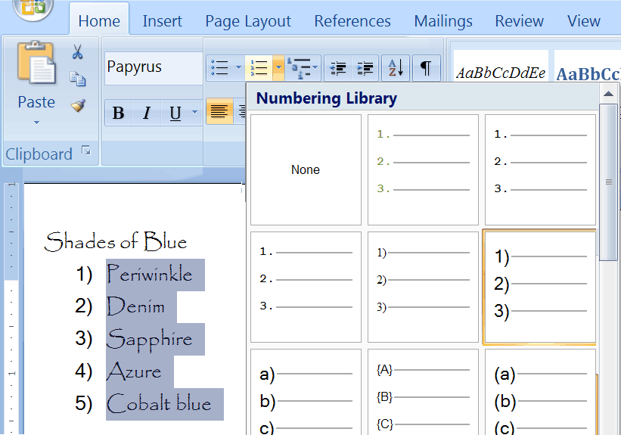
Lists: Numbering Library
Selected
Text

Slide 19
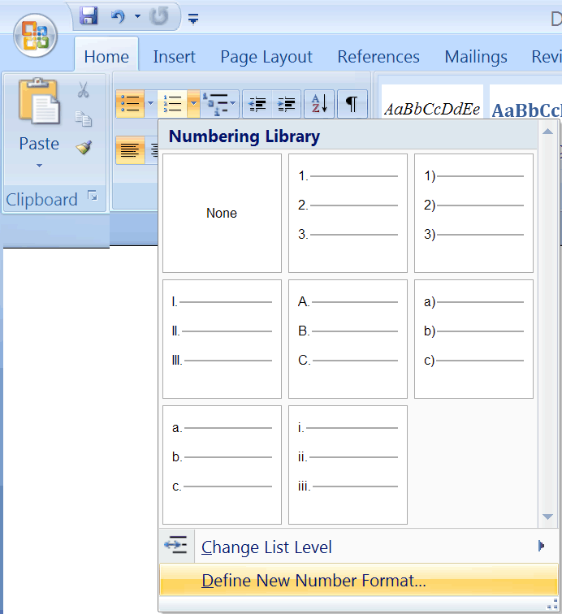
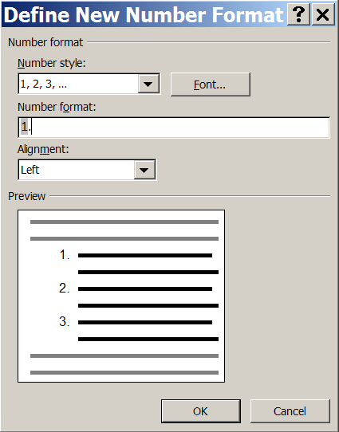
Define New Number Format

Slide 20
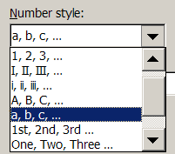
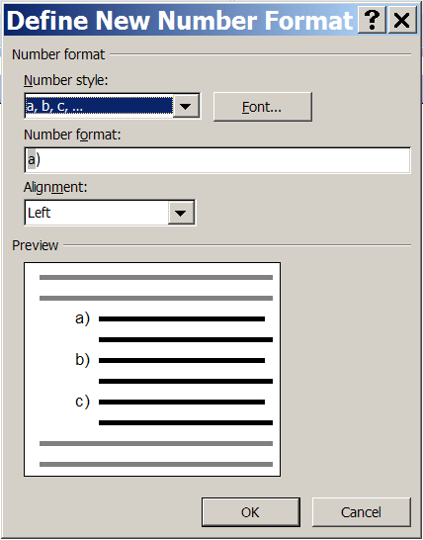
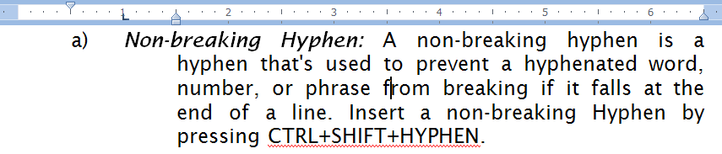
Define New Number Format

Slide 21
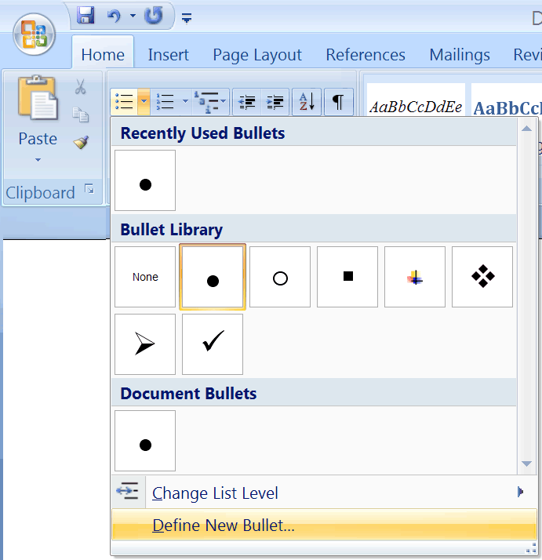
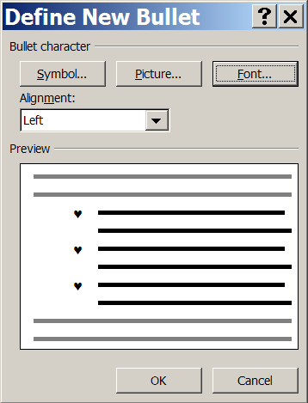
Customized Bullets
First, Select Symbol
Next, set Font & Color

Slide 22
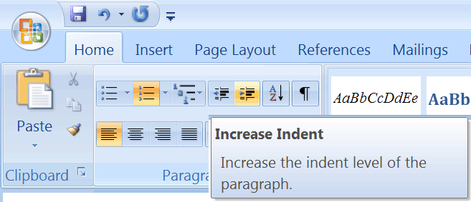
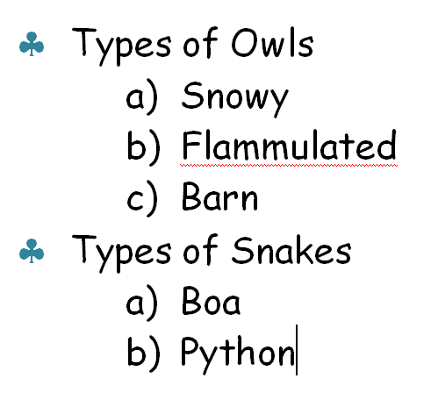
Nested lists (Bullets & Numbered)

Slide 23
Nested List
Enter the text and press “Enter” after each list item.
Select all the items and format all items as the outer list.
Select the inner items and format those.
Red
Blue
Periwinkle
Sapphire
Green
Red
Blue
Periwinkle
Sapphire
Green
Red
Blue
  Periwinkle
  Sapphire
Green

Slide 24
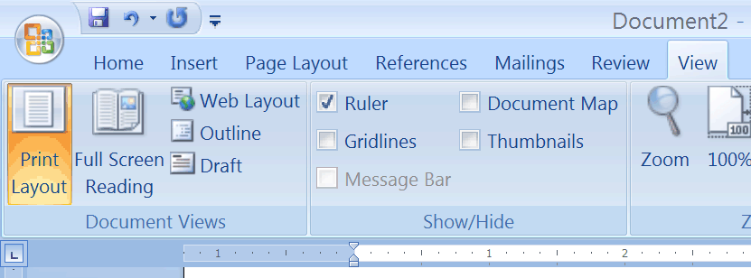

Ruler: Use to set Tabs and Indents
Right Page Margin
Left Page Margin
Left Edge of Paper
Right Edge of Paper

Slide 25
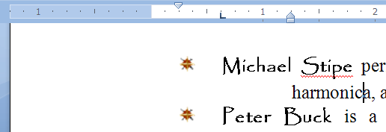
Ruler: The Zero Point
Left Page Margin
0 Mark on Ruler.
Set to 1.25 inches from Edge of Paper
1 inch from
Left Page Margin
Edge of Paper
-1.25 inch mark on Ruler.

Slide 26
Reading the Ruler
⅛
⅜
⅝
⅞
¼
¾
1¼
1¾
½
1½
1 inch from
Left Page Margin
2 inches from
Left Page Margin

Slide 27
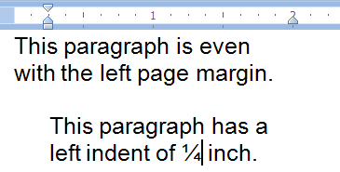
Left Indent Marker
Left Indent set to ¼ inch from the left page margin.
Active Paragraph has the curser.
Each paragraph can have different Ruler settings.
The Ruler displays the settings for the active paragraph

Slide 28

Quiz: Reading The Ruler: Left Indent
What is the left indent setting shown above?
¾ of an inch from the left page margin.
⅝ inches from the left page margin.
1⅝ inches from the left page margin.
1⅜ inches from the left page margin.
1¾ inches from the left page margin.

Slide 29

Geeky Bumper Sticker
9 out of 8 people
have trouble with fractions
http://www.thinkgeek.com

Slide 30
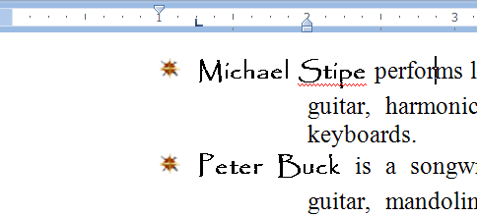
Hanging Indent on a Bulleted List
First Line Indent
The bullet symbol starts here.
Tab Marker
The first line of text starts here
Hanging Indent
Each subsequent line in the paragraph starts here.

Slide 31
Numbered List: Hanging Indent
The numbered list must be formatted with a hanging indent such that the numbers start 0.5 inches (½ inch) from the left margin.
  The first line of text starts 1 inch from the left margin.
    Each subsequent line starts 1.5 inches (1½ inches) from the left page margin.
View  Ruler

Slide 32
Quiz: Reading The Ruler
What is the left indent setting shown above?
¾ of an inch from the left page margin.
1 ½ inches from the left page margin.
1 ¾ inches from the left page margin.
1 ⅜ inches from the left page margin.
1 ⅓ inches from the left page margin.

Slide 33
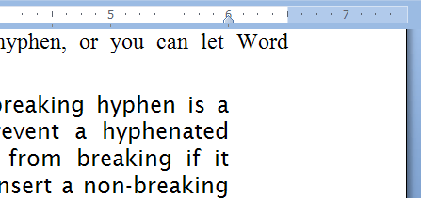
Right Paragraph Margin
Below, the second paragraph is active.
The Right Paragraph Margin is set to 0.5 inches from the Right Page Margin.

Slide 34

Quiz: Reading the Right Margin
What is the setting of the Right Paragraph margin?
5½ inches from the right page margin.
5¾ inches from the right page margin.
½ inches from the right page margin.
¼ inches from the right page margin.
⅜ inches from the right page margin.

Slide 35
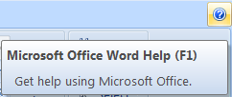
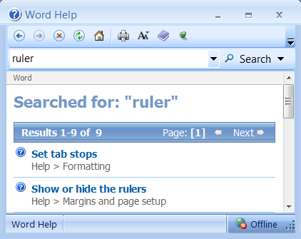
Getting Help in Word
Knowing the name of what you what to know…
is power!

Slide 36
Google is friend (most of the time)
Using Google or another search engine to figure out how to do something is perfectly acceptable for a lab.
Keep in mind that what you find on the Web might not the correct, accurate, or efficient way of doing something.
This applies only to labs. Use of the Internet for any purpose is forbidden during exams!!

Slide 37
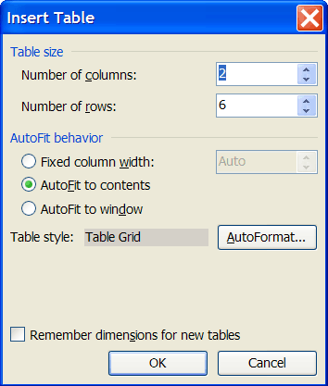
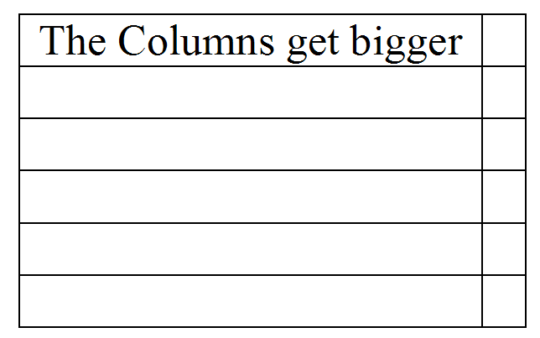
Insert Ribbon→Table→Insert Table...
Default Table:
Columns = 2
Rows = 2
AutoFit to contents

Slide 38
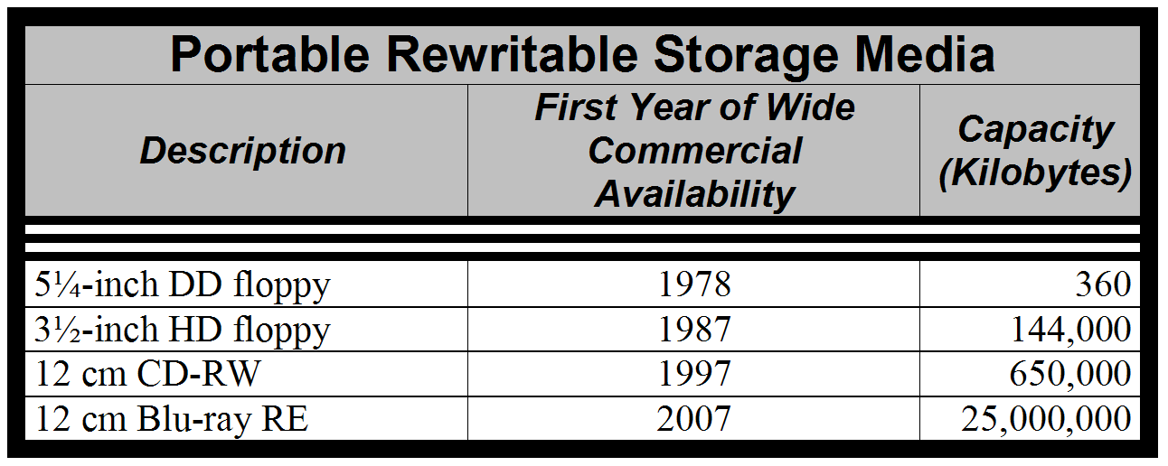
Table Formatting
Merge Cell used on selected cells.
Format → Borders and Shading used to create the 3 different types of cell borders

Slide 39
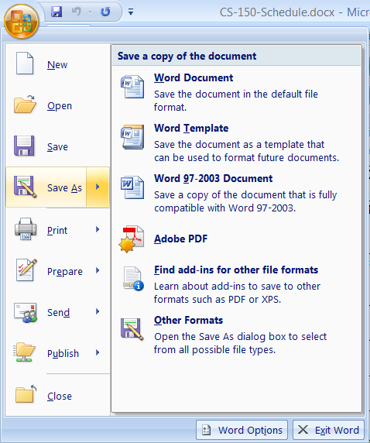
“Save” verses “Save As”
With Save As, you can:
Select a different file name.
  This is important for making backups.
Select the file format.
  All labs in this class must be saved in 97-2003 format.
  Word 2007 files have a file extension of .docx
  Word 97-2003 files have a file extension of .doc.

Slide 40
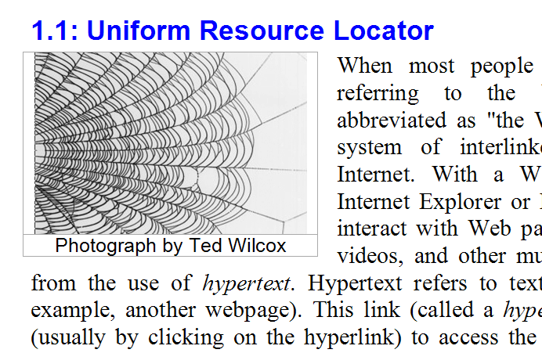
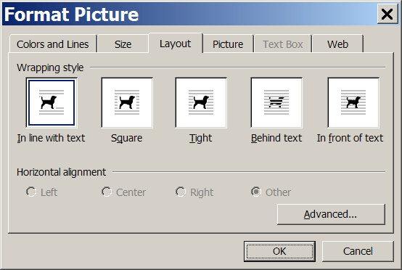
Image layout Options
Double-click on image to open Format Picture dialog.
Table with two rows, one column, and hidden borders

Slide 41
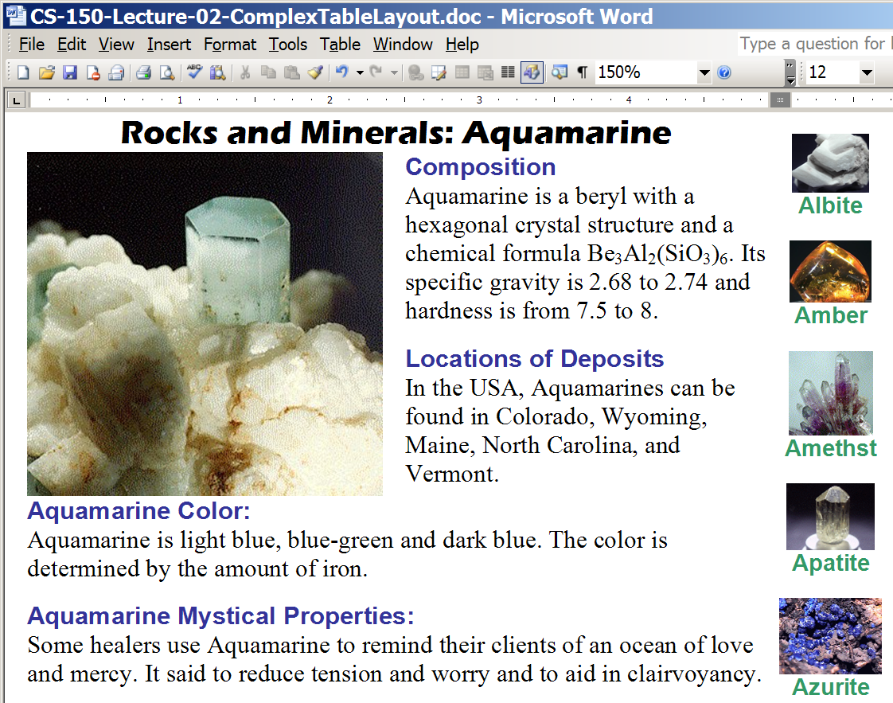
Use Tables for Complex Layouts
Try using nested tables without boarders.

Slide 42
Vertical Centering in a Table
One Row | There are Two Rows Here | This Last Column Has Three Rows of Text
***Bad***
Centered by adding spaces
One Row | There are Two Rows Here | This Last Column Has Three Rows of Text

