Slide 1
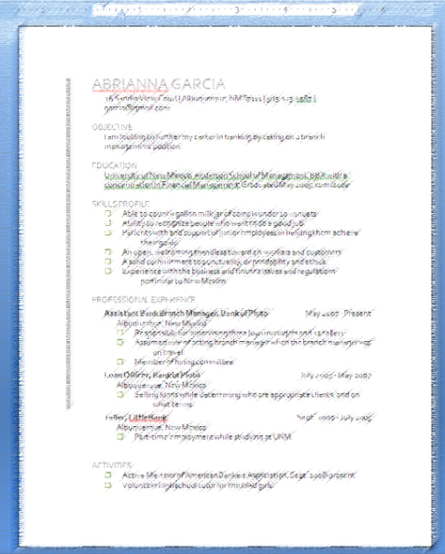
CS-150L Computing for Business Students Lab 2: The Business Letter
Instructor:
Matthew Barrick
e-mail: barrick@cs.unm.edu
www.cs.unm.edu/~barrick
Office: Farris Engineering Center (FEC) room 106

Slide 2
Lab 2: The Business Letter
Using Microsoft Word to Create a Business Letter to Strict Specifications
Skills
Insert International Characters and special symbols
Insert Clipart
Format and use document headers and footers
Use an Internet search engine to research product information.
Understand the specifications of currently available computer components

Slide 3
Typography
Typography is the process of selecting typefaces (or fonts), type styles, and type sizes.
Monospaced typeface
Courier New: WWWW iiii
Proportional typeface
Times New Rowan: WWWW iiii
Great for printing: compact, and low ink.
Arial: WWWW iiii
Great for Projection

Slide 4
Double Space after Period?
Two spaces after a period was common on typewriters with Monospaced typeface.
When using a proportional font, there should be only one space after a period.
A single space after a full stop has been the norm in mainstream publishing for many decades. This is supported by:
Modern Language Association of America (MLA),
American Psychological Association (APA) style
The Chicago Manual of Style.

Slide 5
ASCII Art
__
(___()'`;
/,`.':/`
\\"--\\
,-._,-.
\/)"(\/
(_o_)
/ \/)
(|| ||)
oo-oo
__
o-''|\_____/)
\_/|_) )
\ __ /
(_/ (_/
,-""""""-.
/\j__/\ ( \`--.
\`@_@'/ _) >--.`.
_{.:Y:_}_{{_,' ) )
{_}`-^{_} ``` (_/
Font: Monospaced typeface.
Line Spacing: Single spacing
Zero points after a paragraph and
Zero points before each paragraph
.-.
(-`))
//
//
((_.="""=.
'. ,. \
'-._,)__\
|\ `
__|_\
((` |
|
=="-
_-. .-_
_..-'( )`-.._
./'. '||\\. (\_/) .//||` .`\.
./'.|'.'||||\\|.. )*.*( ..|//||||`.`|.`\.
./'..|'.|| |||||\``````` " '''''''/||||| ||.`|..`\.
./'.||'.|||| ||||||||||||. .|||||||||||| ||||.`||.`\.
/'|||'.|||||| ||||||||||||{ }|||||||||||| ||||||.`|||`\
'.|||'.||||||| ||||||||||||{ }|||||||||||| |||||||.`|||.`
'.||| ||||||||| |/' ``\||/` '\||/'' `\| ||||||||| |||.`
|/' \./' `\./ |/\ /\| \./' `\./ `\|
V V V }' `\ /' `{ V V V
` ` ` U ' '

Slide 6
Quiz: Proportional Typeface
What is a proportional typeface?
A font where the letters are in proper proportion to the page size.
A font where the letters are in proper proportion to any pictures on the page.
A font in which different letters take up different amounts of space on the line.
A font that is very fancy.

Slide 7
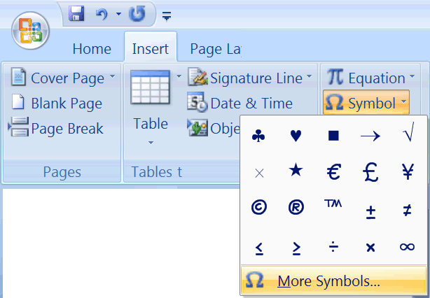
Insert Symbol
,, ,,
\ /
/ \
\ /
\__/
./ \.
| |
/ \oo/ \
\ /
" "

Slide 8
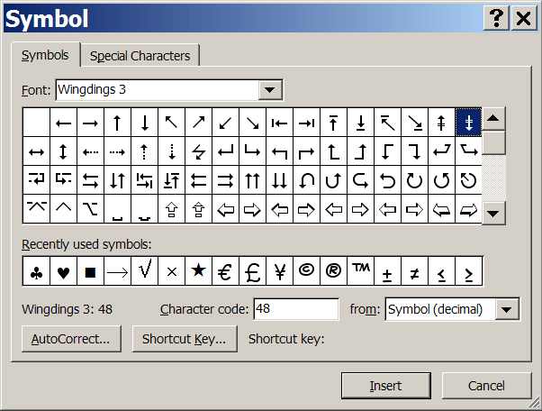
More Symbols...
Select a Font.
Arial and Times New Roman contain many characters visible on the keyboard:
¿ Ñ ñ ë á.
Greek Letters and Math symbols can be found in the Symbol Font: Ω λ ≅ π Δ

Slide 9
Simple Equations
Times New Roman
Italic
Arial Superscript
C = ½πr²
Arial
Insert Symbol
Times New Roman

