Slide 1
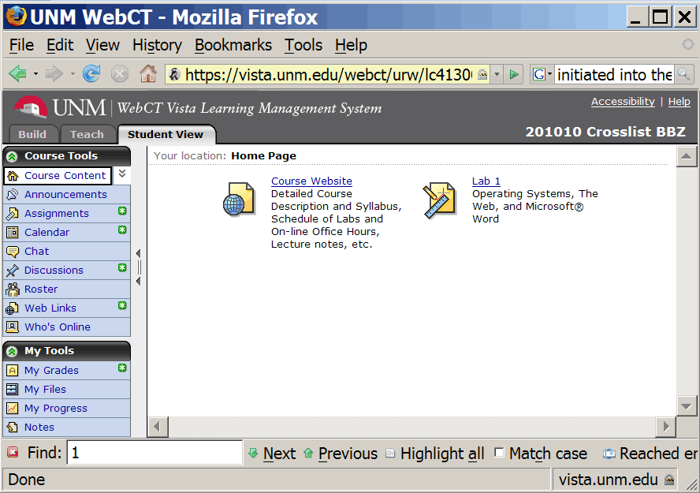
CS-150L
Computing for Business Students
WebCT
Instructor:
Matthew Barrick
e-mail: barrick@cs.unm.edu
www.cs.unm.edu/~barrick
Office: Farris Engineering Center (FEC) room 106

Slide 2
Class Web Site & WebCT
Class Web Site (Public Access) http://cs.unm.edu/~joel/cs150/cs150.html
  Syllabus
  Lab Section Schedule and Lab Instructor e-mail.
  Lab Assignments
  Lecture Notes
WebCT (Enrolled Students Only): http://vista.unm.edu/
  Assignment Drop-box
  Assignment discussions (blogs)
  Grades
  Lab Attendance

Slide 3
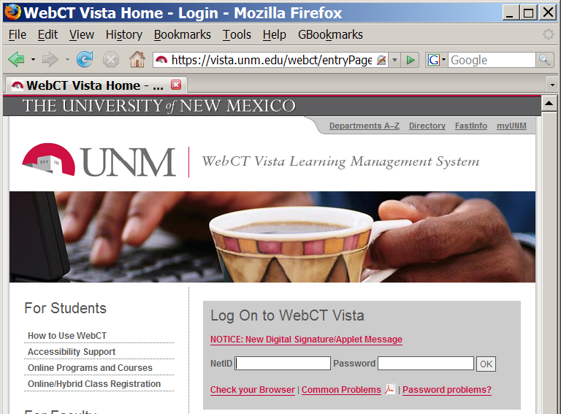
WebCT Login: http://vista.unm.edu/
Internet Browser:
Internet Explorer
Firefox
Safari,
...
UNM NetID

Slide 4
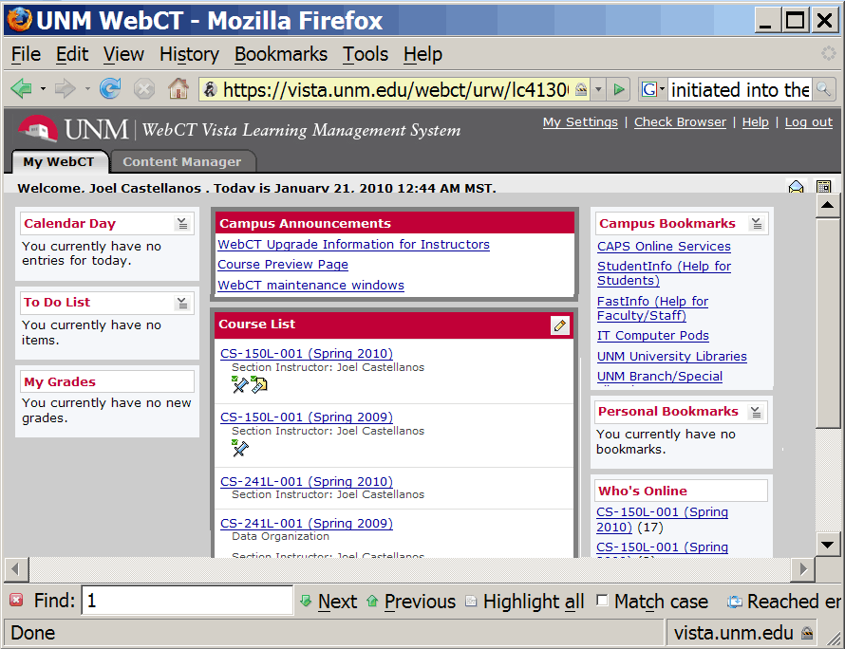
WebCT Login: http://vista.unm.edu/
Course List

Slide 5
WebCT Login: http://vista.unm.edu/
Click on Tabs:
Calendar,
Assignments,
My Grades,
My Files,
...

Slide 6
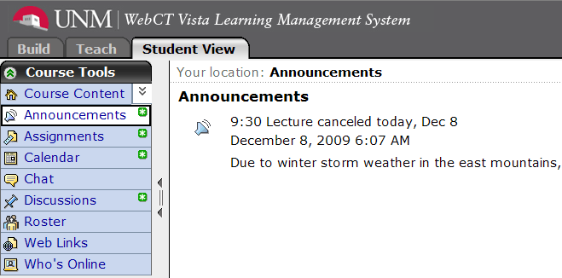
WebCT Announcements

Slide 7
Always Verify WebCT Submissions
When you attach your homework document into in WebCT, do not forget to click Submit.
It is your responsibility to verify that your submit worked.
After submitting, Exit WebCT.
Log back in.
Check that your file is are attached.
Check that the contents of the submission are what you expect them to be.
  Open and examine carefully.
  Make sure you submitted the correct version.
  Up until the assignment due date, you can take back your submission, and resubmit.

Slide 8

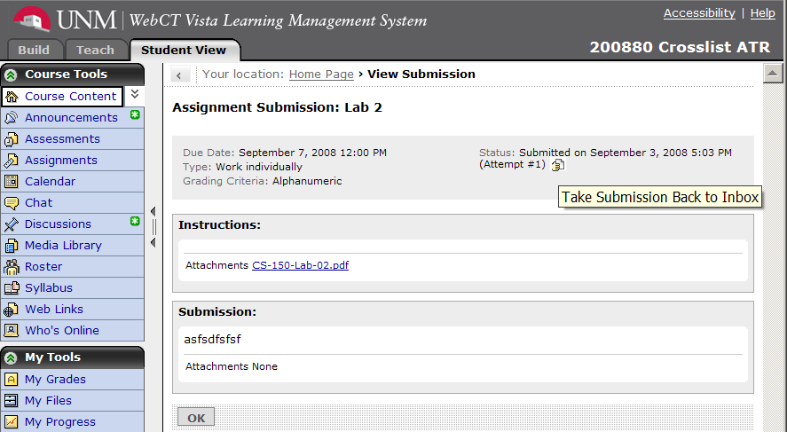
WebCT: Take Back Submission

Slide 9
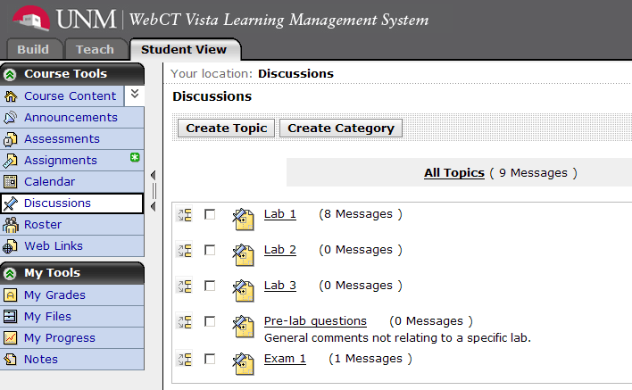
Web CT Discussion

Slide 10
Good Question with Good Title
Subject: lab TA Topic: Lab 1
Author: Lauren Liwski Date: August 25, 2008 7:40 PM
Hello,
My lab TA is named Moe, I accidentally copied his email address wrong I think today during the lab and I was wondering if somebody could give me the correct address? Thanks!
Subject: Re:lab TA Topic: Lab 1
Author: Roxanne Roessner Date: August 26, 2008 6:18 PM
TA emails and lab schedules can be found on the class website: http://cs.unm.edu/~joel/cs150/cs150.html
It should be about the fourth link down!

Slide 11
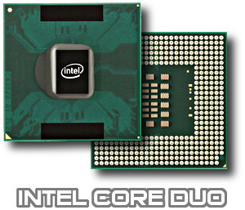
Personal Computer Hardware
CS-150L
Computing for Business Students
Instructor:
Matthew Barrick
e-mail: barrick@cs.unm.edu
www.cs.unm.edu/~barrick
Office: Farris Engineering Center (FEC) room 106

Slide 12
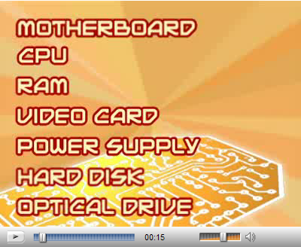

Computer Tour
http://videos.howstuffworks.com/howstuffworks/23-computer-tour-video.htm

Slide 13
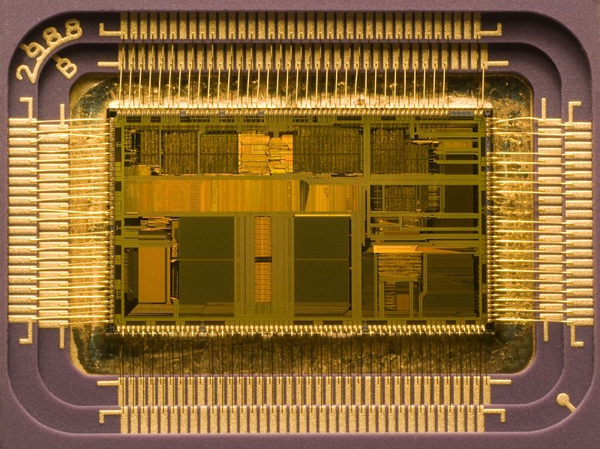
CPU: Central Processing Unit
A class of logic machines that can execute computer programs.
UNM CS prof. just made a "CPU" with fish in Second Life®.
Intel's i486DX2 Dual Core CPU introduced in 1992

Slide 14
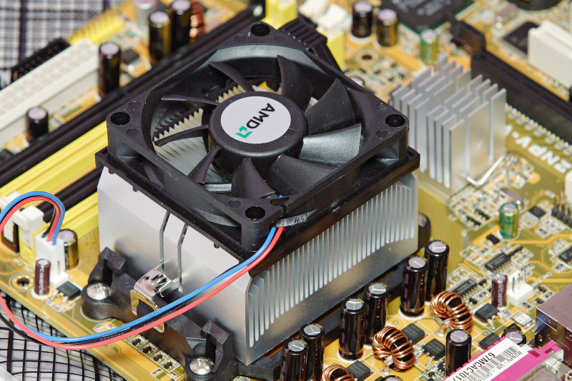
AMD CPU, Heatsink and Fan
An object that absorbs and dissipates heat from another object by using thermal contact.
Size,
Thermal Conductivity,
Surface Area,
Air Movement.

Slide 15
Quiz: Heatsink
In computer science, a heatsink is:
A sink for cleaning computer components that gets very hot.
A sink for cleaning computer components that can operate under extreme heat.
An object that absorbs and dissipates heat from another object by using thermal contact.
An object that generates heat.
An object that locates and destroys its target by following the target's heat signature.

Slide 16
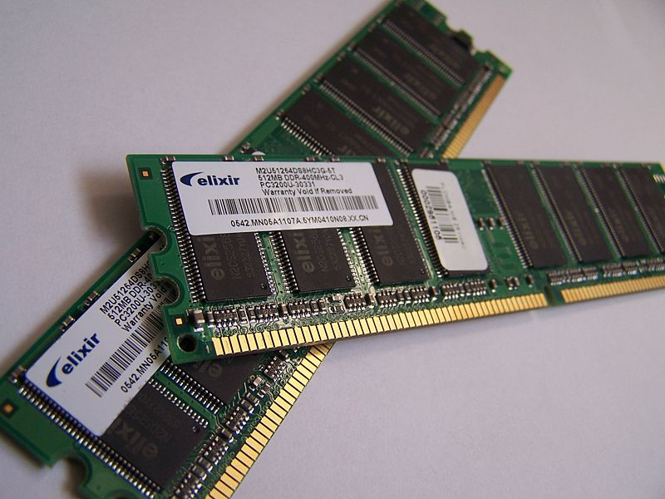
RAM - Random Access Memory
Random access memory (usually known by its acronym, RAM) is a type of computer data storage.
Allow the stored data to be accessed in any order, i.e. at random. The word random thus refers to the fact that any piece of data can be returned in a constant time, regardless of its physical location and whether or not it is related to the previous piece of data.
RAM is mostly associated with volatile types of memory where the information is lost after the power is switched off.
However, other types of memory are RAM as well (i.e. flash memory).

Slide 17
RAM Disk
A RAM disk is a software layer that enables applications to transparently use RAM, often a segment of main memory, as if it were a hard disk, USB Flash Drive or other secondary storage.
Access time may be greatly improved to files held on RAM disks compared to data held on other secondary storage.
The volatility of RAM means that data will be lost if power is lost.
"What do you mean by 'RAM DISK is not an installation procedure' ?"

Slide 18
Quiz: RAM
Random Access Memory
Is memory that is accessed randomly.
Is memory that can be accessed in constant time.
Uses random amounts of power.
Is used for random games of chance.
Is use for stock market prediction and modeling due to its random nature.

Slide 19
CPU: Central Processing Unit
CPU speed is measure in megahertz.
A 1MHz CPU can accomplish one million CPU cycles in one second.
Does this mean that a 2MHz CPU is twice as fast as a 1Mhz CPU?
Not necessarily. This depends on how much work each CPU accomplishes in each clock cycle.
The 1MHz CPU might very well be faster, in practice, than the 2Mhz CPU - if it is more efficient or can process more tasks in each CPU cycle.

Slide 20
CPU: Front Side Bus (FSB)
The Front Side Bus (FSB) is the connection between the CPU and system memory.
The Front Side Bus operates at a speed which is a percentage of the CPU clock speed.
The faster the speed at which the Front Side Bus allows data transfer, the better the performance of the CPU.

Slide 21
CPU: System Memory
RAM has an access speed.
  Faster RAM will mean the CPU has to wait less often for data.
  This will, effectively, make the CPU faster.
RAM also has a Quantity.
  The larger the RAM the less often temporary data needs to be written to the hard disk.

Slide 22
CPU: The Cache
The purpose of a cache is to enable the CPU to access recently used information very quickly.
Cache significantly affects CPU performance.
Some caches are bigger than others. A typical L1 cache is 256Kb and a typical L2 cache is 1MB.
Generally speaking, the larger the cache, the better the system performance boost. However, this is not always the case.
A cache operates at a certain speed. Some caches operate at the full speed of the CPU, while others operate at half that speed or less.
A small, full-speed cache may be much more useful than a large half-speed cache.

Slide 23
CPU: Single, Dual, and Quad Core
A multi-core processor combines two or more independent units into a single package composed of a single integrated circuit (IC)
A dual-core processor contains two cores
A quad-core processor contains four cores.
The amount of performance gained by the use of a multicore processor depends on the problem being solved and the algorithms used, as well as their implementation in software.
Dual-core systems offer a significant advantage over single-core when multi-tasking.

Slide 24
Change of Topic
Email

Slide 25
e-mail Flaming
When one person sends an angry and/or antagonistic message.
Assumed to be more common today because of the ease and impersonality of e-mail communications.
Confrontations in person or via telephone require direct interaction, where social norms encourage civility.
Typing a message to another person is an indirect interaction, so civility may be forgotten.
When you are mad write an e-mail, before you click send:
  Ask a friend to read the e-mail to you aloud, or
  Do some other activity, and return to read it again.

Slide 26
e-mail Codes and Abbreviations
THE RECIPIENT OF A MESSAGE IN ALL CAPS MAY PERCEIVE SHOUTING AND ANGER.
When people e-mail something intended to be funny, but might be taken seriously, it is common to end the message with a smile :)
LOL: laughing out loud
IMO: In My Opinion
BTW: By The Way
TTYL: Talk To You Later
FAQ: Frequently Asked Questions
COB: Close of Business

Slide 27


e-mail Bankruptcy
A decision to close an e-mail account due to an overwhelming receipt of garbage messages, compared to legitimate messages.
When a person deletes a large number of unread e-mail messages after falling behind in reading and answering them.
Sometimes a boilerplate message is sent explaining that the e-mail inbox is being closed or cleared out.

Slide 28
e-mail Privacy Concerns
E-mail messages are generally not encrypted.
Encryptions can be broken.
E-mail messages have to go through intermediate computers before reaching their destination, meaning it is relatively easy for others to intercept and read messages.
Many Internet Service Providers (ISP) store copies of e-mail messages on their mail servers before they are delivered. The backups of these can remain for up to several months on their server, despite deletion from the mailbox.

Slide 29
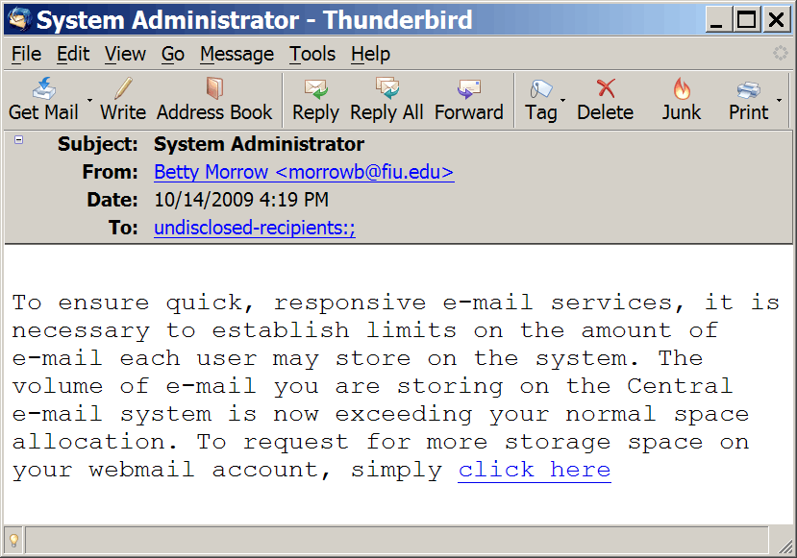
e-mail Phishing Attacks

Slide 30
Computer Security: Phishing
Phishing is the criminally fraudulent process of attempting to acquire sensitive information such as usernames, passwords and credit card details by masquerading as a trustworthy entity in an electronic communication.
Communications purporting to be from popular social web sites, auction sites, online payment processors or IT administrators are commonly used to lure the unsuspecting public.
Phishing is typically carried out by e-mail or instant messaging, and it often directs users to enter details at a fake website whose look and feel are almost identical to the legitimate one.
Even when using server authentication, it may require tremendous skill to detect that the website is fake.

Slide 31
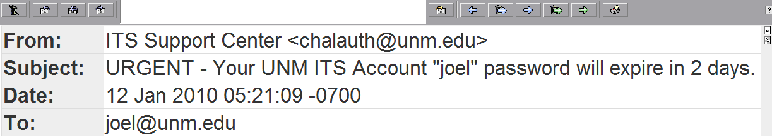
Is this a Phishing Attack?
Your UNM NetID password will expire on 01/14/2010.
Please go immediately to http://netid.unm.edu and follow the instructions to update your password.
For more information or to chat with an agent online go to http://fastinfo.unm.edu.
Thank you,
ITS Support Center

Slide 32
e-mail: Pros
Much of the business world relies on communication between individuals who are physically distant from one another.
Travel is time-consuming and expensive.
E-mail is near-instantaneous and has little cost.
Teleconferencing has logistical difficulties: organizing people to “meet” at the same time often across different time zones.
E-mail allows each participant to decide when and how they will process the information.
E-mail allows the recipient to research before answering.
E-mail provides automatic archiving.

Slide 33
e-mail: Cons
Spam
Soliloquies
Loss of Context
Distraction
Duplication of information. This may be a problem when a team is collaboratively working on documents.
Security Threats

Slide 34
e-mail: Some Statistics
Organizations lose around $1,250 per user in annual productivity because of time spent dealing with spam, $1,800 on unnecessary emails from co-workers, and $2,100 to $4,100 due to poorly written communications. --ITBusinessEdge.com, 12/2008
In 2007, a group of Microsoft workers took, on average, 15 minutes to return to serious mental tasks, such as writing reports or computer code, after dealing with incoming email. --New York Times, 3/25/2007
About 24% of companies have had employee emails subpoenaed by a court or regulator, and 15% have gone to court to defend against lawsuits triggered by an employee email. --American Management Association and the ePolicy Institute, in Columbus, Ohio. Wall Street Journal, 7/2006

Slide 35
Quiz: Least Suited for e-mail
Which of the following business tasks is least suited for e-mail:
Sending an announcement regarding a location change for a meeting to be held the next week to the fifty employees scheduled to attend that meeting.
Sending all employees an e-mail attachment of an updated, three page outline of the employee benefits package.
Planning a lunch meeting with a collogue.
Five collogues collaboratively authoring a twenty page Microsoft Word document by each person e-mailing updates to the group.
Sending a copy of meeting minutes (meeting notes) to the attendants of a recent meeting.

Slide 36
e-mail – Importance of Good Subject Line
I received e-mails with the following subjects:
Which are from students in CS-150, and which are spam?
Hi
Important Problem
Please Help
Please Help!
CS 150 Lab 2
CS-150 Web CT issue
Question
CS-150L Registration
Need help
Grade
<blank>
<blank>
Hi – student
Important Problem – spam
Please Help – spam
Please Help! – student
CS 150 Lab 2 – student
CS-150 Web CT issue – student
Question – student
CS-150L Registration – student
Need help – student
Grade – spam
<blank> – student
<blank> – spam

Slide 37
e-mail body – Give Context
"Professor, I registered for the class on Jan 22. Why am I not registered for WebCt. Please help with this problem. Thanks."
What class?
Spring 2008 I taught 10 sections of CS-150 and 2 sections CS-257. All used WebCT.
Tell me what class and what section.

Slide 38
e-mail body – Necessity of Context
Subject: English Credit
Body:
Joel,
I was wondering if it was possible to fill the English core requirement with English 221 (Creative Writing) in place of English 219 or 220. I've had some scheduling issues with those classes.
Thanks,
--Will
Reply:
Sorry Will, but I think you have the wrong Joel.
I teach computer science.

Slide 39
e-mail – Necessity of Context: part 2
The reply to the reply:
Joel,
Sorry for the confusion. I talked to Lynne [the Computer Science department's Coordinator of Program Advisement] about it, and she said you're on the CS Undergrad Curriculum Committee and might know the answer. Do you know who I might talk to about that?
Thanks,
--Will

Slide 40
Quiz: e-mail Subject
Travis is was breezing through lab 2 of CS-150 when he got stuck on part 3b. He decided to e-mail his lab instructor with a question. Which of the options below is his best choice for the e-mail's subject?
a)
b) Help
c) Help!
d) Hi
e) CS-150: Lab 2 part 3b

Slide 41
Send Plain Text Email, Not Rich Text
Sure, using fancy formatting in emails is nice.
Outlook Express and Gmail make fancy formatting easy.
But not everybody can or wants to receive rich text messages.
Some email programs are not capable of rendering the HTML used for rich formatting in email messages.
Other email programs try, but fail miserably (or even crash), rendering your message unreadable.
Send plain text emails by default.
Avoid special characters: “smart quotes”, ☺, π
If you need fancy formatting, attach a document.

Slide 42
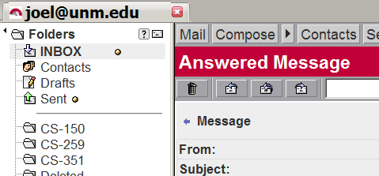
UNM Webmail
What button is this?

Slide 43
How To Look Stupid: Reply To All
Kathy, in Atlanta, replies to a message sent by her coworker Steve. The message she replies to, however, was on a different topic that Steve had sent to entire sales force. Kathy hits “Reply To All”.
What time are we supposed to be on that call Friday?
She’s referring to a scheduled phone call with a local client, and she meant to ask only her coworker Steve.
John in Seattle is confused. He replies to all:
What call? I’m planning on being out of the office Friday.
Sam in New York is also confused:
Do I know you?
And Jane in Tampa accidentally makes things much worse:
I think it’s at 2:30
Jane has a call scheduled at 2:30 for her regional office by coincidence. Now, many of the people who initially dismissed the emails are starting to wonder if there really is a call.

Slide 44
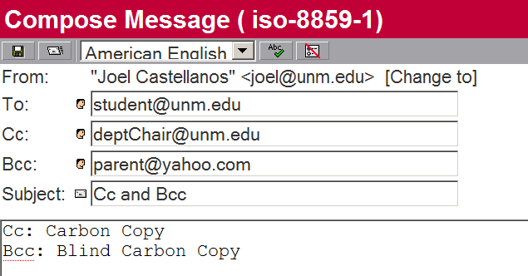
e-mail: To, Cc and Bcc

