Slide 1

CS-150L
Computing for Business Students
Lab 5: Date Functions and Currency Conversion
Instructor:
Matthew Barrick
e-mail: barrick@cs.unm.edu
www.cs.unm.edu/~barrick
Office: Farris Engineering Center (FEC) room 106

Slide 2
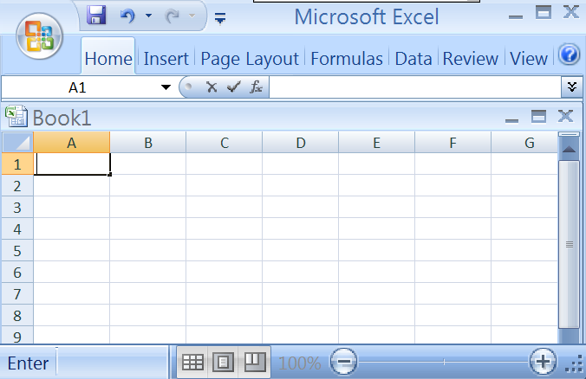


It lost my Workbook Tabs!
A case of the Double Maximize

Slide 3

Clicking Around

Slide 4
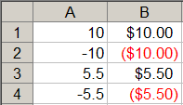
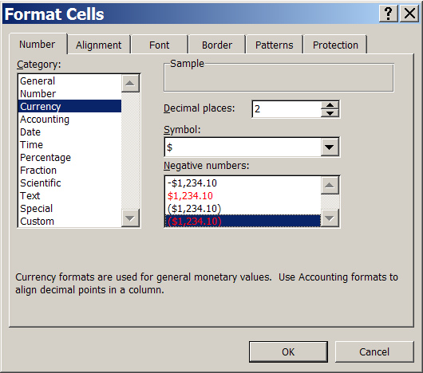
Currency Formatting
Should be 0 or 2
Bad – what if print in B&W or colorblind?

Slide 5
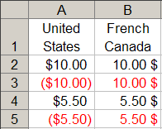
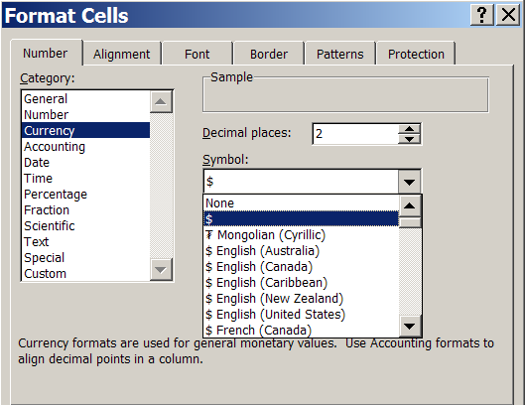
Currency Formatting - Symbol
Even though all of these use the same symbol $, some use it in a different place.

Slide 6

Excel Date – Serial Number
Microsoft Excel stores dates as sequential serial numbers so they can be used in calculations.
By default, January 1, 1900 is serial number 1. Thus, if you format a cell that contains the value 2 as a date, then the cell will display 1/2/1900.
January 1, 2008 is serial number 39448 because it is 39,448 days after January 1, 1900.
Microsoft Excel for the Macintosh uses a different date system as its default (1900 vs 1904 Systems).

Slide 7
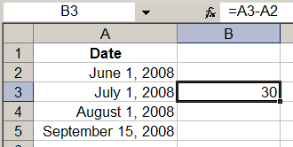
Date Arithmetic
Formula using cells that contain dates.
Excel knows about months with 30 days, 31 days and leap years.
What is the value of A5-A4?
45

Slide 8

TODAY()
Reads the local computer's system clock and returns the Excel Serial Number.
What is wrong here?

Slide 9
WEEKDAY(serial_number)
Returns the day of the week corresponding to a given date.
The day is given as an integer, ranging from 1 (Sunday) to 7 (Saturday)
To see the actual day names, use custom formatting ddd or dddd.

Slide 10

EDATE(start_date, number_of_months)
Returns the serial number is number_of_months before or after a specified date (start_date)
=EDATE("2/15/2008", 0) ➔ 2/15/2008
=EDATE("2/15/2008", 1) ➔ 3/15/2008
=EDATE(1, 1) ➔ 2/1/1900
=EDATE(2/15/2008, 1) ➔ 1/31/1900

Slide 11

EOMONTH(start_date, number_of_months)
Returns the serial number for the last day of the month that is number_of_months after start_date.
=EOMONTH("2/15/2008", 0) ➔ 2/29/2008
=EOMONTH("2/15/2008", 1) ➔ 3/31/2008
=EOMONTH(1, 1) ➔ 2/28/1900
=EOMONTH(2/15/2008, 1) ➔ 2/28/1900

Slide 12
EOMONTH() #NAME?
If this function is not available, and returns the #NAME? error, install and load the Analysis ToolPak add-in:
On "Tools" menu, ➔ "Add-ins".
In the "Add-ins" available list, select the "Analysis ToolPak" box, and click OK.

Slide 13
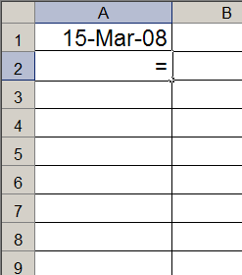
Quiz: EOMONTH
Which of the following will fill down from cell A2 through cell A6 to produce the 1st of each successive month?
a) = EOMONTH(A1,1)
b) = EOMONTH(A2:A6,1)
c) = EOMONTH(A1:A6,1)
d) = EOMONTH(A1,0) + 1
e) = EOMONTH(15,A1)

Slide 14
Quiz: EOMONTH
If the value in cell A1 is 1/1/2008, which of the following will fill down from cell A2 through cell A6 to produce the 1st of each successive year?
a) = EOMONTH(A1,0) + 365
b) = EOMONTH(A1,11) + 365
c) = EOMONTH(A1,11) + 1
d) = A1 + 365
e) = EOMONTH(A1,365)

Slide 15
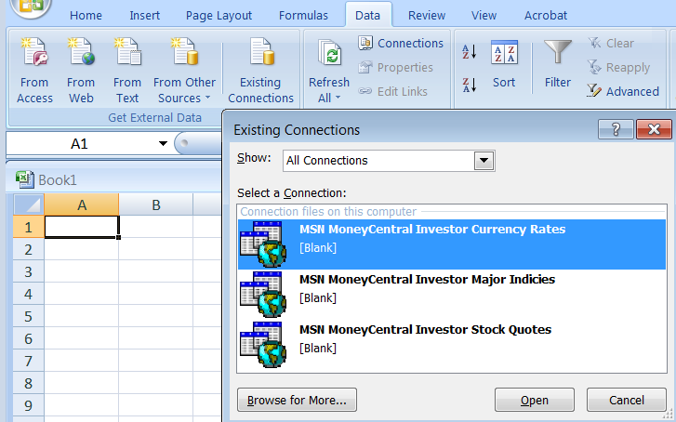
Web Query
In general, a query is one question in a line of inquiry.
In computer science, a query is a request for information from a database.

Slide 16
Currency Conversion
One US Dollar is more than one Mex Peso.
Thus, convert dollars to pesos by multiplying by the conversion rate that is > 1.

Slide 17
Simple Interest
Interest = Principal * Periodic Rate * Number of Periods
If $100 was borrowed for 2 years at an annual periodic interest rate of 10%, the simple interest would be:
$100 * 10% * 2 periods = $20.
$100 * (10/100) * 2 = $20.
If $100 was borrowed for 5 months at a monthly periodic interest rate of 1.00%, the simple interest would be:
$100 * 1.0% * 5 periods = $5.
$100 * (1.0/100) * 5 = $5.
Simple interest is generally charged for borrowing money for short periods of time.

Slide 18
Simple Interest – more examples
Interest = Principal * Periodic Rate * Number of Periods
If $100 was borrowed for 5 months at a annual periodic interest rate of 10.0%, the simple interest would be:
$100 * 10.0% * (5/12) periods = $4.17.
$100 * (1.0/100) * 0.4167 = $4.17.
If $100 was borrowed for 228 days at a annual periodic interest rate of 10.0%, the simple interest would be:
$100 * 10.0% * (228/365) periods = $6.24.
$100 * (1.0/100) * 0.6247 = $6.24.

Slide 19
Compound Interest
The account balance (interest plus principal) is calculated at the end of each period.
During the next period, interest is calculated on the full balance at the end of the last period.
If $100 was borrowed for 2 years at an annual periodic interest rate of 10%, the interest compounded annually would be:
$100 * 10% * 1 period = $10 (in the 1st period).
Balance at the end of the first period: $100 + $10 = $110.
$110 * 10% * 1 period = $11 (in the 2nd period).
Thus, the total interest in the loan is:
$10.00 + $11.00 = $21.00

Slide 20
Simple verses Compound Interest
Simple Interest:
Future Value = Principal +
Principal × Periodic Rate × Number of Periods
$100 + $100*10%*2 years = $120.00
Compound Interest:
Future Value =
Principal × (1 + Periodic Rate)^{Number of Periods}
$100 × (1 + 10%)² = 100*(1+10%)^2 = $121

Slide 21
Annual Percentage Rate & Yield
APR (Annual Percentage Rate) is the annual rate of interest without taking into account the compounding of interest within that year.
APY (Annual Percentage Yield) does take into account the effects of intra-year compounding.
For example, a credit card company might charge 2% interest each month.
  APR = 24% (2% x 12 months).
  APY = (1 + 0.02)¹² – 1 = 26.82%

Slide 22
Credit Card Interest
Credit cards usually charge simple interest for each day with in the month, and compound interest between months.
For example:
A credit card that charges 27.99% APR.
The Daily Periodic Rate = 27.99%/365= 0.0786%
During a month with 29 days, your interest is:
balance * 0.0786% * 29 days
At the end of the month, this interest is added into the balance.

Slide 23
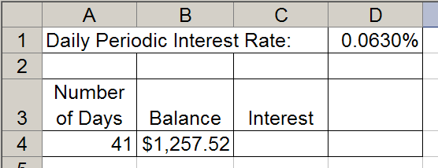
Quiz: Interest
The simple interest in cell C4 can be calculated by which equation?
a) =$D$1*B4
b) =$D$1*B4 + A4
c) =$D$1 + B4*A4
d) =$D$1 + A4*B4
e) =$D$1*A4*B4

Slide 24
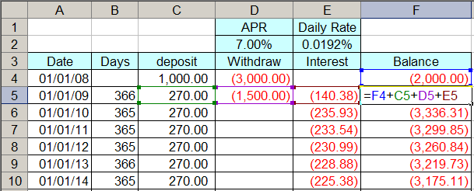
Account Balance
Since the withdraw amounts and interest amounts are negative numbers, they are added to the balance.

Slide 25
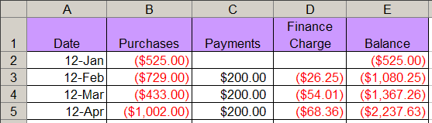
Quiz: Account Balance
Which equation will produce the correct value in cell E3?
a) =E3+B3+C3+D3 d) =E3-B3+C3+D3
b) =E2+B3+C3+D3 e) =E2-B3+C3-D3
c) =E3+B2+C2+D2

Slide 26
Quiz: Account Balance
Which equation entered in cell E3 can be correctly filled down to cell E5?
a) =E2+B3+C3+D3 d) =E2+B3+$C$3+D3
b) =$E$2+B3+C3+D3 e) =E2+B3+C3+$D$3
c) =E2+$B$3+C3+D3

Slide 27

Constants
!Throughout this lab, no equations may include “hard coded” assumptions (CONSTANTS). As usual, this prohibition does not apply to universal constants such as using “7” for the number of days in a week, nor “1” as a unit increment.
Converting a number to a percentage by dividing by 100, is a perfectly fine use of a constant. The 100 does not need to be placed in a cell and referenced as would an interest rate or a salary.

Slide 28
Quiz: Interest
The simple interest on the balance in cell B4 over a period of days given in cell A4 can be calculated by?
a) =$D$1*B4
b) =$D$1 + B4 + A4
c) =$D$1*B4*A4
d) =$D$1 + B4*A4
e) =$D$1*B4 + A4

