Slide 1
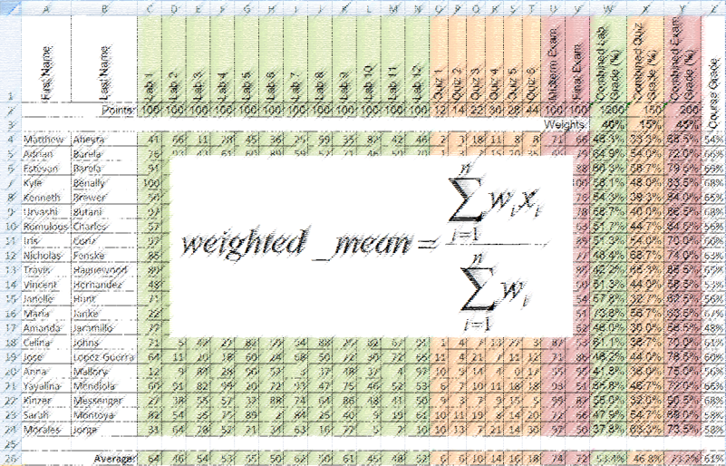
Lab 5: Weighted Mean
CS-150L
Computing for Business Students
Instructor:
Matthew Barrick
e-mail: barrick@cs.unm.edu
www.cs.unm.edu/~barrick
Office: Farris Engineering Center (FEC) room 106

Slide 2
Quiz 1 Results
Quiz == i-Clicker Questions
Total of 16 questions so far (including 1 “question” each class for attendance, which you get for answering at least one question)
Bonus credit for:
  Perfect Attendance
  Perfect Nights (getting all questions right on a given night)
  Curve (linear to 82%)
Capped at 100%
Doubled from n/16 -> 2n/32 to match other lecture
If you have zero credit you get no bonus credit

Slide 3
Quiz 1 Results
OMG!!! I got a Zero
Don’t Panic
Most likely you haven’t registered your clicker (or registered it incorrectly)
Re-register it online (see slides about details)
Email me (barrick@cs.unm.edu) afterwards
Or talk to me in lab to manually register

Slide 4
Lab Reminders
Lab attendance is mandatory (remember?)
Sections 9 and 10 use a sign-up sheet (if you in someone else’s lab the procedure may vary) – It is your responsibility to make sure you sign it!
If you arrive more than 10 minutes late, you are absent. (You’ll notice the sign-up sheet disappear about this time)
If you leave early, you are marked absent (I’ll announce when the end of lab-time has been reached
If you finish your lab, you must still stay for the duration of lab, and use that time for class-related work (other labs, Office training, Office use) *

Slide 5
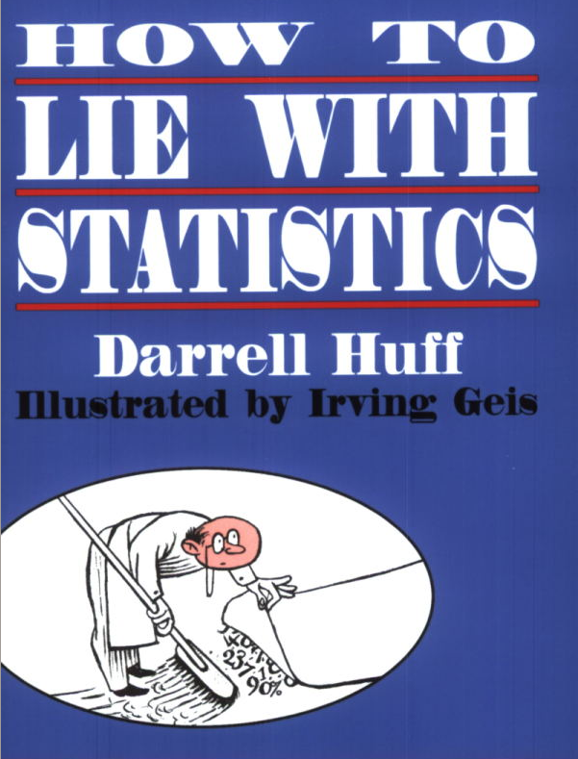
What is the Correct Average?
Two students take a test. One scores 100% the other scores 0%. What is the mean?
(100% + 0%)/2 = 50%
(A + F)/2 = F
(4.0 + 0.0)/2 = 2.0
(A + F)/2 = C
A "must read" book by Darrell Huff for all educated persons.

Slide 6

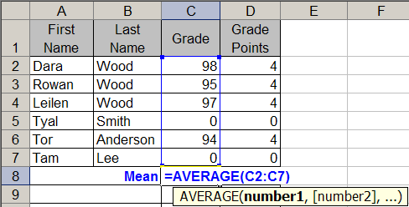
AVERAGE()
AVERAGE(): Returns the arithmetic mean of the arguments. This equals the sum of the arguments divided by the number of arguments.

Slide 7
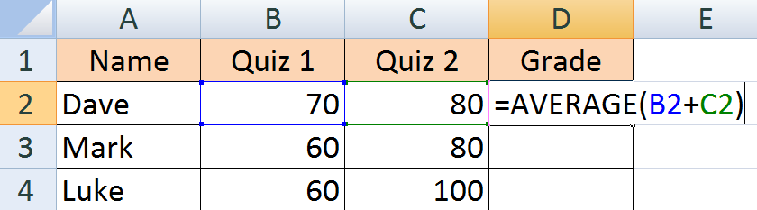
Quiz: Average
What is the value of the Excel Expression:
=AVERAGE(B2+C2)?
a) 75 b) 75.5 c) 70
d) 80 e) 150

Slide 8
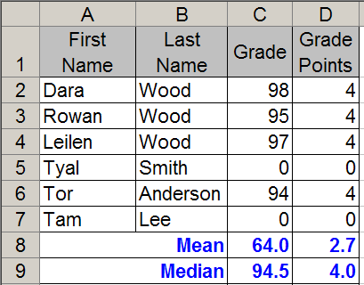
MEDIAN()
MEDIAN() sorts the values from lowest to highest.
  If there is an odd number of cells, then this function returns the middle number.
  If there is an even number of cells, then this function returns the mean of the two middle numbers.
98 97 95 94 0 0
94.5

Slide 9
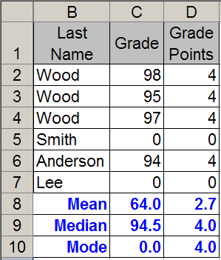
MODE()
MODE() returns the value that has the highest number of occurrences.
  =MODE(1, 2, 2, 6, 7) = 2
  =MODE(1, 2, 6, 7) = #N/A
  =MODE(1, 2, 2, 6, 7) = 2
  =MODE(1, 2, 2, 6, 6) = 2
  =MODE(1, 6, 2, 2, 6) = 6
When using MODE(), it is important to have many more data points than bins.

Slide 10

Quiz: Median
In Excel, what is the value of =MEDIAN(A1:I1)?
2
2.1111
2.5
3
4

Slide 11
Median - Solution
In Excel, what is the value of =MEDIAN(A1:I1)?
4 3 3 3 2 2 1 1 0
Sort the numbers.
The Median is the number in the middle

Slide 12
Quiz: Mode
In Excel, what is the value of =MODE(A1:I1)?
2
2.1111
2.5
3
4

Slide 13
Quiz: Order of Operations
In Excel, what is the value of the formula:
=(2 + 4 + 6) / 2 + 1
10
8
7
6.5
4
=( 6 + 6) / 2 + 1
= (12) / 2 + 1
= 6 + 1
= 7

Slide 14
Equation Terms: Fraction Parts
Numerator
Denominator

Slide 15
Equation Terms: Subscripts and SUM
Subscripts
Summation

Slide 16
Weighted Mean
Each data point (x_{i}) has an associated weight (w_{i})
The weight determines how much that data point should contribute to the average
Similar to an arithmetic mean, but instead of each of the data points contributing equally to the final average, some data points contribute more than others.
If w_{i}=1 for all i then is the same as arithmetic mean

Slide 17
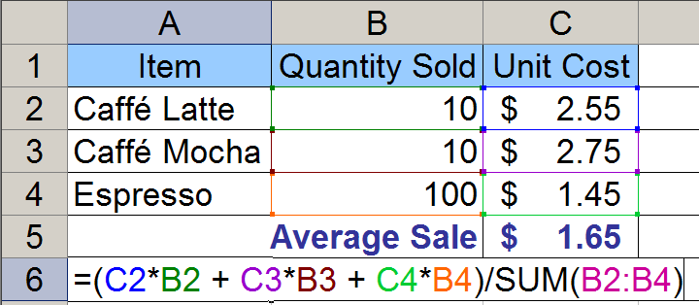
Weighted Mean
n = 3
w₁ = Quantity of Caffé Latte
x₁ = Cost of Caffé Latte
w₂ = Quantity of Caffé Mocha
x₂ = Cost of Caffé Mocha

Slide 18
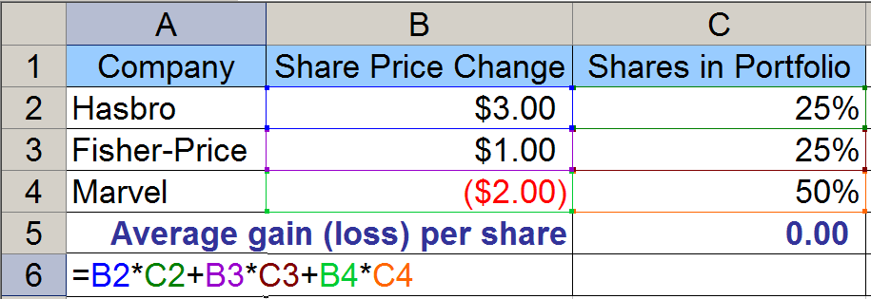
Mean: When Total Weight = 100%
There is a special case when the weights are percentages of a whole. Then the weights must sum to 100% Thus, there is no need to divide by the total weight. Why?

Slide 19
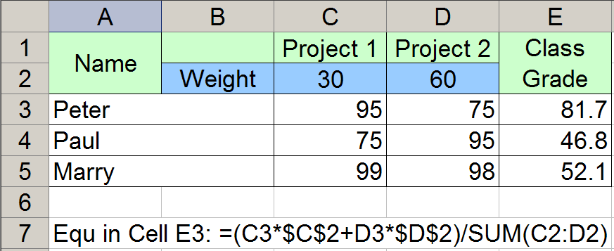
Weighted Mean: What is Wrong?
Cell E3 has the correct answer, but the total weight, SUM(C2:D2) are relative references. Thus, the equation fills down with the total weight use for Paul as SUM(C3:D3): very bad.

Slide 20
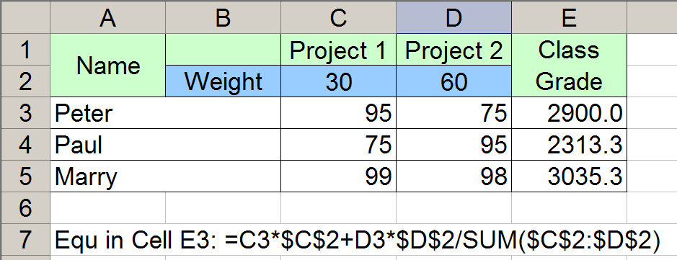
Weighted Mean: What is Wrong? #2
Parenthesis, ( ), are missing from around the numerator.
Thus, only D3*$D$2 is divided by the total weight.

Slide 21
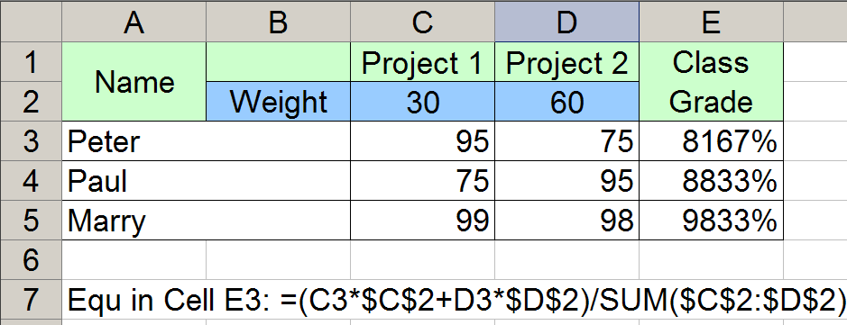
Weighted Mean: What is Wrong? #3
The equation is golden.
The Class Grades are formatted as percentages and are not percentages.
Fix: Either divide by 100 or
Change column C and D to percentages.

Slide 22
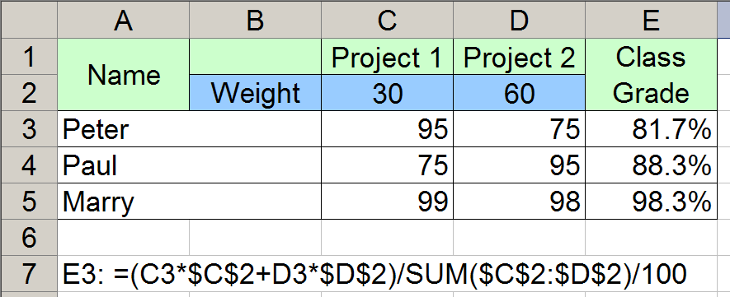
Weighted Mean: All Golden?
Peter and Paul got the same grades, a 95 and a 75.
How come they do not have the same average?

Slide 23
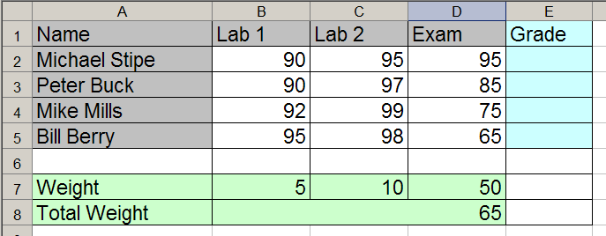
Quiz: Weighted Mean
Which equation can be filled down from cell E2, to correctly calculate the weighted mean in cells E2:E5?
a) =(B2*B7 + C2*C7 + D2*D7)/B8
b) =(B2*$B$7 + C2*$C$7 + D2*$D$7)/$B$8
c) =($B$2*$B$7 + $C$2*$C$7 + $D$2*$D$7)/$B$8
d) =($B$2*$B$7 + $C$2*$C$7 + $D$2*$D$7)/B8

Slide 24
Scenario: Concession Stand
A concession stand at the Albuquerque Bio Park sells snow cones for $1.00 each, hot pretzels for $1.50 each and caramel apples for $2.00 each.
Monday was sunny, and the stand sold 210 snow cones, 55 hot pretzels and 105 caramel apples.
On Tuesday, the sky was cloudy and the stand sold 85 snow cones, 165 hot pretzels and 100 caramel apples.
On Wednesday it rained and the stand sold 7 snow cones, 87 hot pretzels and 25 caramel apples.

Slide 25
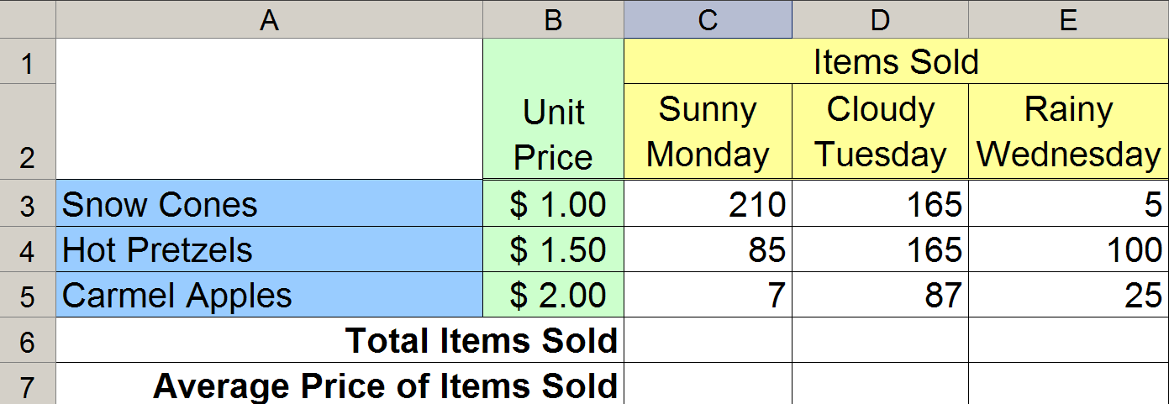
Concession Stand: Words to Spreadsheet
The background of each cell of your table must match the figure.
The horizontal and vertical alignment of the text in your table must match the figure.
Cells that are Merged and formatted with Wrap Text must match the figure.
Cell boarders must match the figure.

Slide 26
Concession Stand: Estimate
If an equal number of the three items were sold, then the average price of a sale would be $1.50.
On Monday, the average price of an item sold will be the lowest.
On Tuesday, the average will be higher than on Monday, but still below $1.50 since more $1.00 items were sold than $2.00 items.
On Wednesday, the average price of an item sold will be above $1.50.

Slide 27
Quiz: Total Items Sold
What equation should be entered in cell C6?
a) =sum(C3:C5)
b) =sum($C$3:$C$5)
c) =sum(C3:E3)
d) =sum($C3:$E3)
e) =sum($C$3:$E$3)

Slide 28
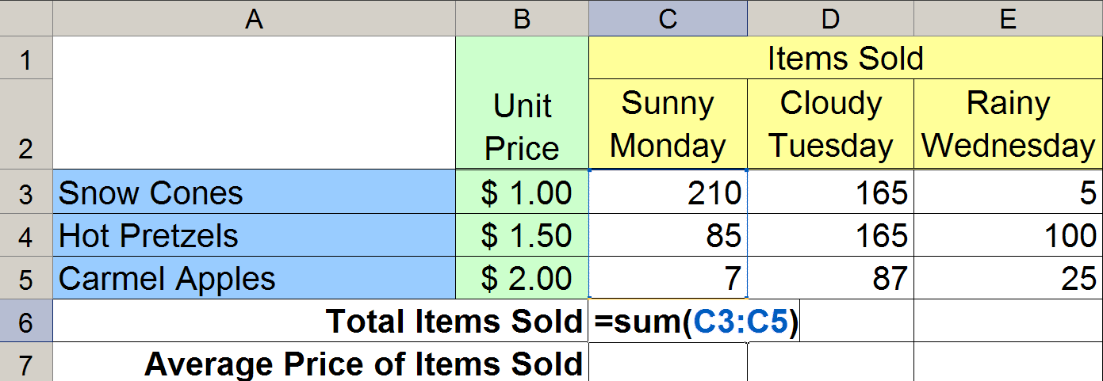
Concession Stand: Total Items Sold
In cell C6, enter an Excel equation that calculates the indicated value.
This equation must be entered so that it can be filled right to correctly calculate the values in D6:E6.
The equation MUST NOT use any constants.

Slide 29
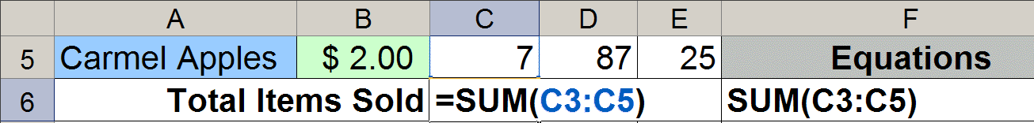
Copy the Equation as Text
Equation copied as text has no equals, =.
The cell column letter and row number must match exactly the equation being copied.
Copy the equation used in C6 as text into F6. In order to receive any credit for this part, your equation must appear with all the cell references used in C6 printed and visible in F6.

Slide 30
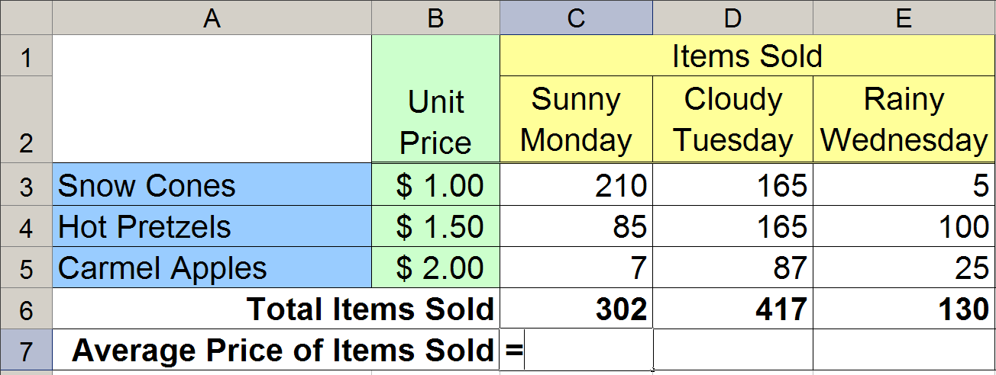
Concession Stand: Average Price
The Average Price of an Item on a particular day is a Weighted Average.
What is the weight of each item?
What is the total weight?

Slide 31
Quiz: Average Price
What equation should go in C7?
a) =($B$3*$C$3+$B$4*$C$4+$B$5*$C$5)/$C$6
b) =(B3*$C$3+B4*$C$4+B5*$C$5)/$C$6
c) =(B3*$C$3+B4*$C$4+B5*$C$5)/C6
d) =($B$3*C3+$B$4*C4+$B$5*C5)/C6
e) =(B3*C3+B4*C4+B5*C5)/C6

Slide 32
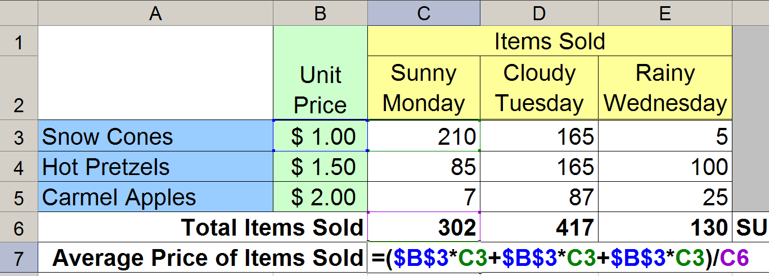
Concession Stand: Average Price
In cell C7, enter an Excel equation that calculates the indicated value.
This equation must be entered so that it can be filled right to correctly calculate the values in D7:E7.
The equation MUST NOT use any constants.

Slide 33
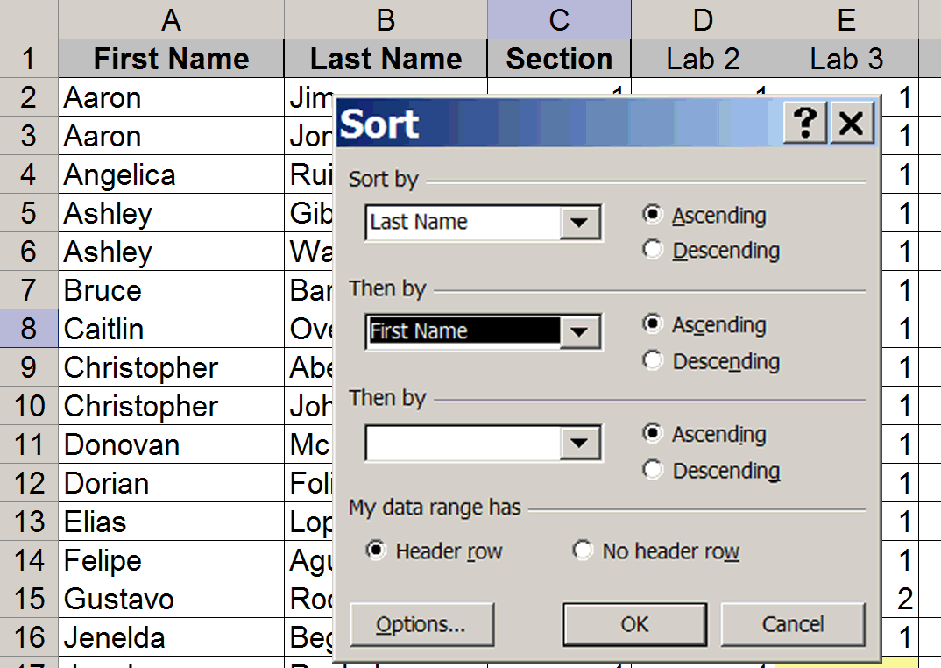
Data →Sort...

Slide 34
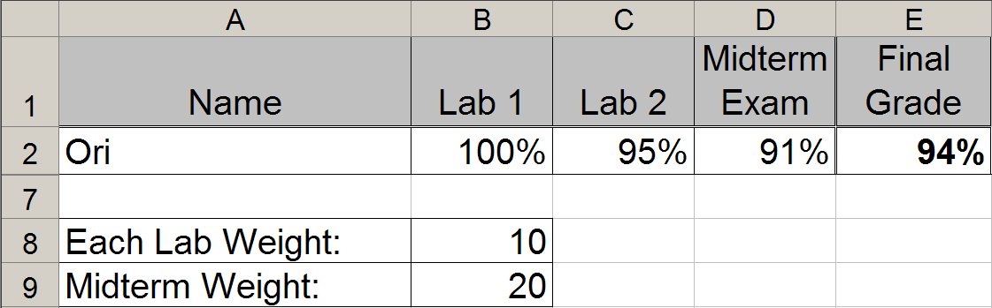
Quiz: Weighted Average Again
Enter an equation calculating Ori’s final grade This equation must be entered so that it can be filled down to correctly calculate the grades in E4:E6. The equation MUST NOT use any constants.
a) = (B2*$B$8 + C2*$B$8 + D2*$B$9) / ($B$8 + $B$8 + $B$9)
b) = (B2*$B$8 + C2*$B$8 + D2*$B$9) / (2*$B$8 + $B$9)
c) = (B2*$B$8 + C2*$B$8 + D2*$B$9) / 40
d) = (B2 + C2 + 2*D2) / 4

