Slide 1
CS-150L
Computing for Business Students
Lab 6: Business Optimization
Instructor:
Matthew Barrick
e-mail: barrick@cs.unm.edu
www.cs.unm.edu/~barrick
Office: Farris Engineering Center (FEC) room 106

Slide 2
Schedule
i-clicker Quiz 1: Grades for newly registered i-clickers posted.
i-clicker Quiz 1 DEADLINE: no updates will be made to quiz 1 after Oct 11.
Week of Sept 27: Lab 6 - Business Optimization
Week of Oct 4: Lab 7 - Excel Charts
Week of Oct 11: Review + Fall Break
Week of Oct 18: Midterm exam - DURING Lab class.

Slide 3
Mac Users
Column Width incompatibility between Mac and PC versions of Excel
We’ll have a fix for you to avoid the problem soon
For the moment please put a comment in your spreadsheet saying you used a Mac to make it

Slide 4
Mac Users
Column Width incompatibility between Mac and PC versions of Excel
We’ll have a fix for you to avoid the problem soon
For the moment please put a comment in your spreadsheet saying you used a Mac to make it
Reminder – Exams are on Office 2007 on PC, if you haven’t spend time using it, you should start.

Slide 5
Objectives
Excel Function MIN
Excel Function INT
Named cells and cross-sheet references
Using Excel formulas to represent individual constraints
Use Excel formulas to solve and clearly illustrate a business optimization problem involving two variables and multiple constraints

Slide 6
Quiz: Filling Right
Which equation calculates the average of all the grades for lab 1 and can be filled right to correctly calculate the average grades in columns C through D. The equation must not use constants.
a) = AVERAGE(B2+B3+B4)
b) = AVERAGE($B$2+$B$3+$B$4)
c) = SUM($B$2:$B$4)/3
d) = AVERAGE(B2:B4)
e) = AVERAGE($B$2:$B$4)

Slide 7
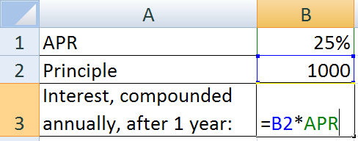
Use of Named Cells
In Excel, the user can assign a name to a cell or a range of cells.
Such names can be used in equations in place of absolute cell references.

Slide 8


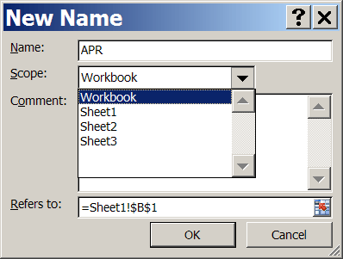
Named Cells: Excel 2007
Select the cell you want to name.
Right click in the selected cell and select “Name a Range...”
Enter the name
Select the Scope.
Click OK.

Slide 9
Named Cells: Scope
Default Scope is Worksheet
This is generally what you want
This makes the reference a cross-sheet reference:
Sheet$A$1

Slide 10
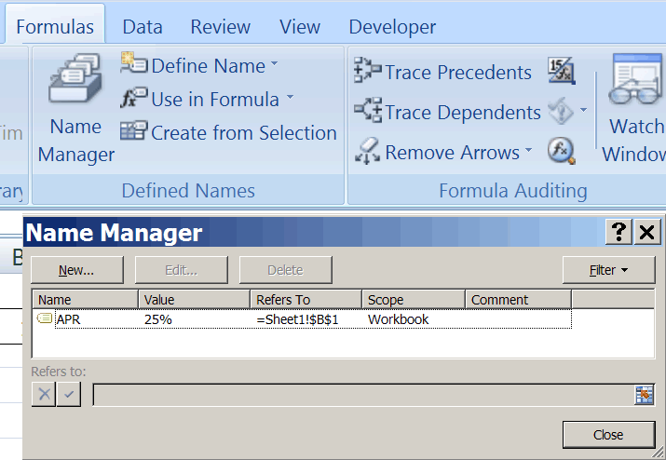
Name Manager

Slide 11
Named Cells: Excel 2003

Slide 12
Writing a Math Equation in Excel
The Excel PMT(rate, nper, -pv) function calculates the periodic payment, P, on a loan by the formula:
  rate: Periodic interest rate.
  nper: Total number of periods.
  pv: Principle value of loan
=(rate*pv*(1+rate)^nper) / ((1 + rate)^nper -1)

Slide 13
Exponents
5² = 5 × 5 = 25 (math notation)
5^2 = 5*5 = 25 (Excel notation)
2⁵ = 2 × 2 × 2 × 2 × 2 = 32 (math notation)
2^5 = 2*2*2*2*2 = 32 (Excel notation)

Slide 14
Quiz: Exponents
In Excel, what is the value of =3^3
3
6
9
12
27

Slide 15
Quiz: Math to Excel
This is the Present Value equation given in the Financial Accounting Textbook (MGMT 202). Which is the correct translation into Excel notation?
a) = (FV) / (1+i^n)
b) = (FV / (1+i^n))
c) = (FV / (1+i*n))
d) = (FV / (1+(i^n)))
e) = FV / ((1+i)^n)

Slide 16
Quiz: Math to Excel
The profitability equation for earnings per share given in the Financial Accounting Textbook (MGMT 202) is:
Which Excel equation is a correct translation?
a) = (NI – PSD)/ACSO
b) = EpS – ((NI – PSD)/ACSO)
c) = NI – PSD/ACSO
d) = (NI – PSD/ACSO)
e) = EpS + ((NI – PSD/ACSO)

Slide 17
Excel MIN() function
MIN (MINimum) -- Returns the smallest number in a set of values.
Syntax: MIN(number1, [number2], ...)
  Number1, number2, ... Number1 is optional, subsequent numbers are optional. 1 to 255 numbers for which you want to find the minimum value.
  From Excel 2010 Help

Slide 18
Excel INT() function
INT – Truncates a number down to the nearest INTeger
Syntax: INT(number)
  number – real number you want to round down to an integer.
  rounds to the integer whose absolute value is closer to zero – so negative numbers are round “up” to the previous number
Used when you want to work with whole units

Slide 19
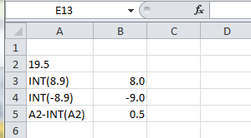
Excel INT() Function
Examples

Slide 20
Business Optimization
Multiple variables (number which may have one of many values)
  We’re only going to work with scenarios of two variables
We have multiple (generally more than the number of variables) constraints
Want to maximize (or minimize) some value based on these constraints (generally profit)
For a given situation, there will be a single constraint that limits your goal. This is the limiting constraint.

Slide 21
Strategy (for two variables X and Y)
Select one variable, say X
Enumerate all possible values for X
For each constraint come up with a formula that says how many Y we can make/buy/have given that constraint in terms of each possible X value (each row)
Once we have done this for all the constraints, we eliminate all impossible values (negative ones, generally)
Take the minimum Y from each constraint, this is the result of using those options
The maximum Y of each minimum is our optimum

Slide 22
Classic Example
Your having a cook-out where you will be serving hotdogs in buns. Hotdogs come in packs of 8 and buns come in packs of 6. We want to serve 2 hotdogs to each person. Assume a pack of either hotdogs or buns costs the same amount, what is the most number of people (P) we can serve given we can buy only 20 packs of supplies?

Slide 23
Classic Example: Constraints
20 <= Hotdog Packs + Bun Packs
#Hotdogs = 8 * Hotdog Packs
#Buns = 6 * Bun Packs
P = INT(#Hotdogs/2) <=(#Hotdogs/2)
P = INT(#Buns/2) <=(#Buns/2)
We want to maximize P, so we figure out all values of P for all values of our constraints

Slide 24
Hotdog Worksheet

Slide 25
Cookie Business Scenario - Part 1
Dara and Rowan have a concession stand that sells cookies at the Albuquerque Botanical Gardens.
They make only two kinds of cookies:
  Plain ginger cookies and
  Ginger cookies decorated with colored sugar icing.
Tomorrow will be a big event at the Gardens, and they need to decide how many dozens of each kind of cookie to bake.
All the cookies must be baked before the start of the next day.

Slide 26
Cookie Business Scenario - Part 2
Dara and Rowan know that each dozen of plain cookies requires 1.2 pounds of cookie dough and no icing.
Each dozen of the decorated cookies requires 0.85 pounds of cookie dough and 0.3 pounds of icing.
Dara and Rowan also know that each dozen of the plain cookies requires about 0.1 hours of preparation time and each dozen of decorated cookies requires about 0.25 hours of preparation time.

Slide 27
Cookie Business Scenario - Part 3
Both types of cookies take the same amount of time to bake, but the decorated cookies must be baked at a lower temperature.
Therefore, they only bake one type of cookie at a time, in even dozen amounts, as a tray of one dozen cookies fills one oven.
With the available oven space they have time and room to bake a total of 100 dozen cookies for the next day.
Dara and Rowan expect a great turnout the next day at the Botanical Gardens and are confident that they will sell all of whatever cookies they make.

Slide 28
Cookie Business Scenario - Part 4
The cookies that Dara and Rowan can make are limited by the ingredients they have on hand:
  115 pounds of cookie dough and
  12 pounds of icing.
Dara and Rowan are also limited by the amount of preparation time available.
  Working together, they have 12 baker-hours of cookie preparation time.

Slide 29
Cookie Business Scenario - Part 5
The plain cookies sell for $5.00 per dozen and the cost $2.00 per dozen in to make.
The decorated cookies sell for $7.00 per dozen and cost $2.50 per dozen to make.
How many dozen of each type of cookie should they make in order to maximize their profit?

Slide 30
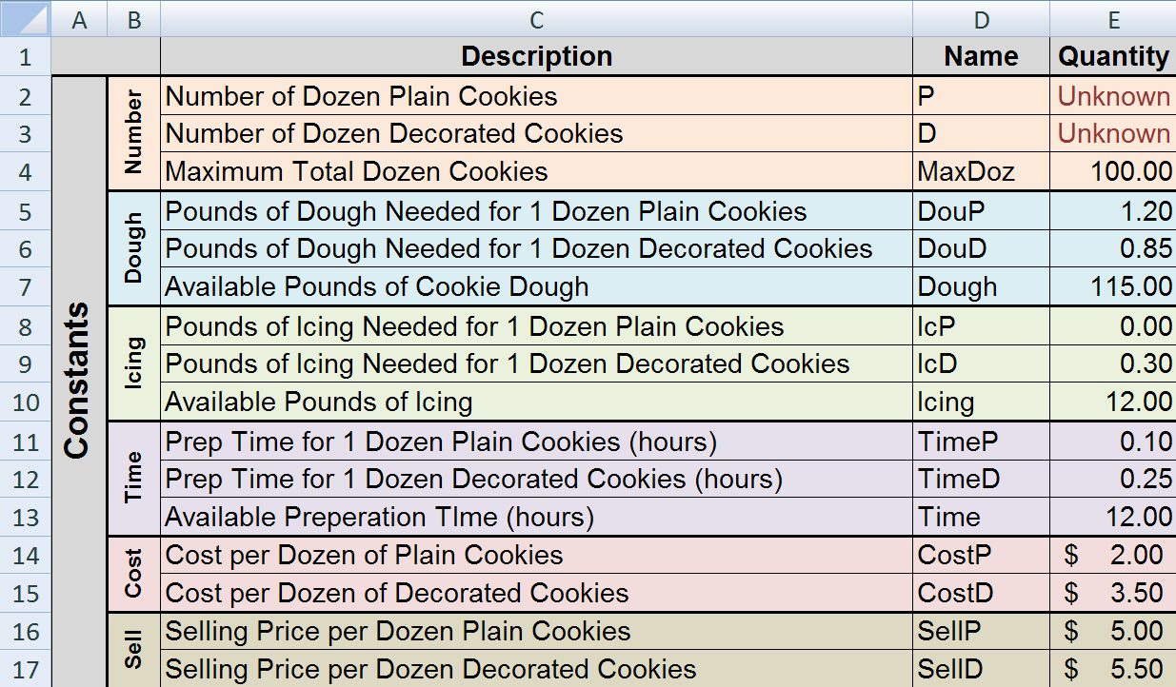
Constants Worksheet

Slide 31
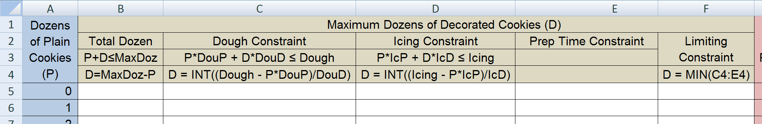
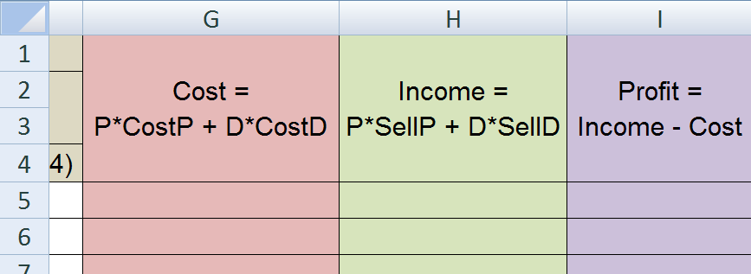
Possibilities Worksheet

