Slide 1
CS-150L
Computing for Business Students
Midterm Exam Review
Instructor:
Matthew Barrick
e-mail: barrick@cs.unm.edu
www.cs.unm.edu/~barrick
Office: Farris Engineering Center (FEC) room 106

Slide 2
Upcoming Schedule
This Week (Oct 11):
  Today: Midterm Exam Review
  No lab assignment this week.
  Lab classes -Exam Review, attendance not taken (no lab tonight if everybody leaves!)
  Fall Break: Thursday & Friday.
  I have your Lab 5 graded, see me after class/in lab
Next Week (Oct 12)
  Lecture Lab 8 intro, No lab assignment.
  Midterm exam during your regular lab class.
Week of Oct 25:
  Lab 8 - Mortgage Loans

Slide 3
Upcoming Schedule (cont’d)
Week of Oct 25:
  Lab 8 - Mortgage Loans
  Lab 8 Grading will be delayed by Samhein, don’t be surprised if they aren’t up until that Monday/Tuesday
Thanksgiving (Week of Nov 22)
  Labs classes are optional that week (None on Thur/Fri)
  Lab Wednesday Nov 24 is cancelled
  Lab 12 not due until Sunday, Dec 5
  Lecture Nov 24 is optional (may be cancelled at a later date)

Slide 4
Midterm Exam
Practical exam on pages 118-120 of Lab Manual.
The actual exams will have the same instructions: Make sure you understand them.
Like the sample exam, the actual exam:
  Reproduce a table and copy formatting,
  "Read the table" and decide what sums, products and weighted means need to be calculated to fill in the blanks.
  Reproduce an Excel chart
Different lab sections will have different exams.
Get permission from lab instructors before attempting to take the exam during a different lab time (Even for me!)

Slide 5
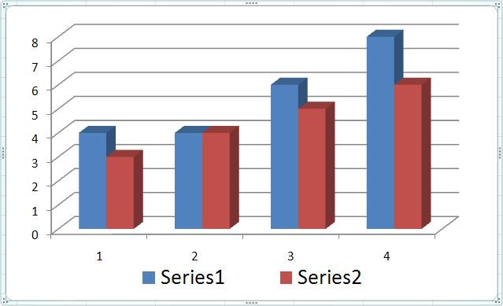
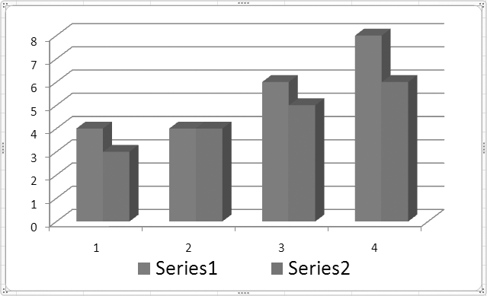
Problems with Fill Colors on a Chart
In a Cluster Column Chart, using a different color for each series is great except when...
The chart is printed on a black-and-white printer.
The person viewing the chart is color blind.

Slide 6
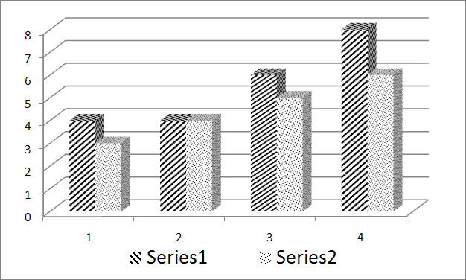
Chart Pattern Fills
Pattern fills work best when color is not available.

Slide 7
Chart Pattern Fills: Procedure Outline
Create a chart.
Select one series by clicking on a pie slice or bar of that series. If you want to change the pattern of only one data point in the series, then click a second time on that slice or bar.
Open the Visual Basic Editor. This can be done by pressing ALT+F11 or by selecting Visual Basic from the Developer tab (how to turn this on in a minute)
From the Visual Basic Editor, open the Immediate Window by pressing CTRL+G or by selecting “Immediate Window” from the Visual Basic Editor “View” menu.
In the immediate window, enter the following command:
selection.fill.patterned(n) n∈ [1,54]

Slide 8
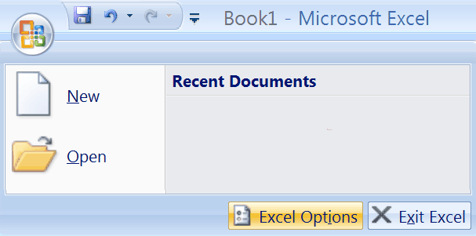
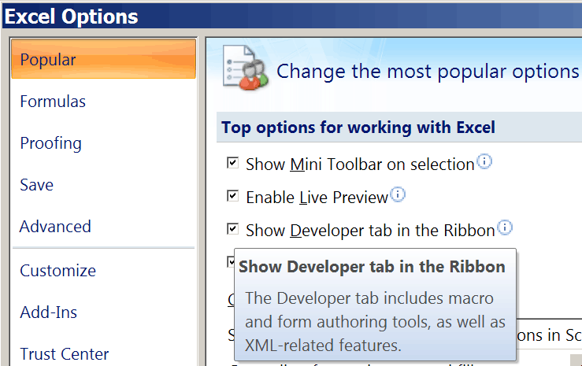
Excel’s Developer Tab
By default, Excel’s Developer Tab is not shown in the Ribbon.
Excel Options
“Show Developer tab in the Ribbon”

Slide 9

Chart Pattern Fills: Select One Series
Select one series by clicking on a pie slice or bar of that series. If you want to change the pattern of only one data point in the series, then click a second time on that slice or bar.

Slide 10
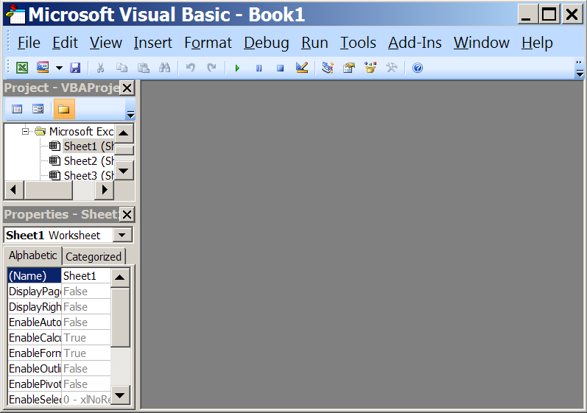
Chart Pattern Fills: Visual Basic Editor
Open the Visual Basic Editor. This can be done by pressing ALT+F11 or by selecting Visual Basic from the Developer tab.

Slide 11
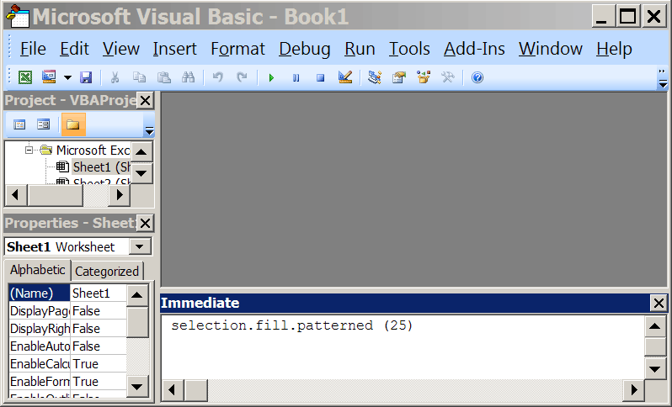
Chart Pattern Fills: Immediate Window
From the Visual Basic Editor, open the Immediate Window by pressing CTRL+G or by selecting “Immediate Window” from the Visual Basic Editor “View” menu.

Slide 12
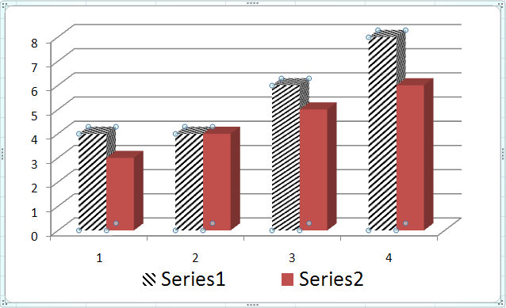
selection.fill.patterned(n)
In the immediate window, enter the following command:
selection.fill.patterned(25)
Different values of n give different patterns.

Slide 13

Excel Exam: Next week
During your regular lab class.
Must use Lab Windows XP computer with Excel 2007
I will check ITS internet usage logs for DSH 141 at the end of the week.
This does not include layer 3 information (user data packets), but does include IP addresses.

Slide 14
Excel Exam: Next week
Must use Lab Windows XP computer with Excel 2007
  That means Mac users should practice on Lab Machines!
  Yes, we actually do this!
I will check ITS internet usage logs for DSH 141 at the end of the week.

Slide 15
Excel Exam: Next week
Section 9 and 10 (a.k.a You) have 75 minute labs
The exam takes 50 minutes
As a courtesy to those that might have traffic/parking problems and for those last minute questions, the exam will begin 10 minutes into the lab.
Don’t plan on being late! But don’t worry if you are normally a little late that you will have a big problem

Slide 16
Excel Exam: Next week
You need to print your exams
  Factor in time for printing (sometimes there is a line)
  Make sure you have money on your card (some extra in case of problems never hurts, $1.00 should be more than enough).
  If you have not used the lab printing system, use it before exam day. It’s not hard to use, but you don’t want to surprised.
  You need your card to print! Don’t leave it at home.

Slide 17

Exam Time ≠ Learn Time
Be cognizant of the clock.
This is a practical exam.
  You are in front of the computer.
  But, there is not much time to:
    Explore dialogs,
    Click around,
    Read help files
Some people, even when they study, need more time.
  If you are such a person, make arrangements BEFORE the final.
  Best to document your disability, then you can use UNM Accessibility Services.
Study

Slide 18
Quiz: Weighted Average
Which equation can be filled right from cell C6, to correctly calculate the weighted average in cells C6:E6?
a) =($C$2*B2+$C$3*B3+$C$4*B4+$C$5*B5)/SUM($B$2:$B$5)
b) =(C2*$B$2+C3*$B$3+C4*$B$4+C5*$B$5)/SUM($B$2:$B$5)
c) =($C$2*B2+$C$3*B3+$C$4*B4+$C$5*B5)/SUM(B2:B5)
d) =AVERAGE(C2:C5)
e) =AVERAGE(C2:C5)/SUM(B2:B5)

Slide 19
Quiz: Weighted Average Again
Enter an equation calculating Ori’s final grade This equation must be entered so that it can be filled down to correctly calculate the grades in E4:E6. The equation MUST NOT use any constants.
a) = (B2*$B$8 + C2*$B$8 + D2*$B$9) / ($B$8 + $B$8 + $B$9)
b) = (B2*$B$8 + C2*$B$8 + D2*$B$9) / (2*$B$8 + $B$9)
c) = (B2*$B$8 + C2*$B$8 + D2*$B$9) / 40
d) = (B2 + C2 + 2*D2) / 4

Slide 20
Scenario: Concession Stand
A concession stand at the Albuquerque Bio Park sells snow cones for $1.00 each, hot pretzels for $1.50 each and caramel apples for $2.00 each.
Monday was sunny, and the stand sold 210 snow cones, 55 hot pretzels and 105 caramel apples.
On Tuesday, the sky was cloudy and the stand sold 85 snow cones, 165 hot pretzels and 100 caramel apples.
On Wednesday it rained and the stand sold 7 snow cones, 87 hot pretzels and 25 caramel apples.

Slide 21
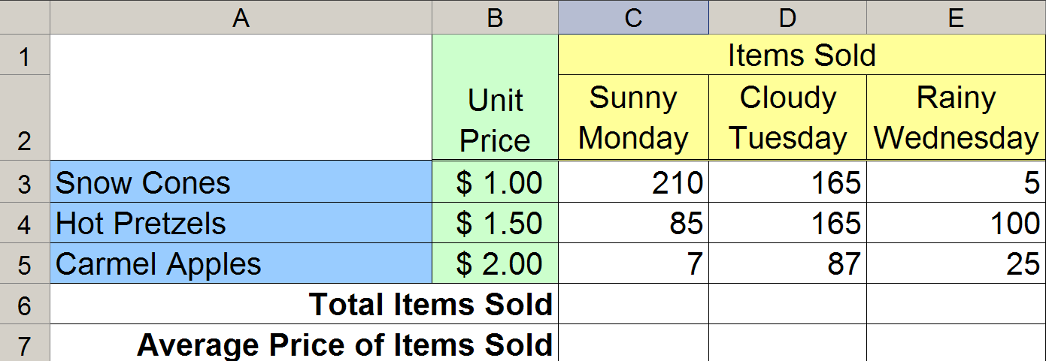
Concession Stand: Words to Spreadsheet
The background of each cell of your table must match the figure.
The horizontal and vertical alignment of the text in your table must match the figure.
Cells that are Merged and formatted with Wrap Text must match the figure.
Cell boarders must match the figure.

Slide 22
Concession Stand: Estimate
If an equal number of the three items were sold, then the average price of a sale would be $1.50.
On Monday, the average price of an item sold will be the lowest.
On Tuesday, the average will be higher than on Monday, but still below $1.50 since more $1.00 items were sold than $2.00 items.
On Wednesday, the average price of an item sold will be above $1.50.

Slide 23
Quiz: Total Items Sold
What equation should be entered in cell C6?
a) =sum(C3:C5)
b) =sum($C$3:$C$5)
c) =sum(C3:E3)
d) =sum($C3:$E3)
e) =sum($C$3:$E$3)

Slide 24
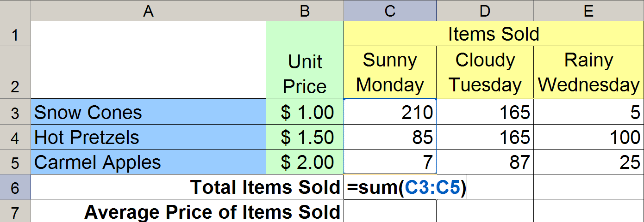
Concession Stand: Total Items Sold
In cell C6, enter an Excel equation that calculates the indicated value.
This equation must be entered so that it can be filled right to correctly calculate the values in D6:E6.
The equation MUST NOT use any constants.

Slide 25
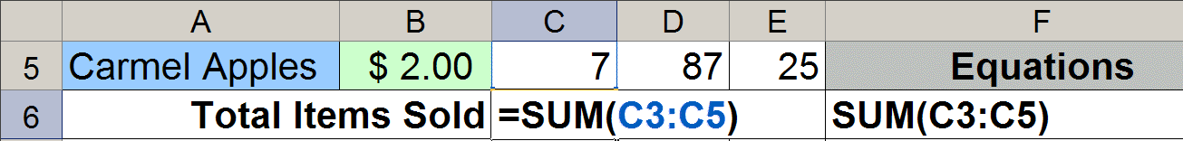
Copy the Equation as Text
Equation copied as text has no equals, =.
The cell column letter and row number must match exactly the equation being copied.
Copy the equation used in C6 as text into F6. In order to receive any credit for this part, your equation must appear with all the cell references used in C6 printed and visible in F6.

Slide 26
Copy the Equation as Text
Equation copied as text has no equals, =.
The cell column letter and row number must match exactly the equation being copied.
Copying the Equations as text is vital!
If I can’t see your equations you will get
ZERO credit for them
Copy the equation used in C6 as text into F6. In order to receive any credit for this part, your equation must appear with all the cell references used in C6 printed and visible in F6.

Slide 27
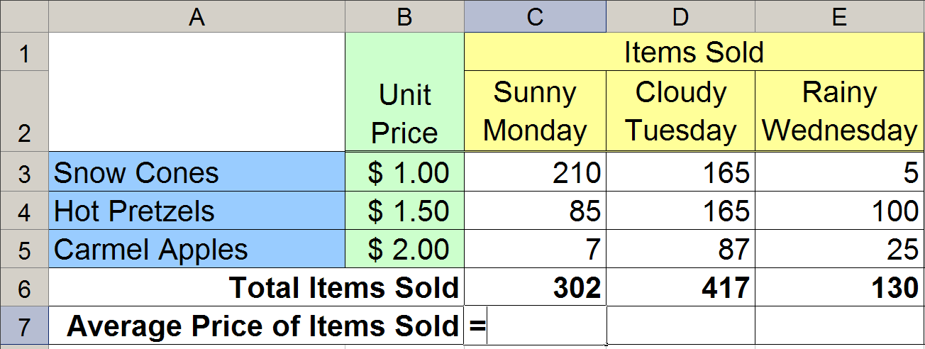
Concession Stand: Average Price
The Average Price of an Item on a particular day is a Weighted Average.
What is the weight of each item?
What is the total weight?

Slide 28
Quiz: Average Price
What equation should go in C7?
a) =($B$3*$C$3+$B$4*$C$4+$B$5*$C$5)/$C$6
b) =(B3*$C$3+B4*$C$4+B5*$C$5)/$C$6
c) =(B3*$C$3+B4*$C$4+B5*$C$5)/C6
d) =($B$3*C3+$B$4*C4+$B$5*C5)/C6
e) =(B3*C3+B4*C4+B5*C5)/C6

Slide 29
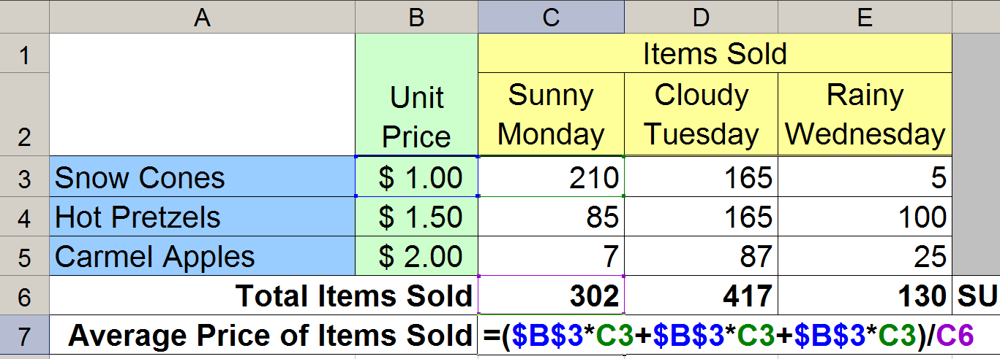
Concession Stand: Average Price
In cell C7, enter an Excel equation that calculates the indicated value.
This equation must be entered so that it can be filled right to correctly calculate the values in D7:E7.
The equation MUST NOT use any constants.

