Slide 1
Lab 8 (Prequel): Loan Amortization
CS-150L
Computing for Business Students
Instructor:
Matthew Barrick
e-mail: barrick@cs.unm.edu
www.cs.unm.edu/~barrick
Office: Farris Engineering Center (FEC) room 106
PMT(rate, nper, -pv)

Slide 2
Upcoming Schedule
This Week (Oct 18):
  Today/Tomorrow Midterm!
  No lab assignment this week.
  Lab classes – Exam (if you haven’t arranged an alternate time, it’s too late)
  Graded Labs 6 & 7 will be returned during your exam (don’t waste time looking at them during the exam )
Next Week (Oct 25)
  Lecture Lab 8 – Mortgage Loans
  Lab 8 Due Sunday October 31 as normal

Slide 3
Lab 8: Due Sunday, October 31
Understanding how a loan works.
Loan Amortization Schedules
Excel PMT( ) function
Textbook equation reading and translating
The meaning of Biweekly and Semimonthly.
The meaning of periodic rate and how it relates to an APR (Annual Percentage Rate).
Compute a running tally of interest or principal paid-to-date.
Use of the EOMONTH( ) function.

Slide 4
What is the Value of Each Equation?
1) =A1+B1+C1
2) =SUM(A1+B1+C1)
3) =SUM(A1, B1, C1)
4) =AVERAGE(A1+B1+C1)
5) =AVERAGE(A1, B1, C1)
1) 60
2) =SUM(60)=60
3) 60
4) 60
5) 20

Slide 5
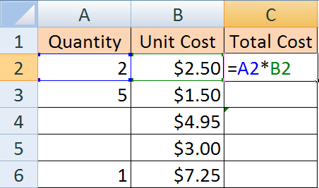
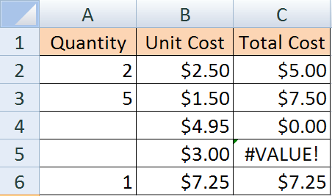
Empty and Space in Equations
+
Fill down
Why is does
C3 display $0.00 and
C5 display #VALUE?
Empty cell

Space Character

Slide 6
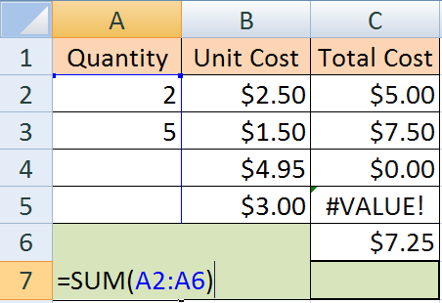
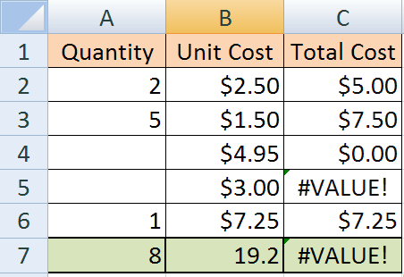
Space in Range of SUM Function
+
=SUM(A2:A6) ignores the
Space Character


Slide 7
Which are Correct?
a) = SUM(B2:B4)/3
b) = AVERAGE(B2:B4)
c) = AVERAGE($B$2:$B$4)
d) = B2+B3+B4/3
e) = (B2+B3+B4)/3
f) = B2/3+B3/3+B4/3
g) = SUM(B2:B4)/COUNT(B2:B4)
Enter an Excel equation that calculates the average of all the grades for lab 1 and will fill across correctly. The equation must not use any constants.
When no weights are given, it can be assumed that all items to be averaged have the same weight.

Slide 8
Business Related Time Intervals
Usually, all of these are equally spaced intervals.
Biannual: Once every two years.
Semiannual: Twice each year.
Quarterly: Four times a year, at three-month intervals.
Bimonthly: Once every two months (6 times per year).
Monthly: 12 times per year.
Semimonthly: Twice each month (24 times per year).
Biweekly: Once every two weeks (26 times per year).
Weekly: Every week, 52 times per year.

Slide 9
Calculating Periodic Interest Rate from APR
  Where APR is the Annual Percentage Rate and
  n is the number of periods in one year.
  For a daily periodic interest rate, most lending institutions use an amortized base of 365.
  Examples: APR = 12.99%
  Monthly Periodic Rate = 12.99%/12 = 1.0825%
  Daily Periodic Rate = 12.99%/365 = 0.0356%

Slide 10
Quiz: Periodic Interest Rates
Witch Excel equation will give the Monthly Periodic Interest Rate in the above spreadsheet?
a) = B2/B1
b) = B1/B2
c) = B2/12
d) = (B2/12) * B1
e) = B2/12 * B1

Slide 11
Multiplying Every Cell By a Constant
Place the constant in a cell.
Copy the value in the cell.
Select all the cells you want to Multiply by the constant.
Paste Special:
  Excel 2003: Edit Menu ➔ Paste Special ➔ Operation: Multiply.
  Excel 2007: Home Ribbon ➔ Paste ➔ Paste Special ➔ Operation: Multiply.

Slide 12
Multiplying Every Cell By a Constant
  Show Example

Slide 13
Exponents
5² = 5 × 5 = 25 (math notation)
5^2 = 5*5 = 25 (Excel notation)
2⁵ = 2 × 2 × 2 × 2 × 2 = 32 (math notation)
2^5 = 2*2*2*2*2 = 32 (Excel notation)

Slide 14
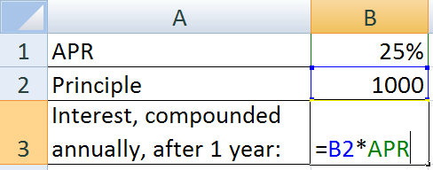
Use of Named Cells
You’ll be expected to used Named Cells where appropriate from here out
Trust me, this will make your life much easier

Slide 15
Named Cells: Excel 2003/Excel Mac

Slide 16
Writing a Math Equation in Excel
The Excel PMT(rate, nper, -pv) function calculates the periodic payment, P, on a loan by the formula:
  rate: Periodic interest rate.
  nper: Total number of periods.
  pv: Principle value of loan
=(rate*pv*(1+rate)^nper) / ((1 + rate)^nper -1)

Slide 17
Quiz: Math to Excel
The profitability equation for earnings per share given in the Financial Accounting Textbook (MGMT 202) is:
Which Excel equation is a correct translation?
a) = (NI – PSD)/ACSO
b) = EpS – ((NI – PSD)/ACSO)
c) = NI – PSD/ACSO
d) = (NI – PSD/ACSO)
e) = EpS + ((NI – PSD/ACSO)

Slide 18
Running Totals
Running Total:
Sum from Beginning (absolute) through Current
(relative)

Slide 19
Quiz: Running Totals
Which Excel Equation can be entered in cell C2 and filled down from C2:C6 to correctly calculate the Payments Made to Date?
a) = SUM($C$2:$C$6)
b) = SUM($B$2:B2)
c) = SUM(B2:B6)
d) = SUM($B$2:B6)
e) = SUM(C2:C6)
Alternate Solution:
C2: = B2
C3: = C2+B3
Correct but less clear

Slide 20
Excel PMT( ) function
PMT (PayMenT) for a loan based on constant payments and a constant interest rate.
Syntax: PMT(rate, nper, -pv)
  rate: Periodic interest rate (APR divided by the number of periods per year),
  nper: Total number of periods during the term of the loan (often number of years times periods per year).
  pv: Principle value of loan (Note this is always, negated. Don’t ask me why, just do it)

Slide 21
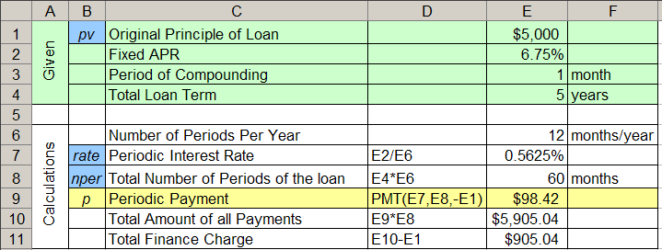
PMT Example
A five year loan is created on an original principal of $5,000 at a fixed APR of 6.75% compounded monthly.

Slide 22
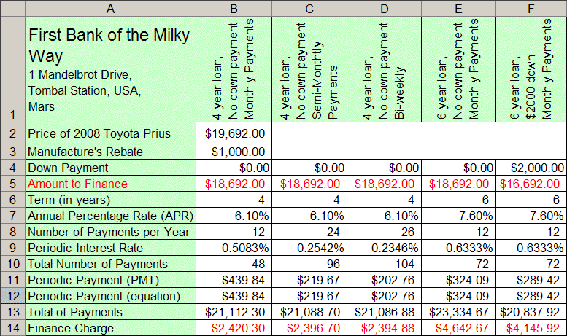
Auto Loan Scenarios

Slide 23
Quiz: PMT(rate, nper, -pv)
A five year loan is created on an original principal of $5,000 at a fixed APR of 6.75% compounded monthly.
The Periodic Payment is given by:
a) PMT(E2, E4, -E1) b) PMT(E7, E8, -E1)
c) PMT(E2, E6, -E1) d) PMT(E7, E6, -E1)

Slide 24
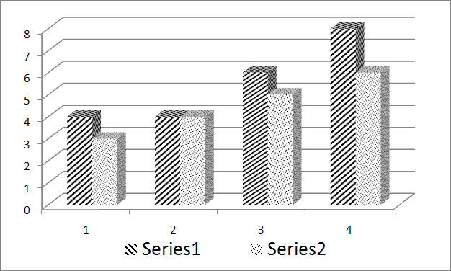
Chart Pattern Fills
Pattern fills work best when color is not available.

Slide 25
Midterm – Mini Last Minute Review
NO Internet
Only application open/or used is Microsoft Excel and the Microsoft Excel help system
One page of notes (printed is ok for this exam, hand-written for the final)
Cell phones OFF (not vibrate, not silent, OFF)
You may not leave the room (even for the restroom)

Slide 26
Midterm – Mini Last Minute Review
Must fit on one printed page (you’ll turn in the print-out)
No USB Keys (I don’t want to see them), you may print an extra copy of your exam if you want to keep a copy. You can’t save an electronic version
50-Minutes:
  Print-out (guard your print-outs)
  Turn-in print-out and the exam sheet
  Sign-out
  Leave quietly

Slide 27
Chart Pattern Fills: Procedure Outline
Create a chart.
Select one series by clicking on a pie slice or bar of that series. If you want to change the pattern of only one data point in the series, then click a second time on that slice or bar.
Open the Visual Basic Editor. This can be done by pressing ALT+F11 or by selecting Visual Basic from the Developer tab (how to turn this on in a minute)
From the Visual Basic Editor, open the Immediate Window by pressing CTRL+G or by selecting “Immediate Window” from the Visual Basic Editor “View” menu.
In the immediate window, enter the following command:
selection.fill.patterned(n) n∈ [1,54]

Slide 28
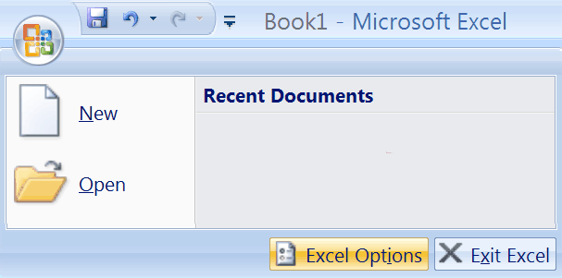
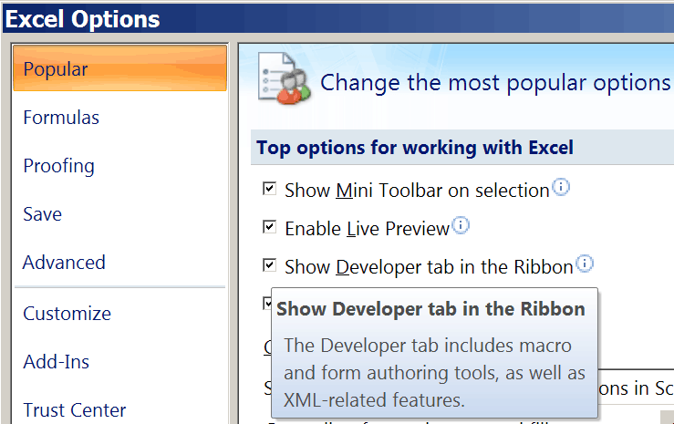
Excel’s Developer Tab
By default, Excel’s Developer Tab is not shown in the Ribbon.
Excel Options
“Show Developer tab in the Ribbon”

Slide 29
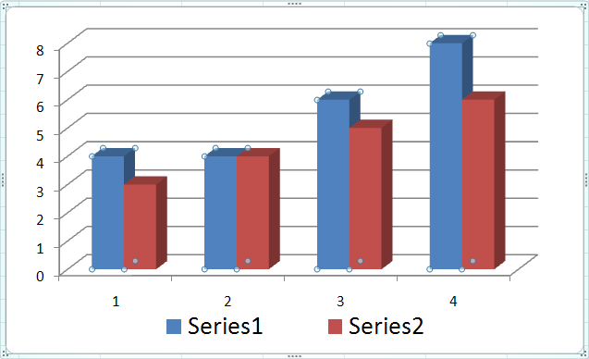
Chart Pattern Fills: Select One Series
Select one series by clicking on a pie slice or bar of that series. If you want to change the pattern of only one data point in the series, then click a second time on that slice or bar.

Slide 30
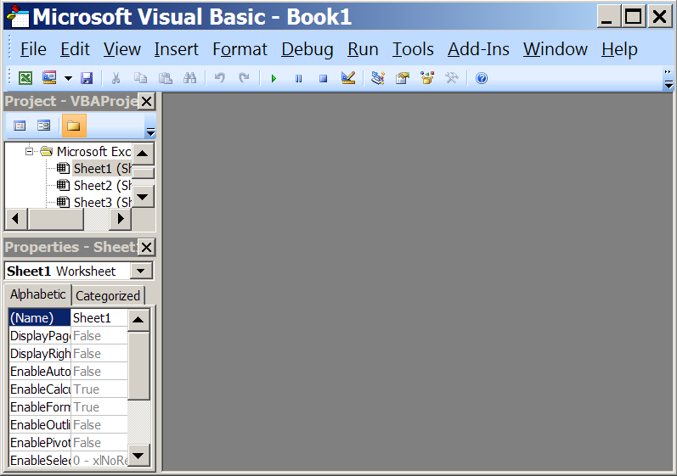
Chart Pattern Fills: Visual Basic Editor
Open the Visual Basic Editor. This can be done by pressing ALT+F11 or by selecting Visual Basic from the Developer tab.

Slide 31
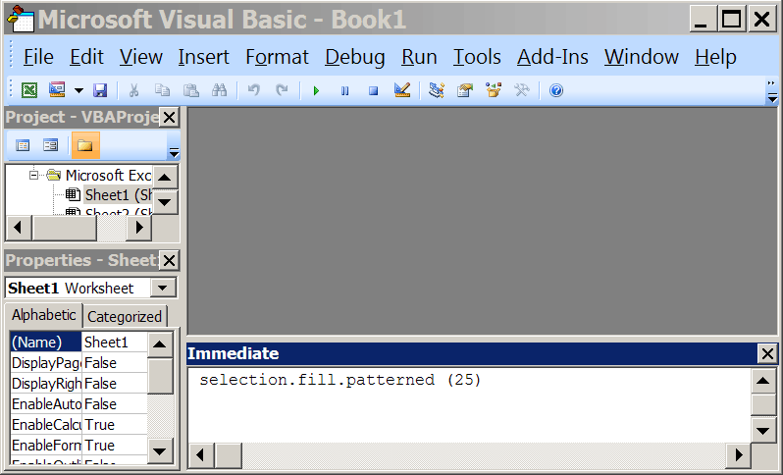
Chart Pattern Fills: Immediate Window
From the Visual Basic Editor, open the Immediate Window by pressing CTRL+G or by selecting “Immediate Window” from the Visual Basic Editor “View” menu.

Slide 32
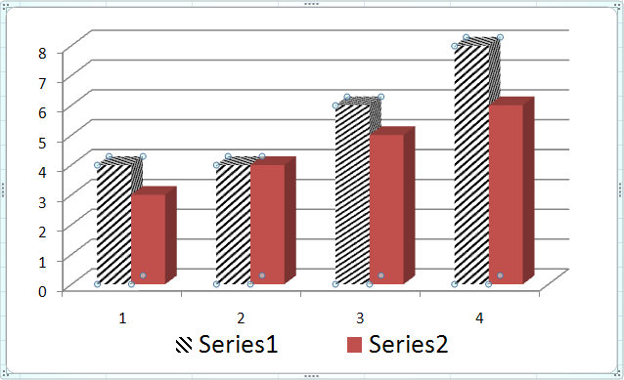
selection.fill.patterned(n)
In the immediate window, enter the following command:
selection.fill.patterned(25)
Different values of n give different patterns.

Slide 33

Excel Exam: Next week
During your regular lab class.
Must use Lab Windows XP computer with Excel 2007
I will check ITS internet usage logs for DSH 141 at the end of the week.
This does not include layer 3 information (user data packets), but does include IP addresses.

Slide 34
Excel Exam: Next week
Section 9 and 10 (a.k.a You) have 75 minute labs
The exam takes 50 minutes
As a courtesy to those that might have traffic/parking problems and for those last minute questions, the exam will begin 10 minutes into the lab.
Don’t plan on being late! But don’t worry if you are normally a little late that you will have a big problem

Slide 35
Excel Exam: Next week
You need to print your exams
  Factor in time for printing (sometimes there is a line)
  Make sure you have money on your card (some extra in case of problems never hurts, $1.00 should be more than enough).
  If you have not used the lab printing system, use it before exam day. It’s not hard to use, but you don’t want to surprised.
  You need your card to print! Don’t leave it at home.

Slide 36
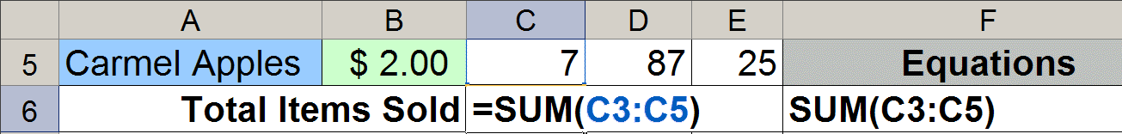
Copy the Equation as Text
Equation copied as text has no equals, =.
The cell column letter and row number must match exactly the equation being copied.
Copy the equation used in C6 as text into F6. In order to receive any credit for this part, your equation must appear with all the cell references used in C6 printed and visible in F6.

Slide 37
Copy the Equation as Text
Equation copied as text has no equals, =.
The cell column letter and row number must match exactly the equation being copied.
Copying the Equations as text is vital!
If I can’t see your equations you will get
ZERO credit for them
Copy the equation used in C6 as text into F6. In order to receive any credit for this part, your equation must appear with all the cell references used in C6 printed and visible in F6.

