Slide 1
Lab 8: Loan Amortization CS-150L Computing for Business Students
Instructor:
Matthew Barrick
e-mail: barrick@cs.unm.edu
www.cs.unm.edu/~barrick
Office: Farris Engineering Center (FEC) room 106
PMT(rate, nper, -pv)

Slide 2
Upcoming Schedule
This Week (Oct 25):
Lecture Lab 8 – Mortgage Loans
Lab 8 Due Sunday October 24 as normal
Exams (taken during Section 9/10) back at end of class
Quiz 2 grades are up (From Sept 22 – Oct 13).
Next Week (Nov 1)
Lecture Lab 9 – Retirement Annuity
Tuesday – U.S Election Day, exercise your franchise if you have it

Slide 3
Quiz 2 Results
 | Section 9/10 | All Sections
Number of Students | 44 | 244
Total Possible | 42 | 42
Mean | 31.1 | 26.8
Median | 35.0 | 34.0
Standard Deviation | 12.7 | 15.9

Slide 4
Lab 8: Due Sunday, October 31
Understanding how a loan works.
Loan Amortization Schedules
Excel PMT( ) function
Structure a worksheet to separate assumptions from calculations, to facilitate cell referencing.
Create an amortization table
Explain the impact on a borrower of making extra principal payments on a loan.

Slide 5
Excel PMT( ) function
PMT (PayMenT) for a loan based on constant payments and a constant interest rate.
Syntax: PMT(rate, nper, -pv)
rate: Periodic interest rate (APR divided by the number of periods per year),
nper: Total number of periods during the term of the loan (often number of years times periods per year).
pv: Principle value of loan (Note this is always, negated. Don’t ask me why, just do it)

Slide 6
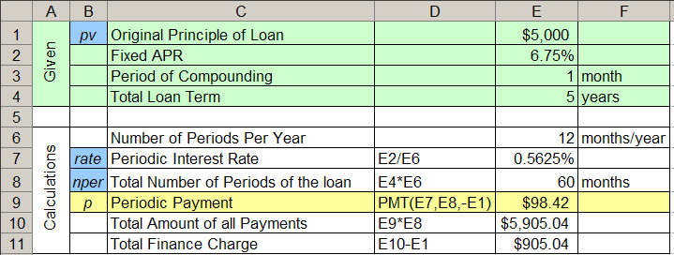
PMT Example
A five year loan is created on an original principal of $5,000 at a fixed APR of 6.75% compounded monthly.

Slide 7
Quiz: PMT(rate, nper, -pv)
A five year loan is created on an original principal of $5,000 at a fixed APR of 6.75% compounded monthly.
The Periodic Payment is given by:
a) PMT(E2, E4, -E1) b) PMT(E7, E8, -E1)
c) PMT(E2, E6, -E1) d) PMT(E7, E6, -E1)

Slide 8
Quiz: Total Finance Charge
A five year loan is created on an original principal of $5,000 at a fixed APR of 6.75% compounded monthly.
The Total Finance Charge is given by:
a) E9 – E10 b) E10 – E9 c) E9 * E10
d) E9 * E8 e) E10 – E1

Slide 9
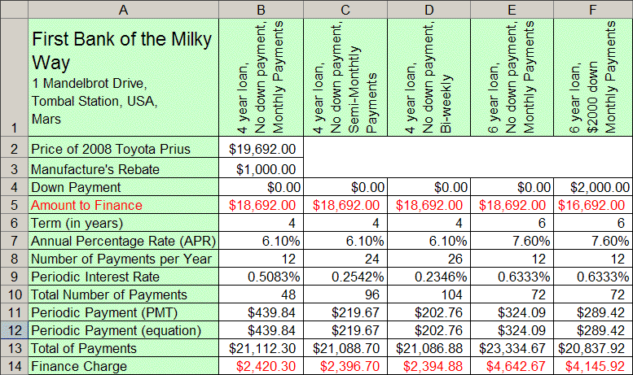
Auto Loan Scenarios

Slide 10
Compound Interest
The account balance (interest plus principal) is calculated at the end of each period.
During the next period, interest is calculated on the full balance at the end of the last period.
If $100 was borrowed for 2 years at an annual periodic interest rate of 10%, the interest compounded annually would be:
$100 * 10% * 1 period = $10 (in the 1st period).
Balance at the end of the first period: $100 + $10 = $110.
$110 * 10% * 1 period = $11 (in the 2nd period).
Thus, the total interest in the loan is:
$10.00 + $11.00 = $21.00

Slide 11
Simple Interest vs Compound Interest
Simple interest =
[Original Principle] * [Periodic Rate] * [The Number of Periods]
Compound Interest For One Period =
[Current Balance] * [Periodic Rate]

Slide 12
Setting Up a Worksheet form Words
On January 1, 2011, Austin took out a loan of $1000.00 at an interest rate of 12.00% APR compounded monthly. He has a minimum payment of $100.00 due the first of every month starting February. He always makes his minimum payment. What is the balance of his account on March 1, 2011?
• Extract the information from the paragraph,
• Organize the information in a spreadsheet with assumptions clearly separated from calculations,
• Solve the problem within the spreadsheet such that changing any of the assumptions automatically changes the results.
• Format a assumptions, calculations and results for clarity and easy readability.

Slide 13
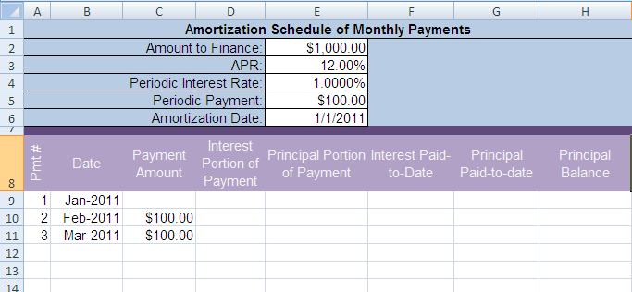
Words to Worksheet – Set up
On January 1, 2008, Austin took out a loan of $1000.00 at an interest rate of 12.00% APR compounded monthly. He has a minimum payment of $100.00 due the first of every month starting February. He always makes his minimum payment. What is the balance of his account on March 1, 2008?

Slide 14
Quiz
On a standard auto loan, interest is accrued on
the loan balance
the payment made this period
the total of all payments made since the start of the loan
the borrower's salary
the principle paid this period

Slide 15
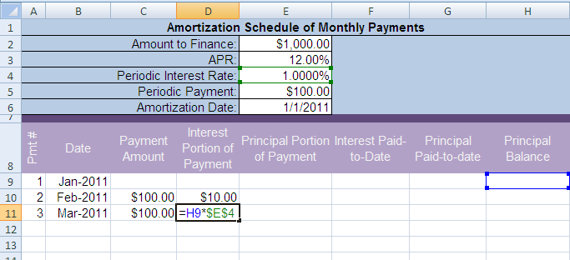
Finance Charge
Row 1: =E2*E4 or =$E$2*$E$4
Row 2: =H10*$E$4 --- it is ok that H10 is empty.

Slide 16
Amount Applied to Principal
Row 2 (not special – fill it down): =C10-D10
The value showing in E11 is incorrect because the Finance Charge in D11 is incorrect until the Principal Balance equation is done.
When Principal Balance equation is done, the other values will update to correct values.

Slide 17
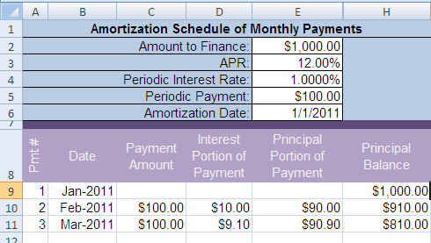
Principal Balance
Row 1: =E2
Row 2: =H9-E10

Slide 18
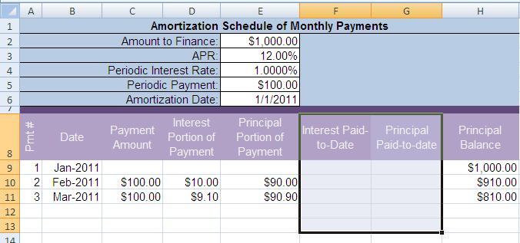
Paid-to-Date Rows?

Slide 19
Paid-to-Date Rows?
These are just running sums
See last week’s notes

Slide 20
Quiz:
Which equation entered in B5 will give the interest (compounded monthly) charged for the month of March?
a) ($B$1 / 12) * C4
b) ($B$1 / 12) * (A5 – A4)
c) ($B$1 / 12) * (A4 – A5)
d) ($B$1 / 12) * (A4 – A5) * C4
e) $B$1 * C4

Slide 21
Quiz:
The simple interest on the balance in cell B4 over a period of days given in cell A4 can be calculated by?
a) =$D$1*B4
b) =$D$1 + B4 + A4
c) =$D$1*B4*A4
d) =$D$1 + B4*A4
e) =$D$1*B4 + A4

Slide 22
Midterm Results
 | Section 9 | Section 10 | All Sections
Number of Students | 24 | 19 | 225
Mean | 88.6% | 81.1% | 80.1%
Median | 93.0% | 78.0% | 87.0%
Standard Deviation | 12.8% | 11.6% | 19.5%

