Slide 1

CS-150L
Computing for Business Students
Lab 9: Future Value of a Retirement Annuity
Instructor:
Matthew Barrick
e-mail: barrick@cs.unm.edu
www.cs.unm.edu/~barrick
Office: Farris Engineering Center (FEC) room 106

Slide 2
Lab 9
Calculating Future Value of a Retirement Annuity
Calculating Retirement Income
Using the Social Security Administration’s benefit calculator.
Excel FV(rate, nper, pmt), Future Value function.
Using an annuity accrual table to vary the payment amount.

Slide 3
Retirement Annuity
Accrual Phase: payments are made into the annuity account. During this phase, the value of the annuity increases by:
  Contributions: Deposits may be made weekly, monthly, quarterly, or yearly. An ordinary annuity is an annuity whose payments are made at the end of each period.
  Interest or Return on Current Investment.
Pension Phase: This begins upon retirement.
  Each period, payments are made out of the annuity.
  Interest on the annuity balance continues to add to the value of the annuity.

Slide 4
Excel FV(rate, nper, -pmt)
Excel built-in function for calculating the future value of an annuity.
rate is the periodic interest rate (APR divided by the number of periods per year),
nper is the total number of periods of the annuity,
pmt is the amount contributed to the annuity each period. In order to use this equation, the payment must be the same every period.

Slide 5
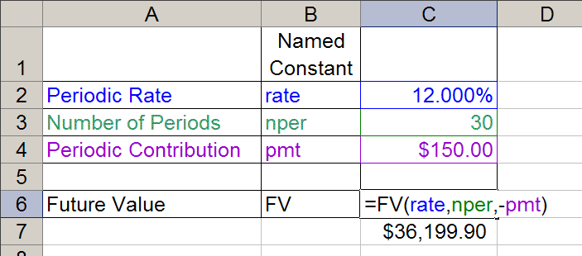
FV(rate, nper, -pmt) example
All of the values are given in periods.
Thus, it does not need to be stated whether the period is days, weeks, months, years, or Mars years.
Judging by the values, make a guess at the period.

Slide 6
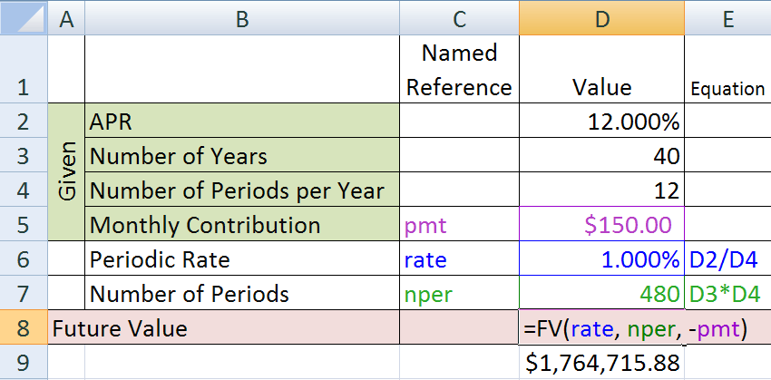
FV – The Magic of Compound Interest
1.7 million is a not bad "nest egg".
Are these numbers realistic?

Slide 7
What if? (Active Excel Worksheet)
What if Monthly Contribution is changed? ($150 → $300)
What if APR is changed? (12.0% → 6.0% , or→ 18.0%)
What if the Number of Years is changed? (40 → 30)

Slide 8
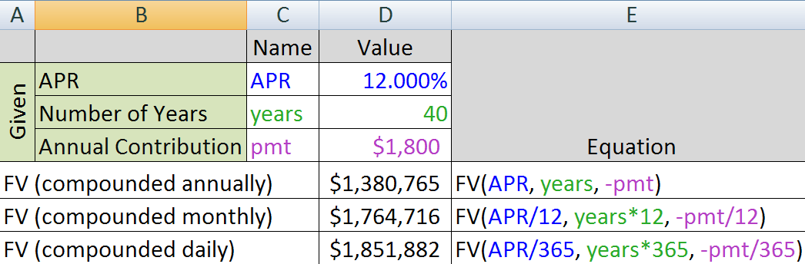
Future Value & Compounding Periods

Slide 9
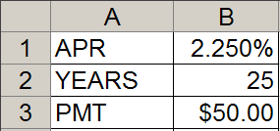
Quiz: Future Value
An annuity is created in which $50.00 is invested every month for 25 years. The annuity offers a guaranteed 2.25% APR.
An Excel worksheet is set up with named references, APR, YEARS, and PMT.
What is the Future Value?
a) =FV(APR, YEARS, -PMT)
b) =FV(APR/12, YEARS, -PMT)
c) = FV(APR/12, YEARS/12, -PMT)
d) = FV(APR/12, YEARS*12, -PMT)
e) = FV(APR/12, YEARS, -PMT/12)

Slide 10
Quiz: Future Value
An annuity is created in which $50.00 is invested every month for 25 years. The APR of the annuity is 2.25%.
One person uses the equation: =FV(APR/12,YEARS*12,-PMT)
Another person uses the equation:
=FV(APR,YEARS,-PMT*12)
Which equation is correct?
a) They are both correct.
b) The 1st. The 2nd gives an answer that is too large.
c) The 1st. The 2nd gives an answer that is too small.
d) The 2nd. The 1st gives an answer that is too large.
e) The 2nd. The 2st gives an answer that is too small.

Slide 11
Quiz: Future Value
An annuity is created in which $50.00 is invested every month for 25 years. The APR of the annuity is 2.25%.
One person uses the equation: =FV(APR/12,YEARS*12,-PMT)
Another person uses the equation:
=FV(APR,YEARS,-PMT*12)
=FV(APR/12,YEARS*12,-PMT) | $20,110.15
=FV(APR,YEARS,-PMT) | $1,653.66

Slide 12
Research
Choose a person: Name & Retirement Date
Choose a Career.
Choose a Geographic Location.
Starting Salary in 2010.
Senior Salary: (salary at retirement in 2010 dollars).
Contribution Rate (percentage of salary)
Accrual Rate of Return
Pension Rate of Return
Years of Life After Retirement.

Slide 13
Research
Choose a person: Name & Retirement Date
Choose a Career.
Choose a Geographic Location.
Starting Salary in 2010.
Senior Salary: (salary at retirement in 2010 dollars).
Contribution Rate (percentage of salary)
Accrual Rate of Return
Pension Rate of Return
Years of Life After Retirement.
These need to
be are Realistic

Slide 14
Employer/Employee Contribution
Many employers will match contributions you make to your retirement annuity up to a certain percent.
This is basically extra money that you can’t access until you retire.
  This is instead of giving you a pension like the old days (welcome to the 21st Century)
The amount they will contribute is generally capped at a certain percent of your salary. For this lab will use a set maximum of 5% (we’ll use a more complex scheme in Lab 10)

Slide 15
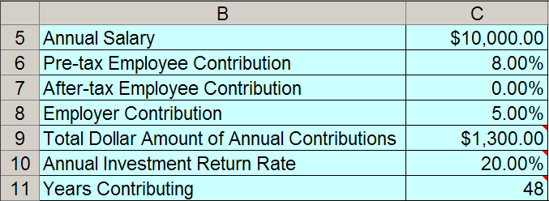
FV Worksheet: Researched Values
Employer Contribution: =MIN(C6,5%)
Total Annual Contributions: ?
=C5*C6 + C5*C7 + C5*C8

Slide 16
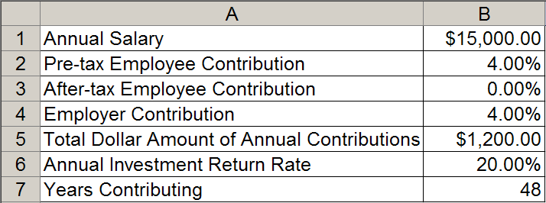
Quiz: Total Annual Contributions
Which equation gives the Total Annual Contributions in B5?
a) =B2*B1 + B3*B1 + B4*B1
b) =B2*B6 + B3*B6 + B4*B6
c) =B6 * (B1+B2+B3+B3)
d) =B6 * (B2+B3+B3)
e) =B2*B7 + B6*B7

Slide 17
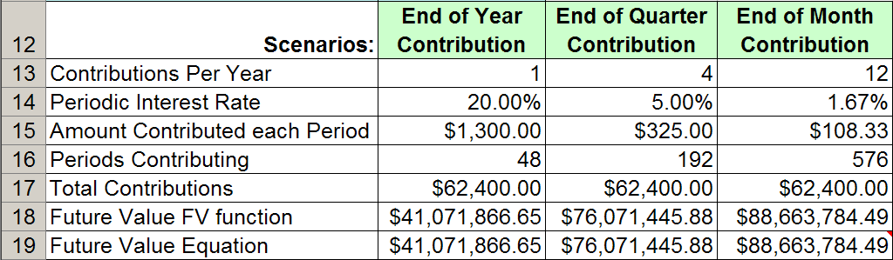
FV Worksheet: Scenarios
Why is the Future Value so much larger in the third column than in the first column?
FV function: =FV(rate, nper, -pmt)
FV Equation:

Slide 18
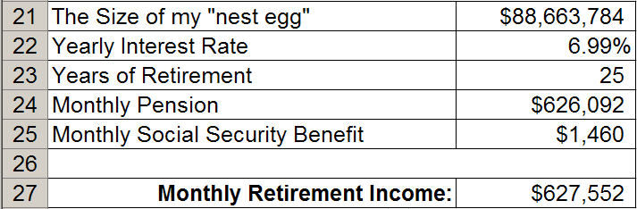
Pension Phase
Use PMT(rate, nper, pv) function to determine the amount you will withdraw from your pension each month. At the end of nper, the value will be zero.
Note: rate is not APR and nper is not years.

Slide 19
Accrual table (Active Excel Worksheet)

Slide 20
CS-150L
Computing for Business Students
Lab 10: Conditional Logic and the Annuity
Instructor:
Matthew Barrick
e-mail: barrick@cs.unm.edu
www.cs.unm.edu/~barrick
Office: Farris Engineering Center (FEC) room 106

Slide 21
Total Dollar Amount of Contribution
B5*C5 + B5*D5 + B5*E5
The contribution information from columns B, C, D, and E is totaled in column F. Thus, when the value column is calculated, columns B, C, D and E and not needed.

Slide 22
Quiz: Value at End of Each Year
What equation should be entered in G5 and filled down?
a) =E5 + F5*B5 b) =G4*F5 + E5*F5
c) =G4 + F5*B4 d) =G4 + G4*F5
e) =G4 + G4*F5 + E5

Slide 23
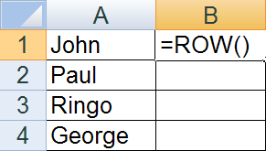
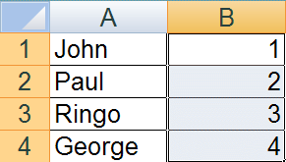
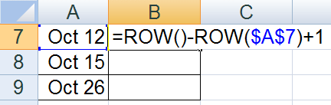
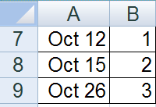
ROW(), ROW(reference) Function
The ROW() function returns the row number of its location.
+

Slide 24
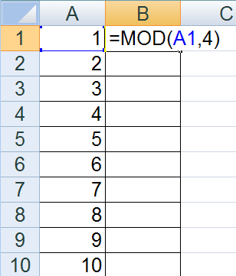
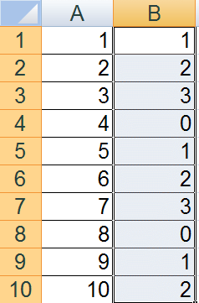
MOD(number, divisor) Function
In computing, the modulo operation finds the remainder of division of one number by another.
The second number is called the divisor.
+

Slide 25
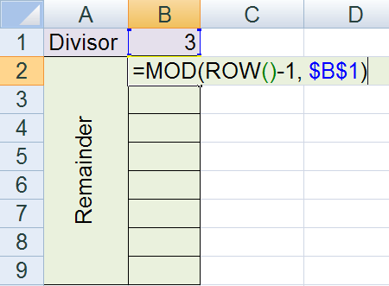
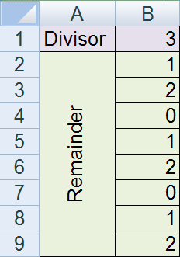
Using MOD() and ROW() Together
What is the result of filling down the equation in B2?

Slide 26
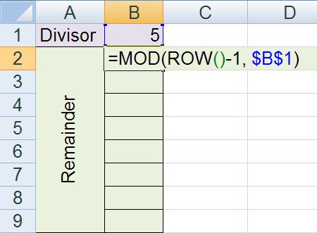
Quiz: ROW() and MOD()
If the equation shown in cell B2 is filled down through B9, then what value will be displayed in cell B6?
0
1
2
3
4

Slide 27
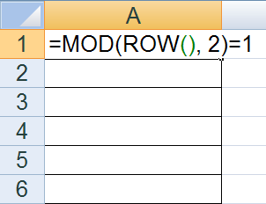
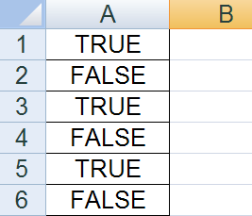
“Logical” Equation
A logical equation is an equation that returns either the value TRUE or FALSE.
two ‘=‘ symbols

Slide 28
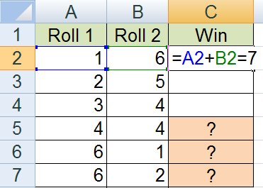
Quiz: Logical Equation
If the equation in C2 is filled down through C7, then what will be displayed in C5, C6 and C7?
FALSE, FALSE, FALSE
FALSE, TRUE, FALSE
FALSE, TRUE, TRUE
TRUE, FALSE, FALSE
TRUE, TRUE, TRUE

Slide 29
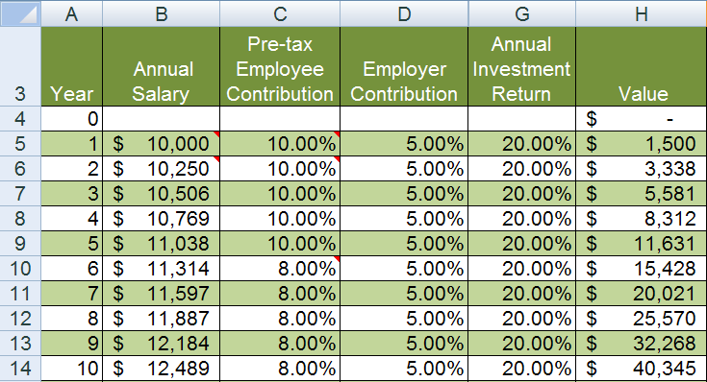
Fill Background on Every Odd Row

Slide 30
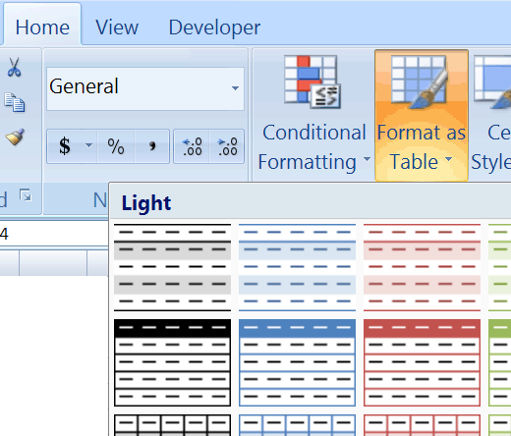

Fill Background on Every Odd Row
Method 1: Format as Table
Works, but often changes the width of one or more columns.
Also, adds a row or adds column dropdown menus to each column.

Slide 31
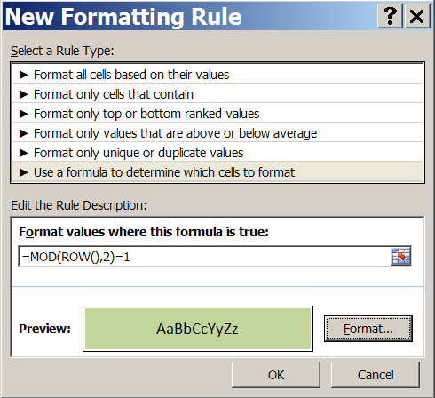
Fill Background on Every Odd Row
Method 2: Conditional Formatting
Select cells.
Select “Conditional Formatting” → “New Rule...”
Select “Use a formula to determine which cells to format”
Enter =MOD(ROW(),2)=1
Click “Format”, and specify the format you want.
Click “OK”.

Slide 32
Quiz
which does NOT give the correct balance?
last period's balance + interest + new deposit
cumulitive Interest + cumulitive deposits
last period's balance + last period's balance*periodic rate of return + new deposit

