Slide 1

CS-150L
Computing for Business Students
Lab 10: Conditional Logic and the Annuity
Instructor:
Matthew Barrick
e-mail: barrick@cs.unm.edu
www.cs.unm.edu/~barrick
Office: Farris Engineering Center (FEC) room 106

Slide 2
Schedule
Lab 10 – Sunday 11/14/2010, 11:59 PM
Lab 11 – Sunday 11/15/2010, 11:59 PM
Thanksgiving – Labs Monday-Wednesday Optional
Lab Wednesday Night-Friday Cancelled
Lecture Wednesday Cancelled
Office Hours Cancelled
Lab 12 – Sunday 12/05/2010, 11:59 PM
Week Dec 6-Dec 10 Final Exam
  No Lecture
  Final During Lab Periods
Saturday December 11 – Last Day to Turn-in Labs

Slide 3
Notes on Lab
You get 2 Free Absences from Lab, after that if you miss the Lab for Lab X you get a zero for Lab X
If you are more than 10 minutes late, or leave early, you are consider absent
If you don’t sign the sign-in sheet, you are considered absent
The cumulative number of labs you have missed on WebCT has been updated in a while
This means you might get grades back for Labs that you won’t get credit for at the end of the semester if you have miss more than 2 labs!

Slide 4
Total Dollar Amount of Contribution
B5*C5 + B5*D5 + B5*E5
The contribution information from columns B, C, D, and E is totaled in column F. Thus, when the value column is calculated, columns B, C, D and E and not needed.

Slide 5
Quiz: Value at End of Each Year
What equation should be entered in G5 and filled down?
a) =E5 + F5*B5 b) =G4*F5 + E5*F5
c) =G4 + F5*B4 d) =G4 + G4*F5
e) =G4 + G4*F5 + E5

Slide 6
Logical Tests
Excel provides a number of ways to test value relative to one another.
Each test asks a question about two values (either constants, equations, or cell references)
The result of each question is either TRUE or FALSE,
These are called Logical Tests, and the resulting values are called Boolean values (after mathematician George Boole)

Slide 7
Logical Tests
Excel provides a number of ways to test value relative to one another:
Logical Operator | Example | Asks the question
= | A1 = B1 | Is A1 equal to B1?
< | A1 < B1 | Is A1 less than B1?
> | A1 > B1 | Is A1 greater than B1?
<= | A1 <= B1 | Is A1 less than or equal to B1?
>= | A1 >= B1 | Is A1 greater than or equal to B1?
<> | A1 <> B1 | Is A1 not equal to B1?

Slide 8
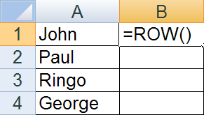
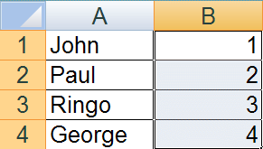
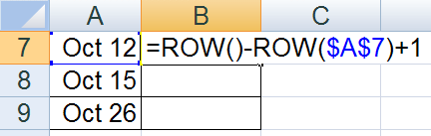
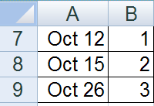
ROW(), ROW(reference) Function
The ROW() function returns the row number of its location.
+

Slide 9
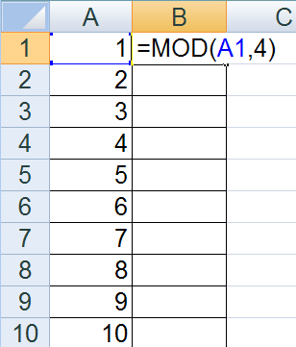
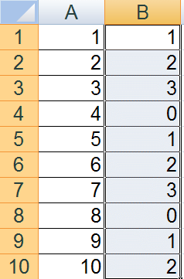
MOD(number, divisor) Function
In computing, the modulo operation finds the remainder of division of one number by another.
The second number is called the divisor.
+

Slide 10
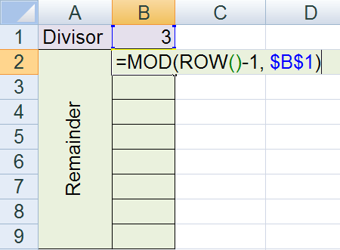
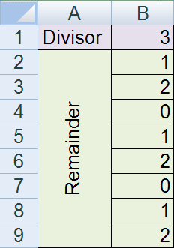
Using MOD() and ROW() Together
What is the result of filling down the equation in B2?

Slide 11
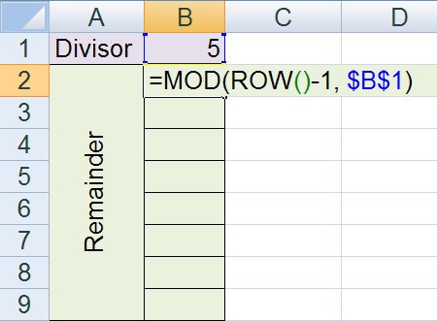
Quiz: ROW() and MOD()
If the equation shown in cell B2 is filled down through B9, then what value will be displayed in cell B6?
0
1
2
3
4

Slide 12
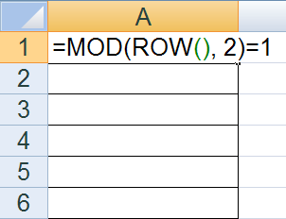
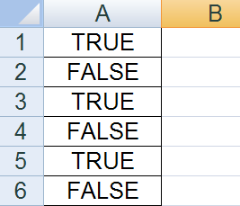
“Logical” Equation
A logical equation is an equation that returns either the value TRUE or FALSE.
two ‘=‘ symbols

Slide 13
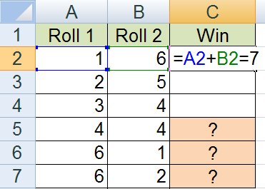
Quiz: Logical Equation
If the equation in C2 is filled down through C7, then what will be displayed in C5, C6 and C7?
FALSE, FALSE, FALSE
FALSE, TRUE, FALSE
FALSE, TRUE, TRUE
TRUE, FALSE, FALSE
TRUE, TRUE, TRUE

Slide 14
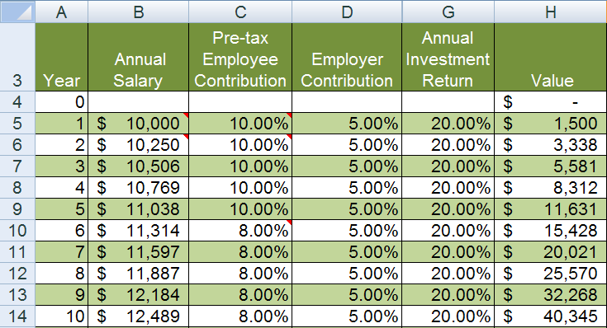
Fill Background on Every Odd Row

Slide 15
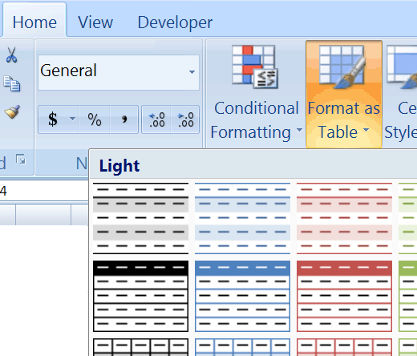

Fill Background on Every Odd Row
Method 1: Format as Table
Works, but often changes the width of one or more columns.
Also, adds a row or adds column dropdown menus to each column.

Slide 16
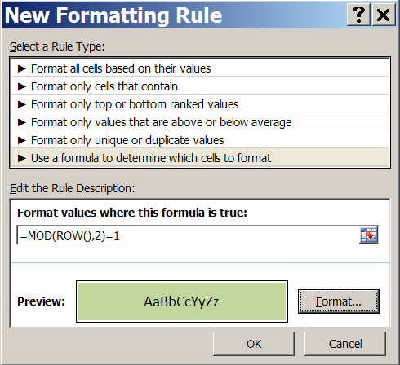
Fill Background on Every Odd Row
Method 2: Conditional Formatting
Select cells.
Select “Conditional Formatting” → “New Rule...”
Select “Use a formula to determine which cells to format”
Enter =MOD(ROW(),2)=1
Click “Format”, and specify the format you want.
Click “OK”.

Slide 17
Quiz
which does NOT give the correct balance?
last period's balance + interest + new deposit
cumulitive Interest + cumulitive deposits
last period's balance + last period's balance*periodic rate of return + new deposit

Slide 18
The Magic of IF
=IF(logical_test, value_if_true, value_if_false)
logical_test – any value or expression that evaluates to TRUE or FALSE, such as A10<100
value_if_true – value return if logical_test is TRUE
value_if_false – value return if logical_test is FALSE

Slide 19
The Magic of IF
=IF(logical_test, value_if_true, value_if_false)
logical_test – any value or expression that evaluates to TRUE or FALSE, such as A10<100
value_if_true – value return if logical_test is TRUE
value_if_false – value return if logical_test is FALSE
Note that any of these arguments could be an IF statement!

Slide 20
If() Examples
IF(logical_test, value_if_true, value_if_false)
When the value in A1 is 76,
Then what will be the value returned by:
=IF(A1>=80, "Good Job", "Harder!")
=IF(A1>=60, "You Passed!", "See You Later")

Slide 21
IF Example (Click to Open Excel)

Slide 22
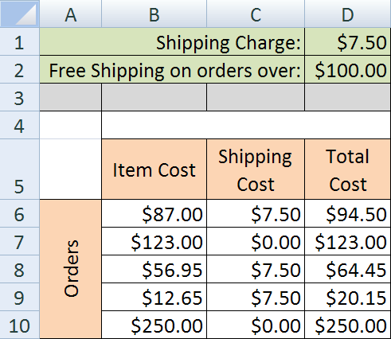
Quiz: If
Which is the best equation to enter in cell C6?
=IF(B6>$D$2, 0, $D$1)
=IF(B6>$D$2, $D$1, 0)
=IF(D2>$B$6, 0, $D$1)
=IF($D$2>B6, 0, $D$1)
=IF($D$2>B6, $D$1, 0)

Slide 23
Applying If: First Weekday of Every Month
=IF( B2=1, A2+1 , IF(B2=7, A2+2, A2))
B2=7 is FALSE
Thus, the day is a Weekday.
Thus, do not change the date.
B2=1 is TRUE
Thus, the day is a Sunday.
Thus, add one day to the date.
B2=1 is FALSE
Thus, the day is NOT a Sunday.
Ask if the day is a Saturday.
B2=7 is TRUE
Thus, the day is a Saturday.
Thus, add two days to the date.

Slide 24
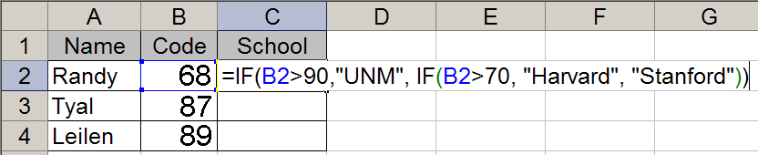
Quiz: If Categories
The equation is C2 is filled down through C4.
What value will display in cells C2, C3, and C4?
a) UNM, Harvard, Stanford
b) Stanford, Harvard, Harvard
c) Stanford, Stanford, UNM
d) Harvard, Harvard, UNM
e) UNM, Stanford, Stanford

Slide 25
Excel Date Functions (Click to Open Excel)

Slide 26
Employer Contribution
The table shows whole number contributions, but the equation also needs to work for 5.5%, 7.25% and other fractional employee contributions.
Me |  | Boss
1% |  | 1%
2% |  | 2%
3% |  | 3%
4% |  | 4%
5% |  | 5%
Full Match
6% | 1% | 5% + 25%(1%) = 5.25%
7% | 2% | 5% + 25%(2%) = 5.50%
8% | 3% | 5% + 25%(3%) = 5.75%
9% | 4% | 5% + 25%(4%) = 6.00%
10% | 5% | 5% + 25%(5%) = 6.25%
11% | 6% | 5% + 25%(6%) = 6.50%
12% | 7% | 5% + 25%(7%) = 6.75%
13% | 7% | 5% + 25%(8%) = 7.00%
+¼ Match
Maxed Out

Slide 27
MONTH(date) Syntax
The Excel MONTH(date) function
Requires one parameter: a date.
Returns a number between 1 and 12.
The return value should be formatted as a number with zero decimal places.
There are four columns in lab 9 that use this value.
Do not be afraid to create new columns with extra columns with intermediate calculations.

Slide 28
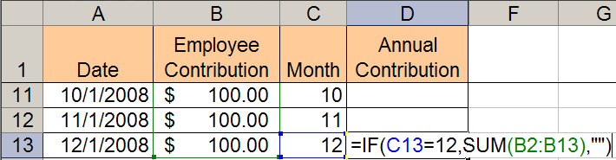
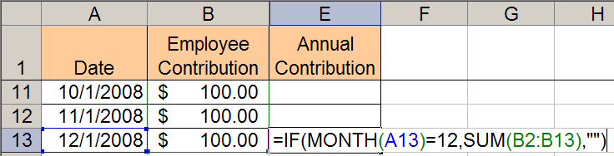
Annual Contribution:
With and without an extra Month Column
=IF( MONTH(A13)=12, SUM(B2:B13), "" )

Slide 29
Quiz: Correct Syntax
Which of the following uses Correct Syntax?
a) =IF(MONTH(B3=7),A1,A1+1)
b) =IF(MONTH(B3),=7,A1,A1+1)
c) =IF(MONTH(B3,=7,A1,A1+1))
d) =IF(MONTH(B3=7,A1),A1+1)
e) =IF(MONTH(B3)=7,A1,A1+1)

Slide 30
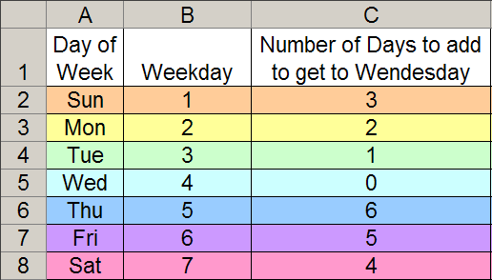
First Wednesday of Month – 7 cases
Always add zero through six days plus the 1st of month.
=IF( B1=1, 3, IF( B1=2, 2, IF ( B1=3, 1, IF (...))))

Slide 31
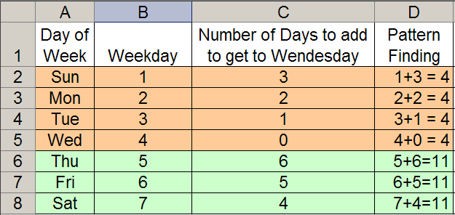
Pattern Finding – 2 Cases
=IF( B1<=4, 4-B1, 11-B1 )

Slide 32
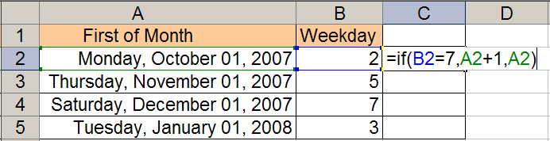
Quiz: Reading If
Filling down the equation shown in C2 will result in which set of values in C2, C3, C4, and C5?
a) 10/2/2007, 11/1/2007, 12/1/2007, 1/1/2008
b) 10/1/2007, 11/2/2007, 12/1/2007, 1/1/2008
c) 10/2/2007, 11/1/2007, 12/2/2007, 1/1/2008
d) 10/1/2007, 11/1/2007, 12/2/2007, 1/1/2008
e) 10/1/2007, 11/2/2007, 12/2/2007, 1/1/2008

Slide 33
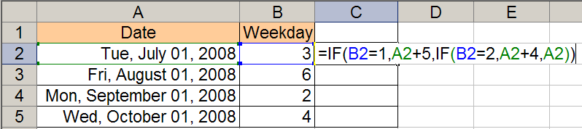
Quiz: Reading Nested If
Filling down the equation shown in C2 will result in which set of values in C2, C3, C4, and C5?
a) 7/1/2008, 8/1/2008, 9/1/2008, 10/1/2008
b) 7/5/2008, 8/5/2008, 9/5/2008, 10/5/2008
c) 7/1/2008, 8/1/2008, 9/5/2008, 10/1/2008
d) 7/4/2008, 8/4/2008, 9/4/2008, 10/4/2008
e) 7/5/2008, 8/5/2008, 9/4/2008, 10/4/2008

Slide 34
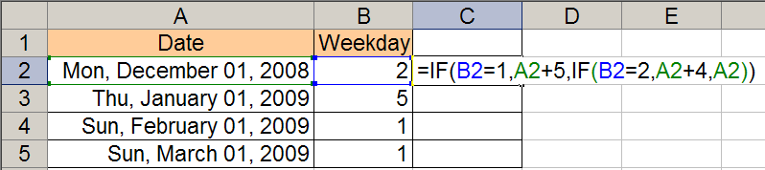
Quiz : Reading If – Same Equation
Filling down the equation shown in C2 will result in which set of values in C2, C3, C4, and C5?
a) 12/1/2008, 1/1/2009, 2/5/2009, 3/5/2009
b) 12/1/2008, 1/1/2009, 2/5/2009, 3/1/2009
c) 12/1/2008, 1/1/2009, 2/6/2009, 3/1/2009
d) 12/5/2008, 1/4/2009, 2/4/2009, 3/6/2009
e) 12/5/2008, 1/1/2009, 2/6/2009, 3/6/2009

Slide 35
Conditional Formatting
This lab REQUIRES conditional formatting
It has been strongly encouraged in previous labs, but never actually required.
See Lab 3, 3.2.1.j for Help on how to do this
Also, there are some more slides on how to do this here, but we won’t go over them in class unless time permits

Slide 36
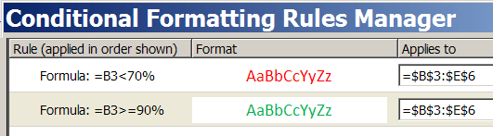
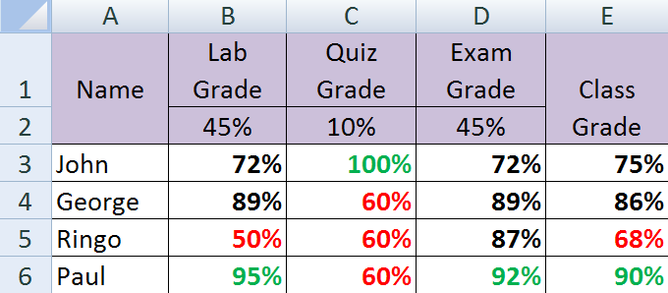
Conditional Formatting
B3
Relative Address

Slide 37
Conditional Formatting: Example
Embedded Excel Worksheet
Click to modify
When a value is changed, its color automatically updates.
The conditional formatting was not applied to the weights.

Slide 38
Conditional Formatting: Procedures
Select cells you want to format.
Home Ribbon → Conditional Formatting → New Rule...
Select: “Use a formula to determine which cells you want to format”.
Enter first rule: =B3<70%
Click “Format” and, from the font tab, select desired formatting.
Click “OK”
Repeat steps 1-6 for second rule: =B3>=90%

Slide 39
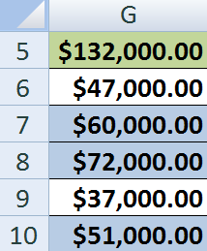
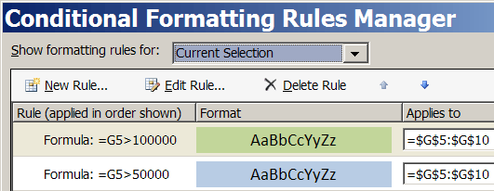
Conditional Formatting: Order Matters
In this example, the order in which the rules are applied is important.
Why?
Change Rule Order

