Slide 1
CS-150L
Computing for Business Students
Lab 3 – Excel Basics
Instructor:
Matthew Barrick
e-mail: barrick@cs.unm.edu
www.cs.unm.edu/~barrick
Office: Farris Engineering Center (FEC) room 106

Slide 2
Lab 3 Skills
Follow instructions involving basic spreadsheet terminology
Recognize and Fix Excel errors
Learn to selection quality formatting and consistent layout options
Relative vs. Absolute References
Master basic Excel formatting: fonts, background shading, width/height, number format, merging cells
Develop and apply equations for checking account balance after each transaction and detailed time sheets

Slide 3
Lab 3 Preparation
Go through the Online Tutorials (Especially if you have little to no experience with Excel)
Read the Front Material for the lab
  There is material in there you need
  There are rules about how to make your spreadsheets that will effect your grades
  Useful information about common errors
  Details of the evils of “Hard Coded” values

Slide 4
Lab 3 Preparation
Go through the Online Tutorials (Especially if you have little to no experience with Excel)
Read the Front Material for the lab
  There is material in there you need
  There are rules about how to make your spreadsheets that will effect your grades
  Useful information about common errors
  Details of the evils of “Hard Coded” values
  I know that it is tempting to skip this material, but it is vital for this lab

Slide 5
Paper Spreadsheets
The word "spreadsheet" came to mean the format used to present book-keeping ledgers:
  Columns for categories of expenditures across the top,
  Invoices listed down the left margin,
  The amount of each payment in the cell where its row and column intersect.
Traditionally, these were "spread" across facing pages of a bound ledger (book for keeping accounting records) or on oversized sheets of paper ruled into rows and columns in that format and approximately twice as wide as ordinary paper.

Slide 6
Computer Spreadsheets
Simulates a paper spreadsheet.
Displays multiple cells that together make up a grid consisting of rows and columns, each cell containing either alphanumeric text or numeric values.
Cell may alternatively contain a formula that defines how the contents of that cell is to be calculated from the contents of any other cell (or combination of cells) each time any cell is updated.
Frequently used for financial information because of their ability to re-calculate the entire sheet automatically after a change to a single cell is made.

Slide 7
History of Computer Spreadsheets
In 1971, Rene K. Pardo and Remy Landau filed a patent on a spreadsheet related algorithm.
Visicalc is usually considered the first electronic spreadsheet, and it helped turn the Apple II computer into a success and greatly assisted in their widespread application.
Lotus 1-2-3 was the leading spreadsheet of DOS era.
Excel is now generally considered to have the largest market share.

Slide 8
Excel
Microsoft Excel is a spreadsheet application written and distributed by Microsoft for Microsoft Windows and Mac OS X.
It features calculation, graphing tools, pivot tables and, except for Excel 2008 for Mac OS X, a macro programming language called VBA (Visual Basic for Applications).
It is overwhelmingly the dominant spreadsheet application available for these platforms and has been so since version 5 in 1993.

Slide 9


Excel
Saying your software is the best in the world "because more people use" it is like saying McDonalds makes the best food in the world.
--unknown author

Slide 10
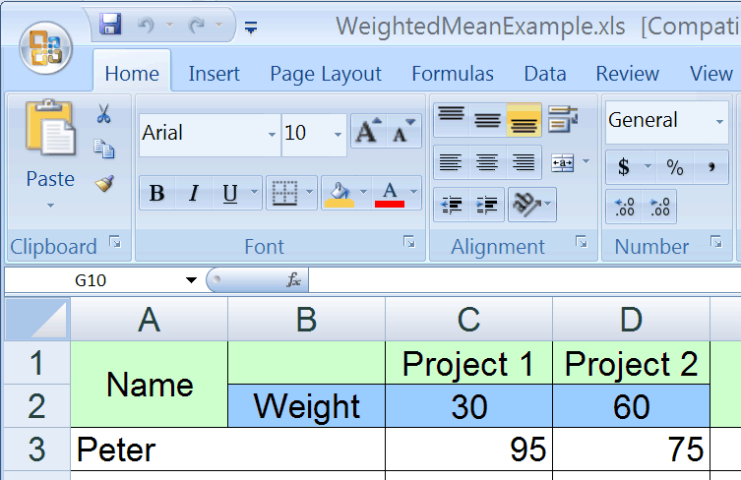
Welcome To Excel

Slide 11
Excel: Rows, Columns, and Cells
Column F contains the checking account balance.
Row 4 contains a share draft transaction on 8/8/08
Cell D8 contains the value of a payroll deposit.
Range A2:A13 contains the dates 8/3/08-8/31/09

Slide 12
Relative and Absolute Reference
A1 Relative Reference
$A$1 Absolute Reference

Slide 13
Credit, Debit, and Balance
The above layout is used by the New Mexico Educator's Federal Credit Union.
Keeping the debits and credits in separate columns allows each to be added up independently so that the total debits and credits can be calculated
The smaller of the two totals is then subtracted from the larger to get the account balance.

Slide 14
Credit?, Debit?: Look to the Balance
Debits and credits are a system of notation used to keep track of money movements (transactions) into and out of an account:
Money paid into an account is a debit,
Money taken out of an account is a credit.
From your perspective, when you pay money into your bank account it is recorded as a debit, your bank account is in debt to you - the bank owes you money.
From the bank's perspective, when you pay money into the bank it has come out of your account (a credit) into their vault: your account is in credit - your account is owed money.

Slide 15
Quiz: Excel Cell Value
What is the value in cell C4?
$67,200
Total Operating Expenses
Gopher Games
Black numbers with a white background.
2005 Total Operating Expenses for Gopher Games.

Slide 16
Excel Functions and Arguments
Build-in Excel functions accept input (also called arguments or parameters) and return a value.
  =SUM (4, 3, 10)
    Here, the function SUM, has three arguments: 4,3 and 10. The function returns the value 17.
  =PRODUCT (A1:A5)
    Here, the function PRODUCT, has one argument: A1:A5. This argument specifies the cells A1, A2, A3, A4 and A5. The function returns the product of the values in those five cells.

Slide 17
Excel Formula
A formula in a spreadsheet, such as Excel, is a mathematical equation used to calculate a value.
In Excel, formulas must begin with an equal ( = ) sign.
  =AVERAGE (4, 3, 10)
  =AVERAGE(A1, B5) * 3
Arguments that are Constants
Function
Constant
Operator
Arguments that are Cell References:
A1: Column A, Row 1
B5: Column B, Row 5

Slide 18
Excel Operators
An operator in Excel is a symbol that represents an arithmetic operation in a spreadsheet formula. The most operators used in CS-150 are:
  addition ( + ) = 6 + 3 has a value of 9
  division ( / ) = 6 / 3 has a value of 2
  subtraction ( - ) = 6 - 3 has a value of 3
  multiplication ( * ) = 6 * 3 has a value of 18
  exponentiation ( ^ ) = 6 ^ 3 has a value of
  6 * 6 * 6 or 216
  Read "six raised to the third power"
  or "six to the power of three".

Slide 19

Excel Addition
=SUM (4, 3, 10)
Function that returns the sum of the three arguments (value is17).
=4+3+10
Equation or Formula that calculates the sum of the three numbers (value is17).
=SUM(4+3+10)
First: The three numbers are added.
Second: The function SUM is given the single argument 17.
This is redundant

Slide 20
SUM: Using Cell Ranges
Square brackets, [ ], indicate that the argument is optional.
SUM(number1 [,number2] [,number3] [,...])
SUM(cellRef1:cellRef2)

Slide 21
SUM – Across and Rectangles
SUM(cellRef1:cellRef2)
Can be used for a range in
a column: SUM(B1:B4) = 90
a row, or : SUM(A1:B1) = 62
a rectangle: SUM(A1:B4) = 152

Slide 22
Quiz: Excel SUM Function
Which of the following will find the sum of the 4 numbers shown in column A, rows 1 through 4?
a) = sum(50-5)
b) = sum(1A-4A)
c) = sum(1A:4A)
d) = sum(A1:A4)
e) = sum(A1-B4)

Slide 23
"Reading" a Spreadsheet
What equation should be placed in cell B8?
From the context of this spreadsheet, cell B8 should be the total hours worked on Monday.
Thus, cell B8 = SUM(B3:B7)

Slide 24
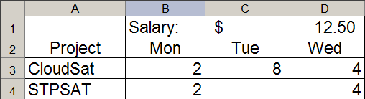

Merged Cells: C1 and D1
Select Cells C1 and D1.
Right-click and select: “Format Cells...”
Select the “Alignment” tab of Format Cells dialog.
Select the “Merge Cells” Check box.
The value of cell C1 is 12.50: ok, good
However, the value of cell D1 is 0!

Slide 25
Format Cells: Alignment Tab
Select Cells... option from the Format Menu.
Center (Hor & Vert)
Wrap Text
Merge Cells

Slide 26
Format Cells: Alignment Tab
Select Cells... option from the Format Menu.
Center (Hor & Vert)
Wrap Text
Merge Cells
Demo Here

Slide 27
Format Cells: Orientation & Wrap Text
Text Alignment
Horizontal: Center
Vertical: Bottom
Wrap Text:
Unchecked &
Checked
Orientation: 90 degrees

Slide 28
Quiz: Excel Reading a Spreadsheet
Which is the best formula to enter in cell G3?
a) =sum(B3:F3) d) =2 + 8 + 4 + 8 + 1
b) =sum(B3:F7) e) =25
c) =sum(B3:B7)

Slide 29
Quiz: Excel Evaluate
What is the value of =D1*B3?
a) 0 d) 25.00
b) 24 e) 14.50
c) 24.50

Slide 30
Relative and Absolute Reference
A1 Relative Reference
$A$1 Absolute Reference

