Slide 1

CS-150L
Computing for Business Students
Retirement Annuity using IF for increased Fidelity
Instructor:
Matthew Barrick
e-mail: barrick@cs.unm.edu
www.cs.unm.edu/~barrick
Office: Farris Engineering Center (FEC) room 106
IF

Slide 2
Lab 9:
Retirement Annuities
Conditional Formatting
Conditional Logic
Excel function:
If(logical_test, value_if_true, value_if_false)

Slide 3
IF(logical_test, value_if_true, value_if_false)
Logical_test is any value or expression that can be evaluated to TRUE or FALSE.
Value_if_true is the value that is returned if logical_test is TRUE. If logical_test is TRUE and value_if_true is blank, this argument returns 0 (zero). To display the word TRUE, use the logical value TRUE for this argument. Value_if_true can be another formula.
Value_if_false is the value that is returned if logical_test is FALSE. If logical_test is FALSE and value_if_false is omitted, (that is, after value_if_true, there is no comma), then the logical value FALSE is returned. If logical_test is FALSE and value_if_false is blank (that is, after value_if_true, there is a comma followed by the closing parenthesis), then the value 0 (zero) is returned. Value_if_false can be another formula.

Slide 4
If() Examples
IF(logical_test, value_if_true, value_if_false)
When the value in A1 is 76,
Then what will be the value returned by:
=IF(A1>=80, "Good Job", "Harder!")
=IF(A1>=60, "You Passed!", "See You Later")

Slide 5
IF Example (Click to Open Excel)

Slide 6
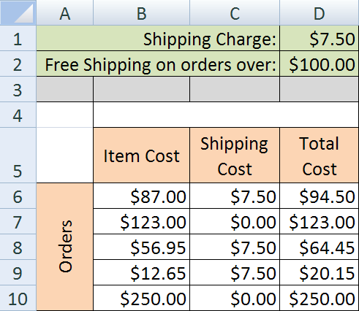
Quiz: If
Which is the best equation to enter in cell C6?
=IF(B6>$D$2, 0, $D$1)
=IF(B6>$D$2, $D$1, 0)
=IF(D2>$B$6, 0, $D$1)
=IF($D$2>B6, 0, $D$1)
=IF($D$2>B6, $D$1, 0)

Slide 7
Applying If: First Weekday of Every Month
=IF( B2=1, A2+1 , IF(B2=7, A2+2, A2))
B2=7 is FALSE
Thus, the day is a Weekday.
Thus, do not change the date.
B2=1 is TRUE
Thus, the day is a Sunday.
Thus, add one day to the date.
B2=1 is FALSE
Thus, the day is NOT a Sunday.
Ask if the day is a Saturday.
B2=7 is TRUE
Thus, the day is a Saturday.
Thus, add two days to the date.

Slide 8
Alternet: First Weekday of Every Month
=IF( B2<7, IF(B2=1, A2+1, A2) , A2+2)
B2=000
B2=jjjj
fgfgg
B2=70000

Slide 9
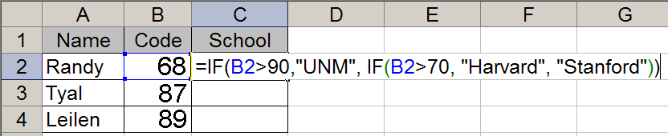
Quiz: If Categories
The equation is C2 is filled down through C4.
What value will display in cells C2, C3, and C4?
a) UNM, Harvard, Stanford
b) Stanford, Harvard, Harvard
c) Stanford, Stanford, UNM
d) Harvard, Harvard, UNM
e) UNM, Stanford, Stanford

Slide 10
Excel Date Functions (Click to Open Excel)

Slide 11
Quiz: Friday, if 1st falls on Weekend
Which Excel equation can be entered in C2 and filled down through C7 to give the first day of the month if the first of the month is a weekday, and to give the Friday before the 1st if the 1st falls on a weekend?
a) =IF(B2=1,A2-2,IF(B2=7,A2-2,A2))
b) =IF(B2=1,A2-2,IF(B2=7,A2-1,A2))
c) =IF(B2=1,A2+2,IF(B2=7,A2+1,A2))
d) =IF(B2=1,A2+1,IF(B2=7,A2+2,A2))
e) =IF(B2=1,A2+1,IF(B2=7,A2+1,A2))

Slide 12
Employer Contribution
The table shows whole number contributions, but the equation also needs to work for 5.5%, 7.25% and other fractional employee contributions.
Me |  | Boss
1% |  | 1%
2% |  | 2%
3% |  | 3%
4% |  | 4%
5% |  | 5%
Full Match
6% | 1% | 5% + 25%(1%) = 5.25%
7% | 2% | 5% + 25%(2%) = 5.50%
8% | 3% | 5% + 25%(3%) = 5.75%
9% | 4% | 5% + 25%(4%) = 6.00%
10% | 5% | 5% + 25%(5%) = 6.25%
11% | 6% | 5% + 25%(6%) = 6.50%
12% | 7% | 5% + 25%(7%) = 6.75%
13% | 7% | 5% + 25%(8%) = 7.00%
+¼ Match
Maxed Out

Slide 13
MONTH(date) Syntax
The Excel MONTH(date) function
Requires one parameter: a date.
Returns a number between 1 and 12.
The return value should be formatted as a number with zero decimal places.
There are four columns in lab 9 that use this value.
Do not be afraid to create new columns with extra columns with intermediate calculations.

Slide 14
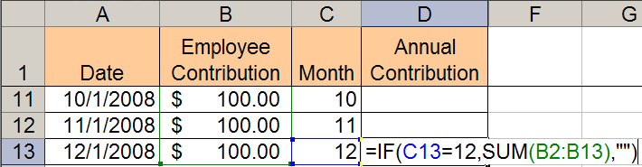
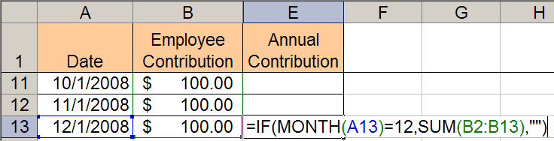
Annual Contribution:
With and without an extra Month Column
=IF( MONTH(A13)=12, SUM(B2:B13), "" )

Slide 15
Quiz: Correct Syntax
Which of the following uses Correct Syntax?
a) =IF(MONTH(B3=7),A1,A1+1)
b) =IF(MONTH(B3),=7,A1,A1+1)
c) =IF(MONTH(B3,=7,A1,A1+1))
d) =IF(MONTH(B3=7,A1),A1+1)
e) =IF(MONTH(B3)=7,A1,A1+1)

Slide 16
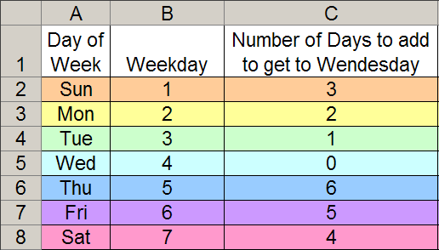
First Wednesday of Month – 7 cases
Always add zero through six days plus the 1st of month.
=IF( B1=1, 3, IF( B1=2, 2, IF ( B1=3, 1, IF (...))))

Slide 17
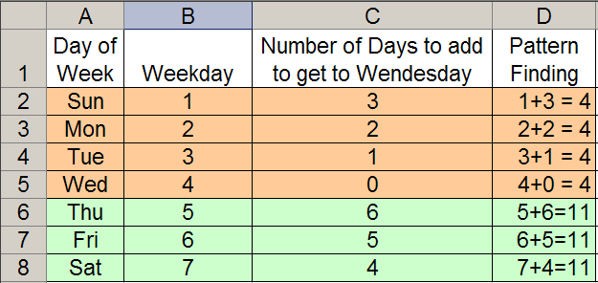
Pattern Finding – 2 Cases
=IF( B1<=4, 4-B1, 11-B1 )

Slide 18
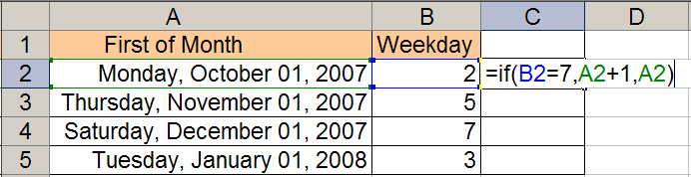
Quiz: Reading If
Filling down the equation shown in C2 will result in which set of values in C2, C3, C4, and C5?
a) 10/2/2007, 11/1/2007, 12/1/2007, 1/1/2008
b) 10/1/2007, 11/2/2007, 12/1/2007, 1/1/2008
c) 10/2/2007, 11/1/2007, 12/2/2007, 1/1/2008
d) 10/1/2007, 11/1/2007, 12/2/2007, 1/1/2008
e) 10/1/2007, 11/2/2007, 12/2/2007, 1/1/2008

Slide 19
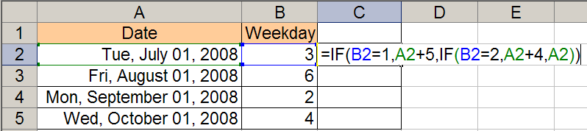
Quiz: Reading Nested If
Filling down the equation shown in C2 will result in which set of values in C2, C3, C4, and C5?
a) 7/1/2008, 8/1/2008, 9/1/2008, 10/1/2008
b) 7/5/2008, 8/5/2008, 9/5/2008, 10/5/2008
c) 7/1/2008, 8/1/2008, 9/5/2008, 10/1/2008
d) 7/4/2008, 8/4/2008, 9/4/2008, 10/4/2008
e) 7/5/2008, 8/5/2008, 9/4/2008, 10/4/2008

Slide 20
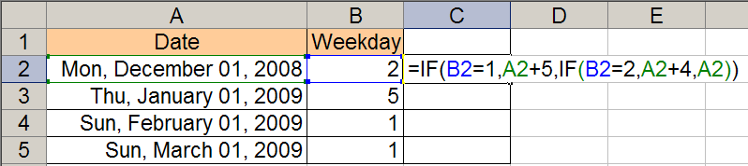
Quiz : Reading If – Same Equation
Filling down the equation shown in C2 will result in which set of values in C2, C3, C4, and C5?
a) 12/1/2008, 1/1/2009, 2/5/2009, 3/5/2009
b) 12/1/2008, 1/1/2009, 2/5/2009, 3/1/2009
c) 12/1/2008, 1/1/2009, 2/6/2009, 3/1/2009
d) 12/5/2008, 1/4/2009, 2/4/2009, 3/6/2009
e) 12/5/2008, 1/1/2009, 2/6/2009, 3/6/2009

Slide 21
Question from an Articulate Student
Subject: CS-150-Lab9-Part N-formula
Professor,
I am going off the lecture notes and I tried
=IF(A16=1,1,IF(A16=2,0,IF(A16=3,6,IF(A16=4,5,IF(A16=5,4,IF(A16=6,3,IF(A16=7,2)))))))+A16
as my equation and A16 is 1/1/09, but all my computer will return is "FALSE" what am i doing incorrectly?
Clear subject.
She gave me her equation.
She told me the value in the cell the equation uses.
She told me the result she gets.

Slide 22
Ideas? What is Wrong?
Rewritten for human reading using a monospace font:
IF(A16=1,1,
: IF(A16=2,0,
: : IF(A16=3,6,
: : : IF(A16=4,5,
: : : : IF(A16=5,4,
: : : : : IF(A16=6,3,
: : : : : : IF(A16=7,2)
: : : : : )
: : : : )
: : : )
: : )
: )
)+A16
=IF(A16=1,1,IF(A16=2,0,IF(A16=3,6,IF(A16=4,5,IF(A16=5,4,IF(A16=6,3,IF(A16=7,2)))))))+A16
A16 = 1/1/09
Value returned: "FALSE"

Slide 23
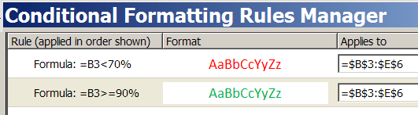
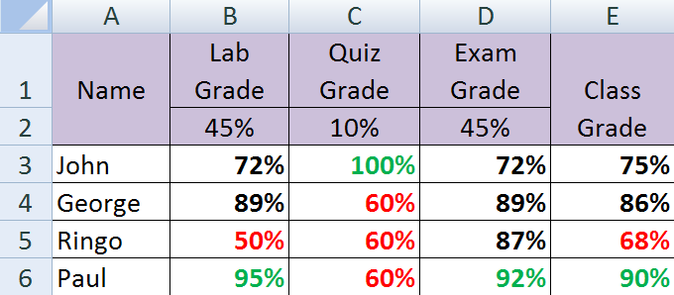
Conditional Formatting
B3
Relative Address

Slide 24
Conditional Formatting: Example
Embedded Excel Worksheet
Click to modify
When a value is changed, its color automatically updates.
The conditional formatting was not applied to the weights.

Slide 25
Conditional Formatting: Procedures
Select cells you want to format.
Home Ribbon → Conditional Formatting → New Rule...
Select: “Use a formula to determine which cells you want to format”.
Enter first rule: =B3<70%
Click “Format” and, from the font tab, select desired formatting.
Click “OK”
Repeat steps 1-6 for second rule: =B3>=90%

Slide 26
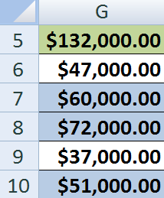
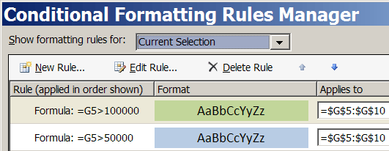
Conditional Formatting: Order Matters
In this example, the order in which the rules are applied is important.
Why?
Change Rule Order

Slide 27
Quiz: Conditional Formatting
Scenario: You need to format cells C4:C500 such that all values greater than or equal to $10,000 have a background color of blue, all values greater than or equal to $20,000 have a background color of green, and all values less 10,000 have the default background color. Which set of rules in which order will accomplish this?
=C4>=10000 =C4>=20000
=$C$4>=10000 =$C$4>=20000
=$C$4:$C$500>=10000 =$C$4:$C$500>=20000
=C4>=20000 =C4>=10000
=$C$4>=20000 =$C$4>=10000

Slide 28
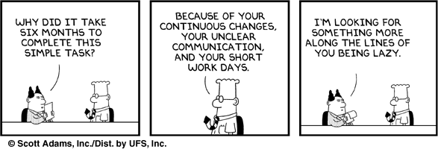
Lab 9 and the Mighty IF
Dilbert – by Scott Adams

