Slide 1

CS-150L
Computing for Business Students
Presentation to a Venture Capitalist
Instructor:
Matthew Barrick
e-mail: barrick@cs.unm.edu
www.cs.unm.edu/~barrick
Office: Farris Engineering Center (FEC) room 106

Slide 2

Microsoft PowerPoint Overview
Microsoft Office PowerPoint enables users to quickly create high-impact, dynamic presentations.
The PowerPoint 2003 document extension is .ppt
PowerPoint document Icons:

Slide 3
Final exam
The Final exam is next week during your regular lab class (50 minutes).
Next Tuesday’s lecture is an optional review time with questions and answers.
The final exam will be one of three types: A Financial Forecast, a Loan or an Annuity.
If you need to miss your regular lab, reschedule with lab instructor during a different lab period.
If you need to miss the full week or feel you need more time:
  Show me that you have studied.
  Tuesday, December 15 7:30–9:30 a.m. DSH 141
  http://registrar.unm.edu/schedule/Fall2009/FinalExamSchedule.pdf

Slide 4
Microsoft PowerPoint Viewer
Free:
Microsoft Office PowerPoint Viewer 2007
http://www.microsoft.com/downloads/details.aspx?familyid=048dc840-14e1-467d-8dca-19d2a8fd7485&displaylang=en
lets you view full-featured presentations created in PowerPoint 97 and later versions through 2007.
Google: PowerPoint Viewer
Before download, make sure you have www.microsoft.com address.

Slide 5
Lab 11
PowerPoint: Presentation Software
  Requires a well defined purpose or message
  Requires a well defined audience
Presentation to a Venture Capitalist
200 Points
  110 points on PowerPoint Features
  90 points in content
This means this lab counts double!!!

Slide 6
PowerPoint Features Requirements
Background Slide Numbering & Clipart.
Lists: Bulleted, Numbered, & Multi-Level.
Image (jpg or gif) in the foreground.
Arrows: Single Arrow, Double Arrow, & Dashed.
Basic Shape: filled & without a fill color.
Connector.
Callout.
3-D style “Basic Shape”.
Hyperlink.
Embedded Excel Spreadsheet & Graph.
Transition effect.
Animation effect.

Slide 7

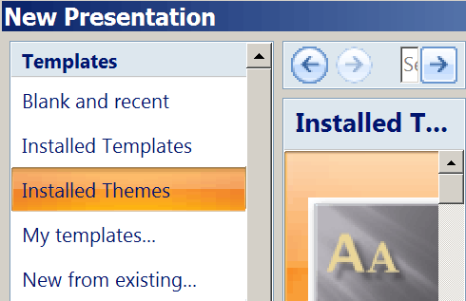
Creating A New Presentation
Microsoft has many more free templates and Themes on the Web

Slide 8
PowerPoint Views
Normal
Slide Sorter
Slide Show
Slide Sorter view shows small icons of each slide. You can drag-and-drop slides to new locations.

Slide 9
Adding Slides
New Slide: Inserts a new blank slide using the selected design template's default format.
Duplicate Slide: Inserts an exact copy of the current slide.

Slide 10
Slide Master
View Menu → Master → Slide Master
Each presentation has two Slide Masters:
Title Slide
Interior Slide

Slide 11
Slide Master Defaults
Each Design Template has its own set of default settings.
Title:
  Arial, Plain Font,
  44 Font Size,
  Centered Alignment,
  Very Pale Blue (227, 227, 255),
  Transparent background,
  No outline
You can change the default on individual slides.
You can change the default on the Slide Master.

Slide 12
Slide Master: Slide Number
View à Master à Slide Master
Include on Slide:
Date
Slide Number
Footer
Apply to All
This Slide Only
Preview
Different Title Slide
The Slide Master dialog is different and more versatile than the View → Header and Footer dialog.

Slide 13
Customizing Slide Master Placements
Default location of Date Area, Footer Area and Page Number Area.
Date Area, and Footer Area deleted. Page Number Area moved, Left Aligned, made smaller and the Main Object Area made a bit larger.

Slide 14
Slide Master Object Groups
On this Design Template, the horizontal blue bar and the sea foam side and top bars are Grouped.

Slide 15
Customizing Slide Master Groups
First, select the group. Then, from the Drawing toolbar, select the Draw dropdown box and select ungroup.
Unselect all the ungrouped objects, then select the object you want to move or resize.
Different components of the original group can be moved separately.

Slide 16
Example of Customizing Groups
If you want to reduce the size of the title box, then you would also want to move the blue line up without moving the green border up and off the slide.
You also might want to reduce the thickness of the border to be in proportion to the title space.

Slide 17
Quiz 9-7: PowerPoint
In a PowerPoint presentation, when you want to place items so that they appear on every page of the presentation, you should place them in the...
a) Clipboard
b) Slide Master
c) Visible Folder
d) Everywhere Folder
e) Required List

Slide 18
Lists
  PowerPoint supports types of lists:
  bulleted Lists, and
  Numbered Lists
The ruler controls the indenting of the list.
The colors and other formatting used in the list can be set using Bullets and Numbering dialog from the Format menu.
The list with the gray bullets is nested inside the list with the brown bullets.
Toolbar icons for numbered & bulleted lists
Toolbar icons increasing & decreasing nesting level

Slide 19
Lines and Arrows
From the Drawing toolbar, select the line or arrow tool.
When the line is selected, format:
Arrow Style
Color
Thickness
Line Style

Slide 21
Basic Shapes
Line color, style and thickness (including no line).
Fill color (including no fill & transparency percentage).
Shadow Style
3-D Style

Slide 22




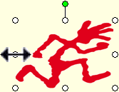


Object Transformations
Translation: Changing the location.
Scaling: Changing the size of both width and height proportionally.
Stretching: Changing the size of just the width or just the height. Can also be used to flip.
Rotation: Changing the orientation.

Slide 23
Insert Picture
Images imported from a file retain their original format: .jpeg, .gif, .png, etc.
Images pasted from the clipboard are converted to bitmaps (an inefficient format).
Insert → Picture → Clip Art... Opens Clip Art Browser.
Insert → Picture → From File... Opens File Browser.

Slide 24
Object Z-Order
1
2
3

Slide 25
Transparency
Fill → More Fill Colors
50% Transparency

Slide 26
Text Boxes
Text Box with No Line
Text Box with 3-point Line
Text Box with 3-point Line and Fill Color
Text
Text
Text without and with Fill Color

Slide 27
Quiz 9-8: Order/Arrange
In PowerPoint, the Order menu (2003) or Arrange Button (2007) does what?
a) Provides an interface to order goods and services from the Internet.
b) Provides an interface to order additional, free clip art from the Internet.
c) Automatically sorts and orders the slides in a presentation.
d) Requires that a transition be applied as apposed to just requesting that it be applied.
e) Lets the user change which objects are in front when objects overlap.

Slide 28

Object Groups
Group objects that you want to stay together when moved.
This text box, rectangle and clip art are a group.

Slide 29
Connectors
Connectors are lines and arrows that are anchored to objects.
Connectors readjust as objects they connect are moved.
Date
Date of Last Day of Month
EOMONTH()
Number of Months to Skip

Slide 30
Slide Transition Effects
Right-click on slide when no object is selected and choose "Slide Transition"
Effect Type
Speed
Sound
On Mouse Click
Timed
Apply to All Slides

Slide 31
Entrance Animation of Objects
Right Click on an Object or Object Group and select Custom Animation...
Add Effect
Start – On Click
Direction
Speed
Animation Order

Slide 32

GIF & Animated GIF
Graphics Interchange Format (GIF) is a bitmap image format that was introduced by CompuServe in 1987.
GIF has widespread usage on the World Wide Web due to its wide support and portability.
The file extension for GIF documents is: .gif.
A GIF file uses lossless image compression
  Often about 3:1 for photographic data
  Often about 10:1 for charts, sketches and cartoons.
A GIF file can have no more than 256 different colors:
  Not good for photos.
  Excellent for drawings, sketches, and charts.
A single GIF file can contain a series of images creating an animation.

Slide 33
Quiz 9-9: Custom Animation
In a PowerPoint presentation, when you add a Custom Entrance Animation to an object it means that...
a) The object is assigned a cartoon figure such as a smiling paper clip or a happy puppy.
b) The object is invisible when the slide is first displayed, and appears when some specified start action occurs.
c) The object goes beyond standard PowerPoint features.
d) The object continuously moves around on the screen.
e) The object appears in one of several cartoon styles such as Anime, Pen and Ink, or Computer-generated imagery (CGI).

Slide 34
Hyperlinks – External Content
Select the text you want to be the link.
Then select Insert → Hyperlink.
Web link to Google (requires Internet Connection).
File Link to Lab 11 (requires relative address: ..\Labs\CS-150-Lab-11.pdf).

Slide 35
Embedded Excel Chart
Insert → Chart
Double Click on chart to edit spreadsheet data or change chart format.

Slide 36
Embedded Excel Worksheet
Insert → Object... → Microsoft Excel Worksheet
Choose:
New or From File

Slide 37
Embedded Worksheet Example
This is an active worksheet, exit the slide show view and double click to modify values or view.

Slide 38
Slide Notes Pane
Does not display during a presentation.
Useful when presentation is reused after long time gap.
Useful when bequeathing a presentation.
Slide Note Area
Notes:
These are some slide notes down here. If you have a cool graphics card and the right setup, you can view these while the slides are up on the screen.

Slide 39
PowerPoint Printing Options
In addition to the usual print options, there are some PowerPoint specific options.
Handouts
  Slides Per Page
Notes Pages
Magic Tree Saver
Notes:
Tfsdfsf
asddfasdfsdfsfsfsfsf
asdfsafsf

Slide 40
Quiz 9-10: Notes Pane
In a PowerPoint presentation, the Notes Pane is
a) Carpal Tunnel Syndrome of the neck that viewers often get when watching long PowerPoint presentations.
b) A text area associated with each slide that is not visible during presentations.
c) The area in the Slide Master that can be shown at the bottom of each slide during a presentation.
d) A graphic object that appears as a stick-note which can be attached for added emphasis of a point.
e) A graphic object that can be given any custom appearance and attached for added emphasis.

Slide 41
Lab 11 Presentation Content
Slide 1: Table of PowerPoint Features
Slide 2: Title Slide
Slide 3: Main Idea
Slide 4: Management – Who & Background
Slide 5: Market Story – Anecdotal
Slide 6: 4Ps
Slide 7: Quantitative Market Analysis – Chart
Slide 8: Product – list of Facts
Slide 9: Financial Forecast (for reference)
Slide 10: Capital – Current Assets & Needs.

Slide 42
Scope of a PowerPoint Presentation
A PowerPoint Presentation is not intended to be a standalone document.
It is an aid to an oral presentation.
If you try to fit all of the information on the slides that you would say during the presentation to the venture capitalist, then you will either need to use very small fonts or significantly more than nine slides.
A PowerPoint Presentation should be an outline that helps keep both the presenter and the audience focused.
A PowerPoint Presentation should offer graphics and visual aids that complement the oral content.

Slide 43

The VC by Robert von Goeben and Kathryn Siegler

Slide 44
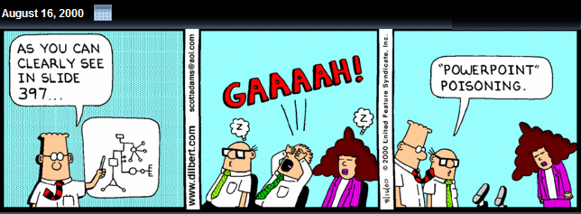
Dilbert, by Scott Adams
...and this is only slide number 44.

Slide 45
Quantitative Market Analysis
Competitor’s Market Share.
Future Market Projections.
Must include an embedded Excel chart
The "Four Ps of Marketing".
Note: you do not need to present a complete market analysis that covers all of these topics.
  You only have one slide for QMA.
  The above are ideas of the types of topics that could be covered on the QMA slide.

Slide 46
The "Four Ps of Marketing"
Product: Specifications of the actual goods or services, and how they relate to the end-user's needs and wants. The scope of a product includes warranties, and support (covered on slides 3 & 5).
Pricing: Refers to the process of setting a price for a product, including discounts.
Placement: Refers to how the product gets to the customer (online, retail, etc.). It could also refer to the geographic region, or the population segment (young adults, families, business people). How does the environment in which the product is sold affect sales.
Promotion: Includes advertising, sales promotion, publicity, personal selling, and branding.

Slide 47
Quiz 9-11: Four Ps of Marketing
What are the Four Ps of Marketing?
Paper, Pencils, Planes and Pajamas.
Parallel import, Penetration index, Perceived quality, and Pilot scheme.
Pilot shop, Pilot survey, Point of sale, and Potential market.
Power, Potential, People, and Perseverance.
Product, Pricing, Placement, and Promotion.
last slide ☺

Slide 48
Kronik Team Management
Logistics Coordinator & Warehousing
Distributor & Chain Stores Inquiries
Team Sponsorship Manager
  Wayne Wynns- Coordinator in the distribution channels for the use of manufacturing exporting and importing to efficiently improve inventory rotation requirements.
  Cliff Prausa- Head of product inquiries of stores and interconnect the product retailers to provide sufficient inventory.
  Noah Means- CEO of Kronik Sponorship, very goal orientated and motivates the company employees to market the product line.
FOR POWER!
Notes:
Gratuitous Slide to show PowerPoint Features

Slide 49
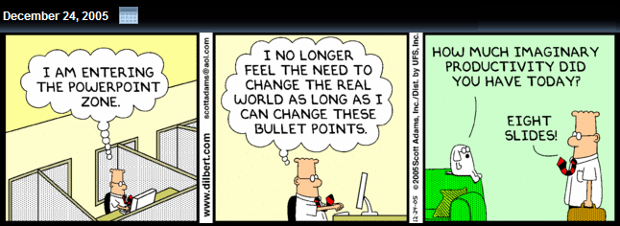
Dilbert, by Scott Adams

