Slide 1


On URL Changes and Handovers in Social Media
Hossein Hamooni
Nikan Chavoshi
Abdullah Mueen

Slide 2
Introduction
On social media sites, every account has a unique user ID that cannot be changed.
However, users can pick/change their screen name.
Changing the screen name affects the user’s page URL.
URL Change
TomHanks
www.twitter.com/TomHanks
T_Hanks
www.twitter.com/T_Hanks
Changing a URL can affect the external links, mentions, etc.

Slide 3
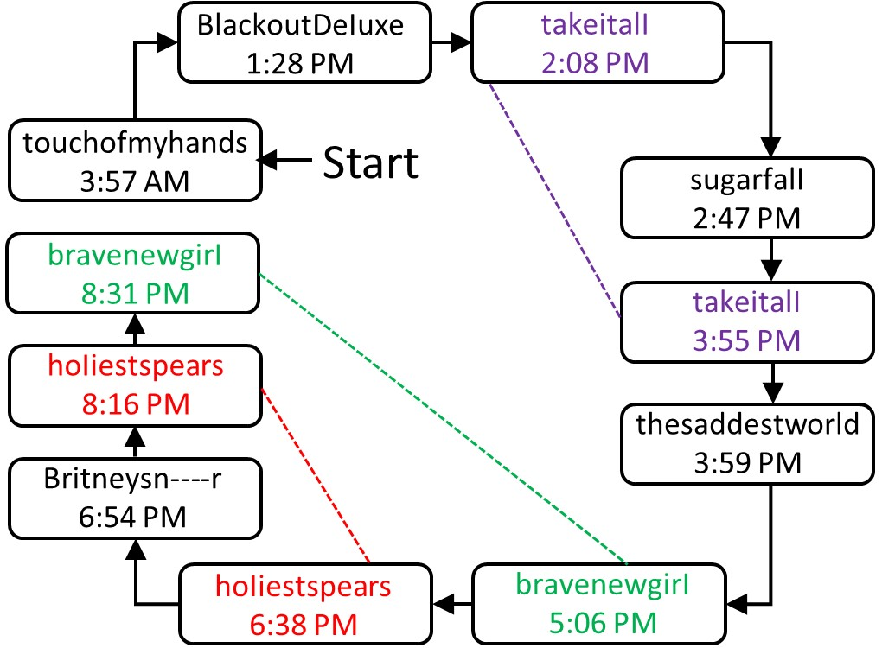
Chain of URL Changes

Slide 4
URL Handover
User1:
  www.twitter.com/TomHanks → www.twitter.com/T_Hanks
User2:
  www.twitter.com/hossein → www.twitter.com/TomHanks
  URL Handover
  www.twitter.com/TomHanks
  User1: “From” user
  User2: “To” user

Slide 5
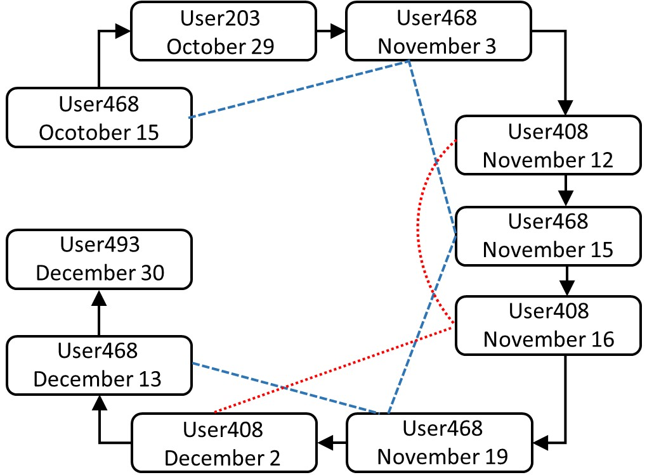
Chain of URL Handover
www.twitter.com/paradisecameron

Slide 6
URL Handovers are suspicious
Number of possible Twitter names: 15²⁶
Number of Twitter Users: 320 million
10⁻²² of possible names are taken
URL handover does not happen randomly (probability is close to zero)
Our goal is to detect the URL handovers

Slide 7
Data Collection
From 15 October 2015 to 31 December 2015.
# tweets | 130M
# users | 5.7M
# URLs | 6M

Slide 8
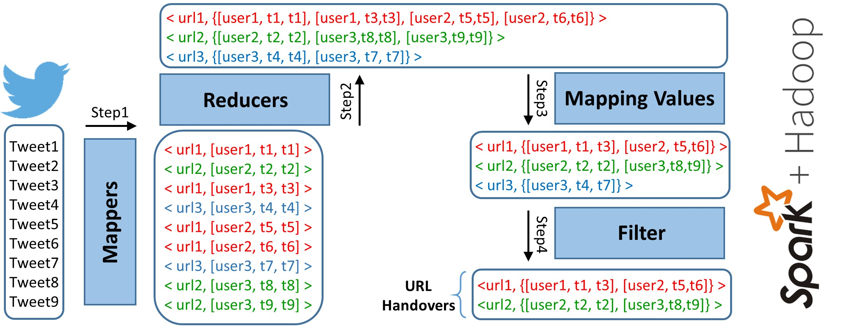
MapReduce Framework
Notes:
No false positives
No false negatives

Slide 9
Results
# users with URL change | 232K
# URL handovers | 14K
# users involved in handover | 21K
# URLs involved in handover | 12K

Slide 10
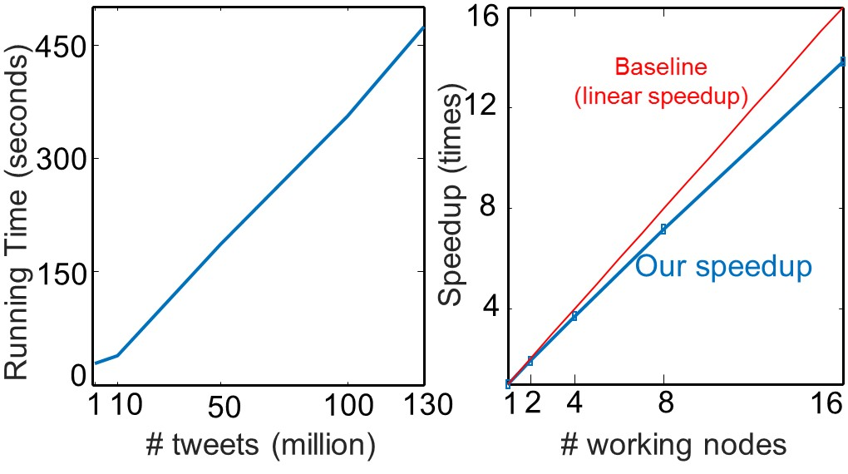
Scalability

Slide 11
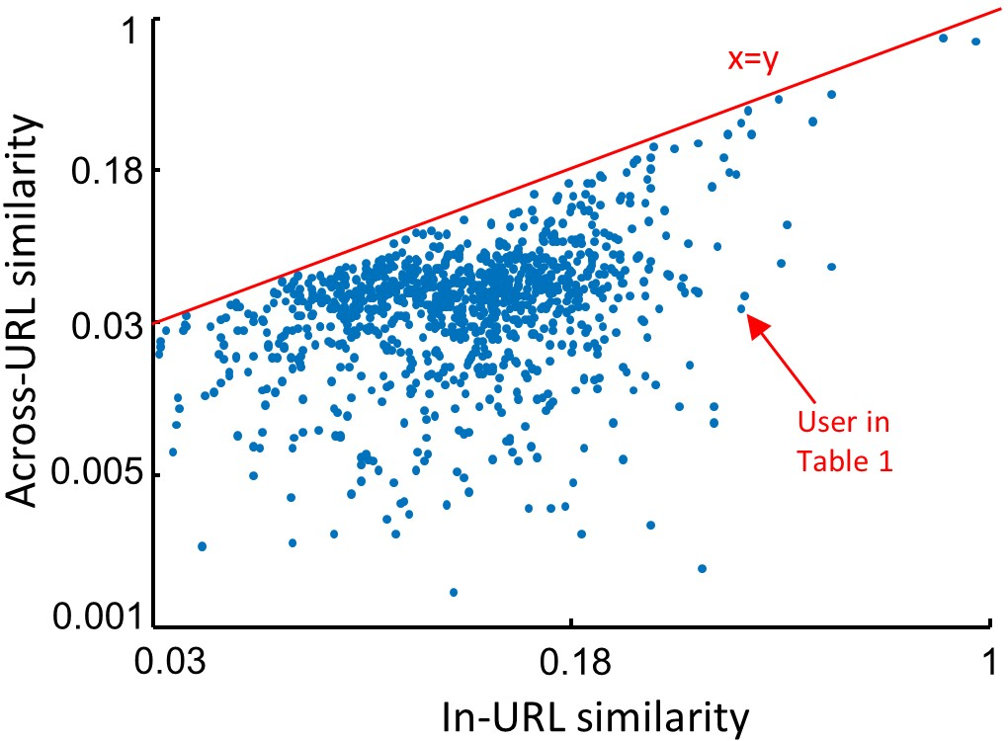
Content Association
Content of tweets changes by changing the URL
Notes:
1051 handover users
with exactly 2 URLs
More than 5 tweets on each URL

Slide 12
Content Association Example
www.twitter.com/zflexins | www.twitter.com/loveyorslf
RT @justinbieber:UK! Tonight on @CapitalOfficial from 7pm ’Justin Bieber’s Capital Album Party Replay’. Hear the tracks from #Purpose | harry styles coisa mais linda gente!!!
RT @JBCrewdotcom: Another photo of Justin Bieber with a fan at the M&G in Tokyo, Japan yesterday. (December 4) https://t.co/ofAYAjzP1M | harry s,tao precioso gente como vcs nao gostam dele???????? https://t.co/o0x2DG38JI
RT @JBCrewdotcom: Another video of Justin Bieber singing at a restaurant in Japan today. (December 5) https://t.co/jZqaMaezrO | vou tweetar video de harry stylesN
RT @favjarbara: interviewer: what do you think about Justin bieber’s relationships?bp: hahaha he’s mine | harry w kendall eu to gRITANDO AQUI, OPSSS https://t.co/MURzVWnc0Q
RT @NME: Justin Bieber announces UK Arena tour dates for 2016 https://t.co/ECsRUqEPxk | @KendallJBrasil: 31/12- Mais fotos de Kendall e Harry Styles em St. Barts, Frana. https://t.co/CytM8Hixk
Notes:
1051 handover users
with exactly 2 URLs
More than 5 tweets on each URL

Slide 13
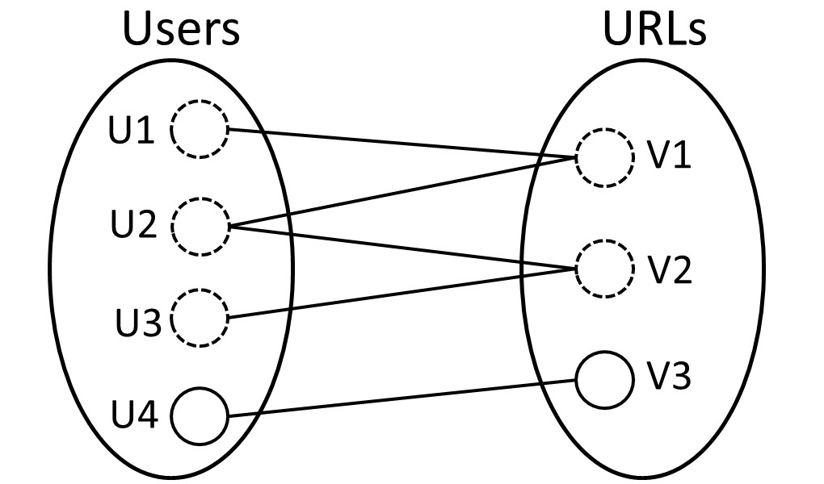
Connectivity Profile
Biggest Connected Component:
  2,273 nodes
  1,205 users
  1.068 URLs
  2,399 edges
Notes:
31% od users are in clusters with more than 3 nodes

Slide 14
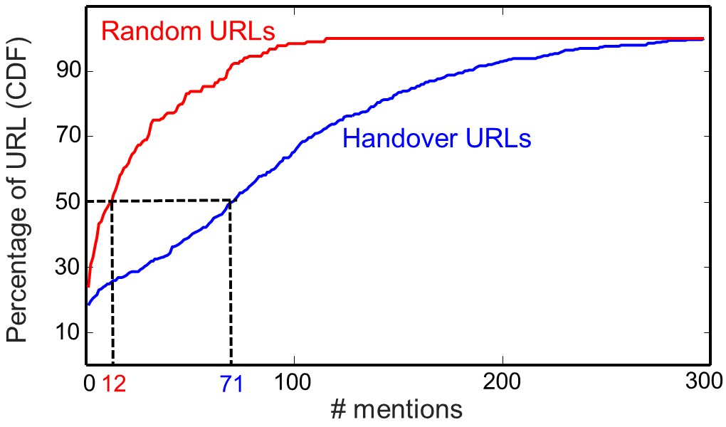
Mention and External URLs
Handover URLs have higher number of mentions
Notes:
Search GUI
First 15 pages
1000 random URLs
1000 handover URLs

Slide 15
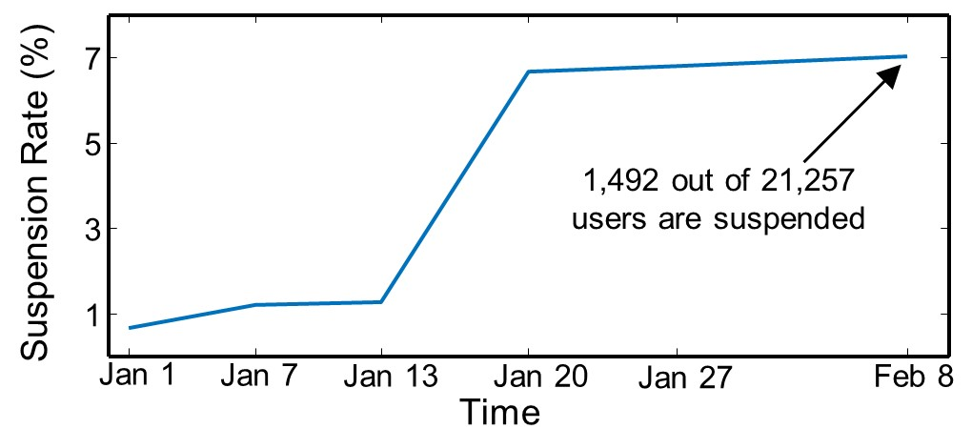
Twitter Suspension

Slide 16
Conclusion
We introduced the URL handover problem for the first time.
Our method is fast, distributed, and scalable.
We explain how and why the users are doing the URL handover.
We have enough evidence for our findings.
Social media sites can use our method to detect suspicious accounts.

Slide 17


Slide 18
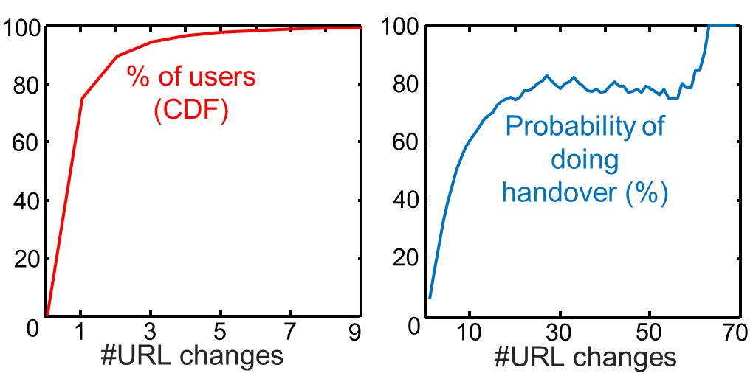
URL Change Analysis

Slide 19
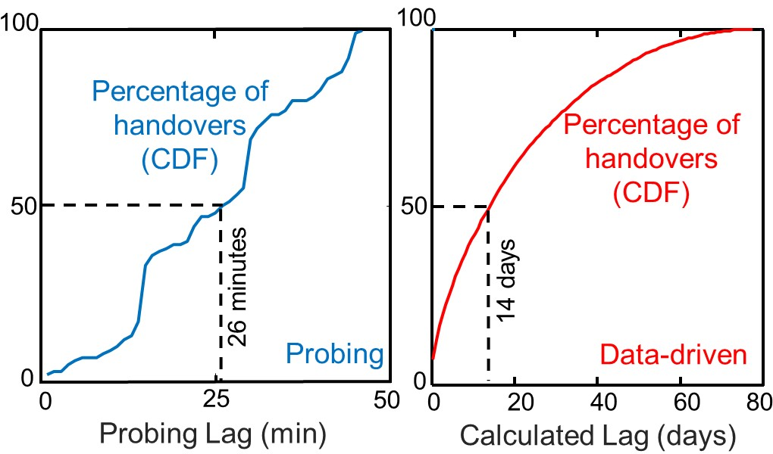
Lag Profile

Slide 20
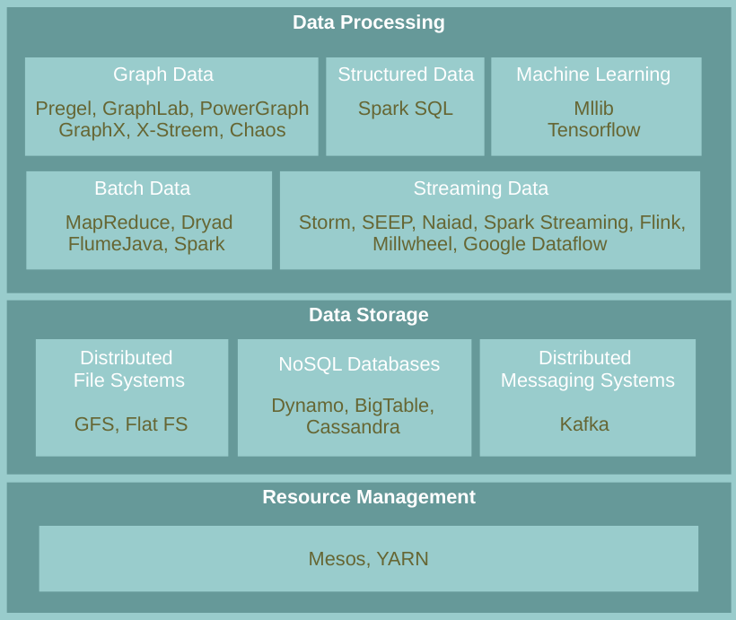
Distributed Computing

Slide 21
Goals
The log analyzer should be:
  Highly scalable for big data
  For heterogeneous log formats
  Purely data oriented
  Able to support efficient information retrieval
  Extensible to arbitrary application

Slide 22
MapReduce Clustering of Logs
Cluster1
LOG5
LOG7
LOG9
LOG1
LOG4
Cluster1
Cluster2
LOG2
LOG3
LOG6
LOG8
LOG10
LOG11
Cluster2
Merge
Cluster1
LOG5
LOG7
LOG9
Cluster2
LOG2
LOG3
LOG6
LOG8
Cluster3
LOG1
LOG4
LOG10
LOG11

Slide 23
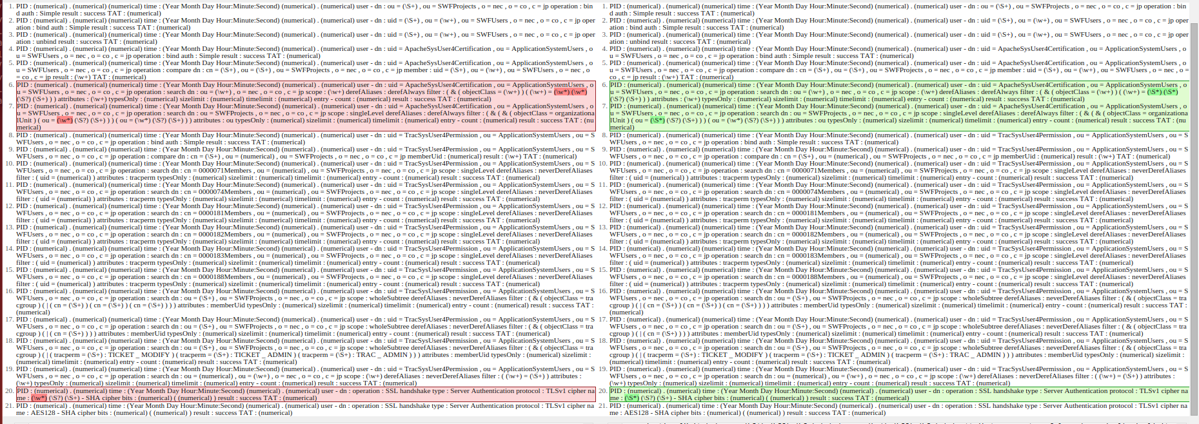
Fast Pattern Recognition
With order
50 seconds
Without order
1.1 seconds

Slide 24
LogMine Steps
Starts with a small epsilon
    It gives us precise patterns
Iteratively merges precise patterns to find more general ones
Outputs the best level of hierarchy based on a cost function

Slide 25
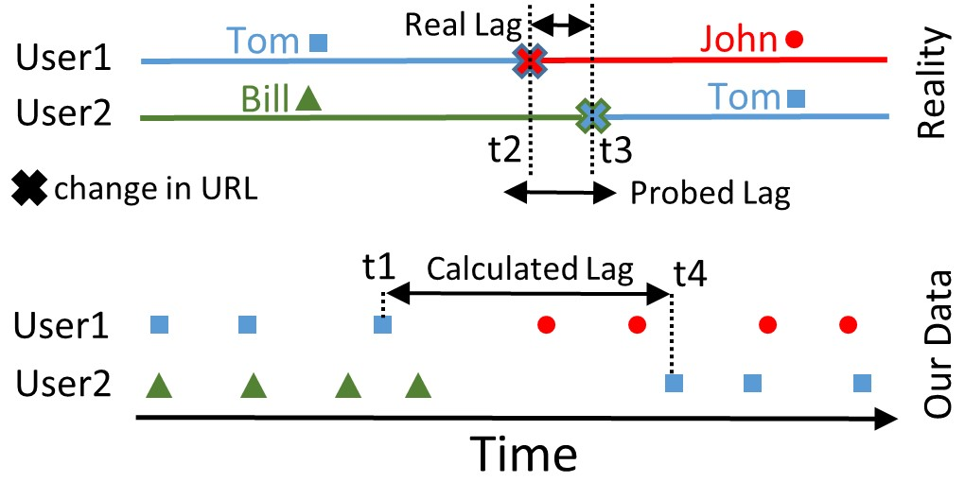
Handover Lag

Slide 26
MapReduce Prog. Model
Map:
  Input: Raw data
  Output: A set of intermediate (key,value) pairs
MR library groups all intermediate values with the same intermediate key and passes them to the Reduce function.
Reduce:
  Input: An intermediate key and all its intermediate values
  Output: (key, Merged value)

Slide 27
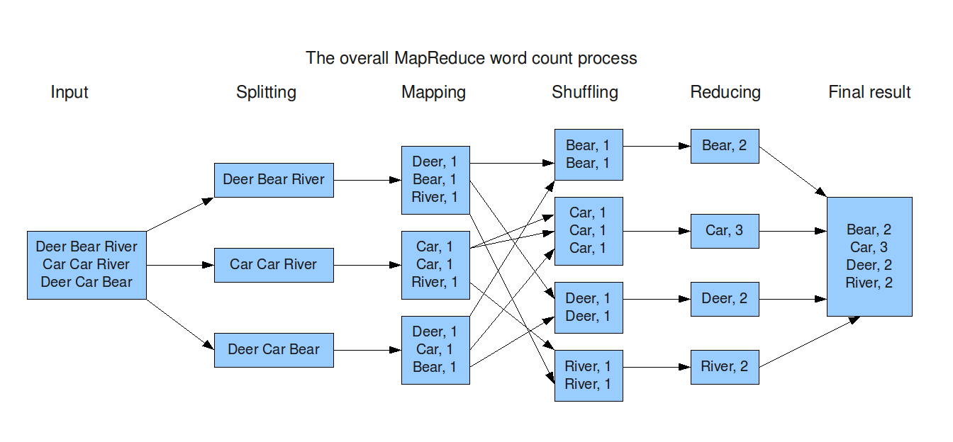
Word Count Example

Slide 28
Fast Clustering of Logs
LOG
LOG1
LOG2
LOG3
LOG4
LOG5
LOG6
LOG7
LOG8
LOG9
Max Distance = 0.01
Dist (LOG4 , LOG 1) = 0
LOG1
LOG4
LOG2
LOG3

Slide 29
Fast Clustering of Logs
LOG
LOG1
LOG2
LOG3
LOG4
LOG5
LOG6
LOG7
LOG8
LOG9
Max Distance = 0.01
Dist (LOG5 , LOG 1) = 0.2
Dist (LOG5 , LOG 2) = 0.5
LOG1
LOG4
LOG2
LOG3
LOG5

Slide 30
Fast Clustering of Logs
LOG
LOG1
LOG2
LOG3
LOG4
LOG5
LOG6
LOG7
LOG8
LOG9
Max Distance = 0.01
Dist (LOG6 , LOG 1) = 0.3
Dist (LOG6 , LOG 2) = 0.001
LOG1
LOG4
LOG2
LOG3
LOG6
LOG5

Slide 31
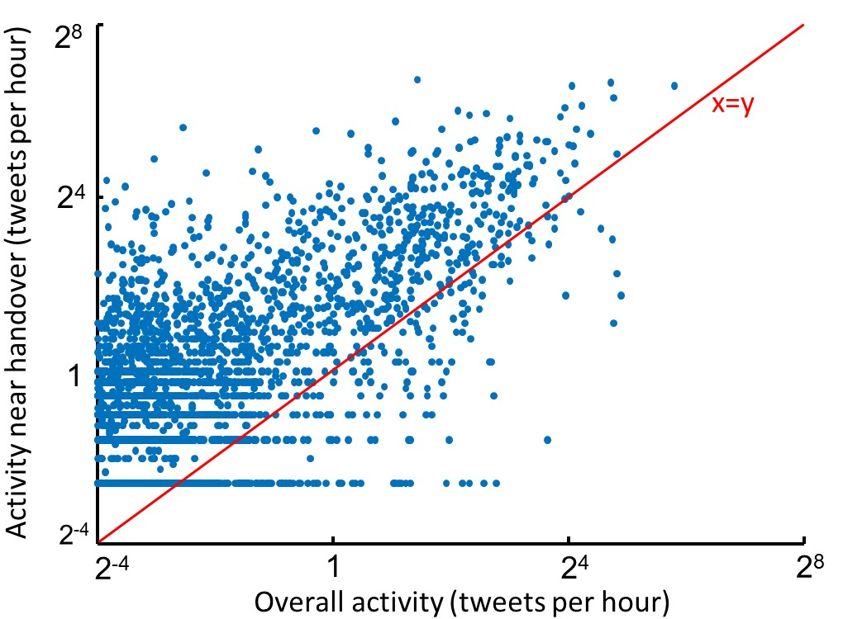
Activity Association
97.4% of points are above the line

