Slide 1



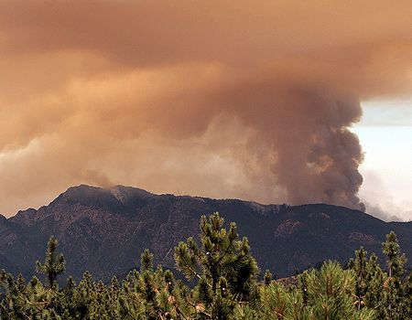
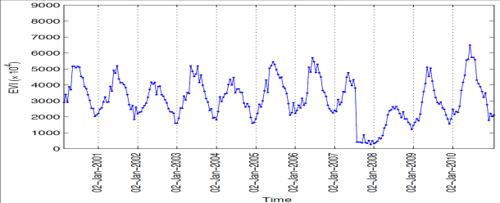
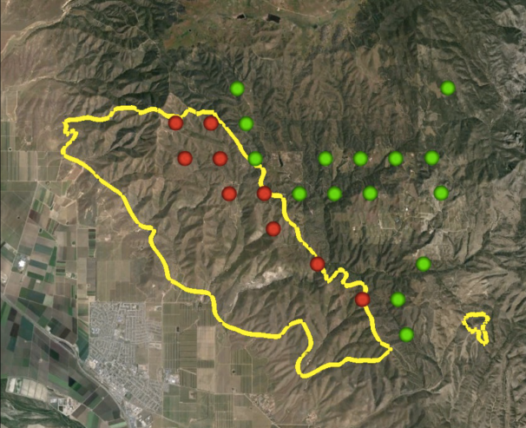

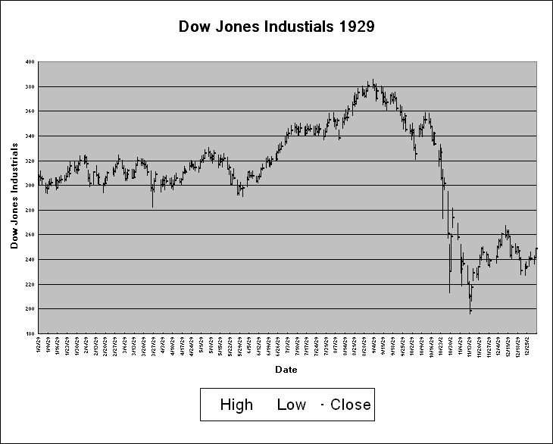
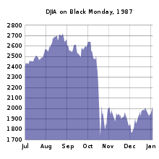
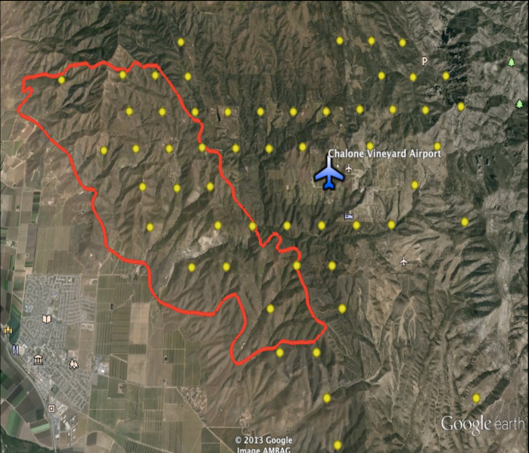
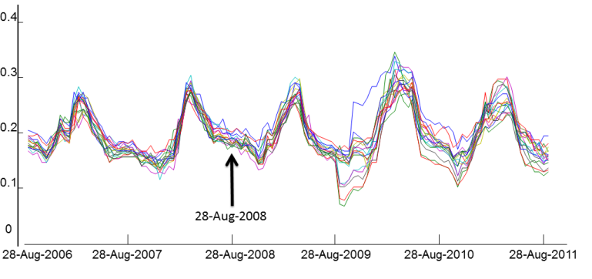
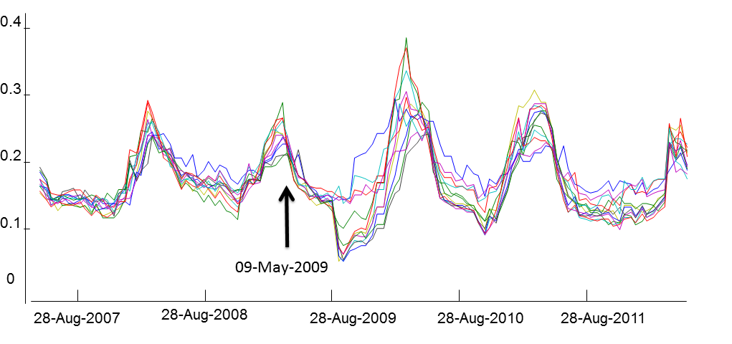
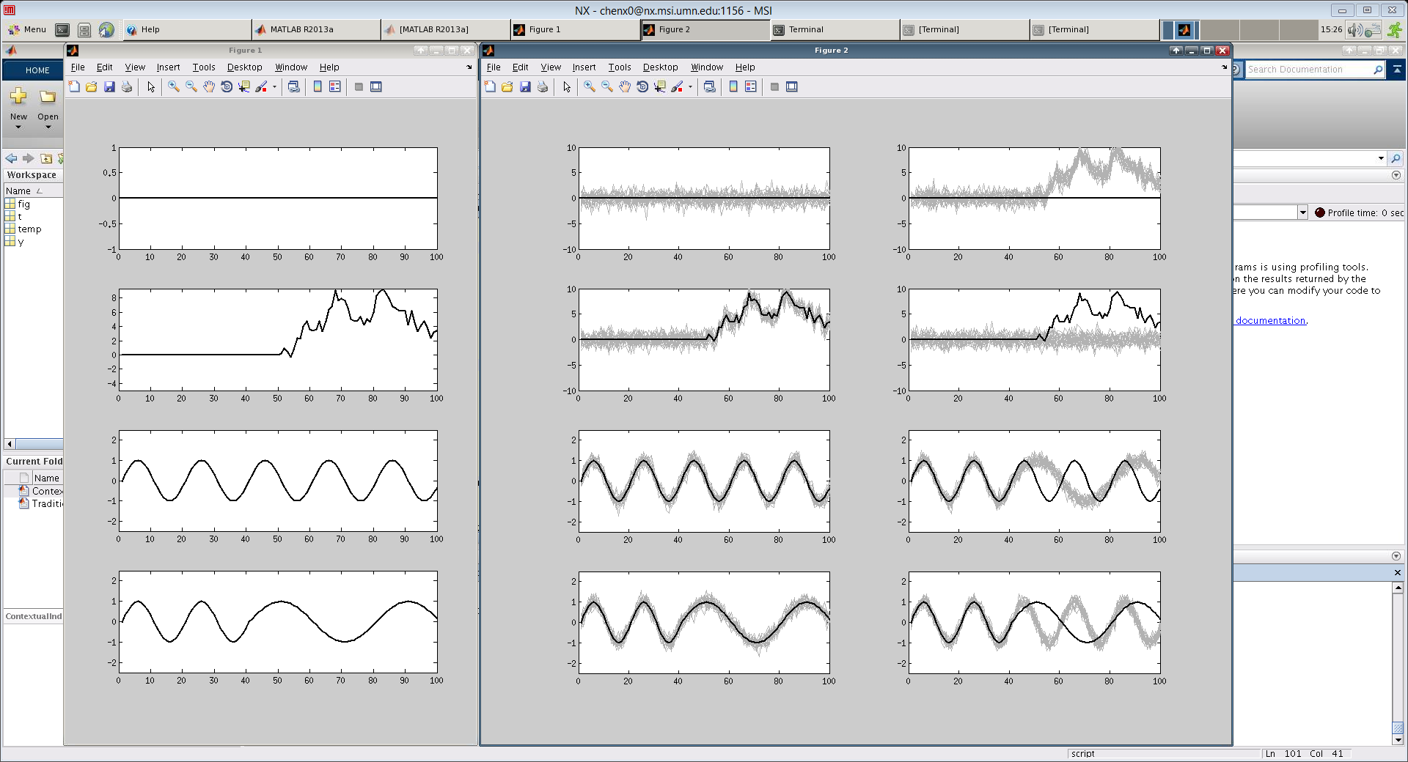
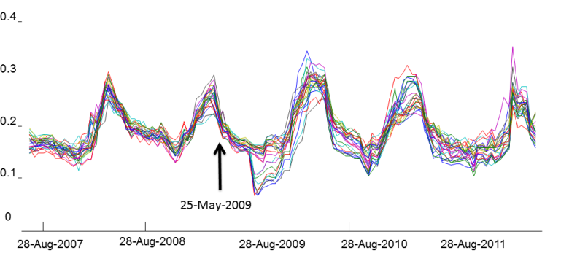
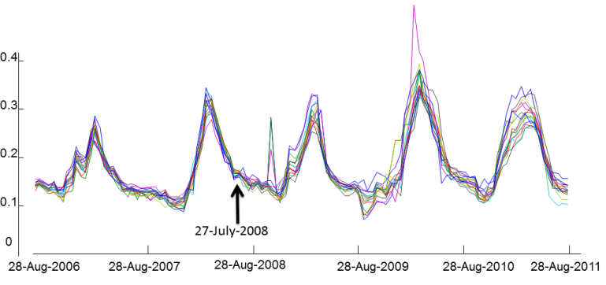
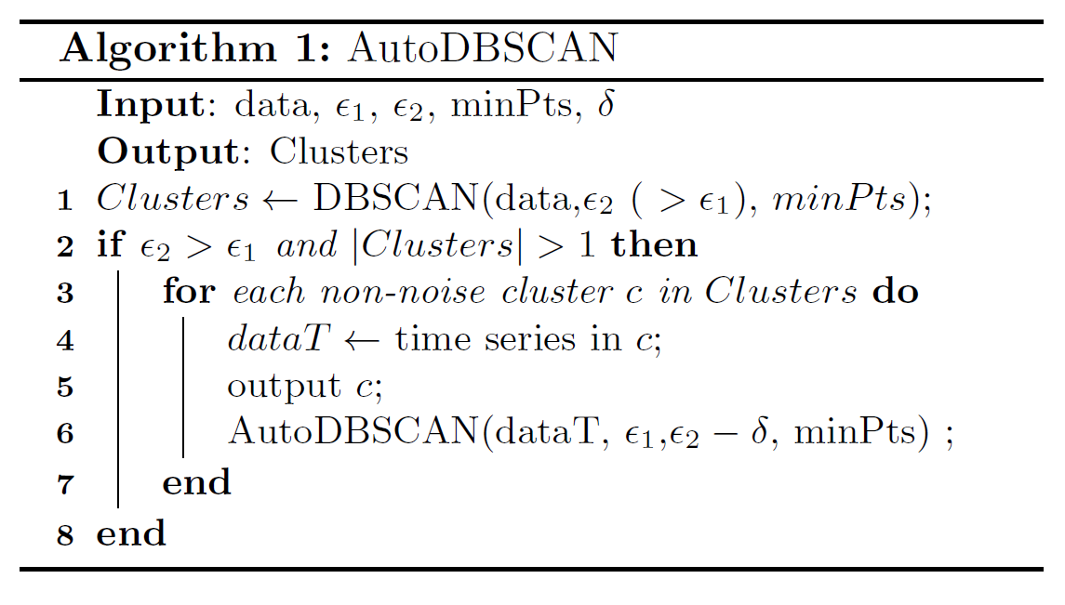
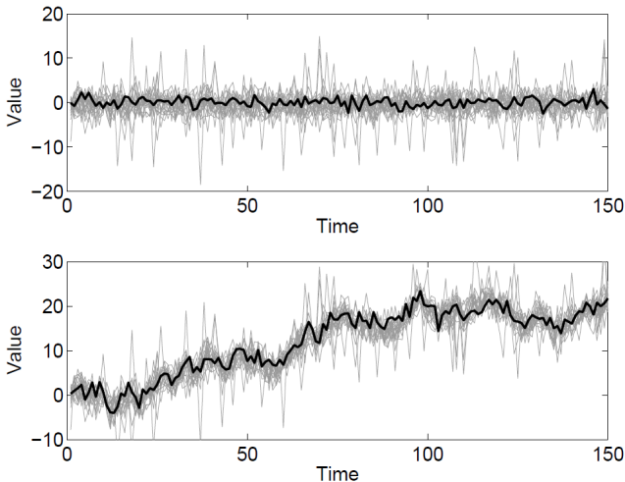
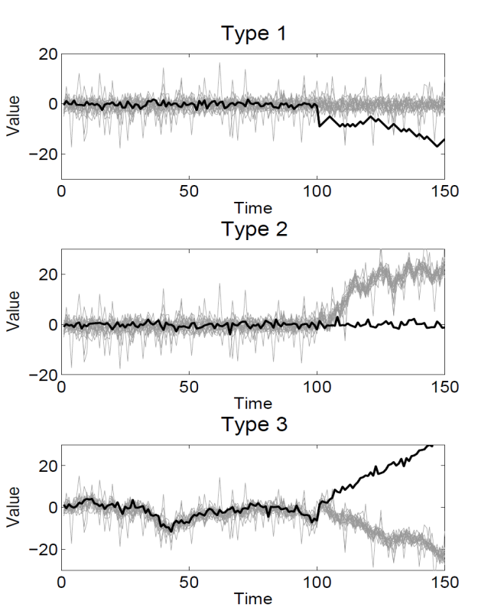



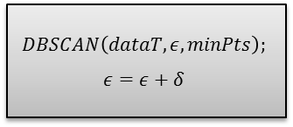
Online Discovery of Group Level Events in Time Series
Xi C. Chen
chen@cs.umn.edu
Computer Science & Engineering
University of Minnesota
Abdullah Mueen
mueen@cs.unm.edu
Computer Science & Engineering
University of Minnesota
Vijay K Narayanan
vkn@microsoft.com
Cloud and Information Services Lab
Microsoft Corporation
Nikos Karampatziakis
nikosk @microsoft.com
Cloud and Information Services Lab
Microsoft Corporation
Gagan Bansal
Gagan.Bansal@microsoft.com
Cloud and Information Services Lab
Microsoft Corporation
Vipin Kumar
kumar@cs.umn.edu
Computer Science & Engineering
University of Minnesota
Real world events in time series
Changes in time series (Continued): group level contextual events
Experimental results
Real world events can be observed in time series.
Group level contextual event
5
15
The date of the forest fire
Vegetation index dataset
A region in California that is bounded by 36.5⁰N, 35.9 ⁰ N, 121.2 ⁰ W and 122 ⁰ W and contains 3345 grid cells.
We have run our algorithm for a window of two years (46 time steps) on this dataset to find historical contextual changes.
Twenty-five group disbanding events were detected for the period Aug 2008 - May 2011.
Forest Fire
EVI (the shown time series) is an indicator of “greenness" of the earth's surface. When fire occurred, EVI would drop significantly due to the drastic changes in the greenness of the area.
Group Disbanding (Top panel):
  Detecting the time when one group of time series disbands into two or more subgroups.
Group Formation (Bottom panel):
  Detecting the time when two or more groups of time series merges into a single larger group
0
10
0.35
-5
5
0
-10
-5
0.25
-15
-10
Disbanding
-20
-15
0.15
The Dow fell 22.61% on Black Monday (1987) from about the 2,500 level to around 1,750. Two days later, it rose 10.15% above the 2,000 level for a mild recovery attempt.
5
0
10
20
30
40
50
60
70
80
90
100
-20
0
10
20
30
40
50
60
70
80
90
100
20
0.05
Fig. (a) shows all the locations that belong to one of the disbanding events around the area shown. Fig. (b) - (e) show four of these group disbanding events. In each of these events, EVI time series that show similar patterns over two years are grouped together and then they split into roughly two groups around Aug 2009, when the patch bounded within the red line was burned. The algorithm reports that all the events occurred during the time window within the two arrows.
0
15
25-May-2007
25-May-2008
25-May-2009
25-May-2010
25-May-2011
25-May-2012
10
-5
5
Figure: A set of EVI time series which disbands in August 2009 because of forest fire. Such disbanding pattern is useful to detect events from time series datasets. Red and green points show the time series of points inside (marked as the red locations) and outside (marked as the green locations) the fire a affected region, respectively.
Significant drop during the Great Depression
-10
0
-5
-10
-15
Formation
Changes in time series
-20
-15
0
10
20
30
40
50
60
70
80
90
100
-20
0
10
20
30
40
50
60
70
80
90
100
Traditional changes in time series
Assume that auto-correlation of a time series should be preserved when no changes happen.
Most algorithms detect breaking points where predeﬁned statistics (e.g., mean and variance) change.
  CUSUM considers the mean of an unchanged time series to be stable and hence it searches for breaking points when the mean shifts.
  BIFAST assume that values in a time series are periodically generated from a certain model. Therefore, it detects the change point when the coefﬁcients of the models change.
Proposed framework
(a)
No
New data obtained?
Yes
AutoDBScan
As new observations are collected, the method performs three steps:
AutoDBScan to group similar time series.
Similarity aware entropy to score group formation/disbanding events
Threshold based method to report Group formation/disbanding detection results
Unchanged
Calculate similarity aware entropy
(b)
(c)
Changed
Report events
(d)
(e)
AutoDBSCAN
More efficient
Similarity-aware entropy
Stock price data
5825 time series of the daily closing price of different stock tickers starting from April, 1996 till July, 2013 in the NYSE.
We have run our algorithm for a window of 60 business days on this dataset to find historical contextual changes of stock tickers.
Contextual changes in time series
Events that change cross-correlation.
There are two types of contextual changes.
  Singleton contextual changes
    Group level contextual changes.
$$ε=ε_{1}$$
Consider a set $𝒳=\{x_{1}, x_{2}, …,x_{m}\}$ that contains m time series. Then, its similarity-aware entropy score S during time period t is
$$S\left(𝒳,t\right)=−\sum_{j=1}^{m}{\frac{1}{m}\log{(\sum_{i=1}^{m}{\frac{\exp\left(−d\left(x_{i},x_{j},t\right)\right)}{m}})}}$$
Where, $d\left(x_{i},x_{j},t\right)$ is the dissimilarity metric between time series $x_{i}$ and $x_{j}$ during time t.
Advantages compared with traditional entropy:
Traditional entropy requires assigning the time series to a unique group ID while similarity-aware entropy does not.
The traditional entropy score only considers cluster membership but is not aware of the distance among clusters. While, similarity-aware entropy provides higher score when the distance among different clusters is larger.
Same results as
$$ε<ε_{2}$$
No
Stop
10
EXR
8
SSS
Yes
6
EQY
TCO
4
KRC
$$DBSCAN\left(dataT, ε, minPts\right);$$
$$ε=ε+δ$$
MAC
2
HIW
Singleton contextual event ^{[1]}
CPT
Changed
0
CLP
ESS
Unchanged
AVB
-2
BRE
Scalable DBSCAN
-4
Indexing-technique
  Order the time series dataset based on a reference time series.
  Reduce search space based on the properties of the ordered dataset.
Iterative-technique
  Reduce time of distance calculation by using the results from previously time step.
-6
05-Jun-2012
2.5
x 10
7
Both panels show 10 time series that belong to the same cluster before the current observation. Assuming that a clustering method discovers 2 clusters in both, event scores based on entropy are identical in the two scenario. While, similarity-aware entropy scores (b) higher than (a). In many scenarios, we believe the event in panel (b) is more significant compared with the event shown in panel (a).
-8
Naive
-10
0
20
40
60
80
100
120
140
160
180
Indexing
Days
2
Indexing+Iterative distance
A disbanding event detected from the stock price data. All tickers in this group are REITs ((Real Estate Investment Trust). Two of the tickers significantly rise after June 2012 while, others remain within the context and show stability for more
than six months after the event.
The two rising time series are stock tickers from two self-service storage companies (EXR and SSS). The others are real estate companies in different parts of US and none of them does self-service storage business as per google finance.
The event started at June 2012 that is the usual time of the year for publishing the quarterly/annual financial reports.
1.5
running time in (Millisecond)
[1]. Xi C. Chen, Karsten Steinhaeuser, Shyam Boriah, Snigdhansu Chatterjee, and Vipin Kumar: Contextual Time Series Change Detection. SDM 2013: 503-511
1
0.5
The running time of the original DBSCAN implementation and the two optimized implementations. We see a speedup of up to 57× over the original implementation, which enabled us to search over more land area as well as larger correlation window in the experiments using EVI data.
0
0
0.5
1
1.5
2
2.5
3
3.5
4
4.5
5
(a)
(b)
Number of time series
x 10
4
Acknowledgement: Part of this work was done when the first author was an intern in the Cloud & Information Services Lab in Microsoft. It was supported in part by the National Science Foundation under Grants IIS-1029711 and IIS-0905581, as well as the Planetary Skin Institute. Access to computing facilities was provided by the University of Minnesota Supercomputing Institute.

