Slide 1
Induction and recursion
Chapter 5
With Question/Answer Animations
Copyright © McGraw-Hill Education. All rights reserved. No reproduction or distribution without the prior written consent of McGraw-Hill Education.

Slide 2
Chapter Summary
Weak Induction
Strong Induction
Recursive Definitions
Structural Induction
Recursive Algorithms

Slide 3
Mathematical Induction
Section 5.1

Slide 4
Section Summary
Mathematical Induction
Examples of Proof by Mathematical Induction
Mistaken Proofs by Mathematical Induction
Guidelines for Proofs by Mathematical Induction

Slide 5
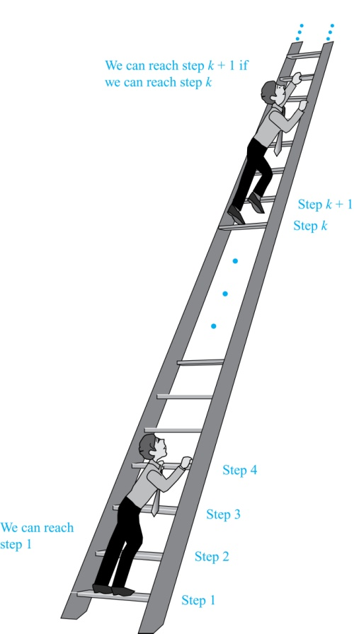
Climbing an
Infinite Ladder
Suppose we have an infinite ladder:
We can reach the first rung of the ladder.
If we can reach a particular rung of the ladder, then we can reach the next rung.
From (1), we can reach the first rung. Then by applying (2), we can reach the second rung. Applying (2) again, the third rung. And so on. We can apply (2) any number of times to reach any particular rung, no matter how high up.
This example motivates proof by mathematical induction.

Slide 6
Principle of Mathematical Induction
Principle of Mathematical Induction: To prove that P(n) is true for all positive integers n, we complete these steps:
  Base Case: Show that P(1) is true.
  INDUCTIVE STEP: Show that P(k-1) → P(k) is true for all positive integers k.
To complete the INDUCTIVE STEP, assuming the inductive hypothesis that P(k-1) holds for an arbitrary integer k, show that must P(k) be true.
Climbing an Infinite Ladder Example:
  BASE CASE: By (1), we can reach rung 1.
  INDUCTIVE STEP: Assume the inductive hypothesis that we can reach rung k-1. Then by (2), we can reach rung k.
Hence, P(k-1) → P(k) is true for all positive integers k. We can reach every rung on the ladder.

Slide 7
Important Points About Using Mathematical Induction
Mathematical induction can be expressed as the rule of inference
where the domain is the set of positive integers.
In a proof by mathematical induction, we don’t assume that P(k-1) is true for all positive integers! We show that if we assume that P(k-1) is true, then P(k) must also be true.
Proofs by mathematical induction do not always start at the integer 1. In such a case, the base case begins at a starting point b where b is an integer.
(P(1) ∧ ∀k (P(k-1) → P(k))) → ∀n >=1 P(n),

Slide 8
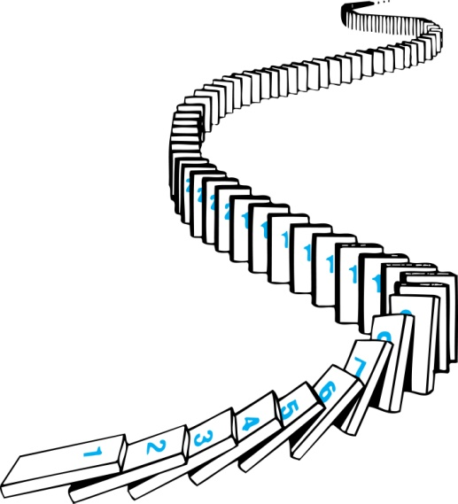
Remembering How Mathematical Induction Works
Consider an infinite sequence of dominoes, labeled 1,2,3, …, where each domino is standing.
We know that the first domino is knocked down, i.e., P(1) is true .
We also know that if whenever the kth domino is knocked over, it knocks over the k-th domino, i.e, P(k-1) → P(k) is true for all positive integers k.
Let P(n) be the proposition that the nth domino is knocked over.
Hence, all dominos are knocked over.
P(n) is true for all positive integers n.

Slide 9
Proving a Summation Formula by Mathematical Induction
Note: Once we have this conjecture, mathematical induction can be used to prove it correct.
Example: Show that:
Solution:
  BASE CASE: P(1) is true since 1(1 + 1)/2 = 1.
  INDUCTIVE STEP: Assume true for P(k - 1).
The inductive hypothesis is
Under this assumption,
By IH!

Slide 10
Conjecturing and Proving Correct a Summation Formula
Example: Conjecture and prove correct a formula for the sum of the first n positive odd integers. Then prove your conjecture.
Solution: We have: 1= 1, 1 + 3 = 4, 1 + 3 + 5 = 9, 1 + 3 + 5 + 7 = 16, 1 + 3 + 5 + 7 + 9 = 25.
  We can conjecture that the sum of the first n positive odd integers is n²,
  We prove the conjecture is proved correct with mathematical induction.
  BASE CASE: P(1) is true since 1² = 1.
  INDUCTIVE STEP: P(k-1) → P(k) for every positive integer k.
Assume the inductive hypothesis holds and then show that P(k) holds has well.
  So, assuming P(k-1), it follows that:
  Hence, we have shown that P(k) follows from P(k − 1). Therefore the sum of the first n positive odd integers is n².
1 + 3 + 5 + ∙∙∙+ (2n − 1) = n² .
Inductive Hypothesis: 1 + 3 + 5 + ∙∙∙ + (2k − 3) =(k − 1 )²
1 + 3 + 5 + ∙∙∙+ (2k − 3) + (2k − 1) =[1 + 3 + 5 + ∙∙∙+ (2k − 3)] + (2k − 1)
= (k − 1)² + (2k − 1)(by IH)
= k² - 2k + 1 + (2k − 1)
= k ²

Slide 11
Proving Inequalities
Example: Use mathematical induction to prove that n < 2^{n} for all positive integers n.
Solution: Let P(n) be the proposition that n < 2^{n}.
  BASE CASE: P(1) is true since 1 < 2¹ = 2.
  INDUCTIVE STEP: Assume P(k - 1) holds, i.e., k - 1 < 2^{k-1}, for an arbitrary positive integer k.
  Must show that P(k) holds:
  k = (k - 1) + 1
  < 2^{k-1} + 1
  ≤ 2^{k-1} + 2^{k-1} = 2 ∙ 2^{k-1} = 2^{k}
By IH

Slide 12
Proving Inequalities
Example: Use mathematical induction to prove that 2^{n} < n!, for every integer n ≥ 4.
Solution: Let P(n) be the proposition that 2^{n} < n!.
  BASE CASE: P(4) is true since 2⁴ = 16 < 4! = 24.
  INDUCTIVE STEP: [In Class!]
Note that here the BASE CASE is P(4), since P(0), P(1), P(2), and P(3) are all false.

Slide 13
Proving Divisibility Results
Example: Use mathematical induction to prove that n³ − n is divisible by 3, for every positive integer n.
BC: 3 | 1 – 1 = 0.
IH: 3 | (j – 1)³ − (j – 1)
IS: j³ − j = (j – 1)³ − (j – 1) + 3j² − 3j
= 3x+ 3j² − 3j
Since j³ − j = 3y, for some integer y, we know 3 | j³ − j
BY IH, (j – 1)³ − (j – 1) = 3x,
for some integer x

Slide 14
Number of Subsets of a Finite Set
Example: Use mathematical induction to show that if S is a finite set with n elements, where n is a nonnegative integer, then S has 2^{n} subsets.
(Chapter 6 uses combinatorial methods to prove this result.)
Solution: Let P(n) be the proposition that a set with n elements has 2^{n} subsets.
  BASE CASE: P(0) is true, because the empty set has only itself as a subset and 2⁰ = 1.
  INDUCTIVE STEP: Assume P(k- 1) is true for an arbitrary nonnegative integer k.
continued →

Slide 15
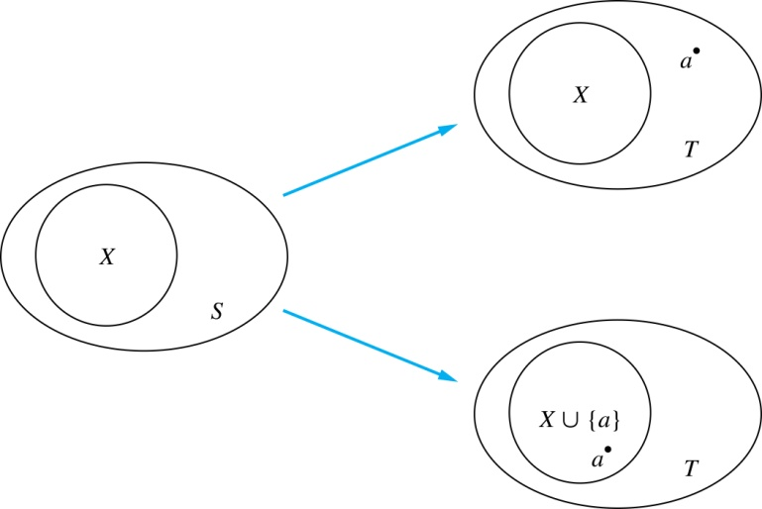
Number of Subsets of a Finite Set
Inductive Hypothesis: For an arbitrary nonnegative integer k - 1, every set with k - 1 elements has 2^{k - 1} subsets.
    Let T be a set with k elements. Then T = S ∪ {a}, where a ∈ T and S = T − {a}. Hence |S| = k - 1.
    For each subset X of S, there are exactly two subsets of T, i.e., X and X ∪ {a}.
    By the inductive hypothesis S has 2^{k - 1} subsets. Since there are two subsets of T for each subset of S, the number of subsets of T is 2 ∙2^{k - 1} = 2^{k} .

Slide 16


Tiling Checkerboards
Example: Show that every 2^{n} ×2^{n} checkerboard with one square removed can be tiled using right triominoes.
Solution: Let P(n) be the proposition that every 2^{n} ×2^{n} checkerboard with one square removed can be tiled using right triominoes. Use mathematical induction to prove that P(n) is true for all positive integers n.
  BASE CASE: P(1) is true, because each of the four 2 ×2 checkerboards with one square removed can be tiled using one right triomino.
  INDUCTIVE STEP: Assume that P(k - 1) is true for every 2^{k-1} ×2^{k-1} checkerboard, for some positive integer k - 1.
A right triomino is an L-shaped tile which covers three squares at a time.
continued →

Slide 17
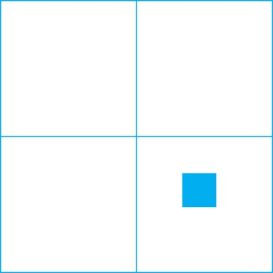

Tiling Checkerboards
    Consider a 2^{k} ×2^{k} checkerboard with one square removed. Split this checkerboard into four checkerboards of size 2^{k-1} ×2^{k-1},by dividing it in half in both directions.
    Remove a square from one of the four 2^{k-1} ×2^{k-1} checkerboards. By the inductive hypothesis, this board can be tiled. Also by the inductive hypothesis, the other three boards can be tiled with the square from the corner of the center of the original board removed. We can then cover the three adjacent squares with a triominoe.
    Hence, the entire 2^{k} ×2^{k} checkerboard with one square removed can be tiled using right triominoes.
Inductive Hypothesis: Every 2^{k-1} ×2^{k-1} checkerboard, for some positive integer k, with one square removed can be tiled using right triominoes.

Slide 18
Strong Induction and Well-Ordering
Section 5.2

Slide 19
Section Summary
Strong Induction
Example Proofs using Strong Induction

Slide 20
Strong Induction
Strong Induction: To prove that P(n) is true for all positive integers n, where P(n) is a propositional function, complete two steps:
  BASE CASE: Verify that the proposition P(1) is true.
  INDUCTIVE STEP: Show the conditional statement [P(1) ∧ P(2) ∧∙∙∙ ∧ P(k - 1)] → P(k) holds for all positive integers k.
Strong Induction is sometimes called the second principle of mathematical induction or complete induction.

Slide 21
Strong Induction and the Infinite Ladder
Strong induction tells us that we can reach all rungs if:
We can reach the first rung of the ladder.
For every integer k, if we can reach the first k - 1 rungs, then we can reach the k-th rung.
To conclude that we can reach every rung by strong induction:
BASE CASE: P(1) holds
INDUCTIVE STEP: Assume P(1) ∧ P(2) ∧∙∙∙ ∧ P(k - 1)
holds for an arbitrary integer k, and show that
P(k) must also hold.
We will have then shown by strong induction that for every positive integer n, P(n) holds, i.e., we can
reach the nth rung of the ladder.

Slide 22
Which Form of Induction Should Be Used?
We can always use strong induction instead of mathematical induction.
I usually approach a problem with the idea of using strong induction, since it is the more powerful tool.
However, for simple problems, weak induction is enough.

Slide 23
Completion of the proof of the Fundamental Theorem of Arithmetic
Example: Show that if n is an integer greater than 1, then n can be written as the product of primes.
Solution: Let P(n) be the proposition that n can be written as a product of primes.
  BASE CASE: P(2) is true since 2 itself is prime.
  INDUCTIVE STEP: The inductive hypothesis is P(j) is true for all integers j with 2 ≤ j < k. To show that P(k) must be true under this assumption, two cases need to be considered:
    If k is prime, then P(k) is true.
    Otherwise, k is composite and can be written as the product of two positive integers a and b with 2 ≤ a ≤ b < k. By the inductive hypothesis a and b can be written as the product of primes and therefore k can also be written as the product of those primes.
Hence, it has been shown that every integer greater than 1 can be written as the product of primes.
(uniqueness proved in Section 4.3)

Slide 24
Proof using Strong Induction
Example: Prove that every amount of postage of 12 cents or more can be formed using just 4-cent and 5-cent stamps.
Solution: Let P(n) be the proposition that postage of n cents can be formed using 4-cent and 5-cent stamps.
  BASE CASE: P(12), P(13), P(14), and P(15) hold.
    P(12) uses three 4-cent stamps.
    P(13) uses two 4-cent stamps and one 5-cent stamp.
    P(14) uses one 4-cent stamp and two 5-cent stamps.
    P(15) uses three 5-cent stamps.
  INDUCTIVE STEP: The inductive hypothesis states that P(j) holds for 12 ≤ j < k, where k ≥ 16.
  Using the inductive hypothesis, P(k − 4) holds since k − 4 ≥ 12. To form postage of k cents, add a 4-cent stamp to the postage for k − 4 cents.
Hence, P(n) holds for all n ≥ 12.

Slide 25
Recursive Definitions and Structural Induction
Section 5.3

Slide 26
Section Summary
Recursively Defined Functions
Recursively Defined Sets and Structures
Structural Induction

Slide 27
Recursively Defined Functions
Definition: A recursive or inductive definition of a function consists of two steps.
  BASE CASE: Specify the value of the function at zero.
  RECURSIVE STEP: Give a rule for finding its value at an integer from its values at smaller integers.
A function f(n) is the same as a sequence a₀, a₁, … , where a_{i}, where f(i) = a_{i}.

Slide 28
Recursively Defined Functions
Example: Suppose f is defined by:
f(0) = 3,
f(n) = 2f(n - 1) + 3
Find f(1), f(2), f(3), f(4)
Solution:
    f(1) = 2f(0) + 3 = 2∙3 + 3 = 9
    f(2) = 2f(1)+ 3 = 2∙9 + 3 = 21
    f(3) = 2f(2) + 3 = 2∙21 + 3 = 45
    f(4) = 2f(3) + 3 = 2∙45 + 3 = 93
Example: Give a recursive definition of the factorial function n!:
Solution:
  f(0) = 1
  f(n) = n∙ f(n-1)

Slide 29
Solving Recurrences by Induction
Recurrence: f(1) = 1; f(n) = 2f(n - 1) + 1.
Fact: f(n) = 2^{n} - 1
Proof:
BC: f(1) = 1 = 2¹ - 1
IH: For all 0 < j <n , f(j) = 2^{j} - 1
IS: f(n) = 2f(n - 1) + 1
= 2 (2^{n-1} - 1) + 1 (by IH)
= 2^{n} - 1

Slide 30
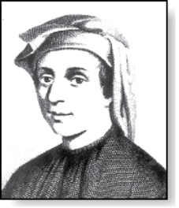
Fibonacci Numbers
Fibonacci
(1170- 1250)
Example : The Fibonacci numbers are defined as follows:
  f₀ = 0
  f₁ = 1
  f_{n} = f_{n−1} + f_{n−2}
Find f₂, f₃ , f₄ , f₅ .
    f₂ = f₁ + f₀ = 1 + 0 = 1
    f₃ = f₂ + f₁ = 1 + 1 = 2
    f₄ = f₃ + f₂ = 2 + 1 = 3
    f₅ = f₄ + f₃ = 3 + 2 = 5
Fibonacci numbers were used to model population growth of rabbits.
Next, we use strong induction to prove a result about the Fibonacci numbers.

Slide 31
Solving Recurrences by Induction
Recurrence: f(0) = 0; f(1) = 1; f(n) = f(n - 1) + f(n-2)
Fact: f(n) > α^{n−2} , for n ≥3, where α = (1 + √5)/2
Proof:
BC: f(3) = 2 > α; f(4) = 3 > α²
IH: For all 2 < j < n , f(j) > α^{j−2}
IS: f(n) = f(n-1) + f(n-2)
> α^{n−3} + α^{n−4} (By IH)
= α^{n -2}
Last step holds since α² = α + 1 (because α is a solution of x² − x − 1 = 0), implies that α^{n-2} = α^{n−3} + α^{n−4}

Slide 32
Recursively Defined Sets and Structures
Recursive definitions of sets have two parts:
  The BASE CASE specifies an initial collection of elements.
  The recursive step gives the rules for forming new elements in the set from those already known to be in the set.
Sometimes the recursive definition has an exclusion rule, which specifies that the set contains nothing other than those elements specified in the BASE CASE and generated by applications of the rules in the recursive step.
We will always assume that the exclusion rule holds, even if it is not explicitly mentioned.
We will later develop a form of induction, called structural induction, to prove results about recursively defined sets.

Slide 33
Recursively Defined Sets and Structures
Example : Subset of Integers S:
  BASE CASE: 3 ∊ S.
  RECURSIVE STEP: If x ∊ S and y ∊ S, then x + y is in S.
Initially 3 is in S, then 3 + 3 = 6, then 3 + 6 = 9, etc.
Example: The natural numbers N.
  BASE CASE: 0 ∊ N.
  RECURSIVE STEP: If n is in N, then n + 1 is in N.
Initially 0 is in S, then 0 + 1 = 1, then 1 + 1 = 2, etc.

Slide 34
Strings
Definition: The set Σ* of strings over the alphabet Σ:
  BASE CASE: λ ∊ Σ* (λ is the empty string)
  RECURSIVE STEP: If w is in Σ* and x is in Σ, then wx ∈ Σ*.
Example: If Σ = {0,1}, the strings in in Σ* are the set of all bit strings, λ,0,1, 00,01,10, 11, etc.
Example: If Σ = {a,b}, show that aab is in Σ*.
  Since λ ∊ Σ* and a ∊ Σ, a ∊ Σ*.
  Since a ∊ Σ* and a ∊ Σ, aa ∊ Σ*.
  Since aa ∊ Σ* and b ∊ Σ, aab ∊ Σ*.

Slide 35
String Concatenation
Definition: Two strings can be combined via the operation of concatenation. Let Σ be a set of symbols and Σ* be the set of strings formed from the symbols in Σ. We can define the concatenation of two strings, denoted by ∙, recursively as follows.
  BASE CASE: If w ∈ Σ*, then w ∙ λ= w.
  RECURSIVE STEP: If w₁ ∈ Σ* and w₂ ∈ Σ* and x ∈ Σ, then w₁ ∙ (w₂ x)= (w₁ ∙ w₂)x.
Often w₁ ∙ w₂ is written as w₁ w₂.
If w₁ = abra and w₂ = cadabra, the concatenation w₁ w₂ = abracadabra.

Slide 36
Length of a String
Example: Give a recursive definition of l(w), the length of the string w.
Solution: The length of a string can be recursively defined by:
  l(λ) = 0;
  l(wx) = l(w) + 1 if w ∊ Σ* and x ∊ Σ.

Slide 37
Balanced Parentheses
Example: Give a recursive definition of the set of balanced parentheses P.
Solution:
  BASE CASE: () ∊ P
  RECURSIVE STEP: If w ∊ P, then () w ∊ P, (w) ∊ P and w () ∊ P.
Show that (() ()) is in P.
Why is ))(() not in P?

Slide 38
Well-Formed Formulae in Propositional Logic
Definition: The set of well-formed formulae in propositional logic involving T, F, propositional variables, and operators from the set {¬,∧,∨,→,↔}.
  BASE CASE: T,F, and s, where s is a propositional variable, are well-formed formulae.
  RECURSIVE STEP: If E and F are well formed formulae, then (¬ E), (E ∧ F), (E ∨ F), (E → F), (E ↔ F), are well-formed formulae.
Examples: ((p ∨q) → (q ∧ F)) is a well-formed formula.
pq ∧ is not a well formed formula.

Slide 39
Rooted Trees
Definition: The set of rooted trees, where a rooted tree consists of a set of vertices containing a distinguished vertex called the root, and edges connecting these vertices, can be defined recursively by these steps:
  BASE CASE: A single vertex r is a rooted tree.
  RECURSIVE STEP: Suppose that T₁, T₂, …,T_{n} are disjoint rooted trees with roots r₁, r₂,…,r_{n}, respectively. Then the graph formed by starting with a root r, which is not in any of the rooted trees T₁, T₂, …,T_{n}, and adding an edge from r to each of the vertices r₁, r₂,…,r_{n}, is also a rooted tree.

Slide 40
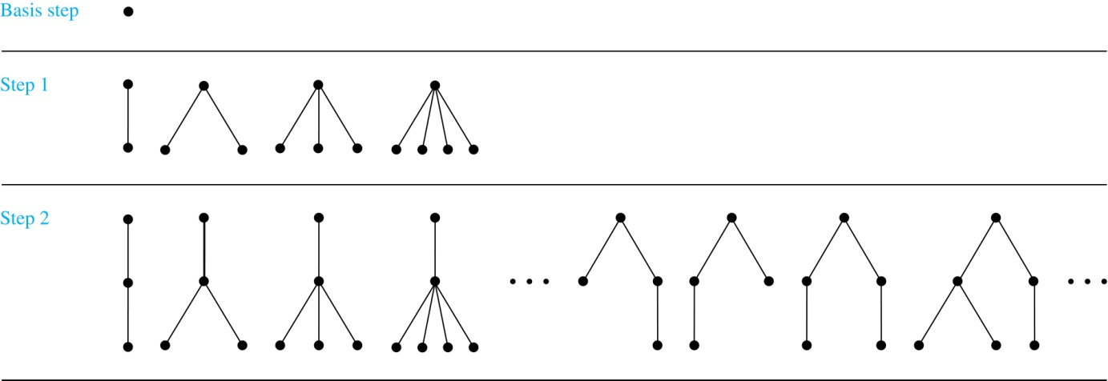
Building Up Rooted Trees
Next we look at a special type of tree, the full binary tree.

Slide 41
Full Binary Trees
Definition: The set of full binary trees can be defined recursively by these steps.
  BASE CASE: There is a full binary tree consisting of only a single vertex r.
  RECURSIVE STEP: If T₁ and T₂ are disjoint full binary trees, there is a full binary tree, denoted by T₁∙T₂, consisting of a root r together with edges connecting the root to each of the roots of the left subtree T₁ and the right subtree T₂.

Slide 42
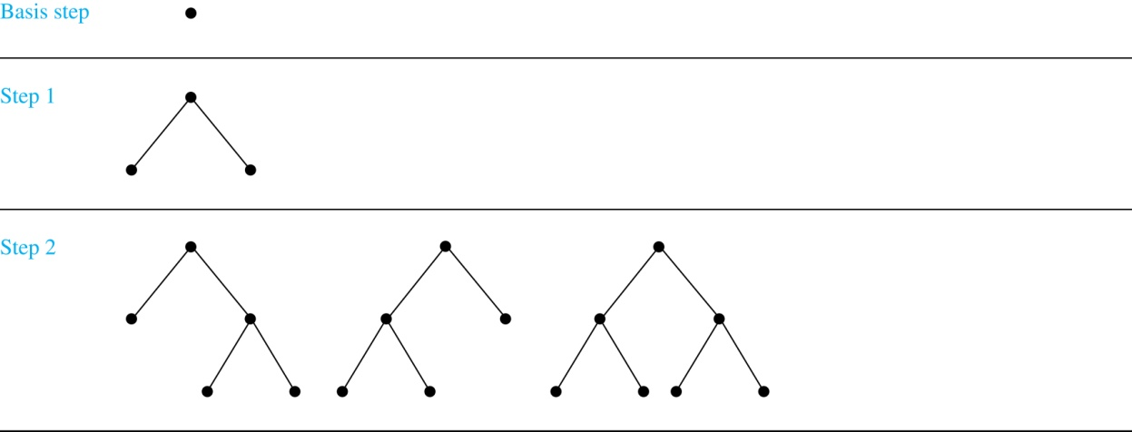
Building Up Full Binary Trees

Slide 43
Induction and Recursively Defined Sets
Example: Show that the set S defined by specifying that 3 ∊ S and that if x ∊ S and y ∊ S, then x + y is in S, is the set of all positive integers that are multiples of 3.
Solution: Let A be the set of all positive integers divisible by 3. To prove that A = S, show that A is a subset of S and S is a subset of A.
  A⊂ S: Let P(n) be the statement that 3n belongs to S.
    BASE CASE: 3∙1 = 3 ∊ S, by the first part of recursive definition.
    INDUCTIVE STEP: Assume P(k-1) is true. By the second part of the recursive definition, if 3k ∊ S, then since 3 ∊ S, 3(k-1) + 3 = 3k ∊ S. Hence, P(k) is true.
  S ⊂ A:
    BASE CASE: 3 ∊ S by the first part of recursive definition, and 3 = 3∙1.
    INDUCTIVE STEP: The second part of the recursive definition adds x +y to S, if both x and y are in S. If x and y are both in A, then both x and y are divisible by 3. By part (i) of Theorem 1 of Section 4.1, it follows that x + y is divisible by 3.

Slide 44
Structural Induction
Definition: To prove a property of the elements of a recursively defined set, we use structural induction.
  BASE CASE: Show that the result holds for all elements specified in the BASE CASE of the recursive definition.
  RECURSIVE STEP: Show that if the statement is true for each of the elements used to construct new elements in the recursive step of the definition, the result holds for these new elements.
The validity of structural induction can be shown to follow from the principle of mathematical induction.

Slide 45
Full Binary Trees
Definition: The height h(T) of a full binary tree T is defined recursively as follows:
  BASE CASE: The height of a full binary tree T consisting of only a root r is h(T) = 0.
  RECURSIVE STEP: If T₁ and T₂ are full binary trees, then the full binary tree T = T₁∙T₂ has height h(T) = 1 + max(h(T₁),h(T₂)).
The number of vertices n(T) of a full binary tree T satisfies the following recursive formula:
  BASE CASE: The number of vertices of a full binary tree T consisting of only a root r is n(T) = 1.
  RECURSIVE STEP: If T₁ and T₂ are full binary trees, then the full binary tree T = T₁∙T₂ has the number of vertices n(T) = 1 + n(T₁) + n(T₂).

Slide 46
Structural Induction and Binary Trees
Theorem: If T is a full binary tree, with h(T) ≥0, then n(T) ≤ 2^{h(T)+1} – 1.
Proof: (by induction on h(T))
BC: For h(T)= 0, n(T) = 1 and 0 ≤ 2¹ – 1
IH: For all 0 ≤ j < h, if h(T) = h then n(T) ≤ 2^{h(T)+1} – 1
IS: Consider a tree T with h(T) = h. Let T₁ be the left subtree of the root and T₂ be the right subtree of the root. Then we know:
n(T) = n(T₁) + n(T₂) + 1
≤ (2^{h(T1)+1} – 1) + (2^{h(T1)+1} – 1) + 1 (by IH)
≤ (2^{h(T)} – 1) + (2^{h(T)} – 1) + 1 (since h(T₁), h(T₂)<h(T))
= 2^{h(T)+1} – 1 (by algebra)
⁻² .

Slide 47
Recursive Algorithms
Section 5.4

Slide 48
Section Summary
Recursive Algorithms
Proving Recursive Algorithms Correct
Merge Sort

Slide 49
Recursive Algorithms
Definition: An algorithm is called recursive if it solves a problem by reducing it to an instance of the same problem with smaller input.
For the algorithm to terminate, the instance of the problem must eventually be reduced to some initial case for which the solution is known.

Slide 50
Recursive Factorial Algorithm
Example: Give a recursive algorithm for computing n!, where n is a nonnegative integer.
Solution: Use the recursive definition of the factorial function.
procedure factorial(n: nonnegative integer)
if n = 0 then return 1
else return n∙factorial (n − 1)
{output is n!}

Slide 51
Recursive Exponentiation Algorithm
Example: Give a recursive algorithm for computing a^{n}, where a is a nonzero real number and n is a nonnegative integer.
Solution: Use the recursive definition of a^{n}.
procedure power(a: nonzero real number, n: nonnegative integer)
if n = 0 then return 1
else return a∙ power (a, n − 1)
{output is a^{n}}

Slide 52
Recursive GCD Algorithm
Example: Give a recursive algorithm for computing the greatest common divisor of two nonnegative integers a and b with a < b.
Solution: Use the reduction
gcd(a,b) = gcd(b mod a, a)
and the condition gcd(0,b) = b when b > 0.
procedure gcd(a,b: nonnegative integers
with a < b)
if a = 0 then return b
else return gcd (b mod a, a)
{output is gcd(a, b)}

Slide 53
Recursive Binary Search Algorithm
Example: Construct a recursive version of a binary search algorithm.
Solution: Assume we have a₁,a₂,…, a_{n}, an increasing sequence of integers. Initially i is 1 and j is n. We are searching for x.
procedure binary search(i, j, x : integers, 1≤ i ≤ j ≤n)
m := ⌊(i + j)/2⌋
if x = a_{m} then
return m
else if (x < a_{m} and i < m) then
return binary search(i,m−1,x)
else if (x > a_{m} and j >m) then
return binary search(m+1,j,x)
else return 0
{output is location of x in a₁, a₂,…,a_{n} if it appears, otherwise 0}

Slide 54
Proving Recursive Algorithms Correct
Both mathematical and str0ng induction are useful techniques to show that recursive algorithms always produce the correct output.
Exercise: Prove that the algorithm for computing the powers of real numbers is correct.
procedure power(a: nonzero real number, n: nonnegative integer)
if n = 0 then return 1
else return a∙ power (a, n − 1)
{output is a^{n}}
⁻² .

Slide 55
Merge Sort
Merge Sort works by iteratively splitting a list (with an even number of elements) into two sublists of equal length until each sublist has one element.
Each sublist is represented by a balanced binary tree.
At each step a pair of sublists is successively merged into a list with the elements in increasing order. The process ends when all the sublists have been merged.
The succession of merged lists is represented by a binary tree.

Slide 56
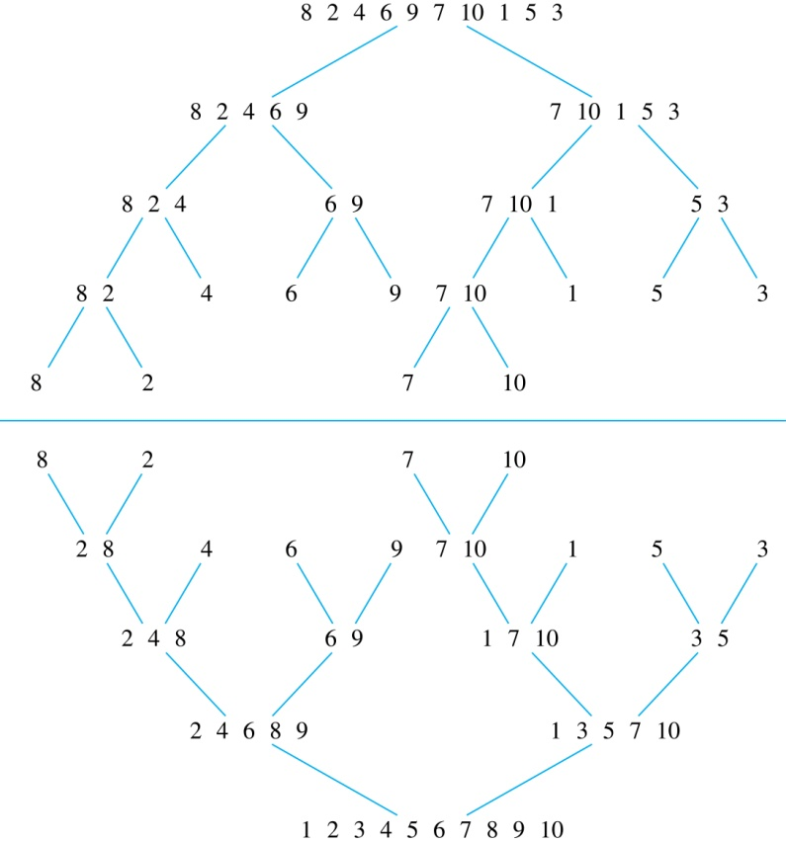
Merge Sort
Example: Use merge sort to put the list
8,2,4,6,9,7,10, 1, 5, 3
into increasing order.
Solution:

Slide 57
Recursive Merge Sort
Example: Construct a recursive merge sort algorithm.
Solution: Begin with the list of n elements L.
procedure mergesort(L = a₁, a₂,…,a_{n} )
if n > 1 then
m := ⌊n/2⌋
L₁ := a₁, a₂,…,a_{m}
L₂ := a_{m+1}, a_{m+2},…,a_{n}
L := merge(mergesort(L₁), mergesort(L₂ ))
{L is now sorted into elements in increasing order}
continued →

Slide 58
Recursive Merge Sort
Subroutine merge, which merges two sorted lists.
Complexity of Merge: Two sorted lists with m elements and n elements can be merged into a sorted list using no more than m + n − 1 comparisons.
procedure merge(L₁, L₂ :sorted lists)
L := empty list
while L₁ and L₂ are both nonempty
remove smaller of first elements of L₁ and L₂ from its list;
put at the right end of L
if this removal makes one list empty
then remove all elements from the other list and append them to L
return L {L is the merged list with the elements in increasing order}

Slide 59
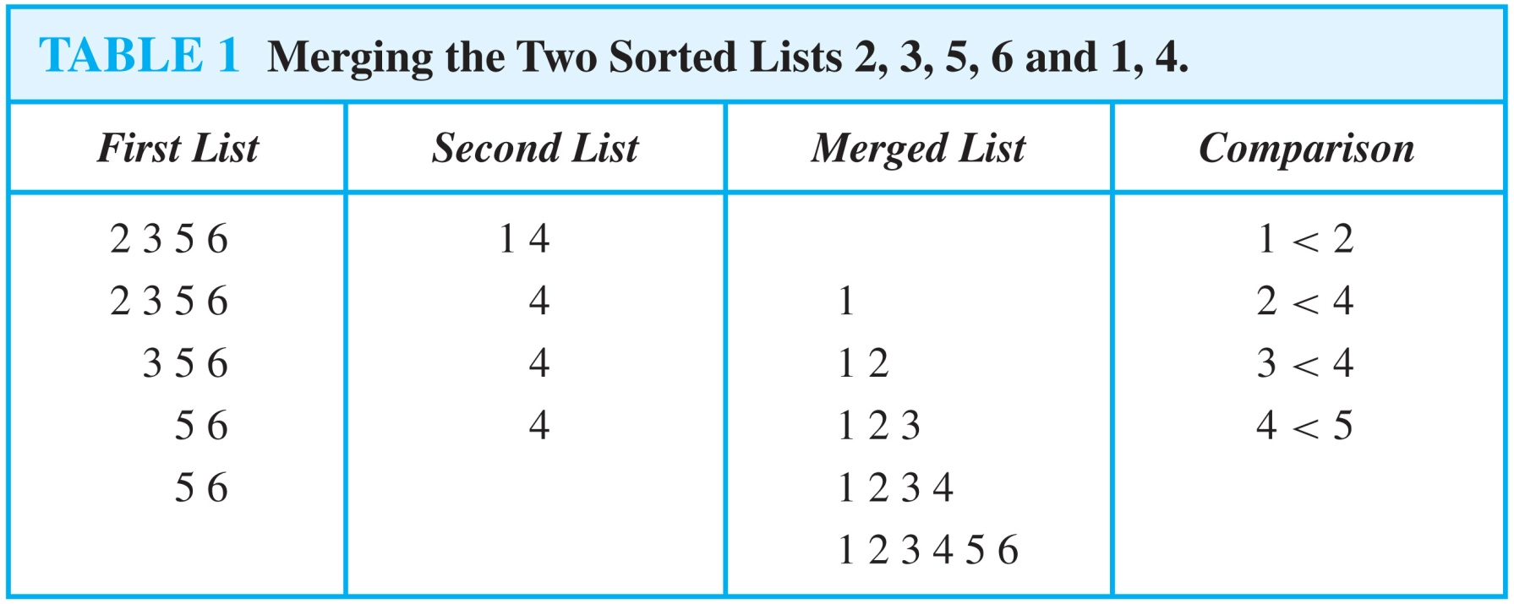
Merging Two Lists
Example: Merge the two lists 2,3,5,6 and 1,4.
Solution:

Slide 60
Complexity of Merge Sort
Complexity of Merge Sort: The number of comparisons needed to merge a list with n elements is O(n log n).
Then runtime is a recurrence relation given by f(2) = 2; f(n) = 2 f(n/2) + n; n power of 2.
In next slide, we show that the solution to this recurrence is no more than n log n.
continued →

Slide 61
MergeSort Runtime
Recurrence: f(2) = 2; f(n) = 2 f(n/2) + n; n power of 2.
Fact: f(n) ≤ n log n, for all n > 1.
Proof (by Strong Induction):
BC: f(2) = 2 ≤ 2 log 2
IH: For all 2 ≤ j<n, f(j) ≤ j log j
IS: f(n) = 2 f(n/2) + n
≤ 2 (n/2 (log n/2)) + n (by IH)
= n log n (since log x/y = log x – log y)

Slide 62
MergeSort Runtime
We’ve shown that MergeSort is a O(n log n) algorithm for sorting lists of size n.
Much better than BubbleSort and InsertionSort which have O(n²) runtime
It turns out that O(n log n) is optimal time for sorting for a large class of algorithms.

