Slide 1
Probability Theory

Slide 2
Section Summary
Assigning Probabilities
Probabilities of Complements and Unions of Events
Conditional Probability
Independence
Random Variables

Slide 3
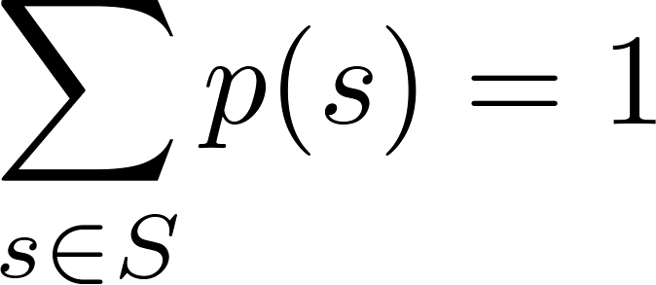
Assigning Probabilities
Let S be a sample space of an experiment with a finite number of outcomes. We assign a probability p(s) to each outcome s, so that:
      i. 0 ≤ p(s) ≤ 1 for each s ∈ S
      ii.
The function p from the set of all outcomes of the sample space S is called a probability distribution.

Slide 4
Probability of an Event
Definition: The probability of the event E is the sum of the probabilities of the outcomes in E.

Slide 5
Assigning Probabilities
Example: What probabilities should we assign to the outcomes H(heads) and T (tails) when a fair coin is flipped? What probabilities should be assigned to these outcomes when the coin is biased so that heads comes up twice as often as tails?
Solution: For a fair coin, we have p(H) = p(T) = ½.
For a biased coin, we have p(H) = 2p(T).
Because p(H) + p(T) = 1, it follows that
2p(T) + p(T) = 3p(T) = 1.
Hence, p(T) = 1/3 and p(H) = 2/3.

Slide 6
Uniform Distribution
Definition: Suppose that S is a set with n elements. The uniform distribution assigns the probability 1/n to each element of S.
Example: Consider again the coin flipping example, but with a fair coin. Now p(H) = p(T) = 1/2.

Slide 7
Probability of a Die
Example: Suppose that a die is biased so that 3 appears twice as often as each other number, but that the other five outcomes are equally likely. What is the probability that an odd number appears when we roll this die?
Solution: We want the probability of the event E = {1,3,5}. We have p(3) = 2/7 and
p(1) = p(2) = p(4) = p(5) = p(6) = 1/7.
Hence, p(E) = p(1) + p(3) + p(5) =
1/7 + 2/7 + 1/7 = 4/7.

Slide 8
Probability of Lottery
Example: There are many lotteries that award prizes to people who correctly choose a set of six numbers out of the first n positive integers, where n is usually between 30 and 60. What is the probability that a person picks the correct six numbers out of 40?
Solution: The number of ways to choose six numbers out of 40 is
C(40,6) = 40!/(34!6!) = 3,838,380.
Hence, the probability of picking a winning combination is 1/ 3,838,380 ≈ 0.00000026.

Slide 9
Probability of a Lottery
Example: What is the probability that the numbers 11, 4, 17, 39, and 23 are drawn in that order from a bin with 50 balls labeled with the numbers 1,2, …, 50 if
  The ball selected is not returned to the bin.
  The ball selected is returned to the bin before the next ball is selected.
Solution: Use the product rule in each case.
  Sampling without replacement: The probability is 1/254,251,200 since there are 50 ∙49 ∙48 ∙47 ∙46 = 254,251,200 ways to choose the five balls.
  b) Sampling with replacement: The probability is 1/50⁵ = 1/312,500,000 since 50⁵ = 312,500,000.

Slide 10
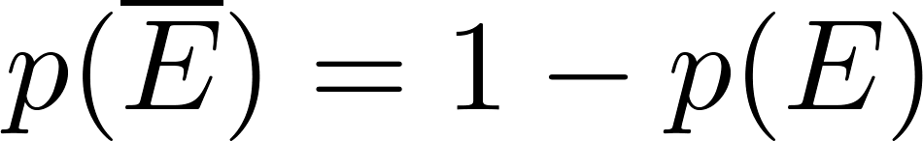

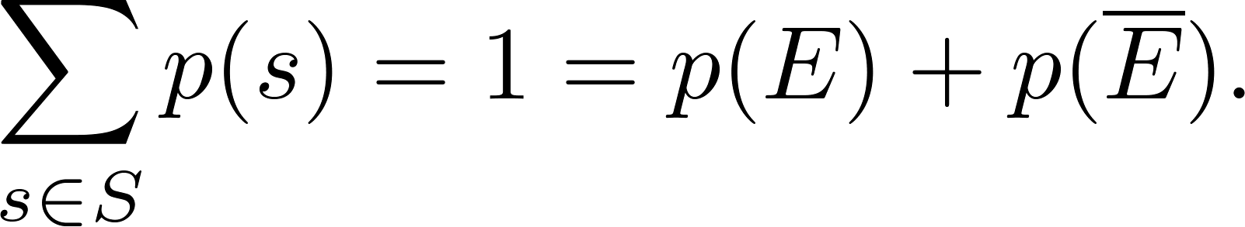
Probabilities of Complements
Proof: Since each outcome is in either E or , but not both,

Slide 11
Probability of Complements
Example: A sequence of 10 bits is chosen randomly. What is the probability that at least one of these bits is 0?
Solution: Let E be the event that at least one of the 10 bits is 0. Then is the event that all of the bits are 1s. The size of the sample space S is 2¹⁰. Hence,

Slide 12
Probability of Union of Events
Proof: Each outcome s that is in E₁ is included in p(E₁). Each outcome s that is in E₂ is included in p(E₂). If s that is in both E₁ and E₂ then it is included in both p(E₁)and p(E₂) but subtracted out in p(E₁∩E₂). Thus the left-hand side of the equation equals the right-hand side.

Slide 13
Probability of Unions
Example: What is the probability that a positive integer selected at random from the set of positive integers not exceeding 100 is divisible by either 2 or 5?
Solution: Let E₁ be the event that the integer is divisible by 2 and E₂ be the event that it is divisible 5? Then the event that the integer is divisible by 2 or 5 is E₁ ∪ E₂ and E₁ ∩ E₂ is the event that it is divisible by 2 and 5.
It follows that:
p(E₁ ∪ E₂) = p(E₁) + p(E₂) – p(E₁ ∩ E₂)
= 50/100 + 20/100 − 10/100 = 3/5.

Slide 14
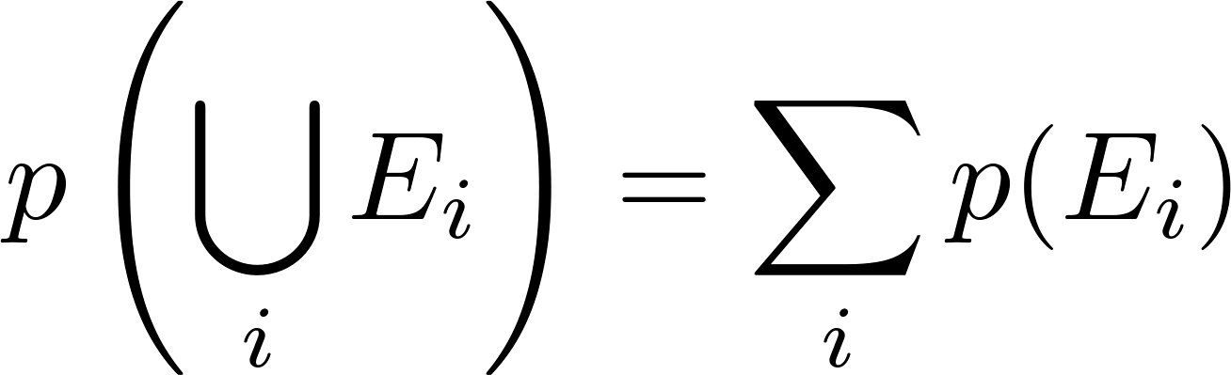
Combinations of Events
Theorem: If E₁, E₂, … is a sequence of pairwise disjoint events in a sample space S, then

Slide 15
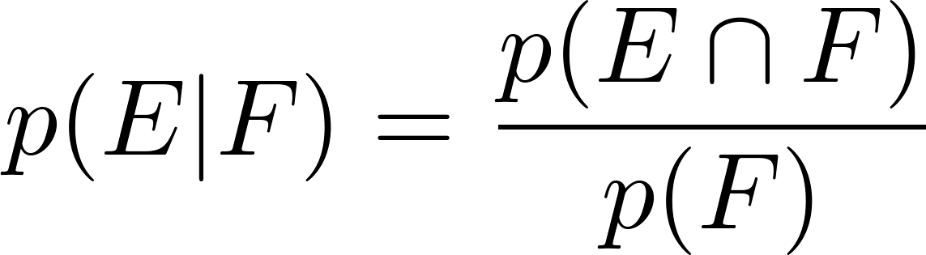
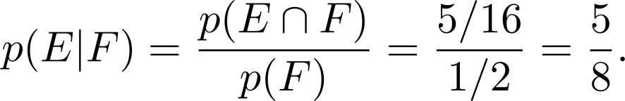
Conditional Probability
Definition: Let E and F be events with p(F) > 0. The conditional probability of E given F, denoted by P(E|F), is defined as:
Example: A bit string of length four is generated at random so that each of the 16 bit strings of length 4 is equally likely. What is the probability that it contains at least two consecutive 0s, given that its first bit is a 0?
Solution: Let E be the event that the bit string contains at least two consecutive 0s, and F be the event that the first bit is a 0.
  Since E ⋂ F = {0000, 0001, 0010, 0011, 0100}, p(E⋂F)=5/16.
  Because 8 bit strings of length 4 start with a 0, p(F) = 8/16= ½.
Hence,

Slide 16
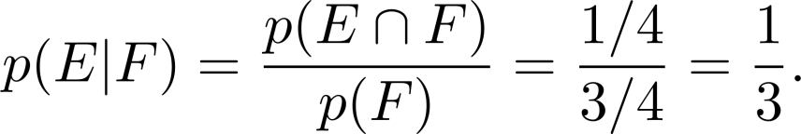
Conditional Probability
Example: What is the conditional probability that a family with two children has two boys, given that they have at least one boy. Assume that each of the possibilities BB, BG, GB, and GG is equally likely where B represents a boy and G represents a girl.
Solution: Let E be the event that the family has two boys and let F be the event that the family has at least one boy. Then E = {BB}, F = {BB, BG, GB}, and E ⋂ F = {BB}.
  It follows that p(F) = 3/4 and p(E⋂F)=1/4.
Hence,

Slide 17
Independence
Definition: The events E and F are independent if and only if
Example: Suppose E is the event that a randomly generated bit string of length four begins with a 1 and F is the event that this bit string contains an even number of 1s. Are E and F independent if the 16 bit strings of length four are equally likely?
Solution: There are eight bit strings of length four that begin with a 1, and eight bit strings of length four that contain an even number of 1s.
  Since the number of bit strings of length 4 is 16,
  Since E⋂F = {1111, 1100, 1010, 1001}, p(E⋂F) = 4/16=1/4.
We conclude that E and F are independent, because
p(E⋂F) =1/4 = (½) (½)= p(E) p(F)
p(E⋂F) = p(E)p(F).
p(E) = p(F) = 8/16 = ½.

Slide 18
Independence
Example: Assume (as in the previous example) that each of the four ways a family can have two children (BB, GG, BG,GB) is equally likely. Are the events E, that a family with two children has two boys, and F, that a family with two children has at least one boy, independent?
Solution: Because E = {BB}, p(E) = 1/4. We saw previously that that p(F) = 3/4 and p(E⋂F)=1/4. The events E and F are not independent since
p(E) p(F) = 3/16 ≠ 1/4= p(E⋂F) .

Slide 19
Pairwise and Mutual Independence
Definition: The events E₁, E₂, …, E_{n} are pairwise independent if and only if p(E_{i}⋂E_{j}) = p(E_{i}) p(E_{j}) for all pairs i and j with i ≤ j ≤ n.
The events are mutually independent if
whenever i_{j}, j = 1,2,…., m, are integers with
1 ≤ i₁ < i₂ <∙∙∙ < i_{m} ≤ n and m ≥ 2.

Slide 20
Random Variables
Definition: A random variable is a function from the sample space of an experiment to the set of real numbers. That is, a random variable assigns a real number to each possible outcome.

Slide 21
Random Variables
Definition: The distribution of a random variable X on a sample space S is the set of pairs (r, p(X = r)) for all r ∊ X(S), where p(X = r) is the probability that X takes the value r.
Example: Suppose that a coin is flipped three times. Let X(t) be the random variable that equals the number of heads that appear when t is the outcome. Then X(t) takes on the following values:
  X(HHH) = 3, X(TTT) = 0,
  X(HHT) = X(HTH) = X(THH) = 2,
  X(TTH) = X(THT) = X(HTT) = 1.
Each of the eight possible outcomes has probability 1/8. So, the distribution of X(t) is p(X = 3) = 1/8, p(X = 2) = 3/8, p(X = 1) = 3/8, and p(X = 0) = 1/8.

Slide 22
Bayes’ Theorem
Section 7.3

Slide 23
Section Summary
Bayes’ Theorem
Generalized Bayes’ Theorem

Slide 24
Motivation for Bayes’ Theorem
Bayes’ theorem allows us to use probability to answer questions such as the following:
  Given that someone tests positive for having a particular disease, what is the probability that they actually do have the disease?
  Given that someone tests negative for the disease, what is the probability, that in fact they do have the disease?
Bayes’ theorem has applications to medicine, law, artificial intelligence, engineering, and many diverse other areas.

Slide 25
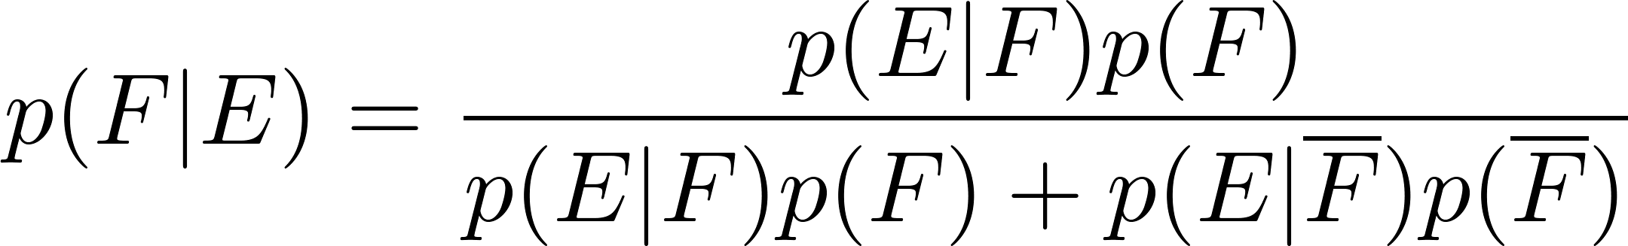
Bayes’ Theorem
Bayes’ Theorem: Suppose that E and F are events from a sample space S such that p(E)≠ 0 and p(F) ≠ 0. Then:
Example: We have two boxes. The first box contains two green balls and seven red balls. The second contains four green balls and three red balls. Bob selects one of the boxes at random. Then he selects a ball from that box at random. If he has a red ball, what is the probability that he selected a ball from the first box.
  Let E be the event that Bob has chosen a red ball and F be the event that Bob has chosen the first box.
  By Bayes’ theorem the probability that Bob has picked the first box is:

Slide 26
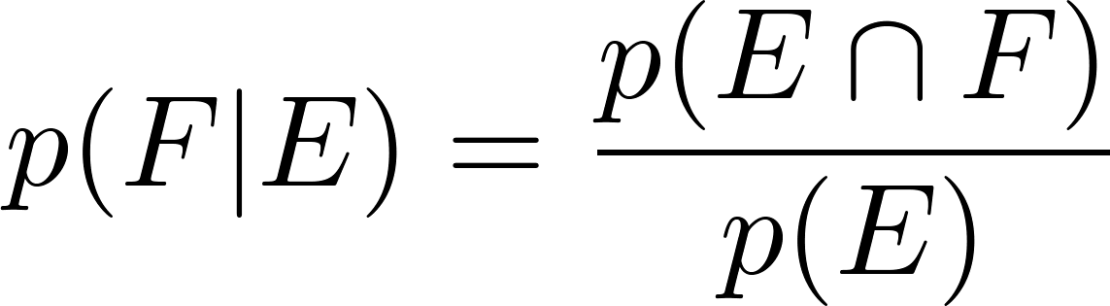
Derivation of Bayes’ Theorem
Recall the definition of the conditional probability p(E|F):
From this definition, it follows that:
,
continued →

Slide 27
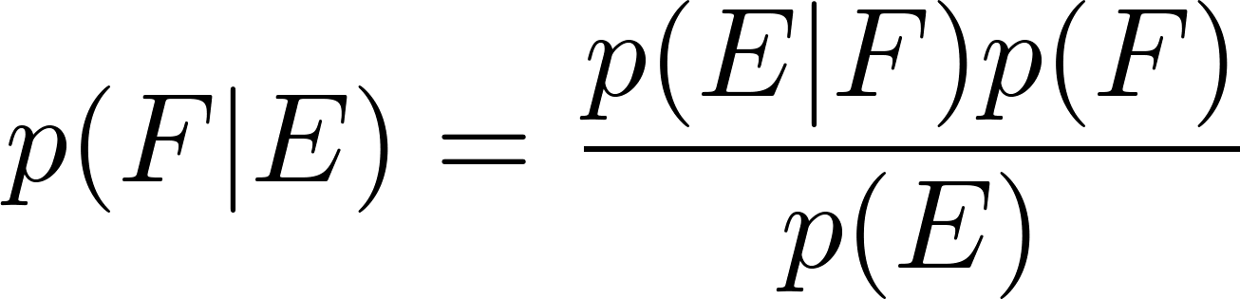
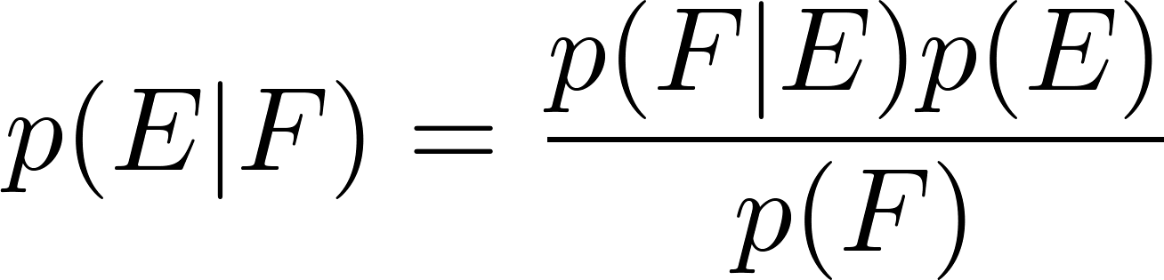
Derivation of Bayes’ Theorem
On the last slide we showed that
,
Equating the two formulas for p(E F) shows that
Solving for p(E|F) and for p(F|E) tells us that
,
continued →

Slide 28
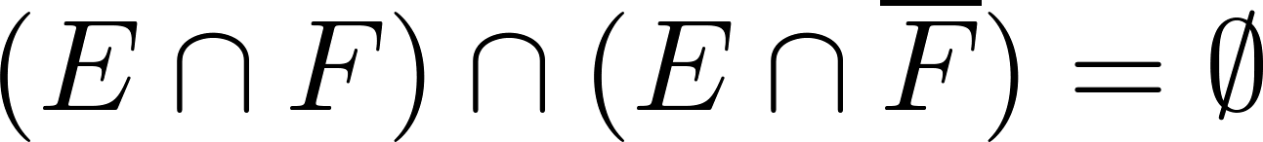
Derivation of Bayes’ Theorem
On the last slide we showed that:
Note that
since
because
and
By the definition of conditional probability,
Hence,

Slide 29
Applying Bayes’ Theorem
Example: Suppose that one person in 100,000 has a particular disease. There is a test for the disease that gives a positive result 99% of the time when given to someone with the disease. When given to someone without the disease, 99.5% of the time it gives a negative result. Find
  the probability that a person who test positive has the disease.
  the probability that a person who test negative does not have the disease.
Should someone who tests positive be worried?

Slide 30

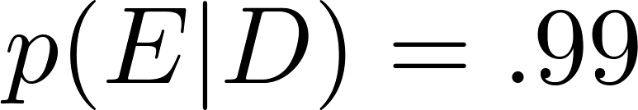

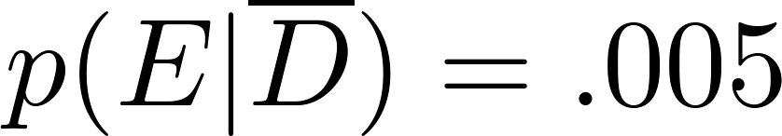
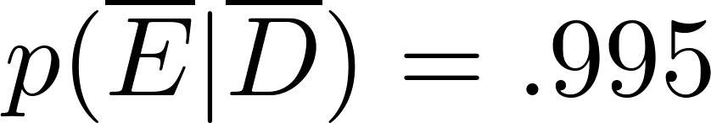
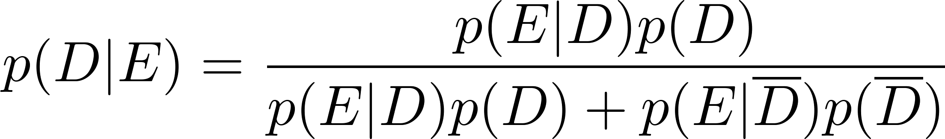
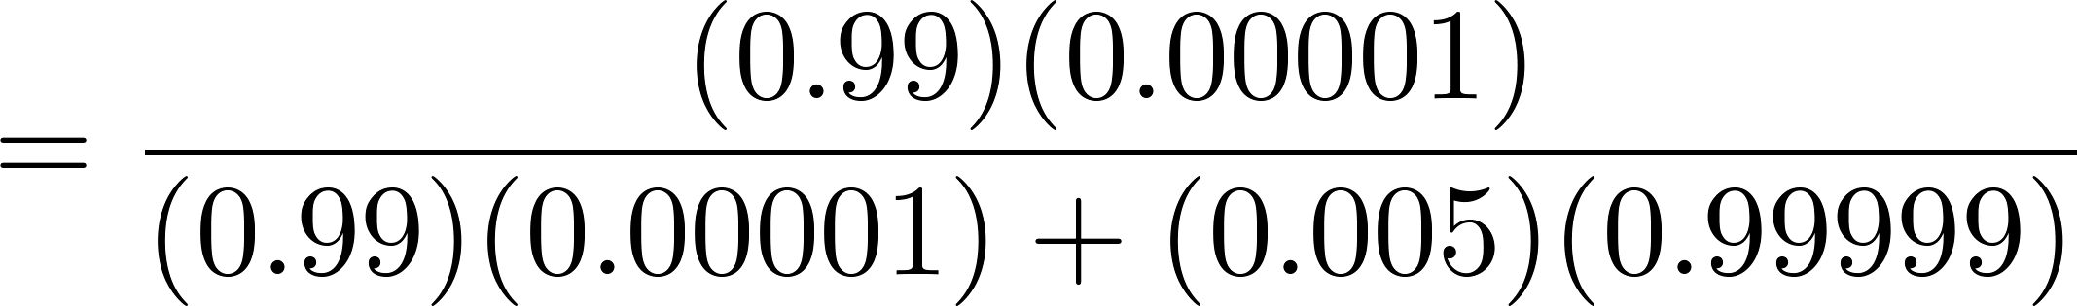

Applying Bayes’ Theorem
Solution: Let D be the event that the person has the disease, and E be the event that this person tests positive. We need to compute p(D|E) from p(D), p(E|D), p( E | ), p( ).
Can you use this formula to explain why the resulting probability is surprisingly small?
So, don’t worry too much, if your test for this disease comes back positive.

Slide 31
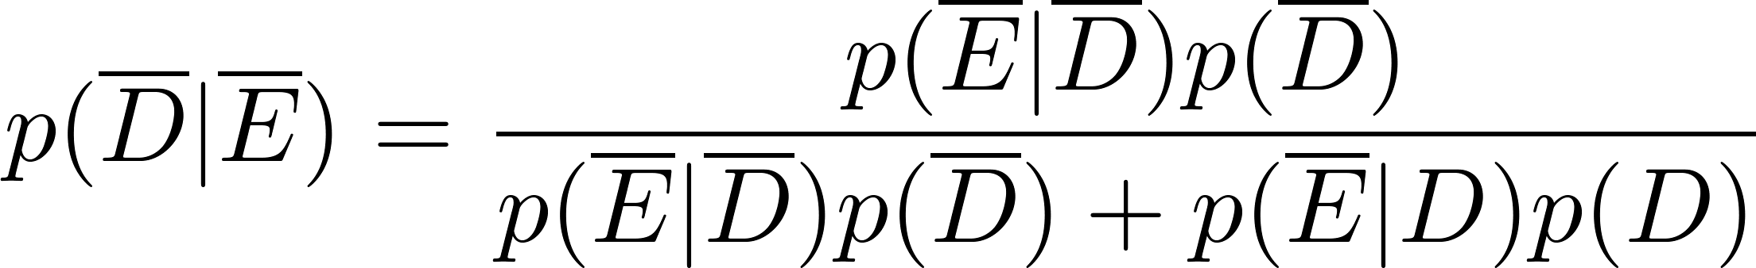
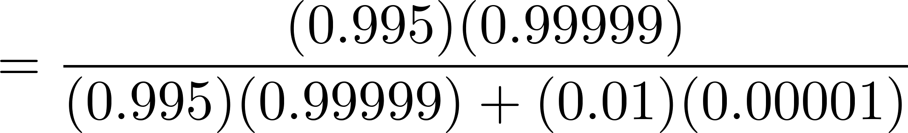
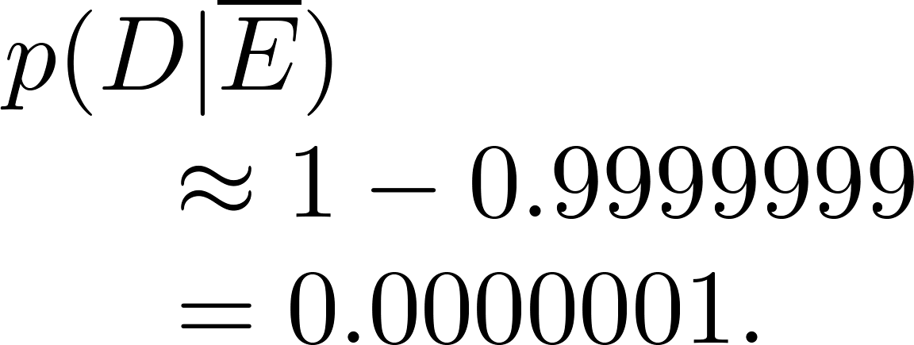

Applying Bayes’ Theorem
  What if the result is negative?
  So, it is extremely unlikely you have the disease if you test negative.
So, the probability you have the disease if you test negative is

Slide 32
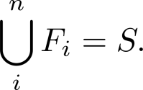
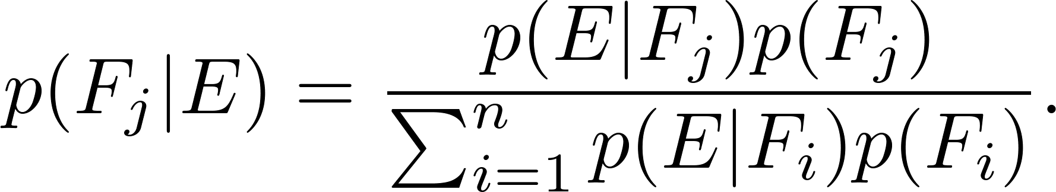
Generalized Bayes’ Theorem
Generalized Bayes’ Theorem: Suppose that E is an event from a sample space S and that F₁, F₂, …, F_{n} are mutually exclusive events such that
Assume that p(E) ≠ 0 for i = 1, 2, …, n. Then

Slide 33
Monty Hall Puzzle
1
2
3
Example: You are asked to select one of the three doors to open. There is a large prize behind one of the doors and if you select that door, you win the prize. After you select a door, the game show host opens one of the other doors (which he knows is not the winning door). The prize is not behind the door and he gives you the opportunity to switch your selection. Should you switch?
Solution: You should switch. We’ll prove this using Bayes’ Theorem.

Slide 34
Expected Value and Variance
Section 6.4

Slide 35
Section Summary
Expected Value
Linearity of Expectation
Average-Case Computational Complexity
Geometric Distribution
Independent Random Variables
Variance
Chebyshev’s Inequality

Slide 36
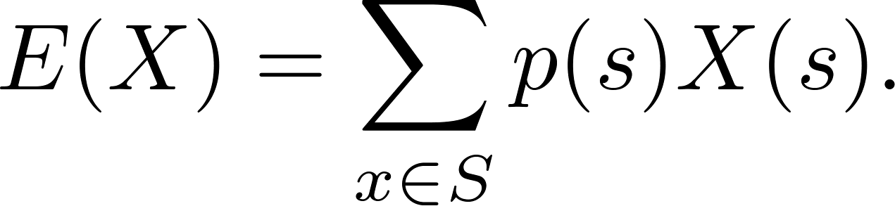
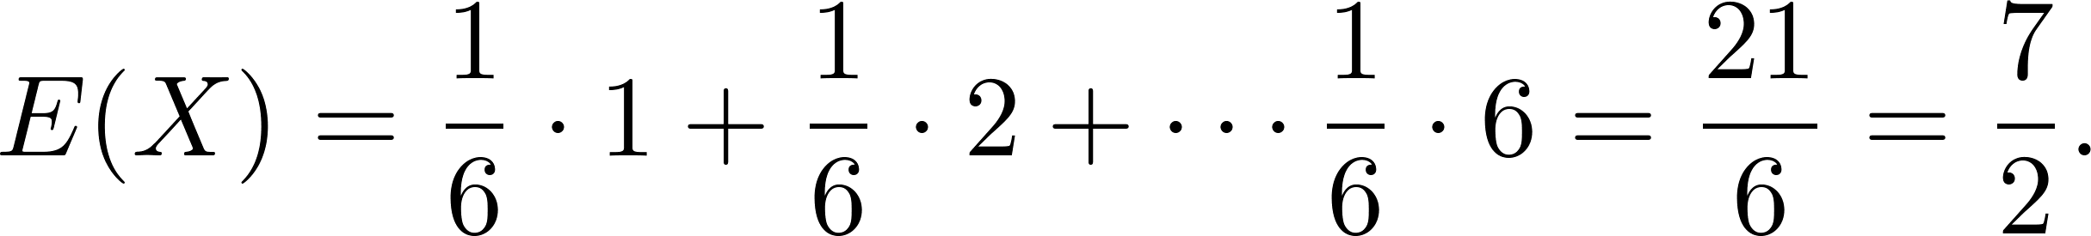
Expected Value
Definition: The expected value (or expectation or mean) of the random variable X(s) on the sample space S is equal to
Example-Expected Value of a Die: Let X be the number that comes up when a fair die is rolled. What is the expected value of X?
Solution: The random variable X takes the values 1, 2, 3, 4, 5, or 6. Each has probability 1/6. It follows that

Slide 37
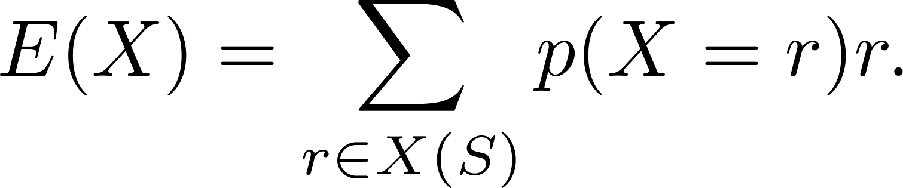
Expected Value
Theorem 1: If X is a random variable and p(X = r) is the probability that X = r, so that
then
Proof: Suppose that X is a random variable with range X(S) and let p(X = r) be the probability that X takes the value r. Consequently, p(X = r) is the sum of the probabilities of the outcomes s such that X(s) = r. Hence,

Slide 38
Linearity of Expectation
The following theorem tells us that expected values are linear. For example, the expected value of the sum of random variables is the sum of their expected values.
Theorem 3: If X_{i}, i = 1, 2, …,n with n a positive integer, are random variables on S, and if a and b are real numbers, then
  (i) E(X₁ + X₂ + …. + X_{n}) = E(X₁ )+ E(X₂) + …. + E(X_{n})
  (ii) E(aX + b) = aE(X) + b.
Proof in Class

Slide 39
Linearity of Expectation
Expected Value in the Hatcheck Problem: A new employee started a job checking hats, but forgot to put the claim check numbers on the hats. So, the n customers just receive a random hat from those remaining. What is the expected number of hat returned correctly?
Solution: Let X be the random variable that equals the number of people who receive the correct hat. Note that X = X₁ + X₂ + ∙∙∙ + X_{n},
where X_{i} = 1 if the ith person receives the hat and X_{i} = 0 otherwise.
  Because it is equally likely that the checker returns any of the hats to the ith person, it follows that the probability that the ith person receives the correct hat is 1/n. Consequently (by Theorem 1), for all I
  E(X_{i}) = 1 ∙p(X_{i} = 1) + 0 ∙p(X_{i} = 0) = 1 ∙ 1/n + 0 = 1/n .
  By the Linearity of Expectation, it follows that:
  E(X )= E(X₁) + E(X₂) + ∙∙∙ + E(X_{n}) = n ∙ 1/n = 1.
Consequently, the average number of people who receive the correct hat is exactly 1.

Slide 40
Linearity of Expectation
Birthday Paradox: There are n people in a room, and m days in a year. What is the expected number of pairs of people who share the same birthday?
  Let X_{i,j} be a random variable that is 1 if person i and person j have the same birthday and 0 otherwise. Let X be number of pairs with same birthday. Then
  By linearity of expectation
Since E(X_{i,j}) = 1 /m, we have that

Slide 41
Quicksort
Divide: Pick an index q in the array. Partition the array into two subarrays, A1 and A2, where all elements in A1 are less than A[q], and all elements in A2 are greater than A[q]
Conquer: Recursively sort A1 and A2

Slide 42
Example
Quicksort the array [2, 6, 4, 1, 5, 3]

Slide 43
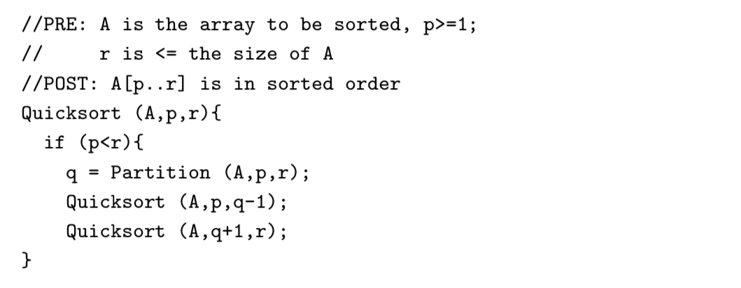
Quicksort
To Be Completed!!!

Slide 44
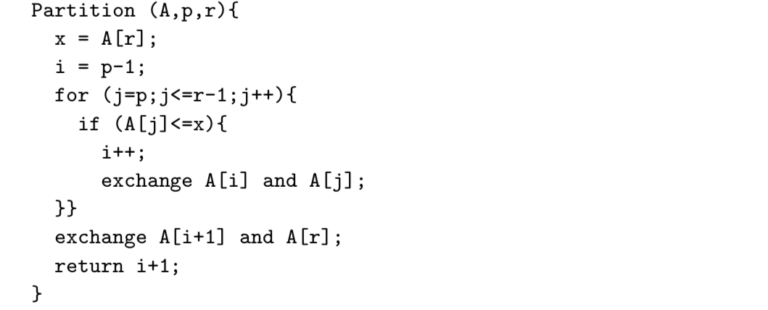
Quicksort

Slide 45
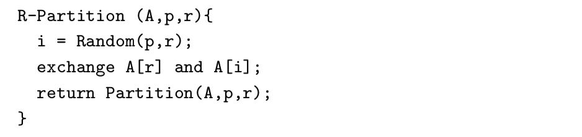
Random Quicksort
Use the following R-Partition function
Protects against bad inputs

Slide 46
Analysis
Quicksort is a randomized algorithm
The runtime is a random variable
Want to compute the expected value

Slide 47
Analysis
Let X be the number of comparisons made by Quicksort
Approach: Will write X as the sum of a bunch of simpler random variables
Then compute E(X) using linearity of expectation

Slide 48
Notation
Let z_{i} be the the i-th smallest element in the array
Let Z_{i,j} = {z_{i} z_{i+1} , …, z_{j}}
X_{i,j} = 1 if z_{i} and z_{j} are compared, 0 otherwise
Then

Slide 49
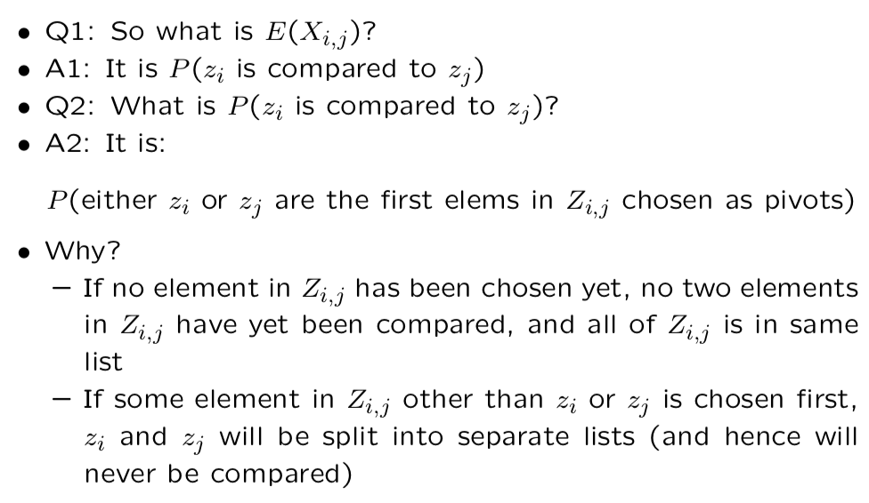
Analysis

Slide 50
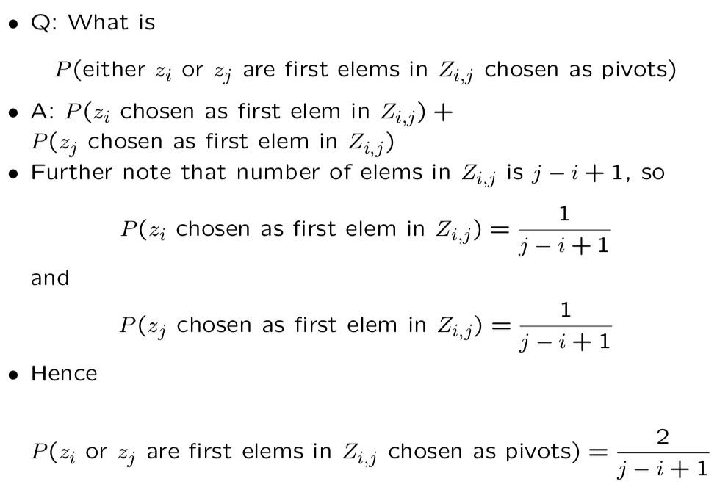

Slide 51
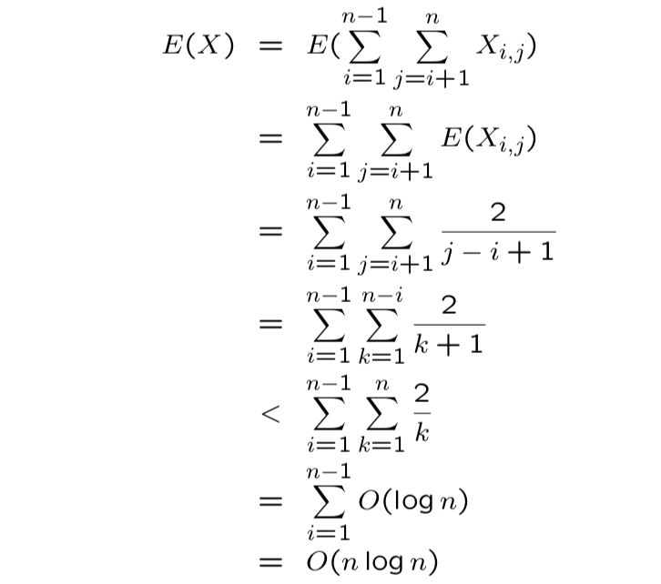
Putting it all Together

Slide 52
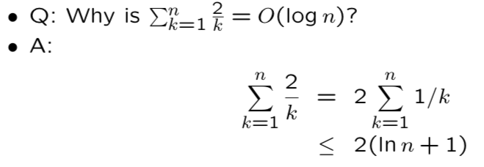
Putting it all Together
Where the last step holds by an integral bound (shown in-class)

