Slide 1
The Foundations: Logic and Proofs
Chapter 1, Part II: Predicate Logic
With Question/Answer Animations
Copyright © McGraw-Hill Education. All rights reserved. No reproduction or distribution without the prior written consent of McGraw-Hill Education.

Slide 2
Summary
Predicate Logic (First-Order Logic (FOL), Predicate Calculus)
  The Language of Quantifiers
  Logical Equivalences
  Nested Quantifiers
  Translation from Predicate Logic to English
  Translation from English to Predicate Logic

Slide 3
Predicates and Quantifiers
Section 1.4

Slide 4
Section Summary
Predicates
Variables
Quantifiers
  Universal Quantifier
  Existential Quantifier
Negating Quantifiers
  De Morgan’s Laws for Quantifiers
Translating English to Logic
Logic Programming (optional)

Slide 5
Propositional Logic Not Enough
If we have:
  “All men are mortal.”
  “Socrates is a man.”
Does it follow that “Socrates is mortal?”
Can’t be represented in propositional logic. Need a language that talks about objects, their properties, and their relations.
Later we’ll see how to draw inferences.

Slide 6
Introducing Predicate Logic
Predicate logic uses the following new features:
  Variables: x, y, z
  Predicates: P(x), M(x)
  Quantifiers (to be covered in a few slides):
Propositional functions are a generalization of propositions.
  They contain variables and a predicate, e.g., P(x)
  Variables can be replaced by elements from their domain.

Slide 7
Propositional Functions
Propositional functions become propositions (and have truth values) when their variables are each replaced by a value from the domain (or bound by a quantifier, as we will see later).
The statement P(x) is said to be the value of the propositional function P at x.
For example, let P(x) denote “x > 0” and the domain be the integers. Then:
  P(-3) is false.
  P(0) is false.
  P(3) is true.
Often the domain is denoted by U. So in this example U is the integers.

Slide 8
Examples of Propositional Functions
Let “x + y = z” be denoted by R(x, y, z) and U (for all three variables) be the integers. Find these truth values:
  R(2,-1,5)
    Solution: F
  R(3,4,7)
    Solution: T
  R(x, 3, z)
    Solution: Not a Proposition
Now let “x - y = z” be denoted by Q(x, y, z), with U as the integers. Find these truth values:
  Q(2,-1,3)
    Solution: T
  Q(3,4,7)
    Solution: F
  Q(x, 3, z)
    Solution: Not a Proposition

Slide 9
Compound Expressions
Connectives from propositional logic carry over to predicate logic.
If P(x) denotes “x > 0,” find these truth values:
  P(3) ∨ P(-1) Solution: T
  P(3) ∧ P(-1) Solution: F
  P(3) → P(-1) Solution: F
  P(3) → ¬P(-1) Solution: T
Expressions with variables are not propositions and therefore do not have truth values. For example,
  P(3) ∧ P(y)
  P(x) → P(y)
When used with quantifiers (to be introduced next), these expressions (propositional functions) become propositions.

Slide 10
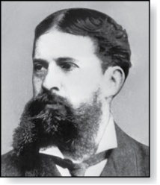
Quantifiers
Charles Peirce (1839-1914)
We need quantifiers to express the meaning of English words including all and some:
  “All men are Mortal.”
  “Some cats do not have fur.”
The two most important quantifiers are:
  Universal Quantifier, “For all,” symbol: ∀
  Existential Quantifier, “There exists,” symbol: ∃
We write as in ∀x P(x) and ∃x P(x).
∀x P(x) asserts P(x) is true for every x in the domain.
∃x P(x) asserts P(x) is true for some x in the domain.
The quantifiers are said to bind the variable x in these expressions.

Slide 11
Universal Quantifier
  ∀x P(x) is read as “For all x, P(x)” or “For every x, P(x)”
  Examples:
    If P(x) denotes “x > 0” and U is the integers, then ∀x P(x) is false.
    If P(x) denotes “x > 0” and U is the positive integers, then ∀x P(x) is true.
    If P(x) denotes “x is even” and U is the integers, then ∀ x P(x) is false.

Slide 12
Existential Quantifier
∃x P(x) is read as “For some x, P(x)”, or as “There is an x such that P(x),” or “For at least one x, P(x).”
  Examples:
    If P(x) denotes “x > 0” and U is the integers, then ∃x P(x) is true. It is also true if U is the positive integers.
    If P(x) denotes “x < 0” and U is the positive integers, then ∃x P(x) is false.
    If P(x) denotes “x is even” and U is the integers, then ∃x P(x) is true.

Slide 13
Uniqueness Quantifier (optional)
∃!x P(x) means that P(x) is true for one and only one x in the universe of discourse.
This is commonly expressed in English in the following equivalent ways:
  “There is a unique x such that P(x).”
  “There is one and only one x such that P(x)”
Examples:
  If P(x) denotes “x + 1 = 0” and U is the integers, then ∃!x P(x) is true.
  But if P(x) denotes “x > 0,” then ∃!x P(x) is false.
The uniqueness quantifier is not really needed as the restriction that there is a unique x such that P(x) can be expressed as:
∃x (P(x) ∧∀y (P(y) → y =x))

Slide 14
Thinking about Quantifiers
When the domain of discourse is finite, we can think of quantification as looping through the elements of the domain.
To evaluate ∀x P(x) loop through all x in the domain.
  If at every step P(x) is true, then ∀x P(x) is true.
  If at a step P(x) is false, then ∀x P(x) is false and the loop terminates.
To evaluate ∃x P(x) loop through all x in the domain.
  If at some step, P(x) is true, then ∃x P(x) is true and the loop terminates.
  If the loop ends without finding an x for which P(x) is true, then ∃x P(x) is false.
Even if the domains are infinite, we can still think of the quantifiers this fashion, but the loops will not terminate in some cases.

Slide 15
Properties of Quantifiers
The truth value of ∃x P(x) and ∀ x P(x) depend on both the propositional function P(x) and on the domain U.
Examples:
  If U is the positive integers and P(x) is the statement “x < 2”, then ∃x P(x) is true, but ∀ x P(x) is false.
  If U is the negative integers and P(x) is the statement “x < 2”, then both ∃x P(x) and ∀ x P(x) are true.
  If U consists of 3, 4, and 5, and P(x) is the statement “x > 2”, then both ∃x P(x) and ∀ x P(x) are true. But if P(x) is the statement “x < 2”, then both ∃x P(x) and ∀ x P(x) are false.

Slide 16
Precedence of Quantifiers
The quantifiers ∀ and ∃ have higher precedence than all the logical operators.
For example, ∀x P(x) ∨ Q(x) means (∀x P(x))∨ Q(x)
∀x (P(x) ∨ Q(x)) means something different.
Unfortunately, often people write ∀x P(x) ∨ Q(x) when they mean ∀ x (P(x) ∨ Q(x)).

Slide 17
Translating from English to Logic
Example 1: Translate the following sentence into predicate logic: “Every student in this class has taken a course in Java.”
Solution:
First decide on the domain U.
  Solution 1: If U is all students in this class, define a propositional function J(x) denoting “x has taken a course in Java” and translate as ∀x J(x).
  Solution 2: But if U is all people, also define a propositional function S(x) denoting “x is a student in this class” and translate as ∀x (S(x)→ J(x)).
    ∀x (S(x) ∧ J(x)) is not correct. What does it mean?

Slide 18
Translating from English to Logic
Example 2: Translate the following sentence into predicate logic: “Some student in this class has taken a course in Java.”
Solution:
First decide on the domain U.
  Solution 1: If U is all students in this class, translate as
  ∃x J(x)
  Solution 2: But if U is all people, then translate as ∃x (S(x) ∧ J(x))
    ∃x (S(x)→ J(x)) is not correct. What does it mean?

Slide 19
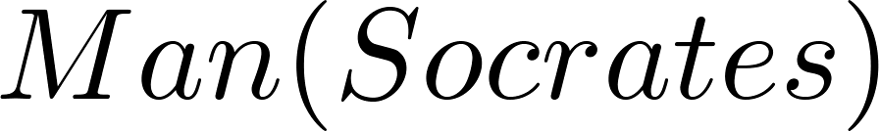
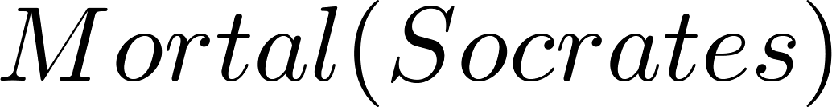
Returning to the Socrates Example
Introduce the propositional functions Man(x) denoting “x is a man” and Mortal(x) denoting “x is mortal.” Specify the domain as all people.
The two premises are:
The conclusion is:
Later we will show how to prove that the conclusion follows from the premises.

Slide 20
Equivalences in Predicate Logic
Statements involving predicates and quantifiers are logically equivalent if and only if they have the same truth value
  for every predicate substituted into these statements and
  for every domain of discourse used for the variables in the expressions.
The notation S ≡T indicates that S and T are logically equivalent.
Example: ∀x ¬¬S(x) ≡ ∀x S(x)

Slide 21
Thinking about Quantifiers as Conjunctions and Disjunctions
If the domain is finite, a universally quantified proposition is equivalent to a conjunction of propositions without quantifiers and an existentially quantified proposition is equivalent to a disjunction of propositions without quantifiers.
If U consists of the integers 1,2, and 3:
Even if the domains are infinite, you can still think of the quantifiers in this fashion, but the equivalent expressions without quantifiers will be infinitely long.

Slide 22
Negating Quantified Expressions
Consider ∀x J(x)
  “Every student in your class has taken a course in Java.”
  Here J(x) is “x has taken a course in Java” and
  the domain is students in your class.
Negating the original statement gives “It is not the case that every student in your class has taken Java.” This implies that “There is a student in your class who has not taken Java.”
Symbolically ¬∀x J(x) and ∃x ¬J(x) are equivalent

Slide 23
Negating Quantified Expressions (continued)
Now Consider ∃ x J(x)
  “There is a student in this class who has taken a course in Java.”
  Where J(x) is “x has taken a course in Java.”
Negating the original statement gives “It is not the case that there is a student in this class who has taken Java.” This implies that “Every student in this class has not taken Java”
Symbolically ¬∃ x J(x) and ∀ x ¬J(x) are equivalent

Slide 24
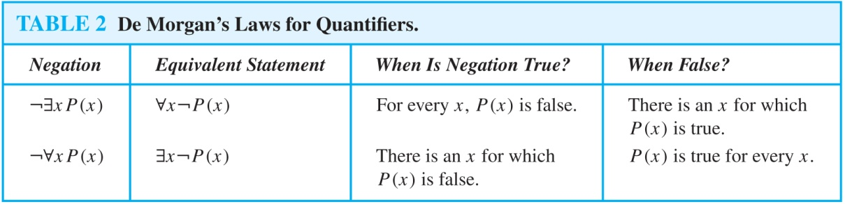
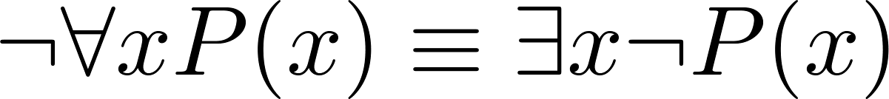
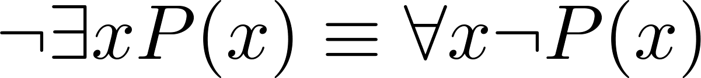
De Morgan’s Laws for Quantifiers
The rules for negating quantifiers are:
The reasoning in the table shows that:
These are important. You will use these.

Slide 25
Translation from English to Logic
Examples:
“Some student in this class has visited Mexico.”
  Solution: Let M(x) denote “x has visited Mexico” and S(x) denote “x is a student in this class,” and U be all people.
  ∃x (S(x) ∧ M(x))
“Every student in this class has visited Canada or Mexico.”
  Solution: Add C(x) denoting “x has visited Canada.”
  ∀x (S(x)→ (M(x)∨C(x)))

Slide 26
Some Fun with Translating from English into Logical Expressions
U = {fleegles, snurds, thingamabobs}
  F(x): x is a fleegle
  S(x): x is a snurd
  T(x): x is a thingamabob
Translate “Everything is a fleegle”
Solution: ∀x F(x)

Slide 27
Translation (cont)
U = {fleegles, snurds, thingamabobs}
  F(x): x is a fleegle
  S(x): x is a snurd
  T(x): x is a thingamabob
“Nothing is a snurd.”
Solution: ¬∃x S(x) What is this equivalent to?
Solution: ∀x ¬ S(x)

Slide 28
Translation (cont)
U = {fleegles, snurds, thingamabobs}
  F(x): x is a fleegle
  S(x): x is a snurd
  T(x): x is a thingamabob
“All fleegles are snurds.”
Solution: ∀x (F(x)→ S(x))

Slide 29
Translation (cont)
U = {fleegles, snurds, thingamabobs}
  F(x): x is a fleegle
  S(x): x is a snurd
  T(x): x is a thingamabob
“Some fleegles are thingamabobs.”
Solution: ∃x (F(x) ∧ T(x))

Slide 30
Translation (cont)
U = {fleegles, snurds, thingamabobs}
  F(x): x is a fleegle
  S(x): x is a snurd
  T(x): x is a thingamabob
“No snurd is a thingamabob.”
Solution: ¬∃x (S(x) ∧ T(x)) What is this equivalent to?
Solution: ∀x (¬S(x) ∨ ¬T(x))

Slide 31
Translation (cont)
U = {fleegles, snurds, thingamabobs}
  F(x): x is a fleegle
  S(x): x is a snurd
  T(x): x is a thingamabob
“If any fleegle is a snurd then it is also a thingamabob.”
Solution: ∀x ((F(x) ∧ S(x))→ T(x))

Slide 32
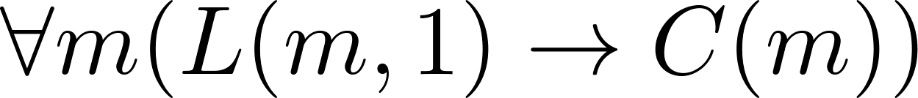
System Specification Example
Predicate logic is used for specifying properties that systems must satisfy.
For example, translate into predicate logic:
  “Every mail message larger than one megabyte will be compressed.”
  “If a user is active, at least one network link will be available.”
Decide on predicates and domains (left implicit here) for the variables:
  Let L(m, y) be “Mail message m is larger than y megabytes.”
  Let C(m) denote “Mail message m will be compressed.”
  Let A(u) represent “User u is active.”
  Let S(n, x) represent “Network link n is state x.
Now we have:

Slide 33
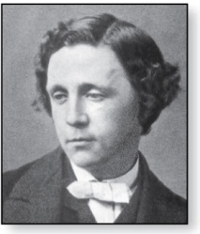
Lewis Carroll Example
Charles Lutwidge Dodgson
(AKA Lewis Caroll)
(1832-1898)
The first two are called premises and the third is called the conclusion.
  “All lions are fierce.”
  “Some lions do not drink coffee.”
  “Some fierce creatures do not drink coffee.”
Here is one way to translate these statements to predicate logic. Let P(x), Q(x), and R(x) be the propositional functions “x is a lion,” “x is fierce,” and “x drinks coffee,” respectively.
  ∀x (P(x)→ Q(x))
  ∃x (P(x) ∧ ¬R(x))
  ∃x (Q(x) ∧ ¬R(x))
Later we will see how to prove that the conclusion follows from the premises.

Slide 34
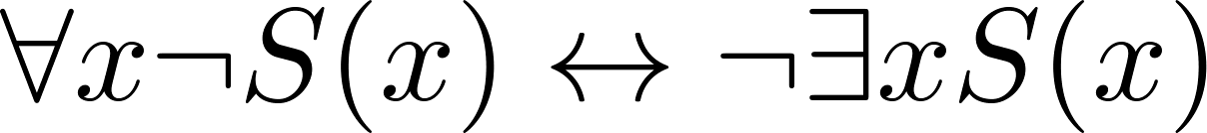
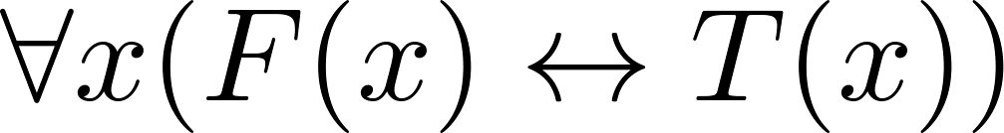
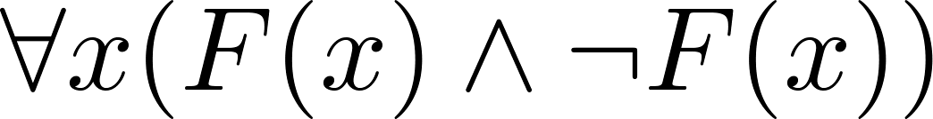
Some Predicate Calculus Definitions
An assertion involving predicates and quantifiers is valid if it is true
    for all domains
    every propositional function substituted for the predicates in the assertion.
  Example:
An assertion involving predicates is satisfiable if it is true
    for some domains
    some propositional functions that can be substituted for the predicates in the assertion.
Otherwise it is unsatisfiable.
Example: not valid but satisfiable
Example: unsatisfiable

Slide 35
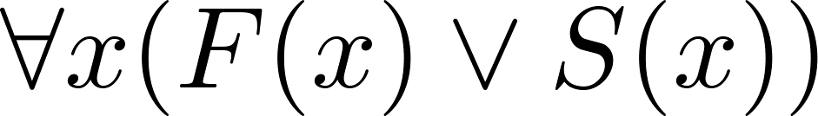
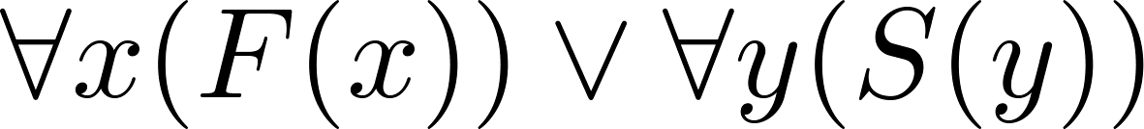
More Predicate Calculus Definitions
The scope of a quantifier is the part of an assertion in which variables are bound by the quantifier.
  Example: x has wide scope
  Example: x has narrow scope

Slide 36
Nested Quantifiers
Section 1.4

Slide 37
Section Summary
Nested Quantifiers
Order of Quantifiers
Translating from Nested Quantifiers into English
Translating Mathematical Statements into Statements involving Nested Quantifiers.
Translated English Sentences into Logical Expressions.
Negating Nested Quantifiers.

Slide 38
Nested Quantifiers
Nested quantifiers are often necessary to express the meaning of sentences in English as well as important concepts in computer science and mathematics.
Example: “Every real number has an inverse” is
∀x ∃y(x + y = 0)
where the domains of x and y are the real numbers.
We can also think of nested propositional functions:
  ∀x ∃y(x + y = 0) can be viewed as ∀x Q(x) where Q(x) is ∃y P(x, y) where P(x, y) is (x + y = 0)

Slide 39
Thinking of Nested Quantification
Nested Loops
  To see if ∀x∀yP (x,y) is true, loop through the values of x :
    At each step, loop through the values for y.
    If for some pair of x andy, P(x,y) is false, then ∀x ∀yP(x,y) is false and both the outer and inner loop terminate.
  ∀x ∀y P(x,y) is true if the outer loop ends after stepping through each x.
  To see if ∀x ∃yP(x,y) is true, loop through the values of x:
    At each step, loop through the values for y.
    The inner loop ends when a pair x and y is found such that P(x, y) is true.
    If no y is found such that P(x, y) is true the outer loop terminates as ∀x ∃yP(x,y) has been shown to be false.
  ∀x ∃y P(x,y) is true if the outer loop ends after stepping through each x.
If the domains of the variables are infinite, then this process can not actually be carried out.

Slide 40
Order of Quantifiers
Examples:
Let P(x,y) be the statement “x + y = y + x.” Assume that U is the real numbers. Then ∀x ∀yP(x,y) and ∀y ∀xP(x,y) have the same truth value.
Let Q(x,y) be the statement “x + y = 0.” Assume that U is the real numbers. Then ∀x ∃yQ(x,y) is true, but ∃y ∀xQ(x,y) is false.

Slide 41
Questions on Order of Quantifiers
Example 1: Let U be the real numbers,
Define P(x,y) : x ∙ y = 0
What is the truth value of the following:
  ∀x∀yP(x,y)
    Answer: False
  ∀x∃yP(x,y)
    Answer: True
  ∃x∀y P(x,y)
    Answer: True
  ∃x ∃ y P(x,y)
  Answer: True

Slide 42
Questions on Order of Quantifiers
Example 2: Let U be the real numbers,
Define P(x,y) : x / y = 1
What is the truth value of the following:
  ∀x∀yP(x,y)
    Answer: False
  ∀x∃yP(x,y)
    Answer: False
  ∃x∀y P(x,y)
    Answer: False
  ∃x ∃ y P(x,y)
    Answer: True

Slide 43
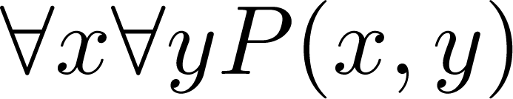
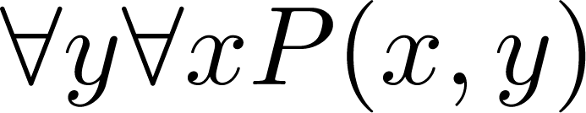
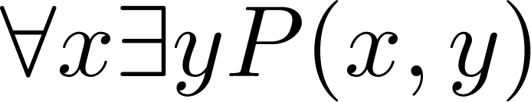
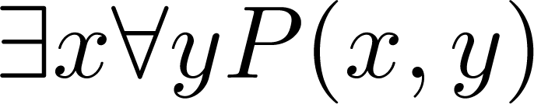
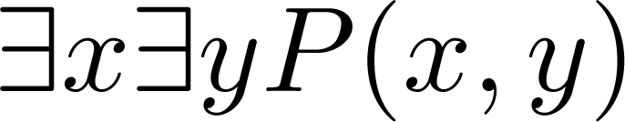
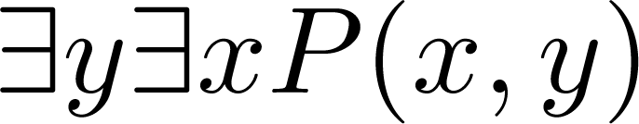
Quantifications of Two Variables
Statement | When True? | When False
 | P(x,y) is true for every pair x,y. | There is a pair x, y for which P(x,y) is false.
 | For every x there is a y for which P(x,y) is true. | There is an x such that P(x,y) is false for every y.
 | There is an x for which P(x,y) is true for every y. | For every x there is a y for which P(x,y) is false.
 | There is a pair x, y for which P(x,y) is true. | P(x,y) is false for every pair x,y

Slide 44
Translating Nested Quantifiers into English
  Example 1: Translate the statement
  ∀x (C(x )∨ ∃y (C(y ) ∧ F(x, y)))
  where C(x) is “x has a computer,” and F(x,y) is “x and y are friends,” and the domain for both x and y consists of all students in your school.
  Solution: Every student in your school has a computer or has a friend who has a computer.
  Example 2: Translate the statement
∃x∀y ∀z ((F(x, y)∧ F(x,z) ∧ (y ≠z))→¬F(y,z))
Solution: There is a student none of whose friends are also friends with each other.

Slide 45
Translating Mathematical Statements into Predicate Logic
Example : Translate “The sum of two positive integers is always positive” into a logical expression.
Solution:
  Rewrite the statement to make the implied quantifiers and domains explicit:
    “For every two integers, if these integers are both positive, then the sum of these integers is positive.”
  Introduce the variables x and y, and specify the domain, to obtain:
    “For all positive integers x and y, x + y is positive.”
  The result is:
    ∀x ∀ y ((x > 0)∧ (y > 0)→ (x + y > 0))
    where the domain of both variables consists of all integers

Slide 46
Translating English into Logical Expressions Example
Example: Use quantifiers to express the statement “There is a woman who has taken a flight on every airline in the world.”
Solution:
  Let P(w,f) be “w has taken f ” and Q(f,a) be “f is a flight on a .”
  The domain of w is all women, the domain of f is all flights, and the domain of a is all airlines.
  Then the statement can be expressed as:
  ∃w ∀a ∃f (P(w,f ) ∧ Q(f,a))

Slide 47
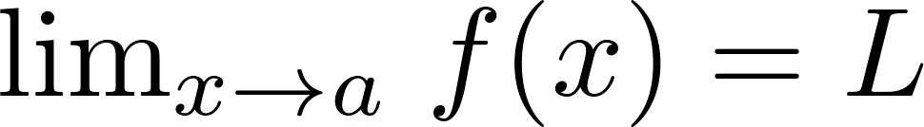
Calculus in Logic (Optional)
Example: Use quantifiers to express the definition of the limit of a real-valued function f(x) of a real variable x at a point a in its domain.
Solution: Recall the definition of the statement
is “For every real number ε > 0, there exists a real number δ > 0 such that |f(x) – L| < ε whenever 0 < |x –a| < δ.”
Using quantifiers:
Where the domain for the variables ε and δ consists of all positive real numbers and the domain for x consists of all real numbers.

Slide 48
Questions on Translation from English
Choose the obvious predicates and express in predicate logic.
Example 1: “Brothers are siblings.”
Solution: ∀x ∀y (B(x,y) → S(x,y))
Example 2: “Siblinghood is symmetric.”
Solution: ∀x ∀y (S(x,y) → S(y,x))
Example 3: “Everybody loves somebody.”
Solution: ∀x ∃y L(x,y)
Example 4: “There is someone who is loved by everyone.”
Solution: ∃y ∀x L(x,y)
Example 5: “There is someone who loves someone.”
Solution: ∃x ∃y L(x,y)
Example 6: “Everyone loves himself”
Solution: ∀x L(x,x)

Slide 49
Negating Nested Quantifiers
Example 1: Recall the logical expression developed three slides back:
∃w ∀a ∃f (P(w,f ) ∧ Q(f,a))
Part 1: Use quantifiers to express the statement that “There does not exist a woman who has taken a flight on every airline in the world.”
Solution: ¬∃w ∀a ∃f (P(w,f ) ∧ Q(f,a))
Part 2: Now use De Morgan’s Laws to move the negation as far inwards as possible.
Solution:
¬∃w ∀a ∃f (P(w,f ) ∧ Q(f,a))
∀w ¬ ∀a ∃f (P(w,f ) ∧ Q(f,a)) by De Morgan’s for ∃
∀w ∃ a ¬ ∃f (P(w,f ) ∧ Q(f,a)) by De Morgan’s for ∀
∀w ∃ a ∀f ¬ (P(w,f ) ∧ Q(f,a)) by De Morgan’s for ∃
∀w ∃ a ∀f (¬ P(w,f ) ∨ ¬ Q(f,a)) by De Morgan’s for ∧.
Part 3: Can you translate the result back into English?
Solution:
“For every woman there is an airline such that for all flights, this woman has not taken that flight or that flight is not on this airline”

Slide 50
Some Questions about Quantifiers
Can you switch the order of quantifiers?
  Is this a valid equivalence?
  Solution: Yes! The left and the right side will always have the same truth value. The order in which x and y are picked does not matter.
  Is this a valid equivalence?
  Solution: No! The left and the right side may have different truth values for some propositional functions for P. Try “x + y = 0” for P(x,y) with U being the integers. The order in which the values of x and y are picked does matter.
Can you distribute quantifiers over logical connectives?
  Is this a valid equivalence?
  Solution: Yes! The left and the right side will always have the same truth value no matter what propositional functions are denoted by P(x) and Q(x).
  Is this a valid equivalence?
  Solution: No! The left and the right side may have different truth values. Pick “x is a fish” for P(x) and “x has scales” for Q(x) with the domain of discourse being all animals. Then the left side is false, because there are some fish that do not have scales. But the right side is true since not all animals are fish.

