Slide 1
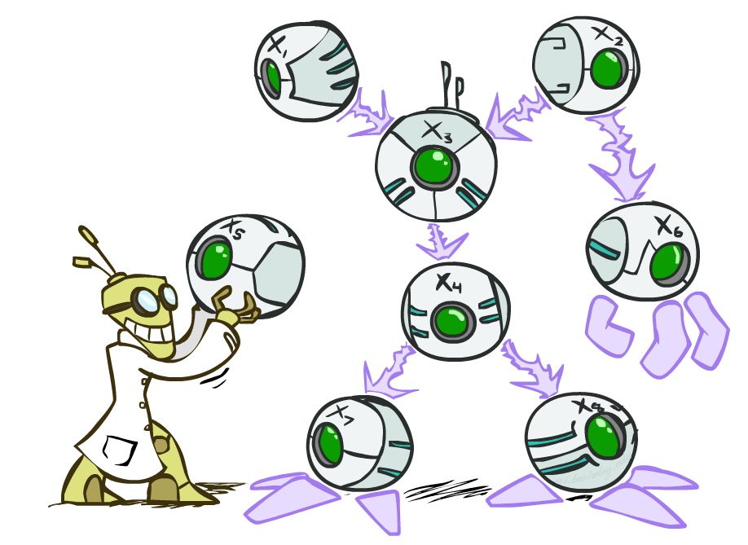
CS 4/527: Artificial Intelligence
Bayes’ Nets
Jared Saia --- University of New Mexico
[These slides were created by Dan Klein and Pieter Abbeel for CS188 Intro to AI at UC Berkeley. All CS188 materials are available at http://ai.berkeley.edu.
Slides on d-separation were created by Davis Foote.]
Notes:
Please retain proper attribution, including the reference to ai.berkeley.edu. Thanks!
5:12

Slide 2
Conditional Independence
X is conditionally independent of Y given Z
if and only if:
or, equivalently, if and only if
Notes:
5:13

Slide 3
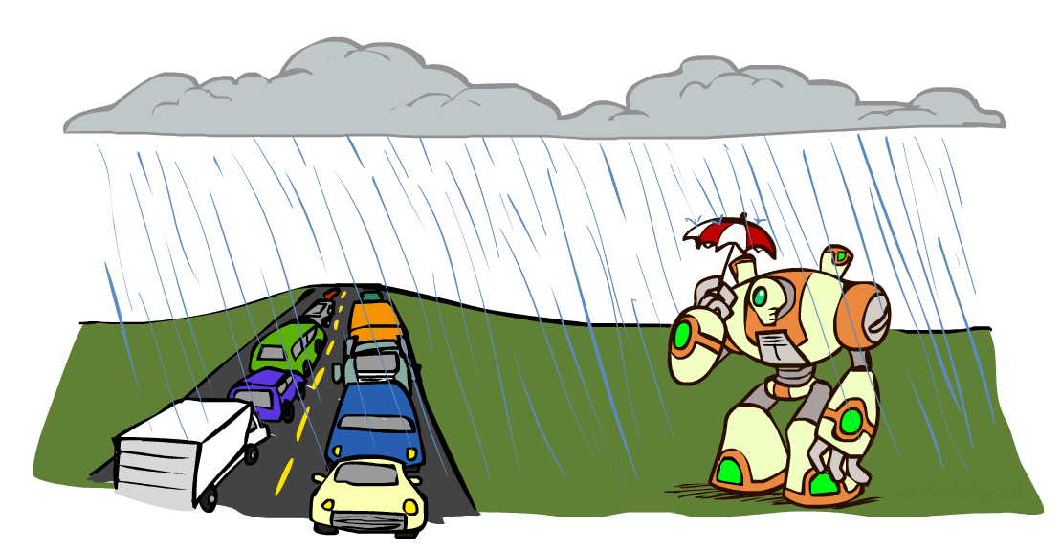
Conditional Independence
What about this domain:
Traffic
Umbrella
Raining
Notes:
5:13

Slide 4
Conditional Independence and the Chain Rule
Chain rule:
Trivial decomposition:
With assumption of conditional independence:
Bayes’ nets / graphical models help us express conditional independence assumptions
Notes:
5:15

Slide 5
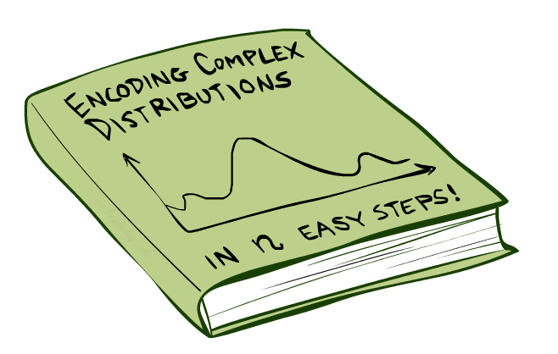
Bayes’Nets: Big Picture

Slide 6
Bayes’ Nets: Big Picture
Two problems with using full joint distribution tables as our probabilistic models:
Unless there are only a few variables, the joint is WAY too big to represent explicitly
Unintuitive. Where do these probabilities come from?
Bayes’ nets: a technique for describing complex joint distributions (models) using simple, local distributions (conditional probabilities)
More properly called graphical models
We describe how variables locally interact
Local interactions chain together to give global, indirect interactions
For about 10 min, we’ll be vague about how these interactions are specified
Notes:
Use a graph to model a probability distribution
5:17

Slide 7
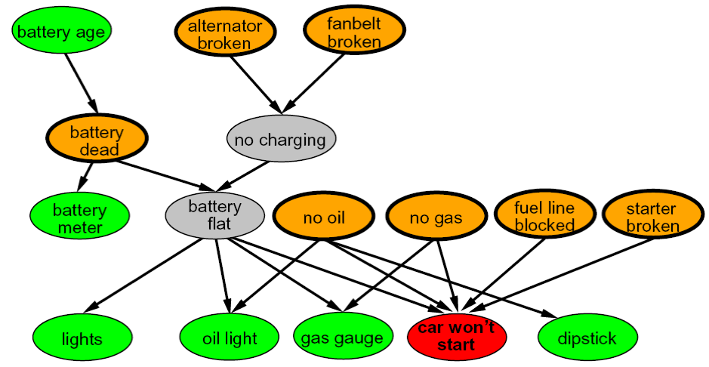
Example Bayes’ Net: Car
Notes:
Diagnosis system: example of a problem we might want to solve with probabilistic inference
Green and red: observable
Orange: possible explanations, we want to know which
Gray: unobservable and not directly what we care about, but mediates causal pathways
5:18

Slide 8
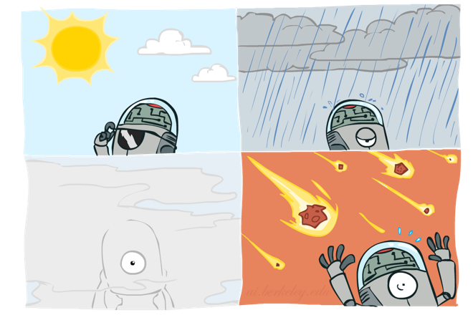
Graphical Model Notation
Nodes: variables (with domains)
Can be assigned (observed) or unassigned (unobserved)
Arcs: interactions
Indicate “direct influence” between variables
Formally: encode conditional independence assumptions (more later)
For now: imagine that arrows mean direct causation (in general, they don’t!)
Notes:
5:21

Slide 9
Example: Coin Flips
N independent coin flips
No interactions between variables: absolute independence
X₁
X₂
X_{n}
Notes:
5:22

Slide 10
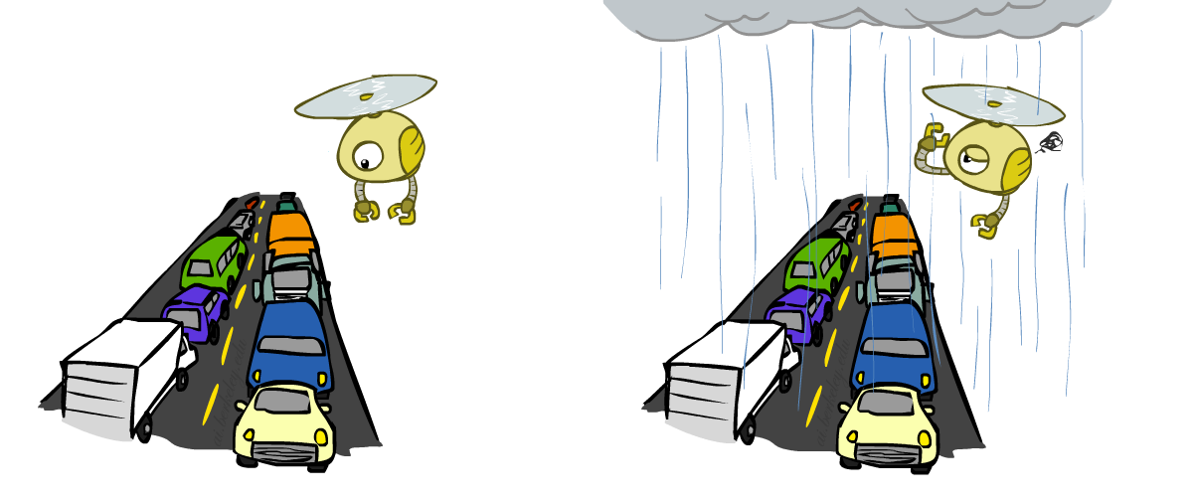
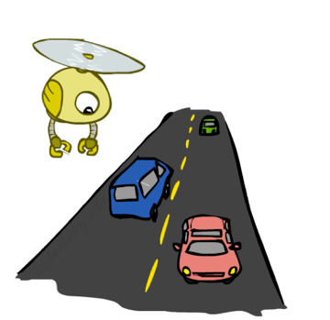
Example: Traffic
Variables:
R: It rains
T: There is traffic
Model 1: independence
Why is an agent using model 2 better?
Model 2: rain causes traffic
R
R
T
T
Notes:
5:23

Slide 11
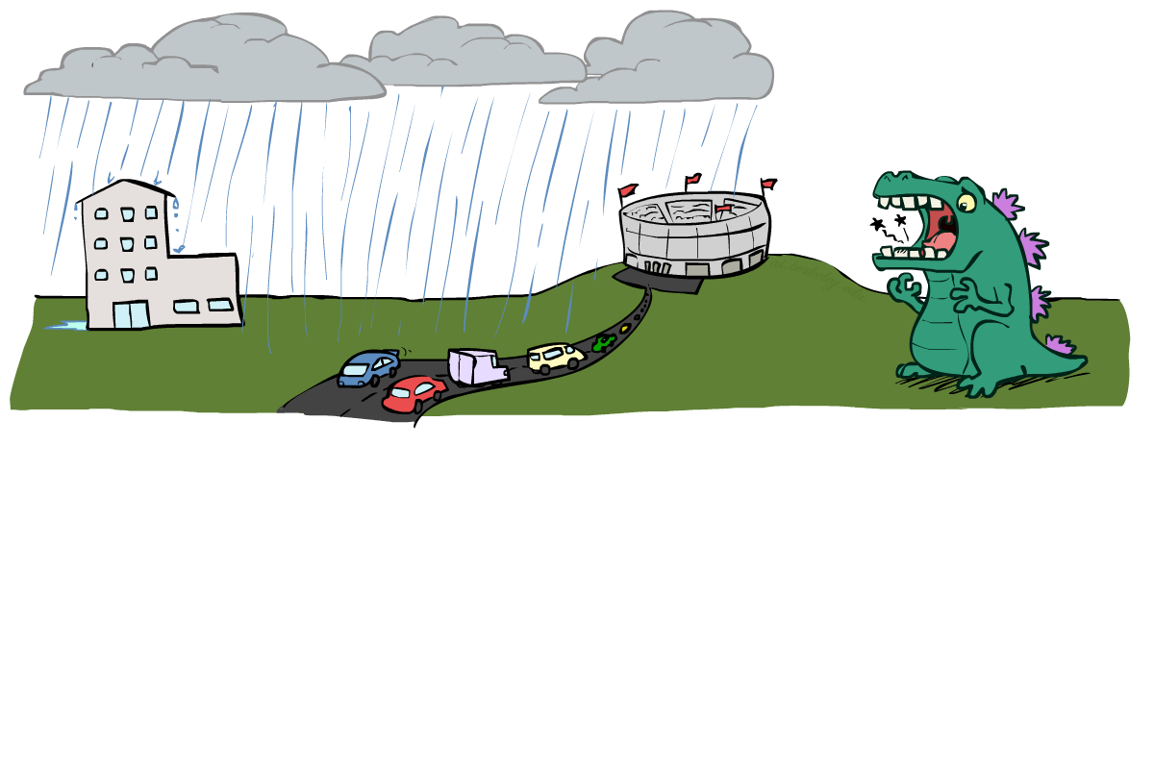
Example: Traffic II
Let’s build a causal graphical model!
Variables
T: Traffic
R: It rains
L: Low pressure
D: Roof drips
B: Ballgame
C: Cavity
Notes:
5:27

Slide 12
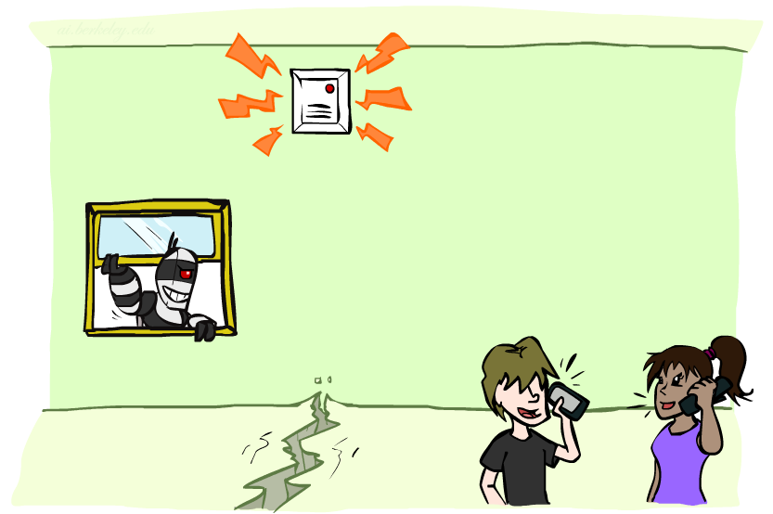
Example: Alarm Network
Variables
B: Burglary
A: Alarm goes off
M: Mary calls
J: John calls
E: Earthquake!
Notes:
5:28

Slide 13
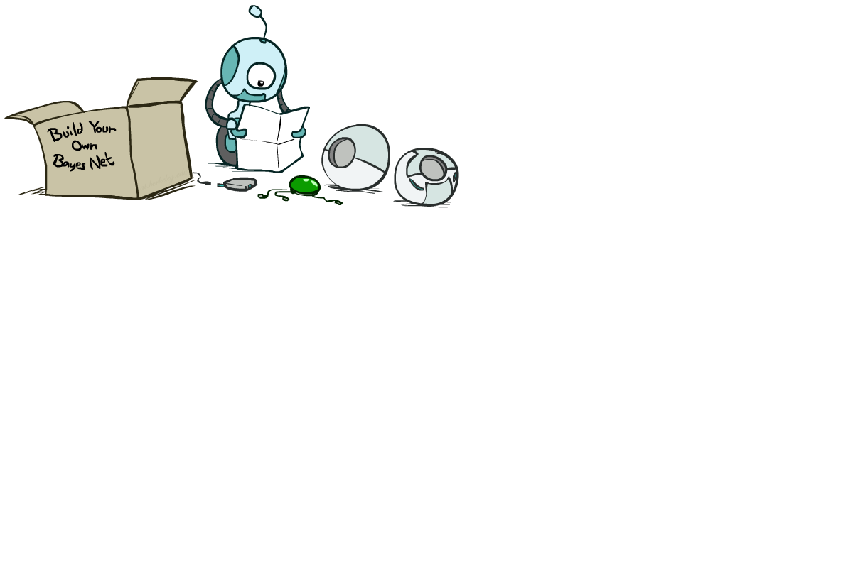
Bayes’ Net Semantics

Slide 14
Bayes’ Net Semantics
A set of nodes, one per variable X
A directed, acyclic graph
A conditional distribution for each node
A collection of distributions over X, one for each combination of parents’ values
CPT: conditional probability table
A₁
A_{n}
X
A Bayes net = Topology (graph) + Local Conditional Probabilities
Notes:
Definition of mathematical object using constituent parts
Like search problem, CSP, MDP, etc.
5:31

Slide 15
Probabilities in BNs
Bayes’ nets implicitly encode joint distributions
As a product of local conditional distributions
To see what probability a BN gives to a full assignment, multiply all the relevant conditionals together:
Example:
Notes:
5:33

Slide 16
Probabilities in BNs
Why are we guaranteed that setting
results in a proper joint distribution?
Chain rule (valid for all distributions):
Assume conditional independences:
→ Consequence:
Not every BN can represent every joint distribution
The topology enforces certain conditional independencies
Notes:
5:36

Slide 17
Example: Coin Flips
X₁
X₂
X_{n}
h | 0.5
t | 0.5
h | 0.5
t | 0.5
h | 0.5
t | 0.5
Only distributions whose variables are absolutely independent can be represented by a Bayes’ net with no arcs.
Note: Now that we know the true meaning of an edge, we can see that it doesn’t necessarily mean causality. We could add an edge between coins and still have a valid BN representing the same distribution; just because X1 and X2 are independent doesn’t mean we can’t write P(X2 | X1).
Notes:
5:37

Slide 18
Example: Traffic
R
+r | 1/4
-r | 3/4
+r | +t | 3/4
 | -t | 1/4
T
-r | +t | 1/2
 | -t | 1/2
On the point of causality: it’s also possible to compute P(T) and P(R | T) using Bayes’ rule, so we could even have a Bayes’ net with the edge reversed to represent this distribution.
Notes:
5:38

Slide 19
Example: Alarm Network
B | P(B)
+b | 0.001
-b | 0.999
E | P(E)
+e | 0.002
-e | 0.998
Burglary
Earth-quake
Alarm
B | E | A | P(A|B,E)
+b | +e | +a | 0.95
+b | +e | -a | 0.05
+b | -e | +a | 0.94
+b | -e | -a | 0.06
-b | +e | +a | 0.29
-b | +e | -a | 0.71
-b | -e | +a | 0.001
-b | -e | -a | 0.999
John calls
Mary calls
A | J | P(J|A)
+a | +j | 0.9
+a | -j | 0.1
-a | +j | 0.05
-a | -j | 0.95
A | M | P(M|A)
+a | +m | 0.7
+a | -m | 0.3
-a | +m | 0.01
-a | -m | 0.99
Notes:
demo

Slide 20
Example: Alarm Network
B | P(B)
+b | 0.001
-b | 0.999
E | P(E)
+e | 0.002
-e | 0.998
B
E
A
A | J | P(J|A)
+a | +j | 0.9
+a | -j | 0.1
-a | +j | 0.05
-a | -j | 0.95
A | M | P(M|A)
+a | +m | 0.7
+a | -m | 0.3
-a | +m | 0.01
-a | -m | 0.99
B | E | A | P(A|B,E)
+b | +e | +a | 0.95
+b | +e | -a | 0.05
+b | -e | +a | 0.94
+b | -e | -a | 0.06
-b | +e | +a | 0.29
-b | +e | -a | 0.71
-b | -e | +a | 0.001
-b | -e | -a | 0.999
J
M
Notes:
5:41

Slide 21
Example: Alarm Network
B | P(B)
+b | 0.001
-b | 0.999
E | P(E)
+e | 0.002
-e | 0.998
B
E
A
A | J | P(J|A)
+a | +j | 0.9
+a | -j | 0.1
-a | +j | 0.05
-a | -j | 0.95
A | M | P(M|A)
+a | +m | 0.7
+a | -m | 0.3
-a | +m | 0.01
-a | -m | 0.99
B | E | A | P(A|B,E)
+b | +e | +a | 0.95
+b | +e | -a | 0.05
+b | -e | +a | 0.94
+b | -e | -a | 0.06
-b | +e | +a | 0.29
-b | +e | -a | 0.71
-b | -e | +a | 0.001
-b | -e | -a | 0.999
J
M
Notes:
5:41

Slide 22
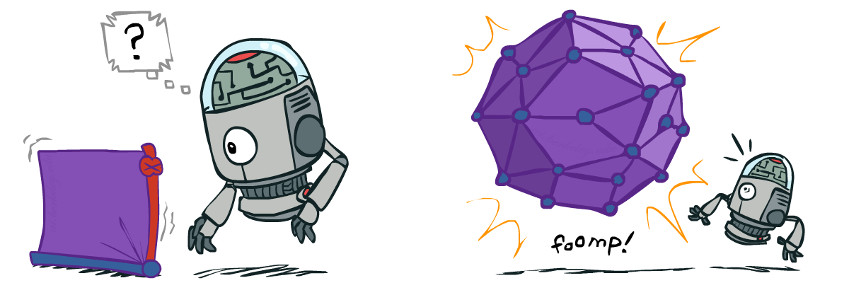
Size of a Bayes’ Net
How big is a joint distribution over N Boolean variables?
2^{N}
How big is an N-node net if nodes have up to k parents?
O(N * 2^{k+1})
Both give you the power to calculate
BNs: Huge space savings!
Also faster to answer queries (coming)
Notes:
5:43

Slide 23
Probability Recap
Conditional probability
Product rule
Chain rule
X, Y independent if and only if:
X and Y are conditionally independent given Z if and only if:

Slide 24
Bayes’ Nets
A Bayes’ net is an
efficient encoding
of a probabilistic
model of a domain
Questions we can ask:
Inference: given a fixed BN, what is P(X | e)?
Representation: given a BN graph, what kinds of distributions can it encode?
Modeling: what BN is most appropriate for a given domain?

Slide 25
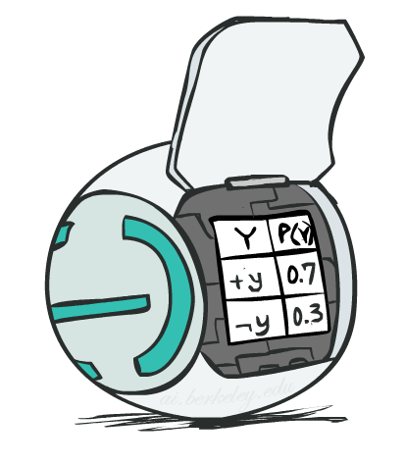
Bayes’ Net Semantics
A directed, acyclic graph, one node per random variable
A conditional probability table (CPT) for each node
A collection of distributions over X, one for each combination of parents’ values
Bayes’ nets implicitly encode joint distributions
As a product of local conditional distributions
To see what probability a BN gives to a full assignment, multiply all the relevant conditionals together:

Slide 26
Example: Alarm Network
B | P(B)
+b | 0.001
-b | 0.999
E | P(E)
+e | 0.002
-e | 0.998
B
E
A
A | J | P(J|A)
+a | +j | 0.9
+a | -j | 0.1
-a | +j | 0.05
-a | -j | 0.95
A | M | P(M|A)
+a | +m | 0.7
+a | -m | 0.3
-a | +m | 0.01
-a | -m | 0.99
B | E | A | P(A|B,E)
+b | +e | +a | 0.95
+b | +e | -a | 0.05
+b | -e | +a | 0.94
+b | -e | -a | 0.06
-b | +e | +a | 0.29
-b | +e | -a | 0.71
-b | -e | +a | 0.001
-b | -e | -a | 0.999
J
M
Notes:
demo

Slide 27
Example: Alarm Network
B | P(B)
+b | 0.001
-b | 0.999
E | P(E)
+e | 0.002
-e | 0.998
B
E
A
A | J | P(J|A)
+a | +j | 0.9
+a | -j | 0.1
-a | +j | 0.05
-a | -j | 0.95
A | M | P(M|A)
+a | +m | 0.7
+a | -m | 0.3
-a | +m | 0.01
-a | -m | 0.99
B | E | A | P(A|B,E)
+b | +e | +a | 0.95
+b | +e | -a | 0.05
+b | -e | +a | 0.94
+b | -e | -a | 0.06
-b | +e | +a | 0.29
-b | +e | -a | 0.71
-b | -e | +a | 0.001
-b | -e | -a | 0.999
J
M
Notes:
demo

Slide 28
Bayes’ Nets
Representation
Conditional Independences
Probabilistic Inference
Learning Bayes’ Nets from Data
Notes:
5:45

Slide 29
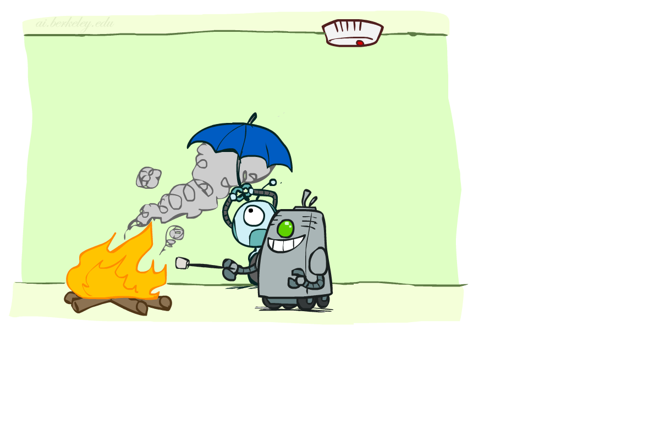
Conditional Independence
X and Y are independent if
X and Y are conditionally independent given Z
(Conditional) independence is a property of a distribution
Example:

Slide 30
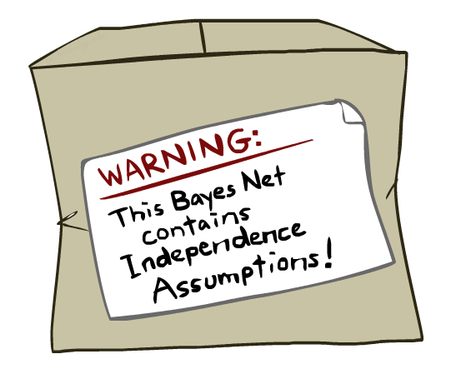
Bayes Nets: Assumptions
Assumptions we are required to make to define the Bayes net when given the graph:
Beyond above “chain rule → Bayes net” conditional independence assumptions
Often additional conditional independences
They can be read off the graph
Why do we care?
Modeling: understand assumptions made when choosing a Bayes net graph
Interpretation: see the consequences of your choice of model
Notes:
5:47

Slide 31
Example
X
Y
Z
W
Implied conditional independence assumptions?
Notes:
5:49

Slide 32
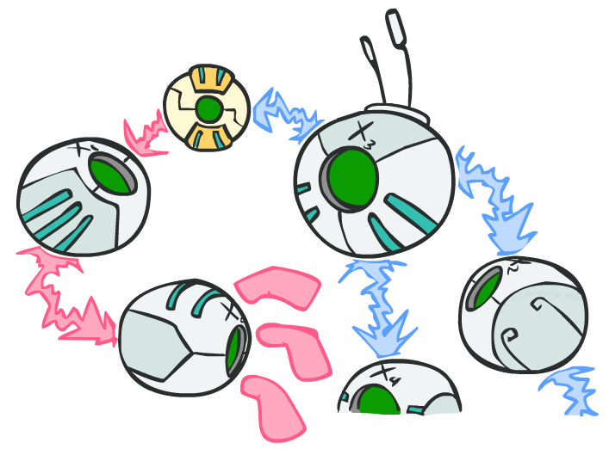
D-separation
Notes:
Break until 5:50?

Slide 33
Independence in a BN
Question of the day: are two nodes independent given certain evidence?
If yes, can prove using algebra (tedious in general)
If no, can prove with a counterexample
Let’s look at some examples
(turns out any larger example can be reduced to these smaller ones we are about to cover)
Notes:
5:50

Slide 34
D-separation: Outline
Study independence properties for triples
Analyze complex cases in terms of member triples

Slide 35
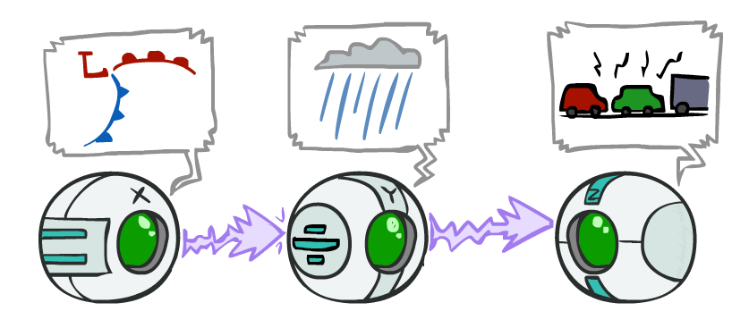
Causal Chains
This configuration is a “causal chain”
Guaranteed X independent of Z ? No!
Counterexample:
Low pressure causes rain causes traffic,
high pressure causes no rain causes no
traffic
In numbers:
P( +y | +x ) = 1, P( -y | - x ) = 1,
P( +z | +y ) = 1, P( -z | -y ) = 1
X: Low pressure Y: Rain Z: Traffic
Notes:
5:52

Slide 36
Causal Chains
This configuration is a “causal chain”
Guaranteed X independent of Z given Y?
X: Low pressure Y: Rain Z: Traffic
Yes!
Evidence along the chain “blocks” the influence
Notes:
5:54

Slide 37
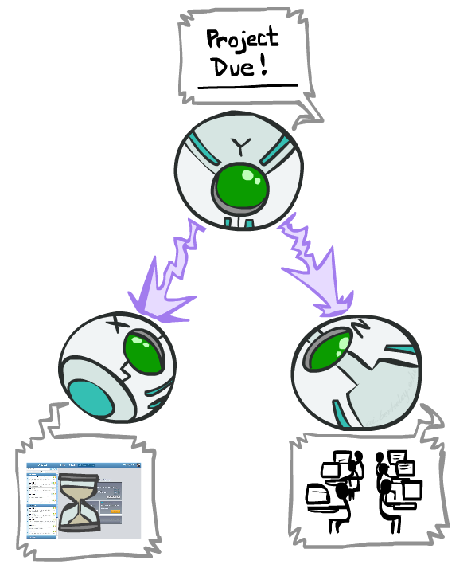
Common Cause
This configuration is a “common cause”
Guaranteed X independent of Z ? No!
Counterexample:
Project due causes both forums busy
and lab full
In numbers:
P( +x | +y ) = 1, P( -x | -y ) = 1,
P( +z | +y ) = 1, P( -z | -y ) = 1
Y: Project due
X: Forums busy
Z: Lab full
Notes:
5:55

Slide 38
Common Cause
This configuration is a “common cause”
Guaranteed X and Z independent given Y?
Y: Project due
X: Forums busy
Z: Lab full
Yes!
Observing the cause blocks influence between effects.
Notes:
5:57

Slide 39
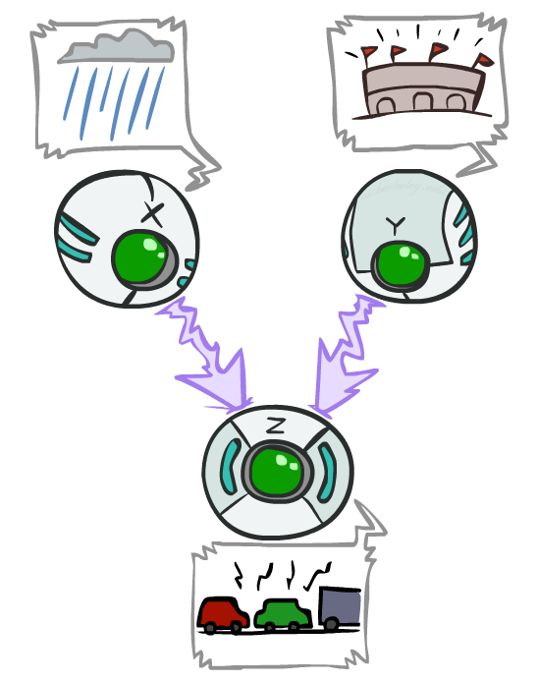
Common Effect
Last configuration: two causes of one effect (v-structures)
Are X and Y independent?
Yes: the ballgame and the rain cause traffic, but they are not correlated
Still need to prove they must be (try it!)
Are X and Y independent given Z?
No: seeing traffic puts the rain and the ballgame in competition as explanation.
Can be shown with numbers (try it!)
This is backwards from the other cases
Observing an effect activates influence between possible causes.
Also true if we observe an effect of Z (such as a traffic report) but not Z itself
X: Raining
Y: Ballgame
Z: Traffic
Notes:
6:00

Slide 40
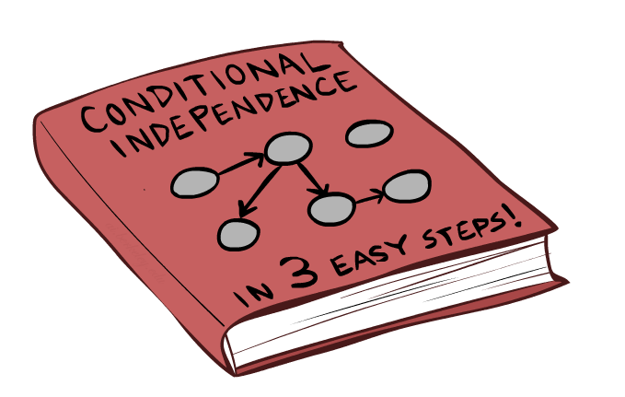
The General Case
Notes:
Break until 6:00?

Slide 41
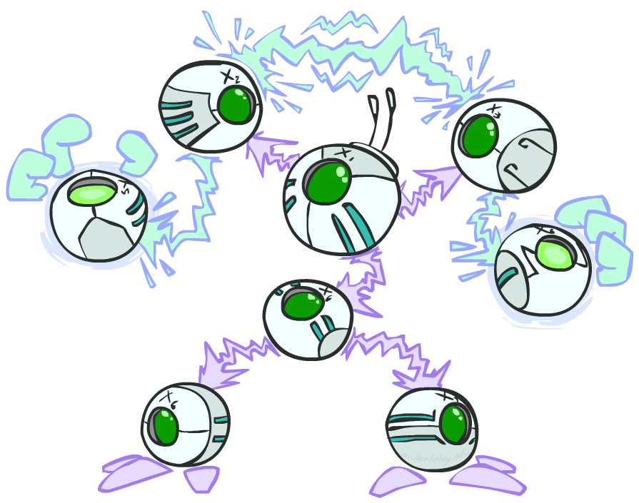
The General Case
General question: in a given BN, are two variables independent (given evidence)?
Solution: analyze the graph
Notes:
6:01

Slide 42
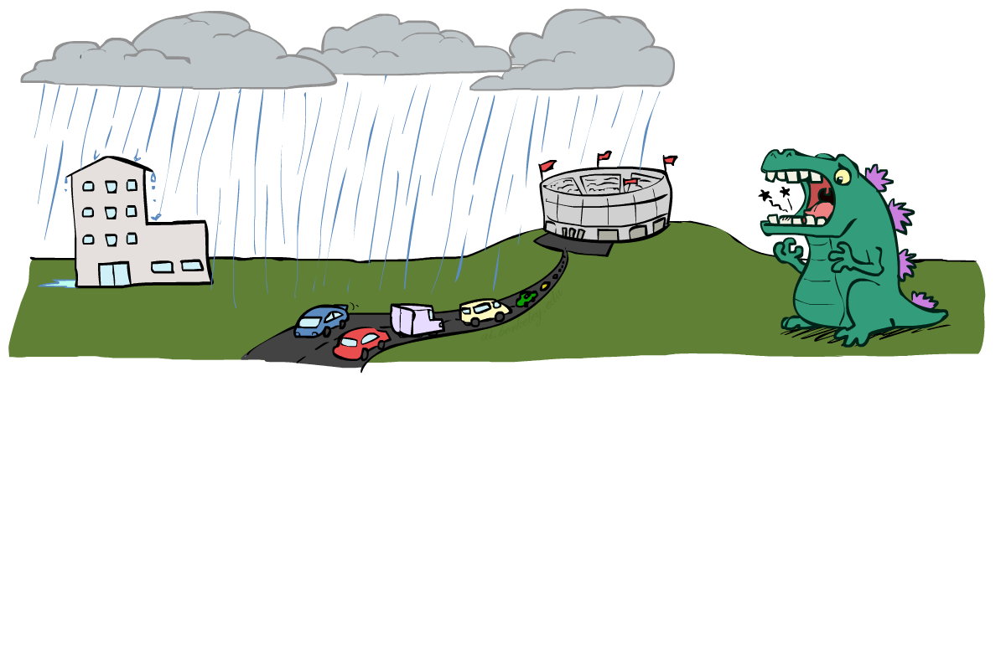
Reachability
Recipe: shade evidence nodes, look for paths in the resulting graph
Attempt 1:
if two nodes are connected by an undirected path not blocked by a shaded node, call them “connected”
If variables are not connected, i.e. “separated,” they can’t influence each other through any path in the graph
Hence they are conditionally independent given the shaded nodes!
Almost works, but not quite
Where does it break?
Answer: the v-structure at T doesn’t count as a link in a path unless “active”
How can we fix this?
L
R
B
D
T
Notes:
6:03

Slide 43
Fixing Reachability
Recipe: shade evidence nodes, look for paths in the resulting graph
Attempt 2:
if two nodes are connected by an undirected path not blocked by a shaded node…
…except for v-structures, where the rules are reversed and the node must be shaded…
… call them “d-connected.”
If variables are not connected, i.e. “d-separated,” they can’t influence each other through any path in the graph
Hence they are conditionally independent given the shaded nodes!
Let’s formalize this into an algorithm
L
R
B
D
T
Notes:
6:06

Slide 44
D-Separation
Goal: determine whether two variables X and Y are conditionally independent given a set of conditional variables Z
Steps:
Shade all nodes corresponding to variables in set Z
Enumerate all candidate paths (ignoring direction of edges) from X to Z
For each path, check if it “d-connects” X and Y
If no path d-connects them, they are d-separated!
nodes
d-separated
X
A
Y
Z1
Z1
Z2
Z2
Z = {Z1, Z2}
Notes:
6:11

Slide 45
Active / Inactive Paths
Question: How can we formalize the “check if this path d-connects X and Y” step?
Call a path that d-connects X and Y an “active path”
Any path in a graph can be decomposed into triples of variables
A path is active if and only if each triple is active
A triple is active or not depending on the middle node (see table)
X
A
Y
Z2
X
Active!
Active Triples
Inactive Triples
A
Y
A
Active!
Z2
Z2
So this path is active!
Notes:
6:16

Slide 46
D-Separation: Full picture
Goal: determine whether two variables X and Y are conditionally independent given a set of conditional variables Z
Steps:
Shade all nodes corresponding to variables in set Z
Enumerate all candidate paths (ignoring direction of edges) from X to Z
For each path:
Decompose the path into triples
If all triples are active, this path is active and d-connects them
If no path is active, they are d-separated
X
A
Y
Z1
Z1
Z2
Z2
Z = {Z1, Z2}
Notes:
6:18

Slide 47
Active / Inactive Paths
Question: Are X and Y conditionally independent given evidence variables {Z}?
Yes, if X and Y “d-separated” by Z
Consider all (undirected) paths from X to Y
No active paths = independence!
A path is active if each triple is active:
Causal chain A → B → C where B is unobserved (either direction)
Common cause A ← B → C where B is unobserved
Common effect (aka v-structure)
A → B ← C where B or one of its descendents is observed
All it takes to block a path is a single inactive segment
Active Triples
Inactive Triples

Slide 48
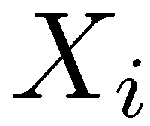
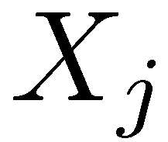
D-Separation
?
Query:
Check all (undirected!) paths between and
If one or more active, then independence not guaranteed
Otherwise (i.e. if all paths are inactive),
then independence is guaranteed

Slide 49
Example
Yes
R
B
No
No
T
T’
Notes:
T’: traffic report
6:20

Slide 50
Example
L
Yes
R
B
Yes
No
D
T
No
Yes
T’
Notes:
6:22

Slide 51
Example
Variables:
R: Raining
T: Traffic
D: Roof drips
S: I’m sad
Questions:
R
T
D
S
No
Yes
No
Notes:
6:24

Slide 52
Structure Implications
Given a Bayes net structure, can run d-separation algorithm to build a complete list of conditional independences that are necessarily true of the form
This list determines the set of probability distributions that can be represented
Notes:
Enumerate all possible queries and run the algorithm
Not something we’d actually do, but useful for understanding what the graph tells us about the joint distribution before even looking at the CPTs
6:26

Slide 53
Computing All Independences
Y
X
Z
Y
X
Z
X
Z
Y
Y
X
Z

Slide 54
Topology Limits Distributions
Given some graph topology G, only certain joint distributions can be encoded
The graph structure guarantees certain (conditional) independences
(There might be more independence)
Adding arcs increases the set of distributions, but has several costs
Full conditioning can encode any distribution
Y
Y
X
Z
X
Z
Y
X
Z
Y
X
Z
Y
Y
Y
X
Z
X
Z
X
Z
Y
Y
Y
X
Z
X
Z
X
Z
Notes:
6:29

Slide 55
Bayes Nets Representation Summary
Bayes nets compactly encode joint distributions
Guaranteed independencies of distributions can be deduced from BN graph structure
D-separation gives precise conditional independence guarantees from graph alone
A Bayes’ net’s joint distribution may have further (conditional) independence that is not detectable until you inspect its specific distribution
Notes:
6:30

Slide 56
Bayes’ Nets
Representation
Conditional Independences
Probabilistic Inference
Enumeration (exact, exponential complexity)
Variable elimination (exact, worst-case
exponential complexity, often better)
Probabilistic inference is NP-complete
Sampling (approximate)
Learning Bayes’ Nets from Data
Notes:
6:30

