Slide 1
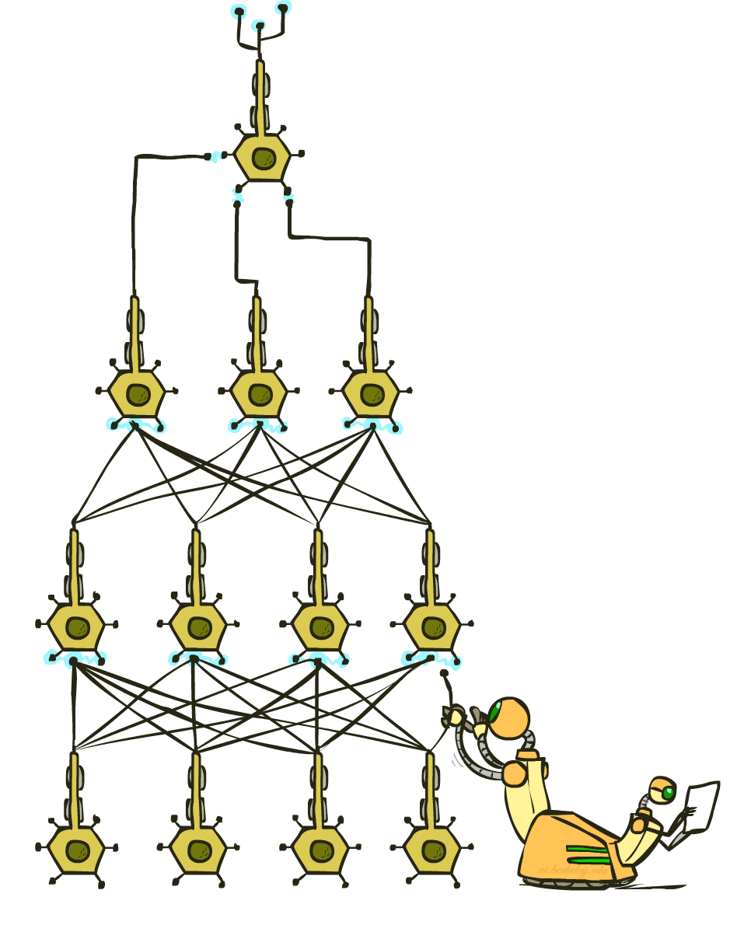
CS 4/527: Artificial Intelligence
Deep Learning
Instructor: Jared Saia--- University of New Mexico
[These slides created by Dan Klein, Pieter Abbeel, Anca Dragan, Josh Hug for CS188 Intro to AI at UC Berkeley. All CS188 materials available at http://ai.berkeley.edu.]
Notes:
Please retain proper attribution, including the reference to ai.berkeley.edu. Thanks!
1

Slide 2

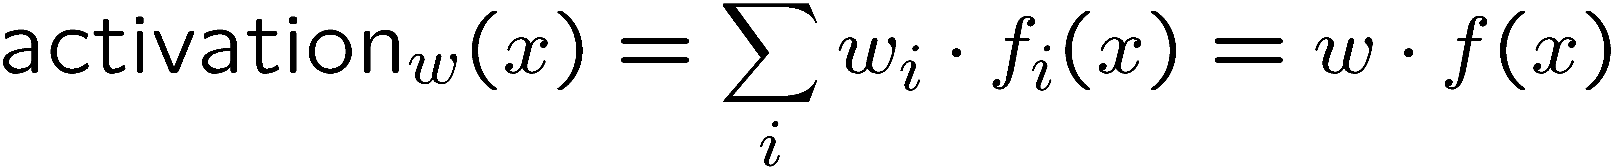
Last Time: Linear Classifiers
Inputs are feature values
Each feature has a weight
Sum is the activation
If the activation is:
  Positive, output +1
  Negative, output -1
w₁
f₁
Σ
w₂
>0?
f₂
w₃
f₃

Slide 3
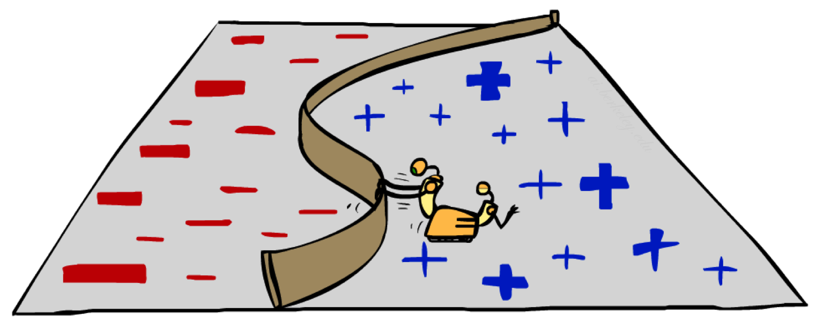
Non-Linearity

Slide 4
Non-Linear Separators
Data that is linearly separable works out great for linear decision rules:
But what are we going to do if the dataset is just too hard?
How about… mapping data to a higher-dimensional space:
0
x
0
x
x²
0
x
This and next slide adapted from Ray Mooney, UT

Slide 5

Computer Vision
Notes:
5

Slide 6
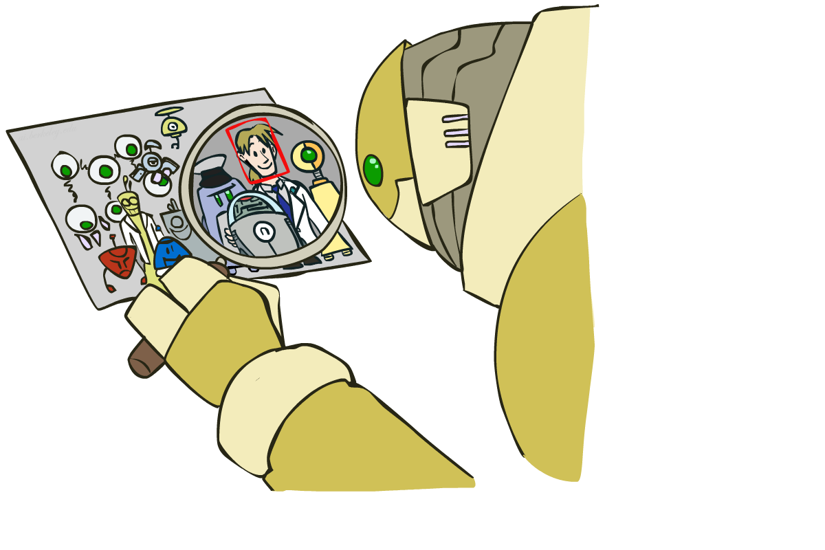
Object Detection
Notes:
6

Slide 7

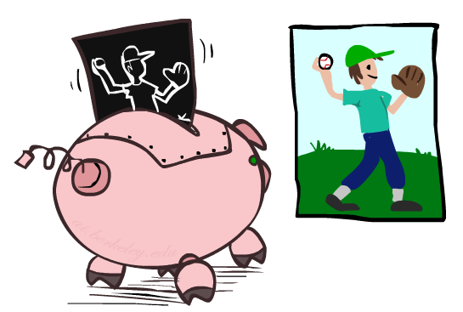

Manual Feature Design
Notes:
7

Slide 8
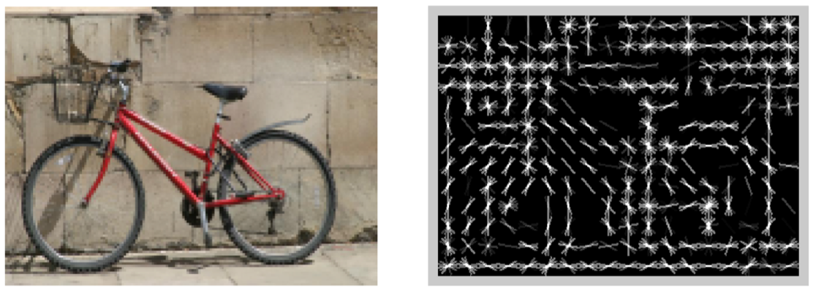
Features and Generalization
[Dalal and Triggs, 2005]
Notes:
8

Slide 9
Features and Generalization
Image
HoG
Notes:
HoG, SIFT, Daisy
Deformable part models
9

Slide 10
Manual Feature Design → Deep Learning
Manual feature design requires:
  Domain-specific expertise
  Domain-specific effort
What if we could learn the features, too?
  -> Deep Learning
Notes:
10

Slide 11
Perceptron
w₁
f₁
Σ
w₂
>0?
f₂
w₃
f₃
Notes:
11

Slide 12
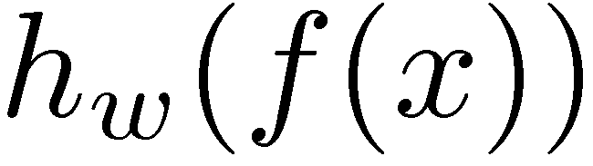
Two-Layer Perceptron Network
w₁₁
Σ
>0?
w₂₁
w₃₁
w₁
f₁
w₁₂
Σ
Σ
w₂₂
>0?
w₂
f₂
>0?
w₃₂
w₃
f₃
w₁₃
Σ
w₂₃
>0?
w₃₃
Notes:
12

Slide 13
N-Layer Perceptron Network
Σ
Σ
Σ
>0?
>0?
>0?
…
f₁
Σ
Σ
Σ
Σ
>0?
>0?
>0?
>0?
f₂
…
f₃
Σ
Σ
Σ
>0?
>0?
…
>0?
Notes:
13

Slide 14
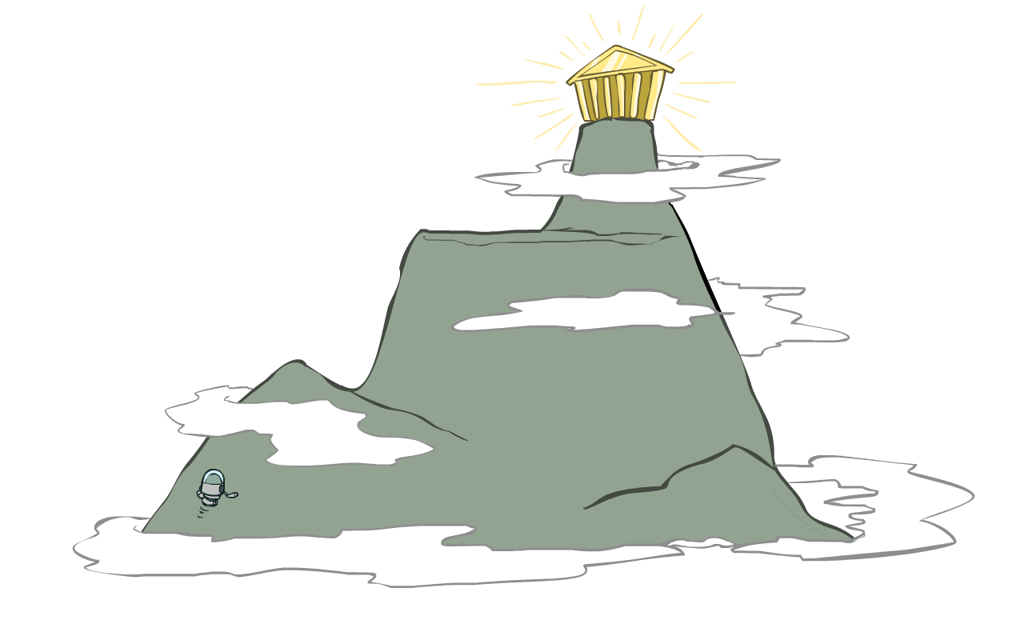
Local Search
Simple, general idea:
  Start wherever
  Repeat: move to the best neighboring state
  If no neighbors better than current, quit
  Neighbors = small perturbations of w
Properties
  Plateaus and local optima
How to escape plateaus and find a good local optimum?
How to deal with very large parameter vectors? E.g.,
Notes:
14

Slide 15
Perceptron: Accuracy via Zero-One Loss
w₁
f₁
Σ
w₂
>0?
f₂
w₃
f₃
Objective: Classification Accuracy
Notes:
15

Slide 16
Perceptron: Accuracy via Zero-One Loss
w₁
f₁
Σ
w₂
>0?
f₂
w₃
f₃
Objective: Classification Accuracy
  Issue: many plateaus → how to measure incremental progress?
Notes:
16

Slide 17
Soft-Max
Score for y=1: Score for y=-1:
Probability of label:
Notes:
17

Slide 18
Soft-Max
Score for y=1: Score for y=-1:
Probability of label:
Objective:
Log:
Notes:
18

Slide 19
Two-Layer Neural Network
w₁₁
Σ
w₂₁
>0?
w₃₁
w₁
f₁
w₁₂
Σ
Σ
w₂₂
>0?
w₂
f₂
w₃₂
w₃
f₃
w₁₃
Σ
w₂₃
>0?
w₃₃
Notes:
19

Slide 20
N-Layer Neural Network
Σ
Σ
Σ
>0?
>0?
>0?
…
f₁
Σ
Σ
Σ
Σ
>0?
>0?
>0?
f₂
…
f₃
Σ
Σ
Σ
>0?
>0?
…
>0?
Notes:
20

Slide 21
Our Status
Our objective
  Changes smoothly with changes in w
  Doesn’t suffer from the same plateaus as the perceptron network
Challenge: how to find a good w ?
Equivalently:

Slide 22
1-d optimization
Could evaluate and
  Then step in best direction
Or, evaluate derivative:
  Which tells which direction to step into

Slide 23
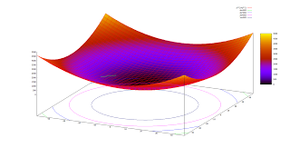
2-D Optimization
Source: Thomas Jungblut’s Blog

Slide 24
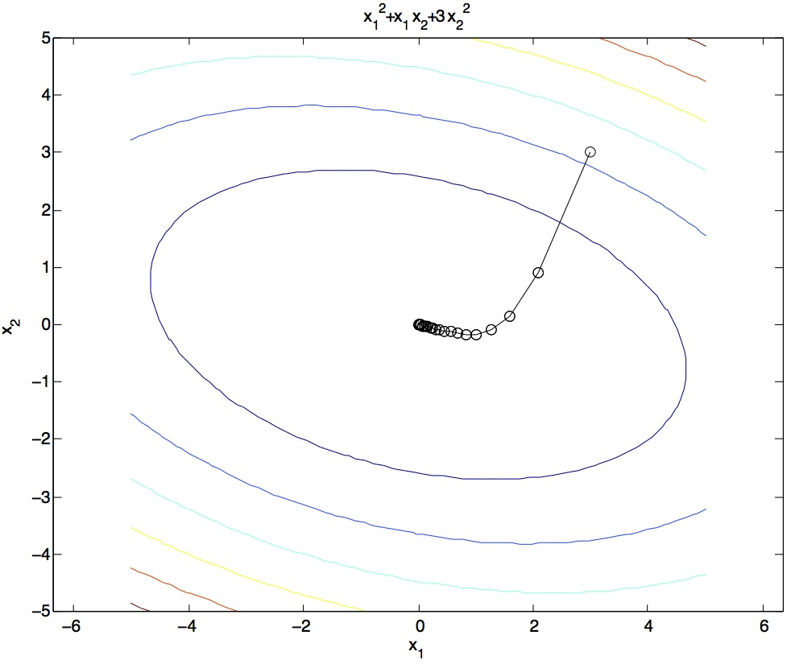
Steepest Descent
Idea:
  Start somewhere
  Repeat: Take a step in the steepest descent direction
Figure source: Mathworks

Slide 25
Steepest Direction
Steepest Direction = direction of the gradient

Slide 26

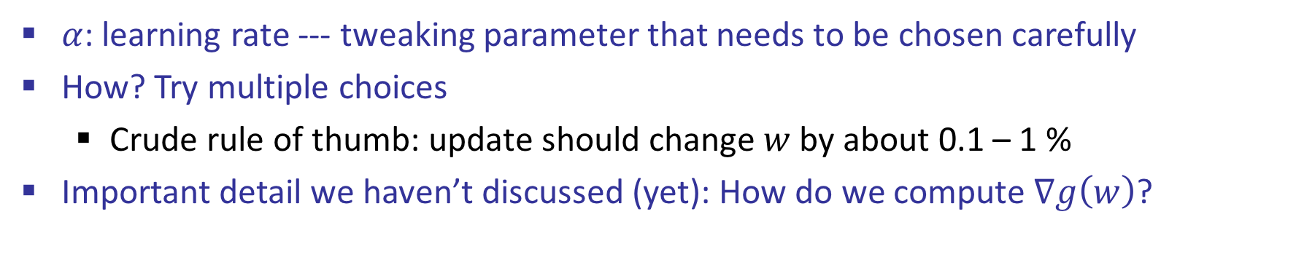
Optimization Procedure: Gradient Descent
Init:
For i = 1, 2, …

Slide 27
Computing Gradients
Gradient = sum of gradients for each term
How do we compute the gradient for one term about the current weights?

Slide 28
N-Layer Neural Network
Σ
Σ
Σ
>0?
>0?
>0?
…
f₁
Σ
Σ
Σ
Σ
>0?
>0?
>0?
f₂
…
f₃
Σ
Σ
Σ
>0?
>0?
…
>0?
Notes:
28

Slide 29

Represent as Computational Graph
x
*
s (scores)
hinge loss
+
L
W
R
29

Slide 30
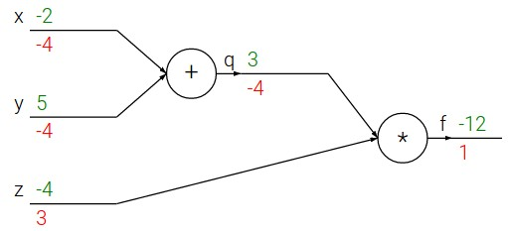

e.g. x = -2, y = 5, z = -4
30

Slide 31





e.g. x = -2, y = 5, z = -4
Want:
31

Slide 32

e.g. x = -2, y = 5, z = -4
Want:
32

Slide 33
e.g. x = -2, y = 5, z = -4
Want:
33

Slide 34
e.g. x = -2, y = 5, z = -4
Want:
34

Slide 35
e.g. x = -2, y = 5, z = -4
Want:
35

Slide 36

e.g. x = -2, y = 5, z = -4
Want:
36

Slide 37
e.g. x = -2, y = 5, z = -4
Want:
37

Slide 38
e.g. x = -2, y = 5, z = -4
Want:
38

Slide 39

e.g. x = -2, y = 5, z = -4
Chain rule:
Want:
39

Slide 40
e.g. x = -2, y = 5, z = -4
Want:
40

Slide 41
e.g. x = -2, y = 5, z = -4
Chain rule:
Want:
41

Slide 42


activations
f
42

Slide 43


activations
f
“local gradient”
43

Slide 44

activations
f
“local gradient”
gradients
44

Slide 45

activations
f
“local gradient”
gradients
45

Slide 46

activations
f
“local gradient”
gradients
46

Slide 47
activations
f
“local gradient”
gradients
47

Slide 48

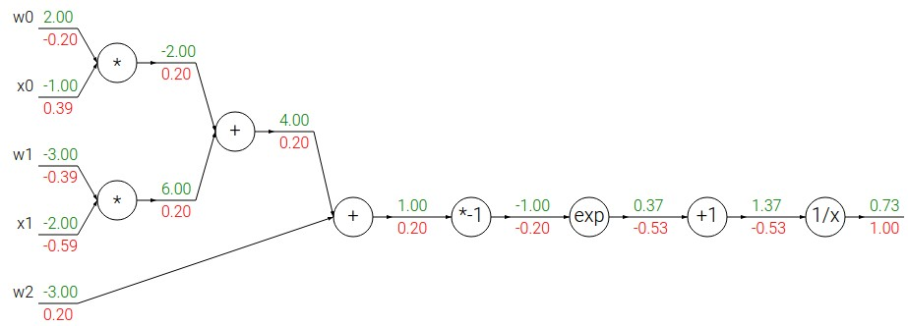
Another example:
48

Slide 49
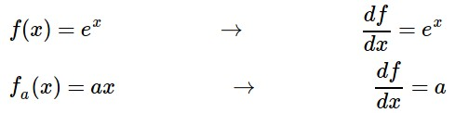
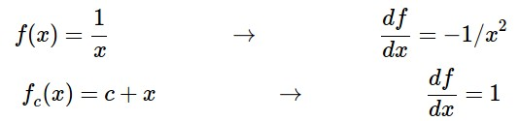
Another example:
49

Slide 50
Another example:
50

Slide 51

Another example:
51

Slide 52
Another example:
52

Slide 53

Another example:
53

Slide 54
Another example:
54

Slide 55

Another example:
55

Slide 56
Another example:
56

Slide 57
Another example:
(-1) * (-0.20) = 0.20
57

Slide 58
Another example:
58

Slide 59
Another example:
[local gradient] x [its gradient]
[1] x [0.2] = 0.2
[1] x [0.2] = 0.2 (both inputs!)
59

Slide 60
Another example:
60

Slide 61
Another example:
[local gradient] x [its gradient]
x0: [2] x [0.2] = 0.4
w0: [-1] x [0.2] = -0.2
61

Slide 62

sigmoid function
sigmoid gate
62

Slide 63
sigmoid function
sigmoid gate
(0.73) * (1 - 0.73) = 0.2
63

Slide 64
Mini-batches and Stochastic Gradient Descent
Typical objective:
= average log-likelihood of label given input
= estimate based on mini-batch 1…k
  Mini-batch gradient descent: compute gradient on mini-batch (+ cycle over mini-batches: 1..k, k+1…2k, ... ; make sure to randomize permutation of data!)
  Stochastic gradient descent: k = 1

