Slide 1


CS 188: Artificial Intelligence
Constraint Satisfaction Problems
Instructor: Jared Saia
University of New Mexico
[These slides adapted from Dan Klein and Pieter Abbeel]
Notes:
Please retain proper attribution, including the reference to ai.berkeley.edu. Thanks!

Slide 2

Constraint Satisfaction Problems
N variables
domain D
constraints
x₂
x₁
states
goal test
successor function
partial assignment
complete; satisfies constraints
assign an unassigned variable
Notes:
coloring problem; silly but good representation for real world problems, e.g. scheduling tasks that need resources – can’t run 2 tasks at the same time if they need the same resource
CSPs as a search problem

Slide 3
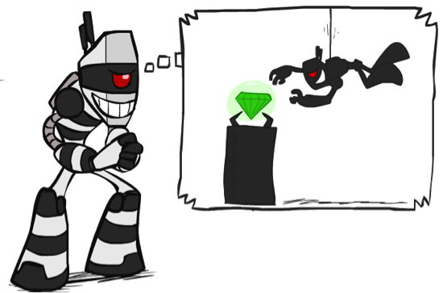

What is Search For?
Assumptions about the world: a single agent, deterministic actions, fully observed state, discrete state space
Planning: sequences of actions
  The path to the goal is the important thing
  Paths have various costs, depths
  Heuristics give problem-specific guidance
Identification: assignments to variables
  The goal itself is important, not the path
  All paths at the same depth (for some formulations)
  CSPs are specialized for identification problems

Slide 4


Constraint Satisfaction Problems
Standard search problems:
  State is a “black box”: arbitrary data structure
  Goal test can be any function over states
  Successor function can also be anything
Constraint satisfaction problems (CSPs):
  A special subset of search problems
  State is defined by variables X_{i} with values from a domain D (sometimes D depends on i)
  Goal test is a set of constraints specifying allowable combinations of values for subsets of variables
Simple example of a formal representation language
Allows useful general-purpose algorithms with more power than standard search algorithms
Notes:
Goal test has structure, it ‘s more like a manual describing a set of constraints that have to hold true

Slide 5
CSP Examples

Slide 6


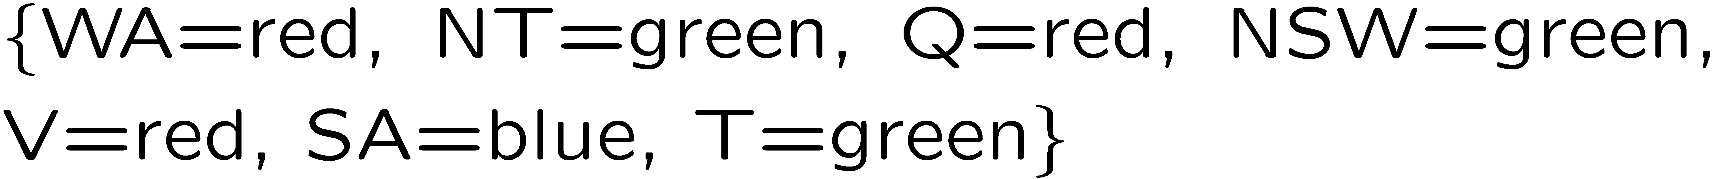
Example: Map Coloring
Variables:
Domains:
Constraints: adjacent regions must have different colors
Solutions are assignments satisfying all constraints, e.g.:
Implicit:
Explicit:

Slide 7
Constraint Graphs

Slide 8
Constraint Graphs
Binary CSP: each constraint relates (at most) two variables
Binary constraint graph: nodes are variables, arcs show constraints
General-purpose CSP algorithms use the graph structure to speed up search. E.g., Tasmania is an independent subproblem!
Notes:
Demo:
Run constraint.jar or constraint.exe, load the 5 queens problem.
Demo is just showing the n-queens applet as illustration of constraint graph, but later in lecture we’ll interact with the applet.
aispace.org will have the latest version

Slide 9


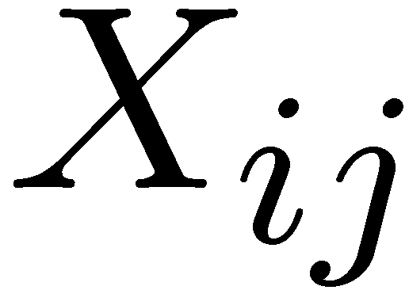

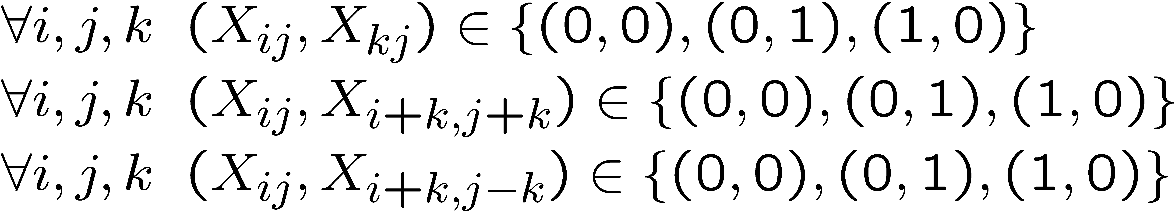
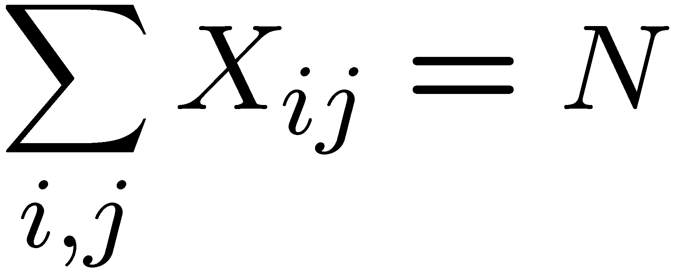
Example: N-Queens
Formulation 1:
  Variables:
  Domains:
  Constraints

Slide 10







Example: N-Queens
Formulation 2:
  Variables:
  Domains:
  Constraints:
Implicit:
Explicit:

Slide 11
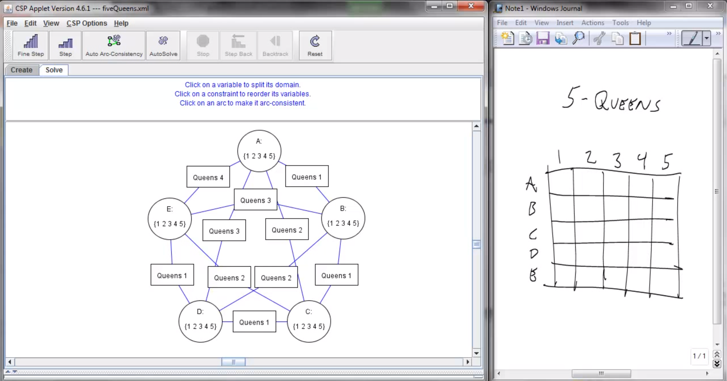
Screenshot of Demo N-Queens
Notes:
Note: the n-queens demo is used later as a demo; at this stage in lecture just the above is shown and talked about without engaging in any interaction with the applet.

Slide 12


Example: Cryptarithmetic
X₁
Variables:
Domains:
Constraints:
Notes:
0=7, R=4, W=6, U=2, T=8, F=1; 867 + 867 = 1734

Slide 13
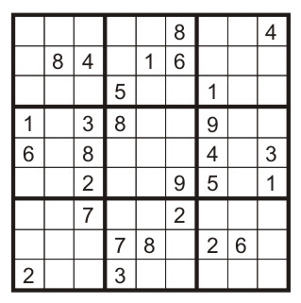
Example: Sudoku
Variables:
  Each (open) square
Domains:
  {1,2,…,9}
Constraints:
9-way alldiff for each column
9-way alldiff for each row
9-way alldiff for each region
(or can have a bunch of pairwise inequality constraints)

Slide 14
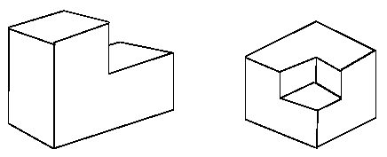
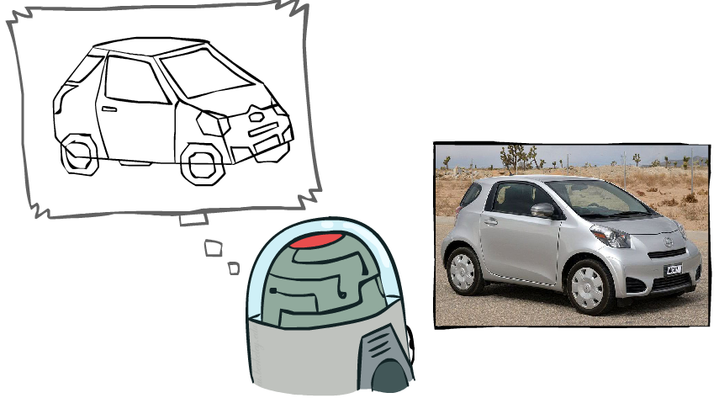
Example: The Waltz Algorithm
The Waltz algorithm is for interpreting line drawings of solid polyhedra as 3D objects
An early example of an AI computation posed as a CSP
?
Approach:
  Each intersection is a variable
  Adjacent intersections impose constraints on each other
  Solutions are physically realizable 3D interpretations

Slide 15


Example: The Waltz Algorithm
The Waltz algorithm is for interpreting line drawings of solid polyhedra as 3D objects
An early example of an AI computation posed as a CSP
?
Approach:
  Each intersection is a variable
  Adjacent intersections impose constraints on each other
  Solutions are physically realizable 3D interpretations

Slide 16
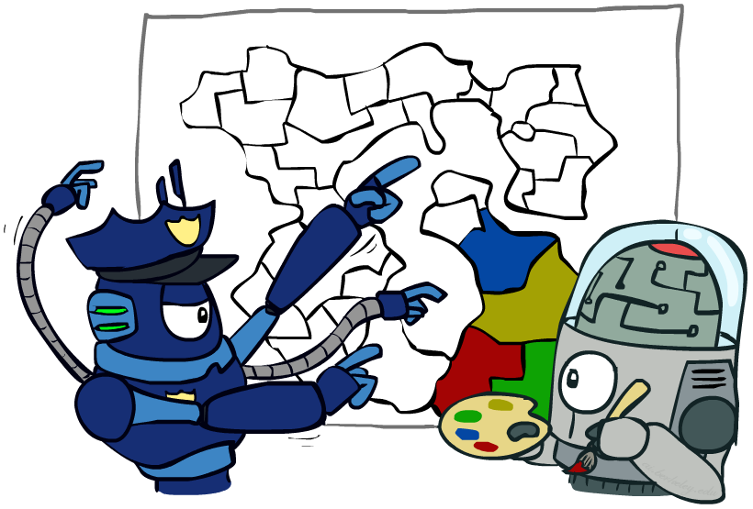
Varieties of CSPs and Constraints

Slide 17


Varieties of CSPs
Discrete Variables
  Finite domains
    Size d means O(d^{n}) complete assignments
    E.g., Boolean CSPs, including Boolean satisfiability (NP-complete)
  Infinite domains (integers, strings, etc.)
    E.g., job scheduling, variables are start/end times for each job
    Linear constraints solvable, nonlinear undecidable
Continuous variables
  E.g., start/end times for Hubble Telescope observations
  Linear constraints solvable in polynomial time by LP methods (see cs170 for a bit of this theory)

Slide 18


Varieties of Constraints
Varieties of Constraints
  Unary constraints involve a single variable (equivalent to reducing domains), e.g.:
  Binary constraints involve pairs of variables, e.g.:
  Higher-order constraints involve 3 or more variables:
  e.g., cryptarithmetic column constraints
Preferences (soft constraints):
  E.g., red is better than green
  Often representable by a cost for each variable assignment
  Gives constrained optimization problems
  (We’ll ignore these until we get to Bayes’ nets)

Slide 19
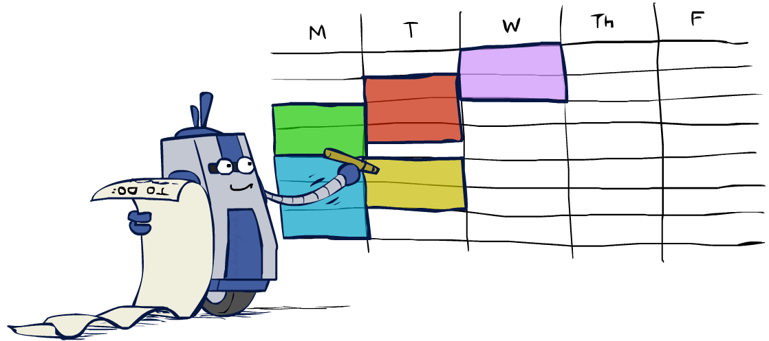
Real-World CSPs
Assignment problems: e.g., who teaches what class
Timetabling problems: e.g., which class is offered when and where?
Hardware configuration
Transportation scheduling
Factory scheduling
Circuit layout
Fault diagnosis
… lots more!
Many real-world problems involve real-valued variables…

Slide 20

Solving CSPs

Slide 21
Standard Search Formulation
Standard search formulation of CSPs
States defined by the values assigned so far (partial assignments)
  Initial state: the empty assignment, {}
  Successor function: assign a value to an unassigned variable
  Goal test: the current assignment is complete and satisfies all constraints
We’ll start with the straightforward, naïve approach, then improve it

Slide 22
Search Methods
What would BFS do?
{}
{WA=g}
{WA=r}
…
{NT=g}
…
[Demo: coloring -- dfs]
Notes:
Demo:
CS188 javascript demos -> source -> exercises -> csps -> CSPs demos -> CSPs demos.html
Settings:
Graph = Simple
Algorithm = Naïve Search
Ordering = None
Filtering = None

Slide 23
Search Methods
What would BFS do?
What would DFS do?
  let’s see!
What problems does naïve search have?
[Demo: coloring -- dfs]
Notes:
Demo:
CS188 javascript demos -> source -> exercises -> csps -> CSPs demos -> CSPs demos.html
Settings:
Graph = Simple
Algorithm = Naïve Search
Ordering = None
Filtering = None

Slide 24

Video of Demo Coloring -- DFS

Slide 25

Backtracking Search

Slide 26
Backtracking Search
Backtracking search is the basic uninformed algorithm for solving CSPs
Idea 1: One variable at a time
  Variable assignments are commutative, so fix ordering -> better branching factor!
  I.e., [WA = red then NT = green] same as [NT = green then WA = red]
  Only need to consider assignments to a single variable at each step
Idea 2: Check constraints as you go
  I.e. consider only values which do not conflict previous assignments
  Might have to do some computation to check the constraints
  “Incremental goal test”
Depth-first search with these two improvements
is called backtracking search (not the best name)
Can solve n-queens for n ≈ 25

Slide 27
Backtracking Example
[Demo: coloring -- backtracking]

Slide 28
Video of Demo Coloring – Backtracking

Slide 29
Backtracking Search
Backtracking = DFS + variable-ordering + fail-on-violation
What are the choice points?
Notes:
Demo:
CS188 javascript demos -> source -> exercises -> csps -> CSPs demos -> CSPs demos.html
Settings:
Graph = Simple
Algorithm = Backtracking
Ordering = None
Filtering = None

